Slide 1
MRI Safety
Safety of Gadolinium-Containing MRI Contrast agents: NSF
MRI Safety:
Environmental Hazards:
Stray B₀ Fields: Projectiles and Implants
Cryogens and quenching
Bioeffect Hazards:
Static Magnetic Field
Time varying fields due to pulsed imaging gradients:
- Peripheral Nerve Stimulation
- Acoustic Noise
RF B₁ Fields
- Heating and Burns
MRI in Pregnancy

Slide 2
MRI Safety: Gadolinium-Containing Contrast Agents and NSF
Until recently Gadolinium-containing MRI contrast agents were considered relatively safe
In 2006, an association between MRI contrast agents and the disease nephrogenic systemic fibrosis (NSF) was suggested
It is now thought that gadolinium-containing contrast agents can cause NSF in patients with advanced kidney dysfunction

Slide 3
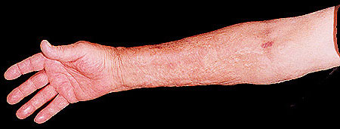
Nephrogenic Systemic Fibrosis
Uncommon but serious acquired systemic disorder
Affects patients with renal insufficiency
Causes swelling and tightening of the skin, usually limited to the extremities
Fewer than 5% of patients have exceedingly rapid disease course that may result in death
No known treatment
Kidney disease

Slide 4
Nephrogenic Systemic Fibrosis
Association with Gd contrast agents
  200 cases of NSF had been reported by May 2007
  In 2006 several studies suggested an association between NSF and MRI contrast agent administration
  In 2007 Omniscan and Magnevist were prohibited in the EU for patients with eGFR < 30 ml /min /1.73m²
eGFR
  estimated glomerular filtration rate
  measure of effectiveness of kidney function
  obtained via a simple blood test

Slide 5
Nephrogenic Systemic Fibrosis
Association with Gd contrast agents
  Current leading hypothesis:
    NSF caused by gadolinium chelate instability
    Specifically Gd³⁺ dechelation in vivo
    Gd³⁺ itself not normally present in body – highly toxic!
  In healthy individuals, contrast agents are excreted too rapidly for effect to be apparent
  Impaired kidney function increases the contrast agent’s half-life in the body sufficiently that significant free Gd³⁺ may accumulate

Slide 6
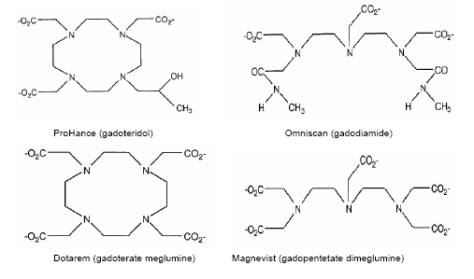
Nephrogenic Systemic Fibrosis
Precautions:
  Kidney function tested in all patients before contrast agent administration
    Blood test to determine eGFR
  Use the most stable contrast agent molecules
Cyclic
Linear

Slide 7

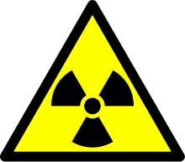
MRI Safety

Slide 8
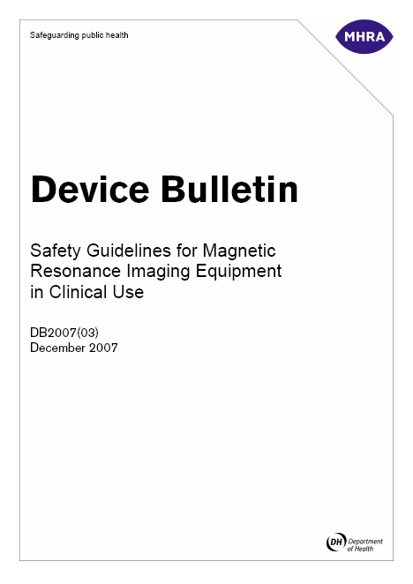
MRI Safety Guidelines
UK (MHRA) Safety guidelines:
“Safety Guidelines for Magnetic Resonance Diagnostic Equipment in Clinical Use”
December 2007
Every MRI unit should draw up local safety rules based on this document
MRI Manufacturers are also subject to IEC standards

Slide 9
Environmental Hazard: Stray B₀ Field
The static magnetic field extends beyond the confines of the scanner over an ellipsoidal region
Guidelines:
  The public should not be exposed to fields > 5 Gauss (0.5 mT)
Cardiac pacemakers and other implants may be affected above this
Fields of 10-20 Gauss can affect electronic equipment e.g. display screens and physiological monitoring equipment
Safety Measures:
Shielding: Modern imaging magnets are actively shielded to reduce the extent of the stray field
Signs and physical barriers must be used to restrict access to areas inside the 5 Gauss field line
The MR CONTROLLED AREA

Slide 10
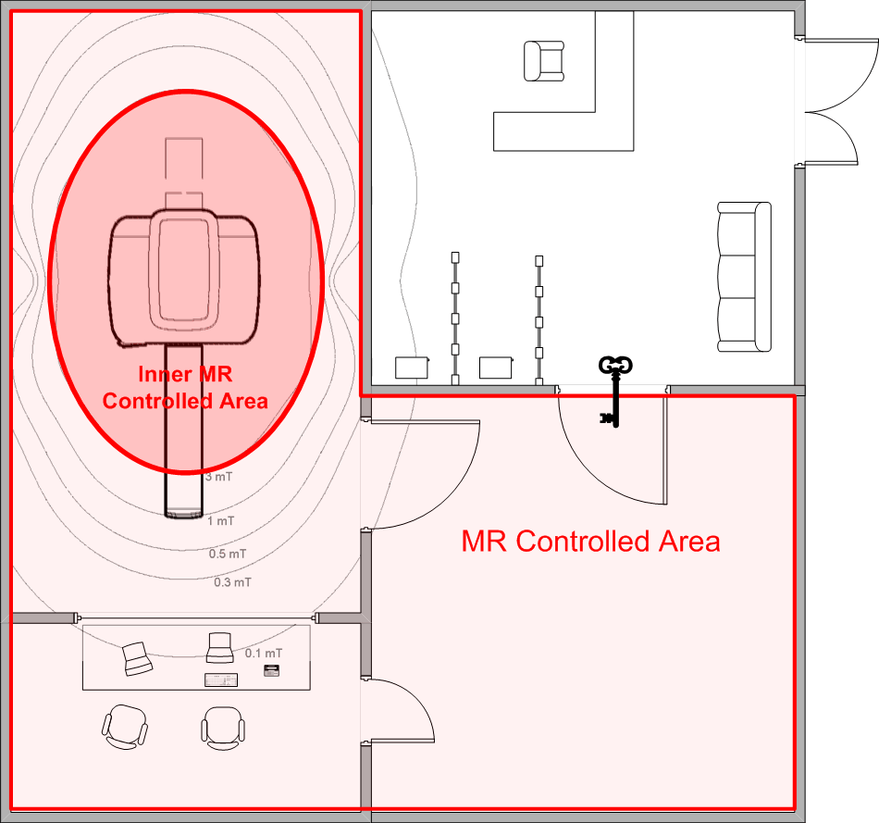
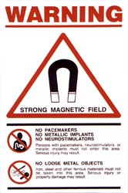
MRI Controlled Areas
Inner MR controlled area
  B < 3mT
MR Controlled area
  B < 0.5mT

Slide 11
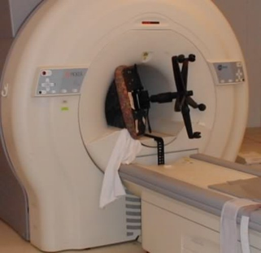
Stray B₀ Field Hazard: Projectiles
  Ferromagnetic objects e.g. pens, scissors, oxygen cylinders and ferromagnetic implants may be attracted to the magnet with great force and act as projectiles
The force on a ferromagnetic object
depends on the magnetic field strength
and gradient: it is often greatest at the
bore opening where the field lines
diverge
Safety Measures:
Effective shielding
Restricted access to scanner room to prevent the unauthorized introduction of ferromagnetic material
Staff and patients screened (see questionnaire) and required to empty pockets and remove jewellery etc.
Metal detectors may be used at the entrance of scanner suites

Slide 12
Stray B₀ Field Hazard: Implants
  Implants include surgical clips, pins, plates, prostheses, neuro-stimulators, implanted infusion pumps…..pacemakers…..
    These can shift due to magnetic forces ⇒ risk of haemorrhage or other injury
    ‘Active’ implants may malfunction: pacemakers are affected by fields > ~1.5 mT
    Implants can get hot (see RF heating below)
Safety Measures:
Screening: Patient notes examined and patients complete a safety questionnaire before scan
Each case may require separate consideration (risk-benefit analysis) before decision to scan
Patients with pacemakers should not be scanned
Metal dust in eyes is a particular danger: a plain x-ray may be required to exclude this possibility

Slide 13
Environmental Hazard: Cryogens
Liquid Helium and Nitrogen are cryogens needed for cooling superconducting MRI magnets
  Superconducting magnets may “quench” in rare cases:
  Need to shutdown magnetic field e.g. if risk of injury
  Magnet fault
  During a quench:
- Magnet windings loose their superconductivity and become resistive
- They heat up rapidly and lead to fast evaporation of liquid cryogens
- Large volumes of Helium (and Nitrogen) gas are produced
The risks of a quench include:
Oxygen is excluded – risk of asphyxia
Chill burns
High Pressures cause damage or injury e.g. magnet door pushed

Slide 14
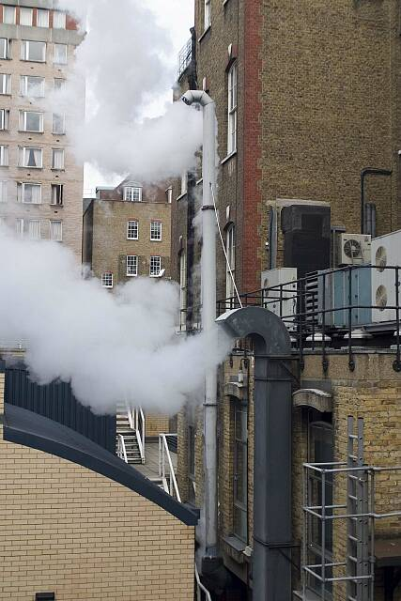
Environmental Hazard: Cryogens
Safety Measures:
Because of the risks of suffocation, provision is made to vent these gases to the outside via large suitable (large diameter) piping
The quench pipes should be checked regularly for any blockages

Slide 15
MRI Safety: Bioeffect Hazards
Bioeffect or acute hazards are those resulting from interactions between tissue and MRI electromagnetic fields:
  Static B₀ Magnetic Field
  Time-varying Magnetic Fields (dB_{z}/dt)
      Switched imaging gradients – Nerve Stimulation
      – Acoustic Noise
  RF B₁ Fields

Slide 16
Bioeffect Hazard: Static B₀ Field
There is no evidence of risk due to short or long-term exposure
Precautionary guideline for clinical scans: 4 T maximum
Research MRI scanners use fields up to 9.4 Tesla for human studies

Slide 17
Bioeffect Hazard: Switched Gradients
Nerve Stimulation
The time varying magnetic fields dB/dt due to switched imaging gradients can induce electrical currents in tissue
Induced currents may exceed the nerve depolarization threshold and cause peripheral nerve stimulation (PNS)
PNS is unlikely to cause permanent injury but may cause discomfort
Safety Measures:
To prevent PNS, guidelines limit dB/dt to < 20T/s for times > 120 ms
Software and hardware interlocks prevent the scanner from exceeding the dB/dt limits
LOW
HIGH
Retina:
Magnetic Phosphenes
Flashing Sensation
Peripheral Nerve
Peripheral Muscle
Cardiac: Fibrillation
Stimulation Threshold

Slide 18
Bioeffect Hazard: Switched Gradients
Acoustic Noise
Sound waves are generated due to mechanical movements of the gradient coil windings against their mountings as the current through them is pulsed in the presence of B₀
Noise may be stressful for patients or even hazardous
Noise levels increase with field strength and gradient switching speed
MRI scan noise levels are typically 80 - 100 dB
Safety Measures:
Hearing protection (ear plugs and / or ear defenders) is recommended for subjects: patients and volunteers (and staff e.g. in interventional MRI)
City Traffic
85 dB
140 dB
Jet Engine
Hearing Protection Recommended
Acoustic Trauma

Slide 19
Bioeffect Hazard: RF B₁ Fields
Heating
RF fields induce currents in electrically conductive tissue causing tissue heating
Tissues with a high concentration of ions will absorb the greatest RF power
Parts of body with low blood supply are at greatest risk (e.g. the eyes)
Heating will depend on patient’s size, age, health (compromised thermoregulation)
The specific absorption rate (SAR) (in watts per kilogram) is used to estimate and reduce the RF heating effect
For a particular imaging sequence SAR depends upon:
- Main magnetic field strength
- RF pulse magnitude and frequency
- RF coil design
- Mass of tissue exposed

Slide 20
Bioeffect Hazard: RF B₁ Fields
Heating
RF Heating Guidelines:
  Whole body SAR < 2 W/kg for exposure times < 15 minutes
Designed to limit the temperature rise of the tissue to less than 1°C
Safety Measures:
MRI systems have software checks and hardware interlock systems to monitor the SAR and prevent the guidelines from being exceeded
In order to accurately estimate the mass of tissue exposed, the weight of the patient is entered at the scanner console prior to scanning

Slide 21
Bioeffect Hazard: RF B₁ Fields
Burns
RF energy is absorbed by highly conductive material (e.g. copper) and converted into heat concentrated in a small area
  Examples of such material includes: RF coils, ECG leads, jewellery, tattoos, permanent make-up
  RF energy deposition is more efficient if the material forms a loop or if its length is a multiple of the RF wavelength
Safety Measures:
Careful patient positioning away from leads and wires and avoiding creating current loops through the body
Effective screening:
    - Remove all jewellery prior to scanning
    - May exclude people with tattoos from MRI scans

Slide 22
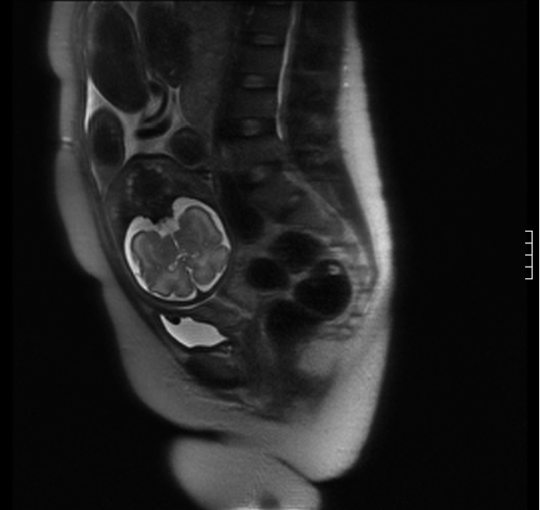
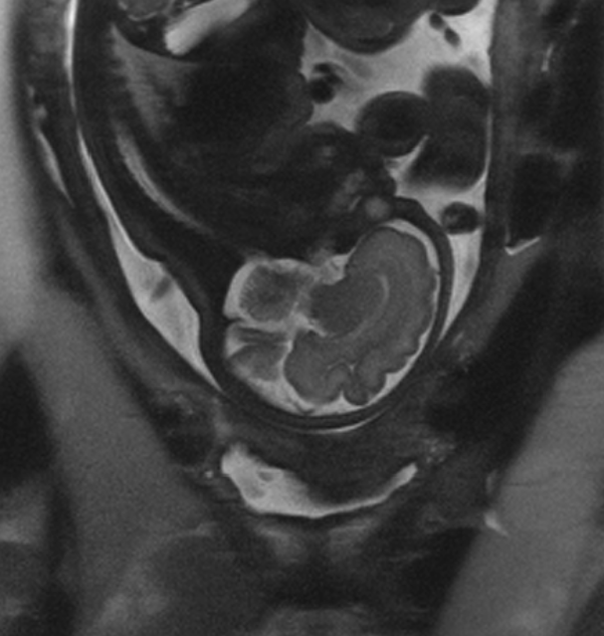
MRI in Pregnancy
Risk to the developing foetus is not well established…
but the primary concerns are:
  Acoustic noise
  Heating
Safety measures:
Risk v. Benefit analysis
Aim to minimise stress to mother and foetus
  Avoid MRI during first trimester
  Careful choice of sequence:
  low acoustic noise
  low SAR
  Monitoring

Slide 23
MRI Safety Summary
MR safety is dominated by short-term risks:
  Projectiles
  Implants
  RF Heating and Burns
  Acoustic Noise
There is no evidence of long-term effects
Good management is essential
  Controlled access
  Screening procedures
  Equipment management

