Slide 1




Disease Progression Analysis of Posterior Cortical Atrophy using a Data-Driven Model
Author:
Răzvan V. Marinescu
Supervisors:
Prof. Daniel C. Alexander
Dr. Sebastian Crutch

Slide 2
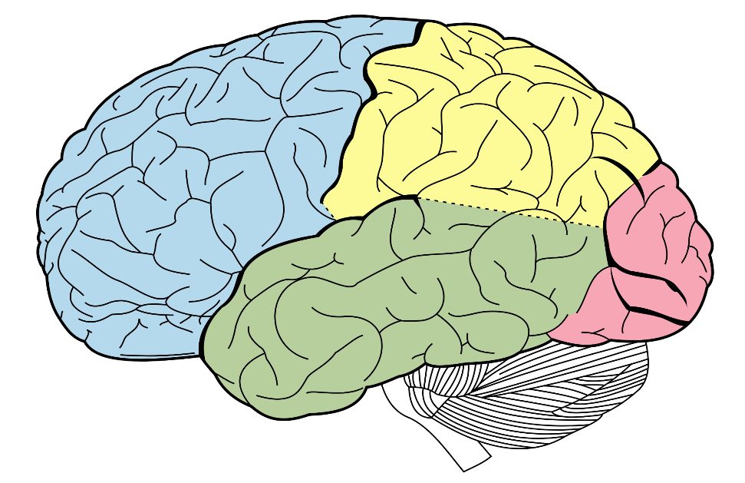
Motivation
Analyse the progression of Posterior Cortical Atrophy (PCA), which is a rare subtype of Alzheimer's Disease
Why is it important?
  Early and accurate diagnosis
  Identify the causes of the disease
  Aid drug development
Parietal lobe
?
Occipital lobe
?
?
Temporal lobe
?
Frontal lobe

Slide 3
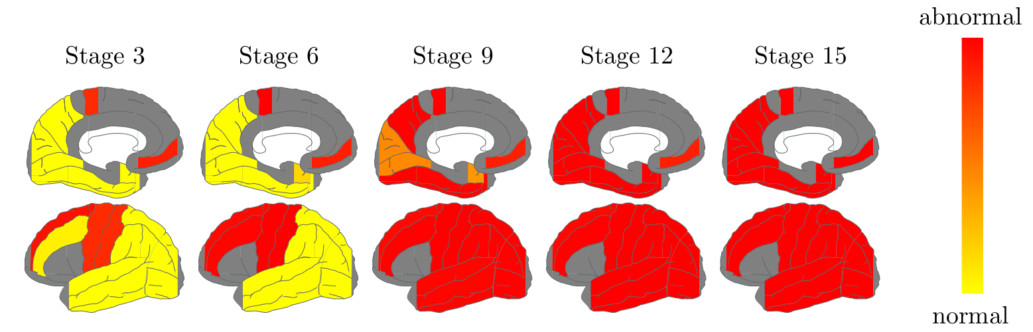
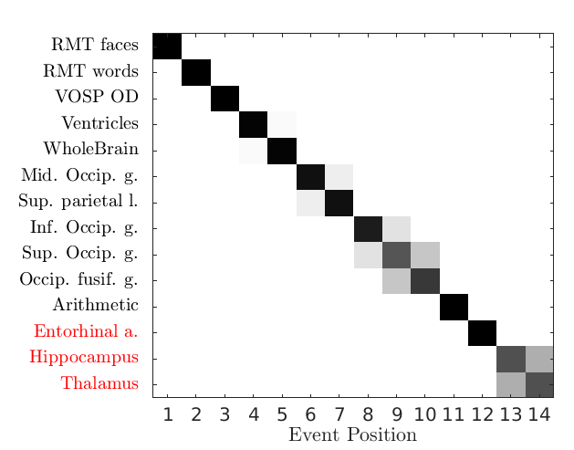
Methods and Results
Used an event-based statistical model
Found out the order in which brain regions are affected
Measurements of brain regions and cognitive tests
Sorted by when they become abnormal
Confidence in the ordering
Ventricles
WholeBrain
RMT words
RMT faces
Sup. Occip. g.
Occip. Fusif. g.
Mid. Occip. g.
VOSP OD
Sup. parietal l.
Hippocampus
Thalamus
Inf. Occip. g.
Arithmetic
Entorhinal a.
generate atrophy snapshots

Slide 4
CDT Experience
  Intense 4-piece coursework
Taught modules I've taken:
Recommendation for future students:
  Volunteer for an MRI scan!
  Graphical Models
  Difficulty
  hard
  Computational Modelling in Biomedical Imaging
  Information Processing
  Good to attend
  Medical Imaging (non-ionising)
  easy
  Python
  Relevance (for my project)
  Less relevant
  More relevant

