Slide 1

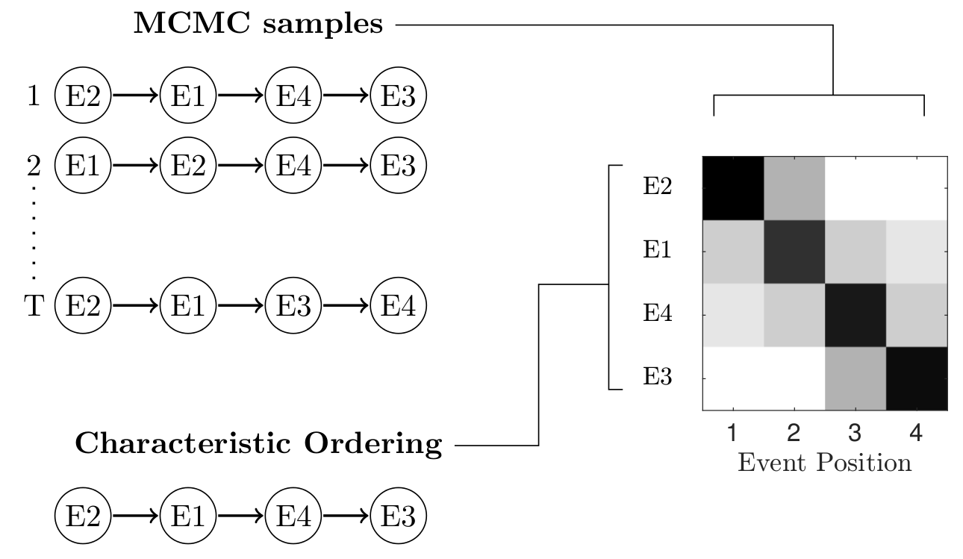
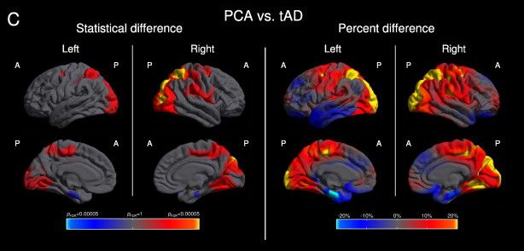
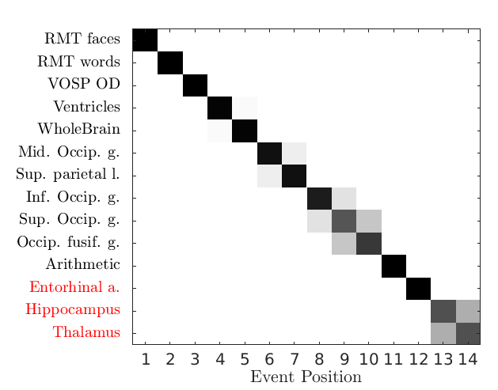
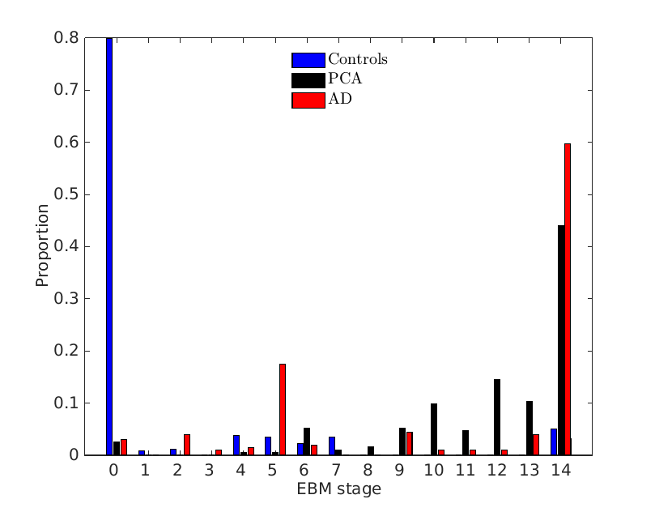
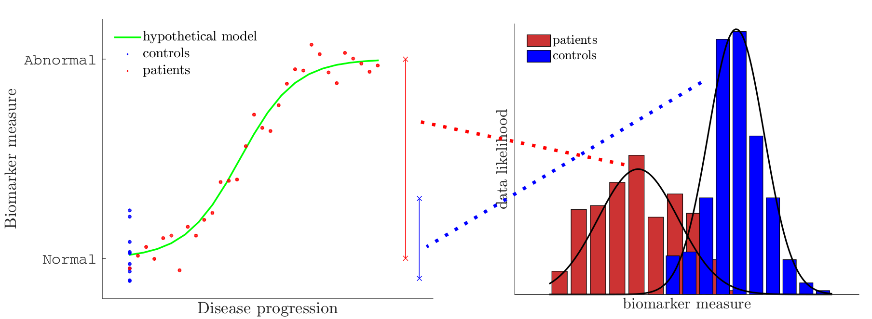
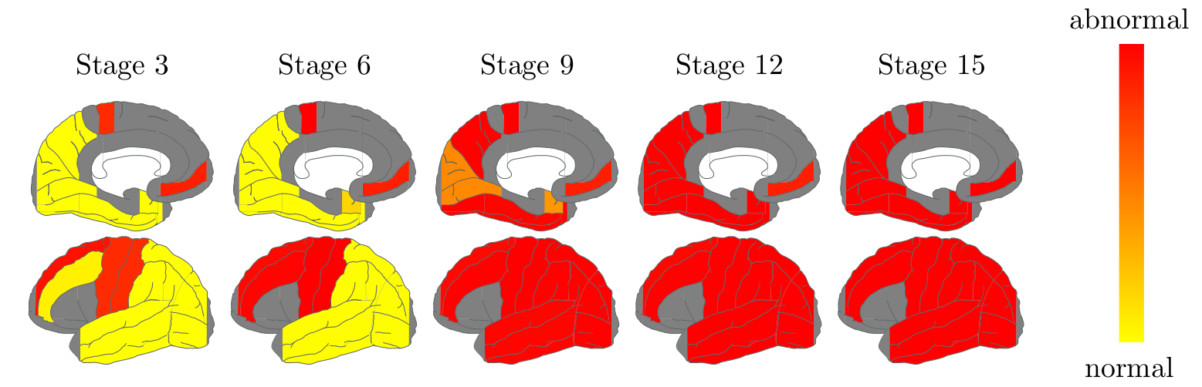

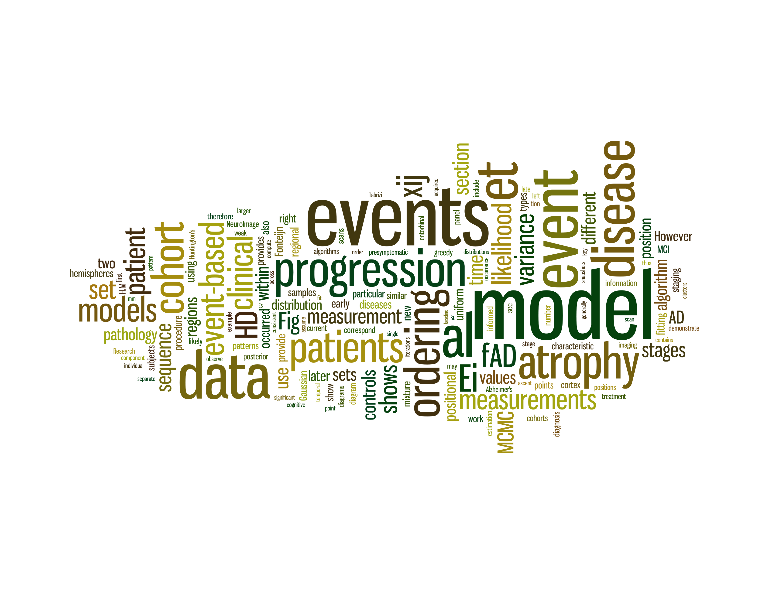


Disease Progression Analysis of Posterior Cortical Atrophy using a Data-Driven Model
Razvan V. Marinescu¹, Alexandra L. Young¹, Neil P. Oxtoby¹, Marco Lorenzi¹, Sebastian Crutch², Daniel C. Alexander¹
¹Centre for Medical Image Computing, University College London, UK
²Dementia Research Center, Institute of Neurology, University College London, UK
Overview
Posterior Cortical Atrophy (PCA), also called Benson's syndrome, is an atypical variant of Alzheimer's disease. Developing a good understanding of how PCA progresses over time could help us identify its causes and diagnose it early and more accurately. Disease progression models such as the event-based model (EBM) characterise its evolution by looking at underlying biomarker data such as atrophy rates in cortical volumes, protein abundance and cognitive test scores. The model is capable of making informative predictions about disease evolution.
Introduction
Results
Posterior Cortical Atrophy (PCA)
Posterior Cortical Atrophy (PCA) is an early-onset variant of Alzheimer's disease that causes atrophy of the posterior part of the cerebral cortex, resulting in disruption of the visual and motor systems. Symptoms include blurred vision, impaired ability to read and difficulty navigating through space. The causes of PCA are still unknown and there is no fully accepted diagnostic criteria. As a result, PCA patients are often misdiagnosed with anxiety disorder or depression. Moreover, no specific and accepted scientific treatment for PCA has been found so far due to the rarity and variation of the disease.
Fig. 3: MCMC sampling finds a series of samples which are then used to derive an average ordering called the characteristic ordering. Entries M(i,j) in the matrix show the number of times biomarker i appeared on position j in the sampled sequences.
Application of the event-based model to PCA
In this project we used the EBM to find the most probable event progression in PCA, classify patients into various disease stages and differentially diagnose PCA from typical AD. We also compared the performance of the EBM differential diagnosis with a support vector machine (SVM). We were interested to see how the progression of PCA differs from the progression of AD. Figure 4 shows the positional variance matrix on the PCA cohort and the histogram of subject staging using the EBM. Figure 5 shows snapshots of atrophy progression in many different brain regions using a larger set of biomarkers.
Fig. 1: Regional variation of cortical thickness in PCA compared to typical Alzheimer's disease. Areas in yellow and red are affected by PCA while areas in cyan and blue are affected by typical AD. The colours for statistical difference represent FDR-corrected p-values at 0.05 significance levels, while the colours for percent difference represent the magnitude of cortical thickness difference. Cortical thickness is calculated as the distance from the GM/WM boundary to the GM/CSF boundary at each vertex. [1]
The event-based model (EBM) [2]
The event-based model (EBM) analyses the progression of the disease as a sequence of events informed by underlying biomarker measurements, such as cortical atrophy rates, cognitive test scores or genetic biomarkers. As the events are discrete, time is not modelled explicitly like in the continuous models of disease progression. The EBM can be used to find the most probable event sequence and has previously been applied to study familial AD [2], sporadic AD [3] and Huntington's disease [2]. It can also be used for longitudinal studies, being able to find the probability of a patient converting from cognitively normal to mild cognitive impairment (MCI) and from MCI to AD/PCA. The main advantages of the EBM are its simplicity and robustness. Moreover, as opposed to previous disease progression models [4,5] it does not need symptomatic staging information. However, it cannot estimate the time between events or brain atrophy rates.
Fig. 4: (Left) Recovered sequence of brain atrophy and clinical events from a PCA disease cohort. Each event corresponds to an underlying biomarker becoming abnormal. Initially, cognitive test scores such as RMT and VOSP become abnormal first, followed by ventricles, whole brain and occipito-parietal areas. Biomarkers in red are usually not affected by PCA and as a result appear at the end of the sequence. (Right) Histogram of stages for controls, PCA and AD patients using the event progression on the left. Most controls are placed in the early stages of the disease, while PCA and AD patients are placed in later stages.
Fig. 2: (Left) Hypothetical progression of a biomarker along with measurements for controls and patients. The controls are assumed to be well-defined, while the patients are assumed to lie anywhere on the disease progression continuum. The right figure shows the mixture model for the two groups. The event-based model fits a mixture model for each biomarker independently.
Fig. 5: Atrophy progression snapshots in the PCA cohort using a larger set of brain regions. The areas that become abnormal first are around the motor cortex and the frontal gyrus. However, in PCA it is usually the occipito-parietal areas that become abnormal first. Further work needs to be done to explain this inconsistency.
References: [1] Lehmann, et al. (2011); [2] Fonteijn, et al. (2012); [3] Young, et al. (2014); [4] Scahill et al. (2001); [5] Dickerson et al. (2008)

