Slide 1
Disease Progression Analysis of Posterior Cortical Atrophy using a Data-Driven Model author: Razvan V. Marinescu supervisors: Prof. Daniel C. Alexander
Dr. Sebastian Crutch
Motivation: Analyse the progression of Posterior Cortical Atrophy (PCA)

Slide 2
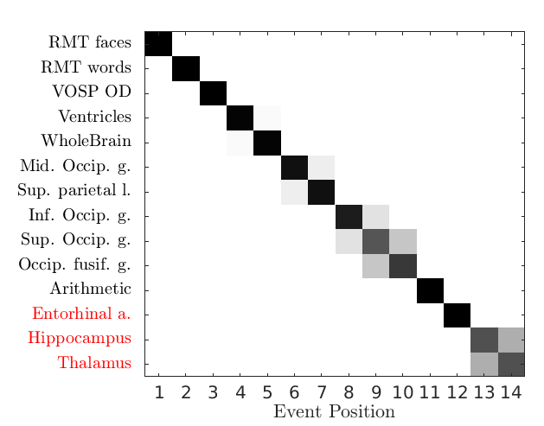
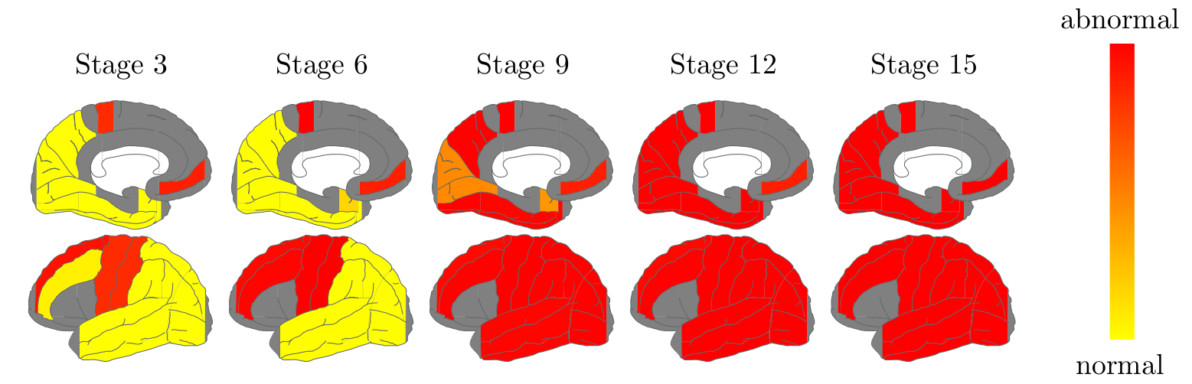
Disease Progression Analysis of Posterior Cortical Atrophy using a Data-Driven Model author: Razvan V. Marinescu supervisors: Prof. Daniel C. Alexander
Dr. Sebastian Crutch
Motivation: Analyse the progression of Posterior Cortical Atrophy (PCA), which is a subtype of Alzheimer's Disease
  symptoms of PCA: blurred vision, difficulty in movement
Methodology: Used an event-based statistical model
Results: Found out the order in which brain areas are affected in PCA
Impact: better understanding of PCA, which will help find it's causes and treatment
Measurements of brain regions and cognitive tests
Sorted by when they become abnormal
Ventricles
WholeBrain
RMT words
RMT faces
Sup. Occip. g.
Occip. Fusif. g.
Mid. Occip. g.
VOSP OD
Sup. parietal l.
Hippocampus
Thalamus
Inf. Occip. g.
Arithmetic
Entorhinal a.
Confidence in the ordering
generate images

Slide 3

CDT experience
  Intense 4-piece coursework
Taught modules I've taken:
Recommendations for future students:
  Volunteer for an MRI scan
  Be active in the journal club discussions
  Start working early on the MRes project
  Graphical Models
  Good background in maths and statistics required
  Difficulty
  hard
  Computational Modelling in Biomedical Imaging
  Information Processing
  Good to attend
  Medical Imaging (non-ionising)
  easy
  Python
  Less relevant
  More relevant
  Relevance (for my project)

