Slide 1

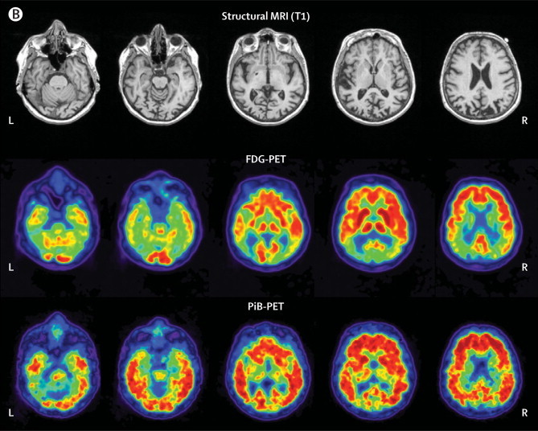
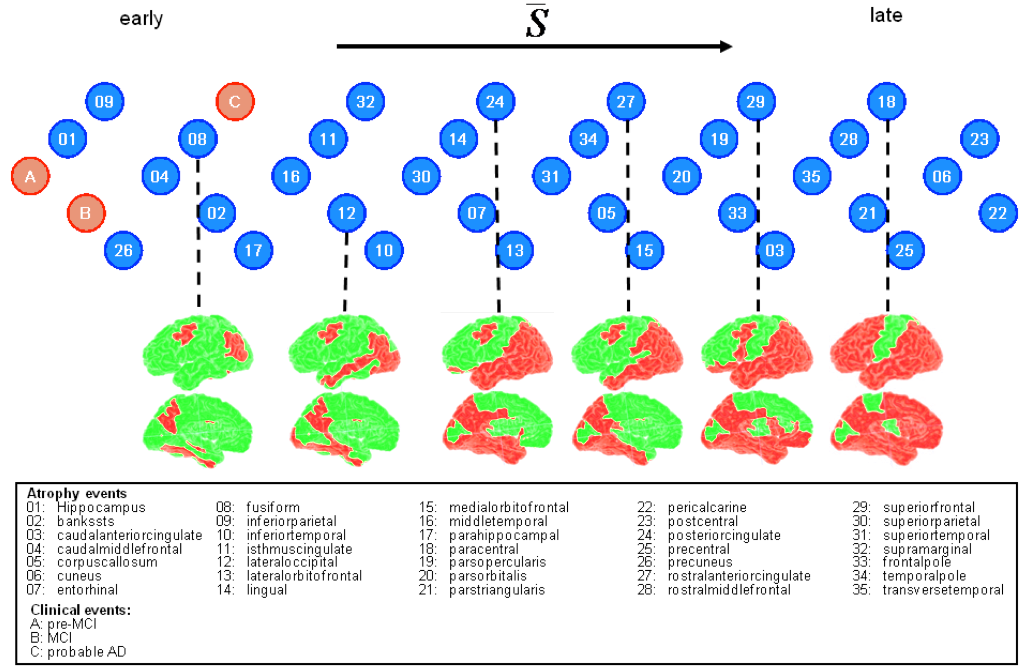
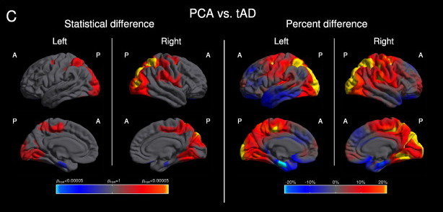

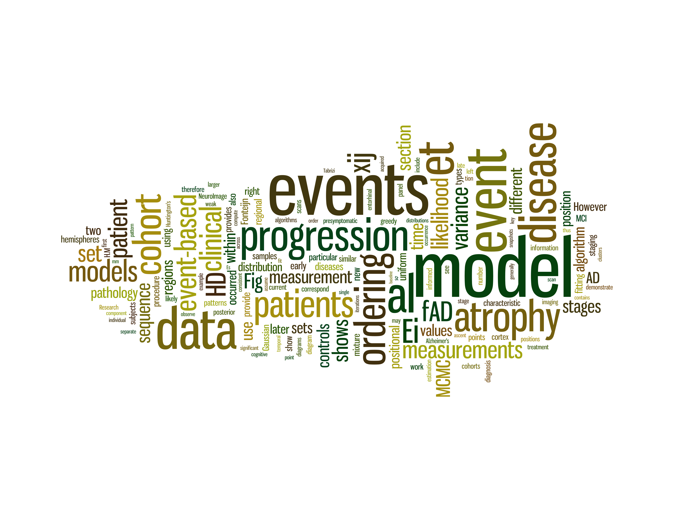
Differential Diagnosis of Alzheimer's subtypes through disease progression modelling
Razvan Valentin Marinescu¹, Daniel C. Alexander¹, Sebastian Crutch, Neil Oxtoby¹
¹Centre for Medical Image Computing, University College London, UK
²Dementia Research Center, Institute of Neurology, University College London, UK
Results
Overview Posterior Cortical Atrophy (PCA), also called Benson's syndrome, is an atypical variant of Alzheimer's disease. Developing a good understanding of how PCA progresses over time could help us identify its causes and diagnose it as earlier and more accurately. Disease progression models characterise its evolution by looking at underlying biomarker data such as atrophy rates in cortical volumes, protein abundance and cognitive test scores. The model is capable of making informative predictions about disease evolution and performing differential diagnosis.
Introduction
Posterior Cortical Atrophy
Posterior Cortical Atrophy (PCA) is an early-onset variant of Alzheimer's disease that causes atrophy of the posterior part of the cerebral cortex, resulting in disruption of the visual and motor systems. Symptoms include blurred vision, impaired ability to read and difficulty navigating through space. The causes of PCA are still unknown and there is no fully accepted diagnostic criteria. As a result, PCA patients are often misdiagnosed with anxiety disorder or depression. Moreover, no specific and accepted scientific treatment for PCA has been found so far due to the rarity and variation of the disease.
The event-based model [3]
The event-based model (EBM) models the progression of the disease as a sequence of events informed by underlying biomarker measurements, such as cortical atrophy rates, cognitive test scores (MMSE) or protein abundance (Amyloid-beta and P-tau in particular). As the events are discrete, time is not modelled explicitly like in the continuous models of disease progression. The EBM can be used to find the most probable event sequence (fig. 3) and has previously been applied to study familial AD [3], sporadic AD [4] and Huntington's disease [3]. It can also be used for longitudinal studies, being able to find the probability of a patient converting from cognitively normal to mild cognitive impairment (MCI) and from MCI to AD/PCA.
Fig. 1: MRI and FDG-PET images of a 62-year old woman with visuospatial dysfunction due to PCA. There is atrophy in the bilateral parietal, posterior temporal and lateral occipital cortex (upper row). The FDG-PET data (middle row) showed hypometabolism in the same regions. PiB-PET data (lower row) showed diffuse cortical uptake throughout both posterior and anterior regions, suggesting the presence of amyloid-beta plaques. [1]
Fig. 3: Event-based model. Recovered sequence of brain atrophy and clinical events from a familial Alzheimer’s disease cohort. In this example, each event corresponds to the underlying biomarker of a brain area becoming abnormal.
Application of EBM to PCA
The EBM will be used to find the most probable event progression in PCA, classify patients into various disease stages and differentially diagnose PCA from other Alzheimer's subtypes. We can also use the EBM to find the probability of patients converting from mild cognitive impairment (MCI) to PCA or from cognitively normal to MCI. We are also interested to see how EBM-based differential diagnosis of PCA compares with other classifiers such as support vector machines.
Conclusion and future work
The EBM could become a very useful clinical tool because it can provide prognostic information regarding the progression of PCA and perform differential diagnosis.
Future work includes exploring continuous models of disease progression, such as those based on differential equations. Moreover, we are also interested in making the PCA-based EBM part of a software suite that diagnoses various AD subtypes.
Fig. 2: Regional variation of cortical thickness in PCA compared to typical Alzheimer's disease. The colours for statistical difference represent FDR-corrected p values at 0.05 significance levels, while the colours for percent difference represent the magnitude of cortical thickness difference. Cortical thickness is calculated as the distance from the GM/WM boundary to the GM/CSF boundary at each vertex. [2]
References: [1] Crutch, et al. (2012); [2] Lehmann, et al. (2011); [3] Fonteijn, et al. (2012); [4] Young, et al. (2014);

