Slide 1

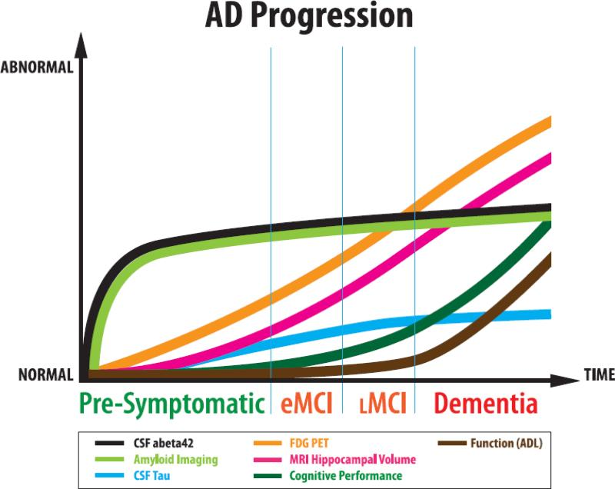

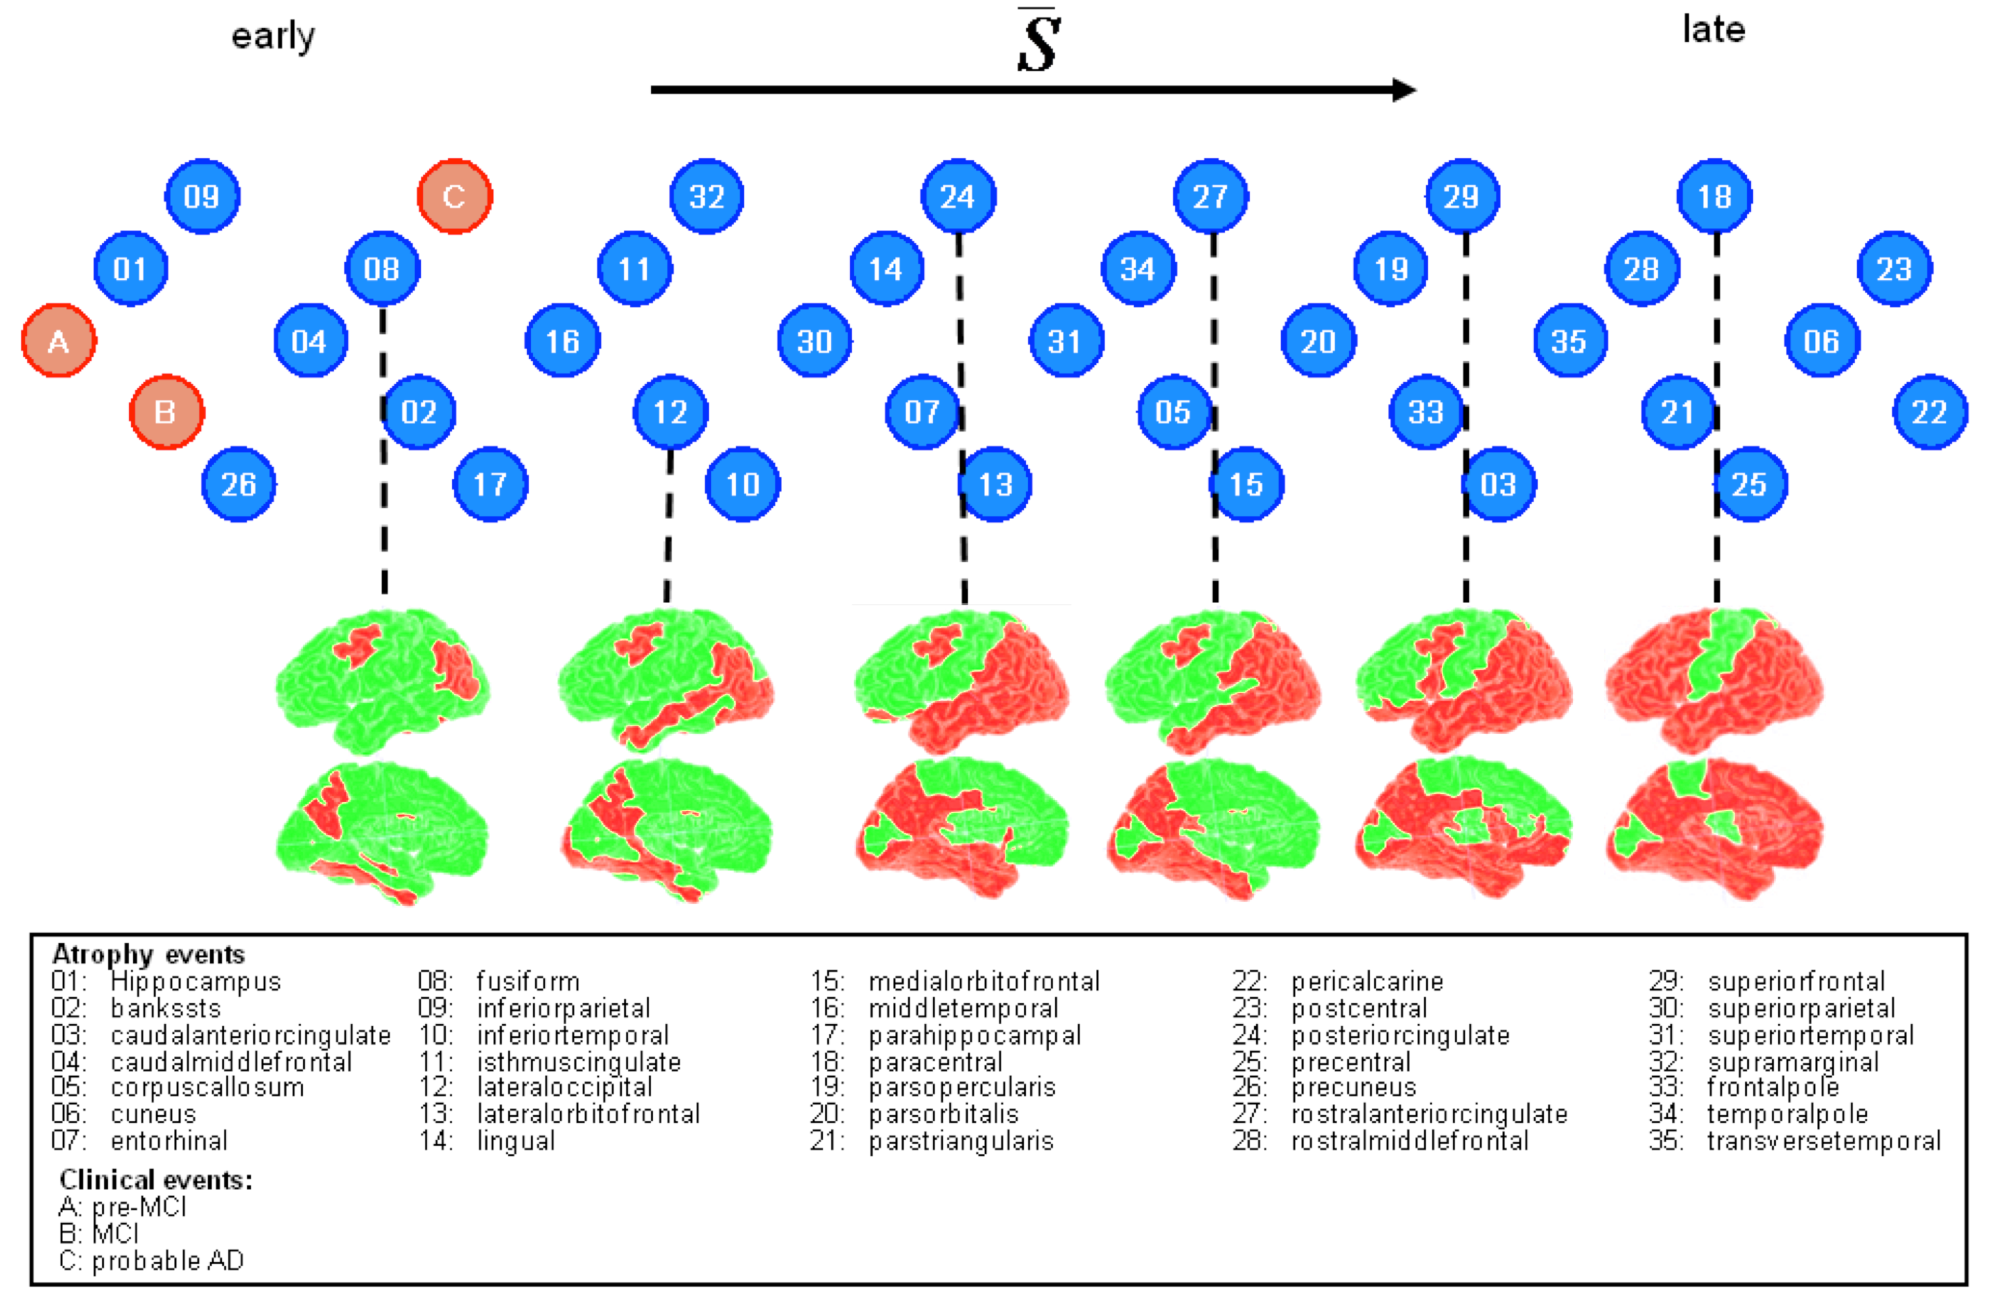
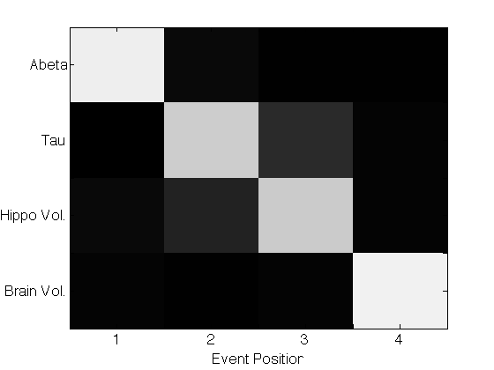

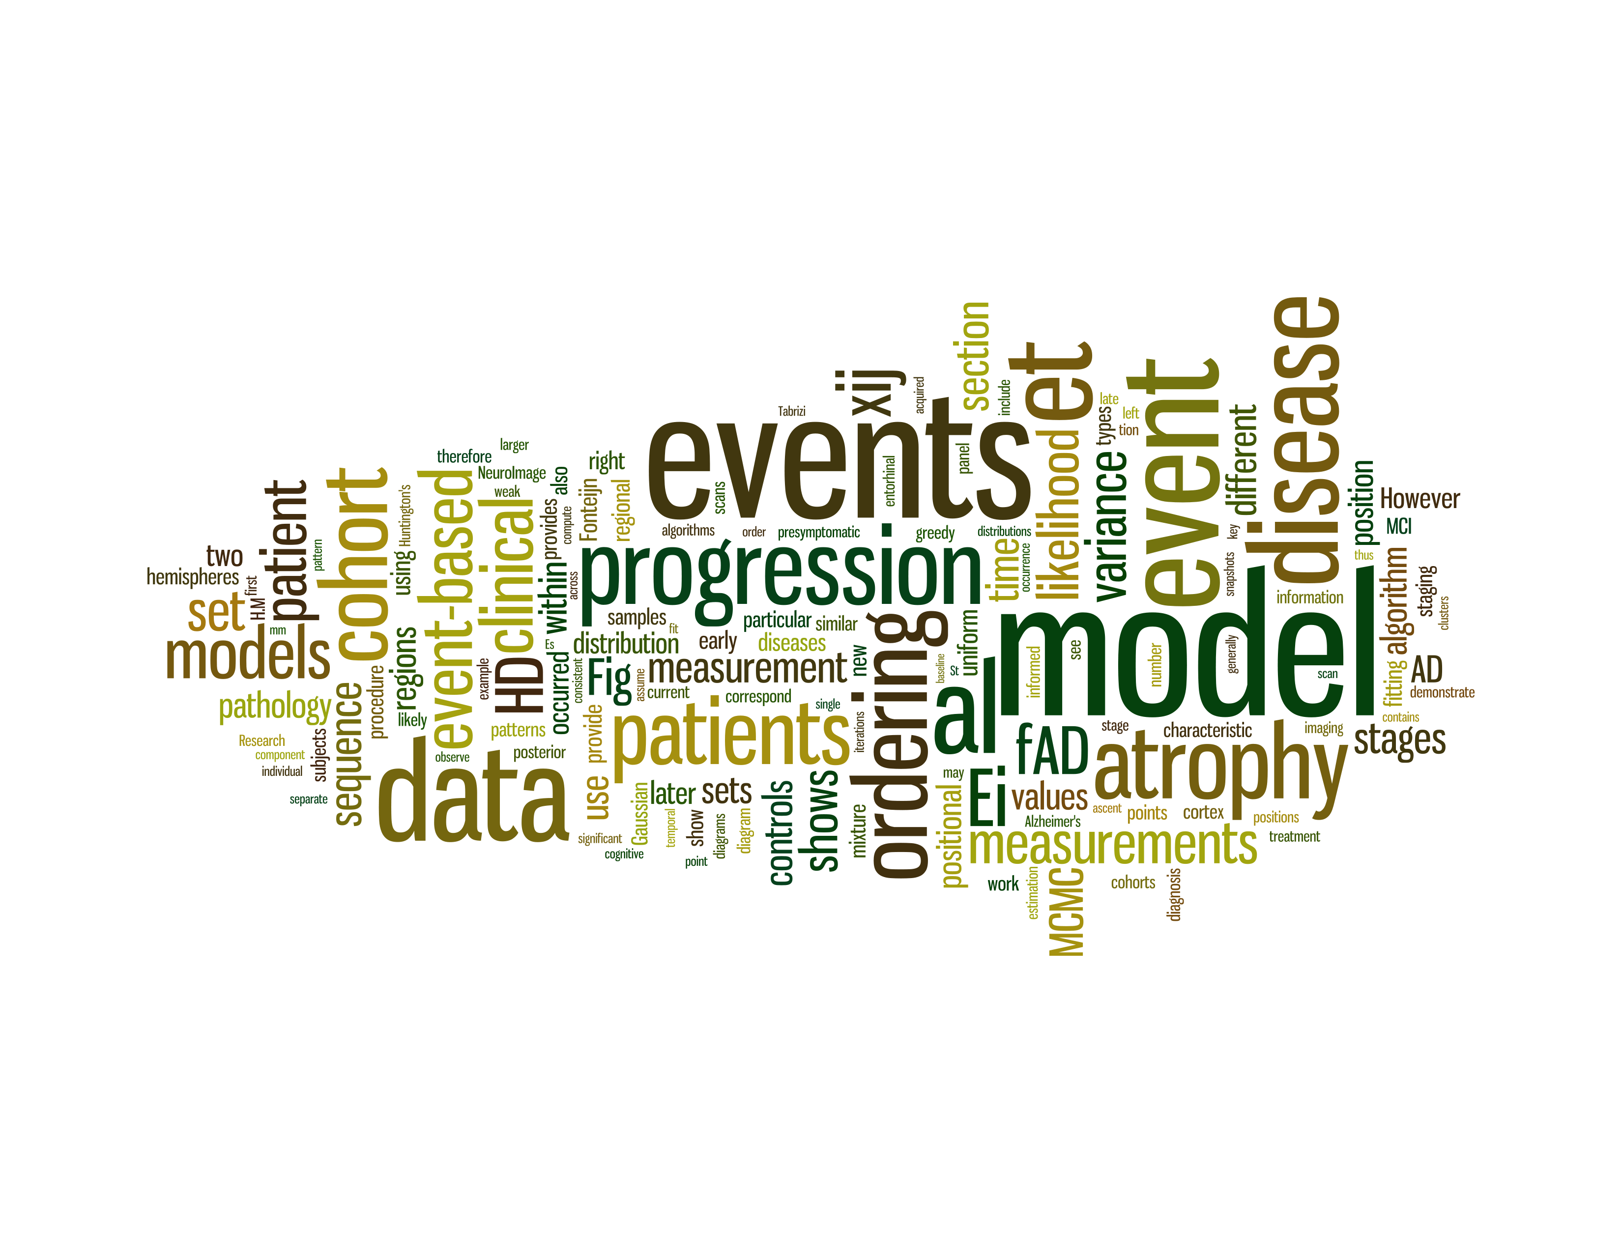
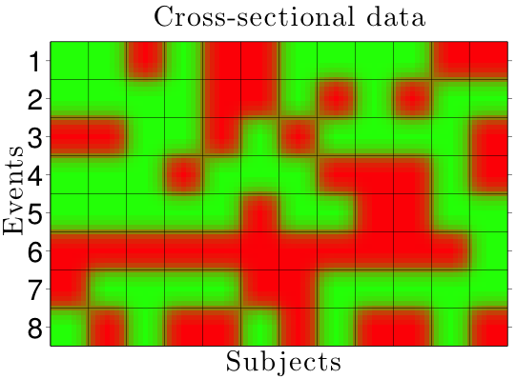
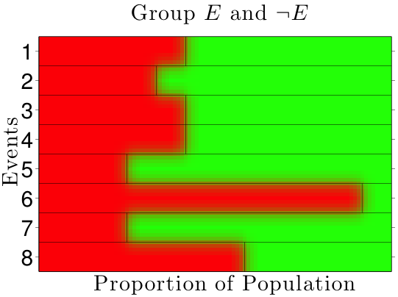
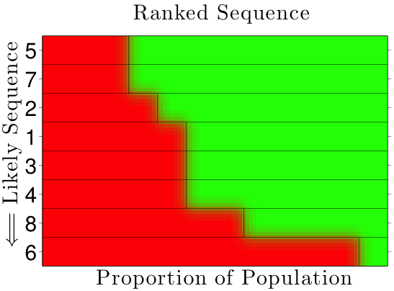
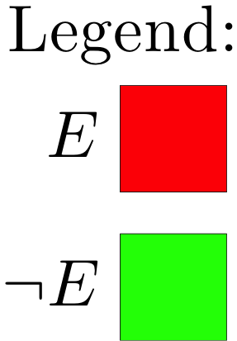
How do degenerative neurological diseases progress?
Neil Oxtoby¹, Alexandra Young¹ and Danny Alexander¹ with Pankaj Daga^{1,2}, Sebastien Ourselin^{1,2}, Jon Schott², Nick Fox²
¹ Centre for Medical Image Computing, University College London, UK
² Dementia Research Centre, University College London, UK
Results
Overview Diseases can be characterised by the order and rate in which biological markers change.
We are learning these “progression patterns” for neurodegenerative disorders, using cross-sectional data.
Insights gained from comprehension of disease progression will improve diagnosis, prognosis, treatment planning and stratification of patients for therapeutic clinical trials.
Introduction
Approaches to modelling disease progression
A disease progression model characterises the changes in symptoms, pathologies and biomarkers over the course of the disease, allowing us to distinguish that disease from others and define distinct stages or progression scores. The primary limitation of current models is that they rely on clinical staging of patients by medical professionals. For neurodegenerative conditions such as Alzheimer’s disease, symptomatic onset occurs late in the progression – when it is too late for disease management.
Biological markers of a disease offer the possibility of early detection, i.e., before visible symptoms. Hypothetical models of biomarker evolution [2,3] and the order in which they change are yet to be verified.
Disease progression models can be continuous or discrete (Fig. 2). Continuous models involve a surrogate biomarker or score [4] that indicates disease stage. They are well-suited to longitudinal data. Discrete models describe the disease as a sequence of measurable events [5, etc.], which extends naturally to patient staging. Importantly, cross-sectional data is amenable to interpretation within a discrete model (Fig. 2). Hybrid continuous-discrete models [6] may also play a role when both longitudinal and cross-sectional data are available.
Fig. 2:
Cross-sectional data for multiple events and subjects contains population-level information about the longitudinal sequence or ordering in which those events typically occur.
Progression models can be continuous or discrete, but discrete models are particularly well-suited to cross-sectional data.
Discrete
Continuous
Fig. 1: The hypothetical model of [3]
The event-based model [5]
This discrete model describes a process as a sequence of events. Events can be informed by a wide range of measurement types, such as abnormal protein levels in the brain, clinical diagnosis, and brain atrophy. The model can be applied to cross-sectional data without the need for a priori clinical staging. Results for familial Alzheimer’s disease [5] (Fig. 3), and sporadic Alzheimer’s disease [unpublished] (Fig. 4) agree with known progression patterns obtained from histology [1]. Importantly, some atrophy events (e.g., in the hippocampus) occur before the onset of clinical symptoms (Fig. 3).
Fig. 3: Event-based model. Recovered sequence of brain atrophy and clinical events from a familial Alzheimer’s disease cohort.
Future Directions
We will consider continuous models and hybrid discrete-continuous models for disease progression, as well as ways to identify disease subtypes. Also of interest are factored models (age, genes, etc.) and the possibility of estimating causal links [7,8] between events. Estimating time to onset of symptoms is a challenge of particular clinical interest.
Applications of Progression Modelling
Currently sequencing sporadic Alzheimer’s disease using the EBM on the ADNI [9] data set, but plan to implement it for other dementias (front-temporal, Huntington’s, Parkinson’s), neurodegenerative conditions (multiple sclerosis, motor neuron disease) and non-brain diseases such as cancer. We are also interested in the design and application of progression models for developmental processes.
Fig. 4: This confusion matrix shows clear support for the ordering (vertical axis) of sporadic Alzheimer’s disease events discovered using the event-based model of [5]. The whiteness of shading represents the probability of each event occurring at each position in the sequence (horizontal axis).
References: [1] Braak & Braak (1991); [2] Jack, et al. (2010); [3] Aisen, et al. (2010); [4] Jedynak, et al. (2012); [5] Fonteijn, et al. (2012); [6] Beerenwinkel & Sullivant (2009); [7] Pearl (2009); [8] Pe’er (2011); [9] Alzheimer’s Disease Neuroimaging Initiative

