Slide 1
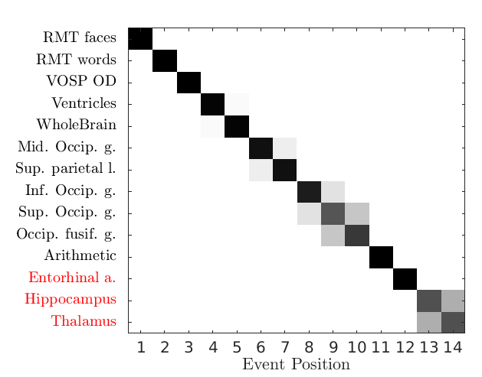
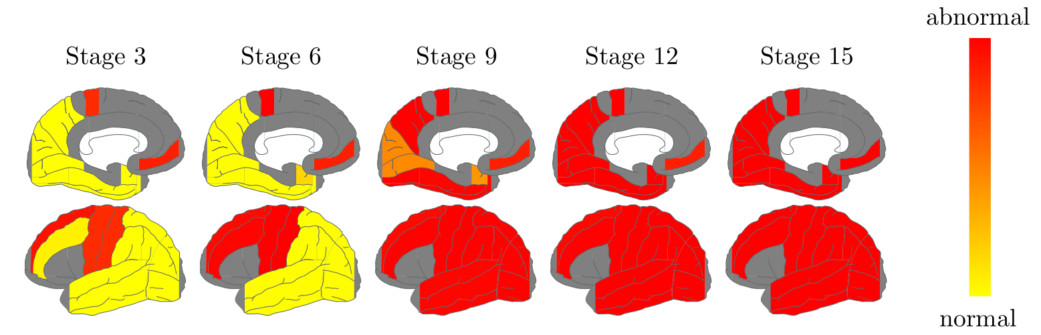
Disease Progression Analysis of Posterior Cortical Atrophy using a Data-Driven Model author: Razvan V. Marinescu supervisors: Daniel C. Alexander
Sebastian Crutch
Motivation: Analysis of Posterior Cortical Atrophy (PCA), which is a subtype of Alzheimer's Disease
  symptoms of PCA: blurred vision, difficulty in movement
Methodology: Used an event-based statistical model
Results: Found out the order in which brain areas are affected in PCA
Future work: improve the mathematical model

Slide 2
CDT experience
  Intense 4-piece coursework
Taught modules I've taken:
Recommendations for future students:
  Volunteer for an MRI scan
  Start reading on MRI and other medical imaging modalities
  Graphical Models
  Good background in maths required
  difficulty
  hard
  Computational Models in Biomedical Imaging
  Learned a lot from the courseworks
  Information processing in medical imaging
  Good to attend
  Medical imaging (non-ionising)
  Do attempt the extra questions in coursework
  easy
  Python
  Less relevant
  Very useful
  Relevance (for my project)

