Slide 1
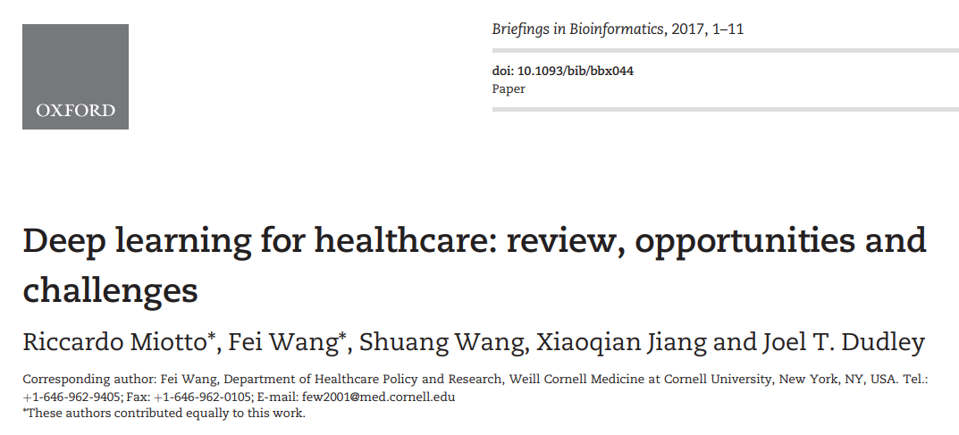

Slide 2
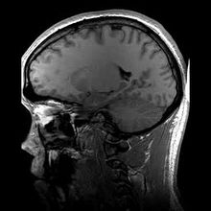
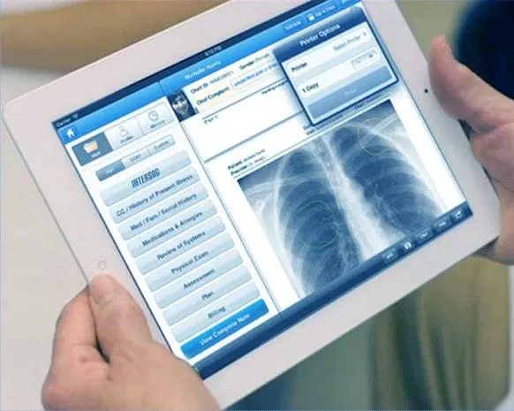
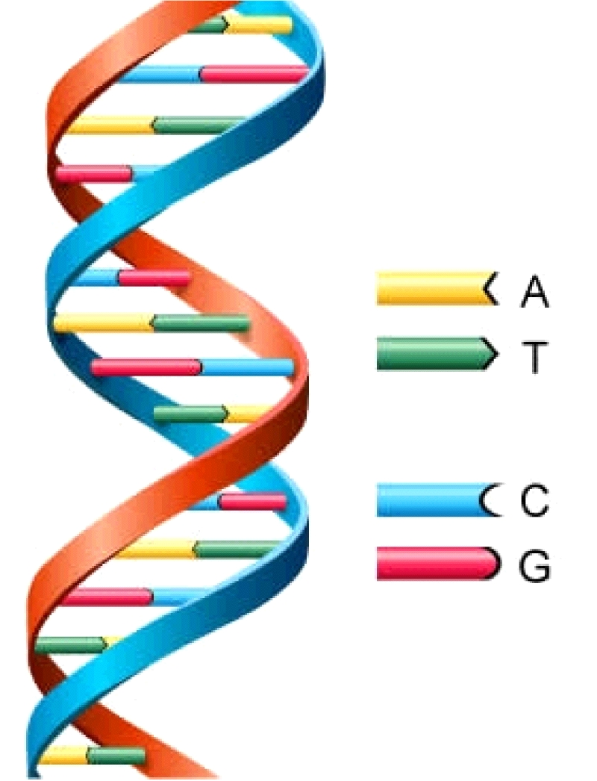
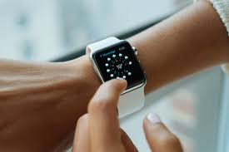
Large collections of healthcare data have been recently made available
Electronic Health Records (EHRs)
Genetics
Wearable
devices
Imaging data

Slide 3
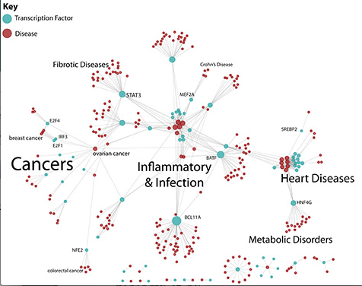
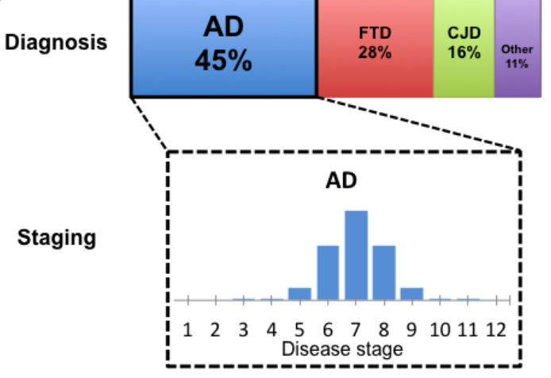
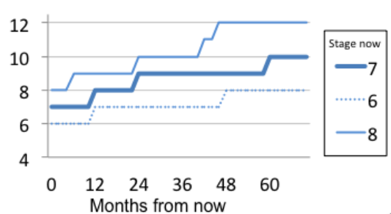
Healthcare data can bring many opportunities in healthcare research
Understand complex diseases
Evaluate risk of subjects to develop disease
Predict subjects’ future evolution

Slide 4
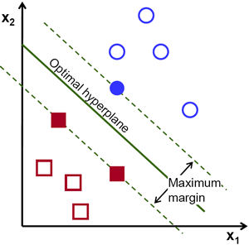
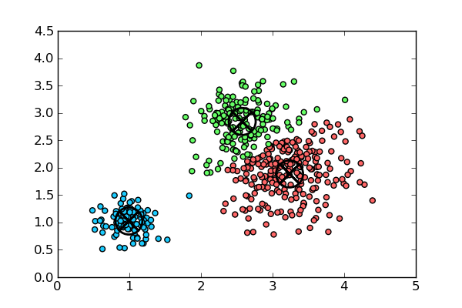
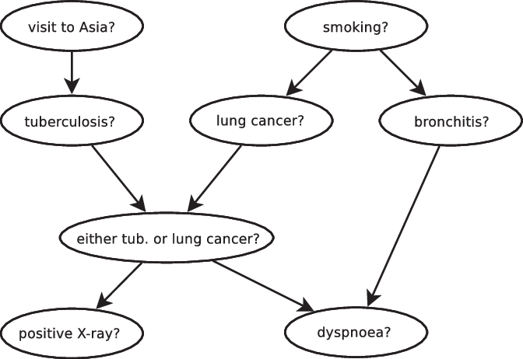
Machine Learning Techniques were developed to model complex data
Support Vector Machines
Bayesian networks
Unsupervised Learning

Slide 5
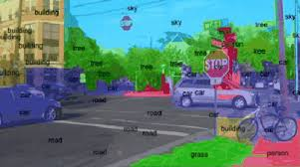
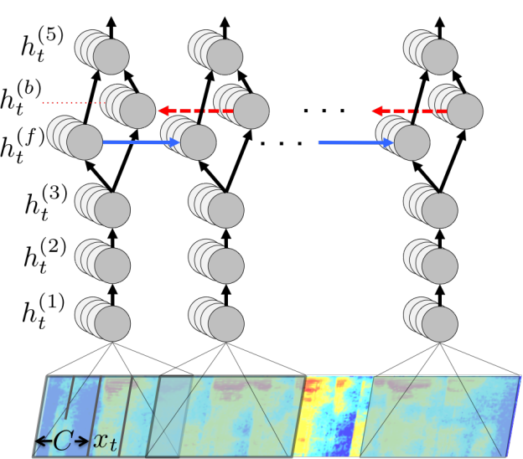
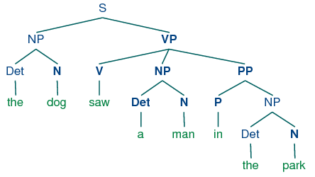
Recently, Deep Learning became popular due to state-of-the-art results
Computer Vision
Speech Recognition
Natural Language Processing

Slide 6
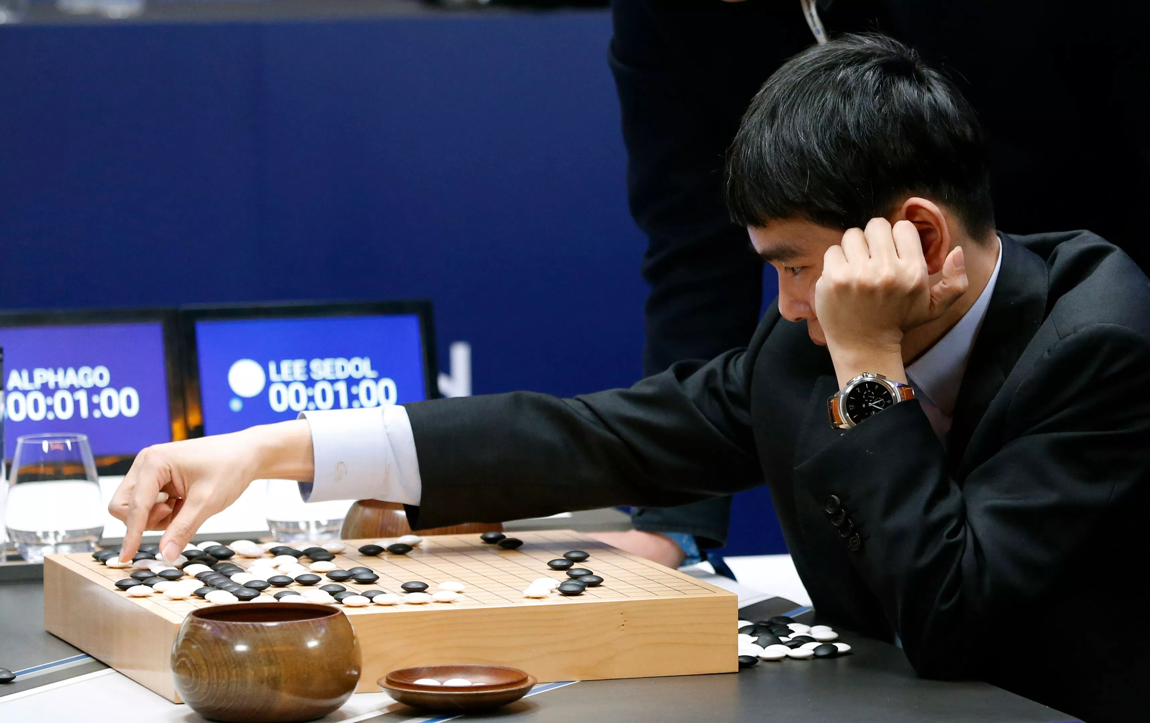
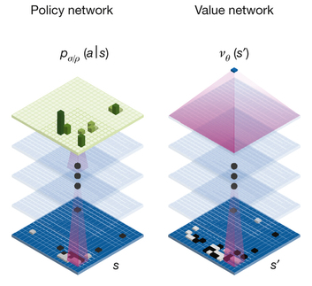
Recently, Deep Learning became popular due to state-of-the-art results

Slide 7
Deep Learning has been increasingly used in healthcare applications
Imaging data
Electronic Health Records (EHRs)
Genetics
Wearable
devices

Slide 8
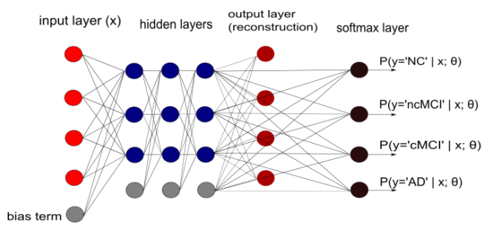
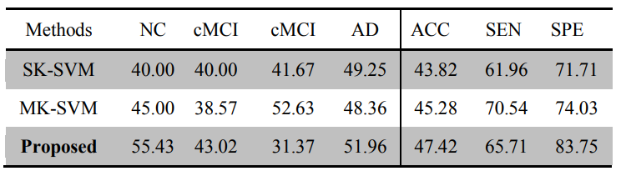
Early diagnosis of Alzheimer disease from brain MRIs
- Liu et al. (2014)

Slide 9
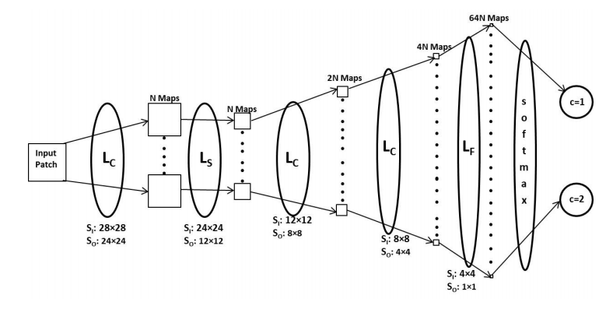
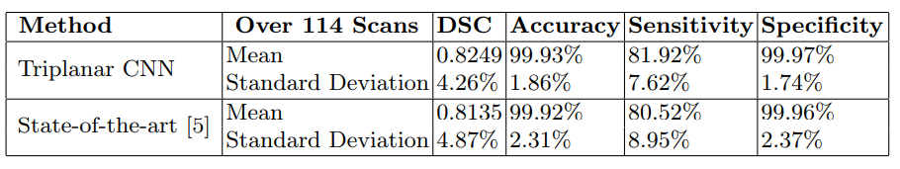
Prasoon et al. - Automatic segmentation of knee cartilage MRIs to predict the risk of osteoarthritis

Slide 10
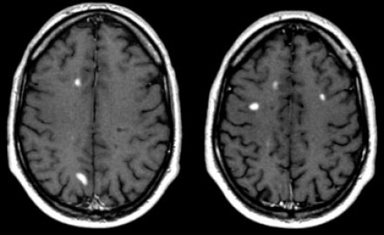
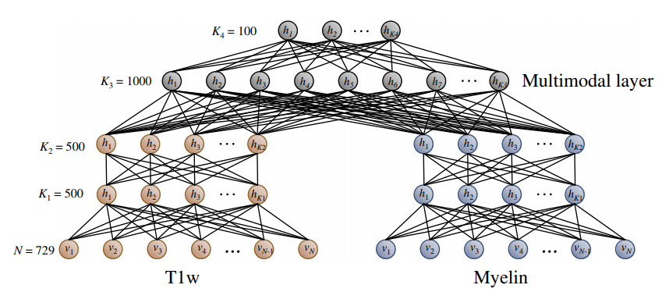
Segmentation of MS lesions in multi-channel 3D MRIs (Yoo et al., 2018)

Slide 11
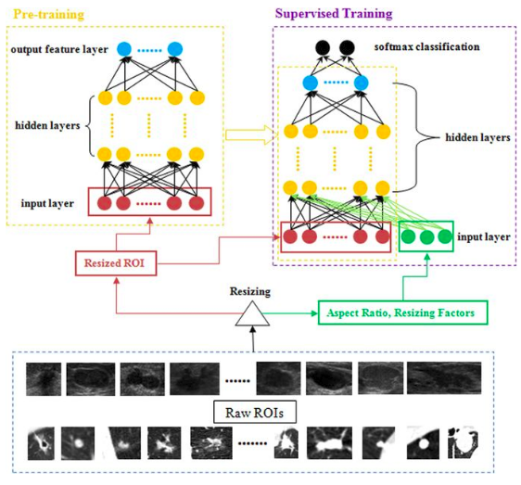
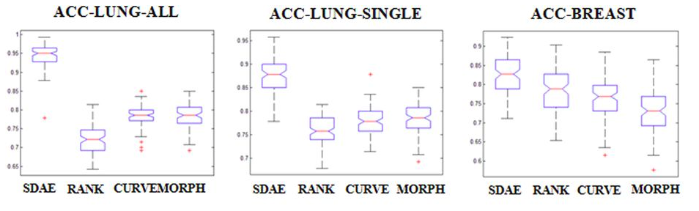
Diagnosis of breast nodules and lesions from ultrasound images (Cheng et al., 2016)

Slide 12
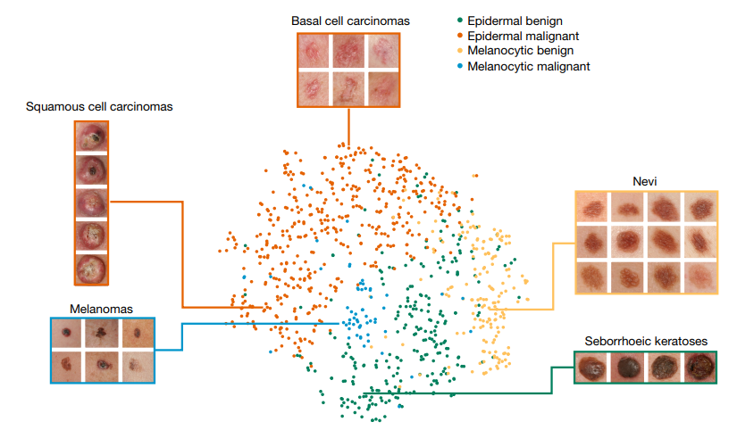
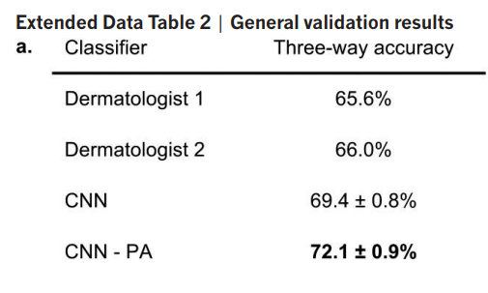
Classification of skin cancer - Esteva et al., 2017

Slide 13
Deep Learning has been increasingly used in healthcare applications
Imaging data
Electronic Health Records (EHRs)
Genetics
Wearable
devices

Slide 14
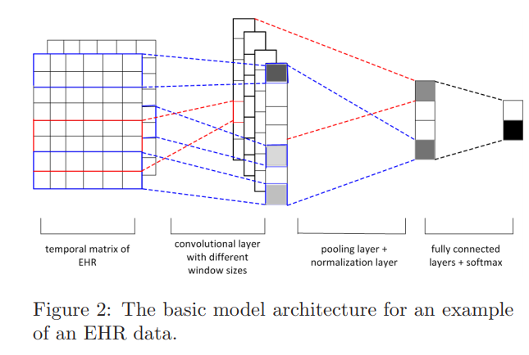
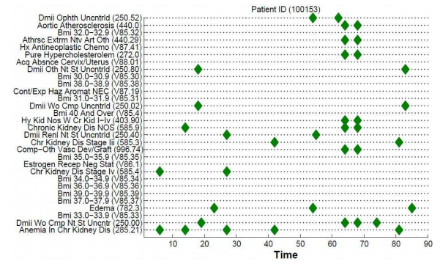
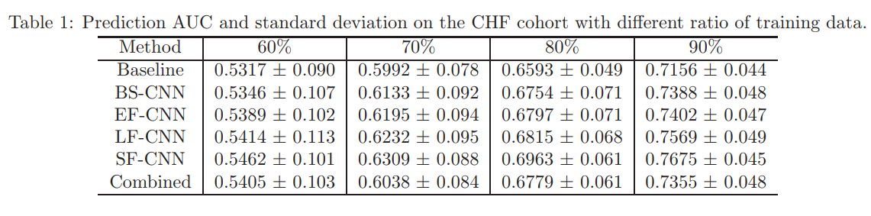
Predict development of congestive heart failure and COPD – Liu et al., 2015

Slide 15
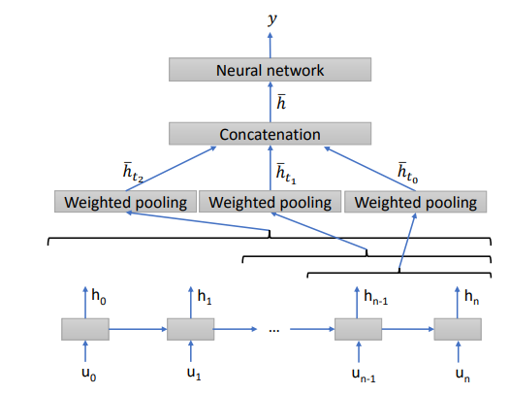
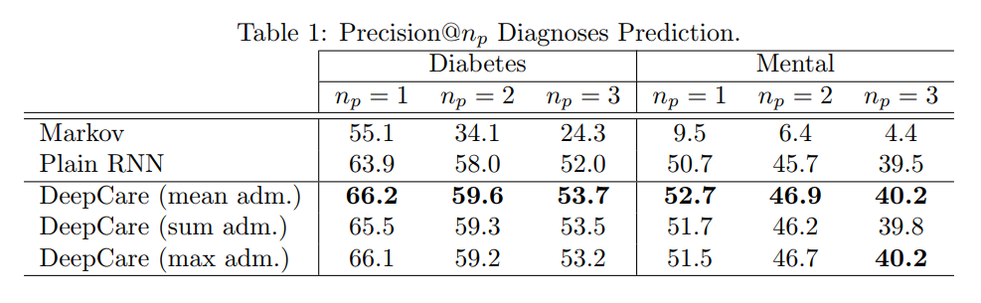
Predict risk of diabetes and mental health – Pham et al, 2016

Slide 16
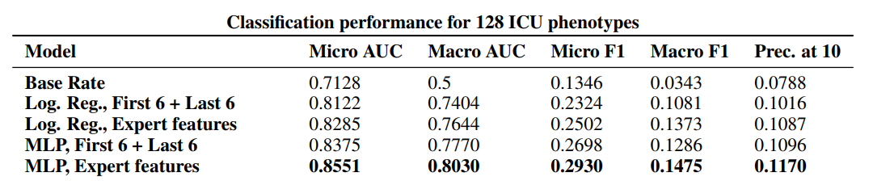
Predict continuous time signals from Intensive Care Units – Lipton et al., 2016
blood pressure
peripheral capillary refill rate
end-tidal CO2
fraction of inspired O2,
glascow coma scale
blood glucose
heart rate
PH
respiratory rate
blood oxygen saturation
body temperature
urine output

Slide 17
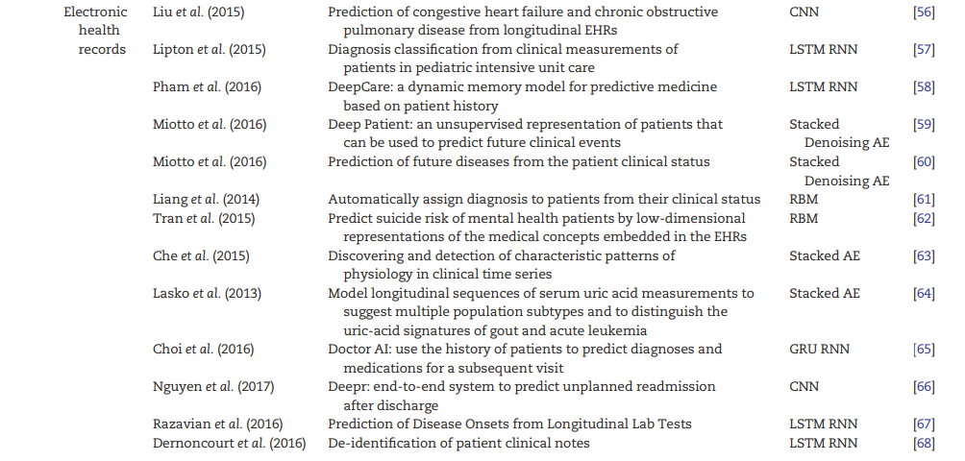
Other Deep Learning EHR applications:

Slide 18
Deep Learning has been increasingly used in healthcare applications
Imaging data
Electronic Health Records (EHRs)
Genetics
Wearable
devices

Slide 19
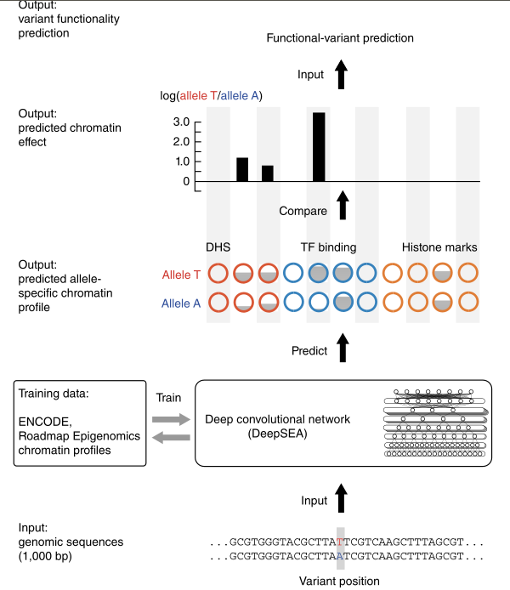
Predict chromatin protein behaviour from DNA sequences - Zhou et al 2015

Slide 20
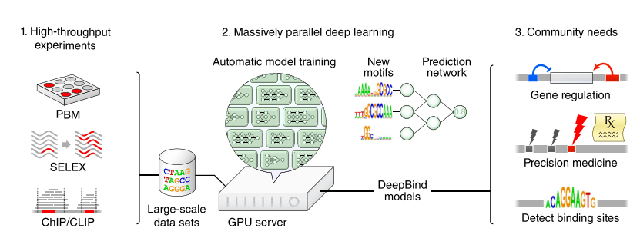
Predict specificities of DNA- and RNA-binding proteins (Alipanahi et al 2015)

Slide 21
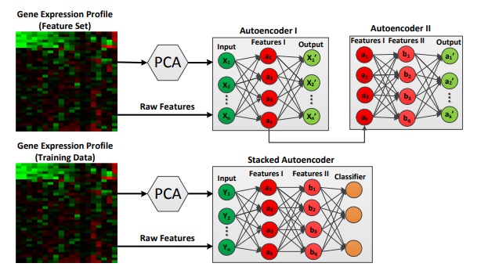
Classification of cancer from gene expression profiles (Fakoor et al., 2013)

Slide 22
Deep Learning has been increasingly used in healthcare applications
Imaging data
Electronic Health Records (EHRs)
Genetics
Wearable
devices

Slide 23
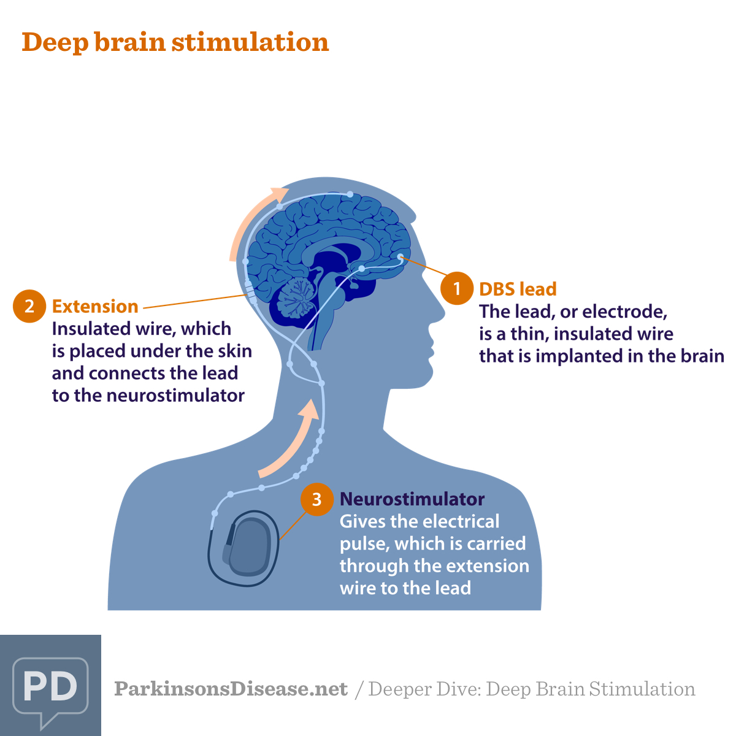
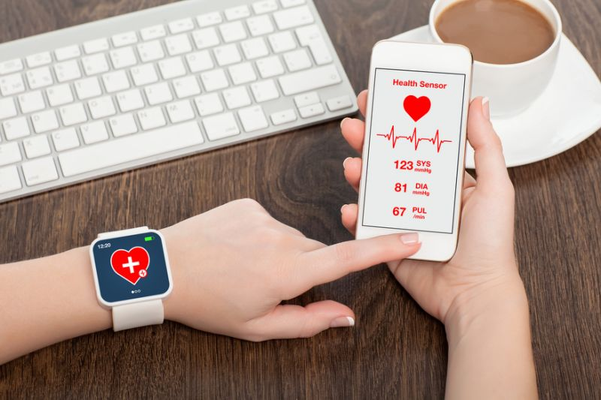
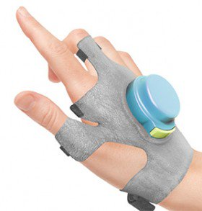
Wearable devices & Internet of Things

Slide 24
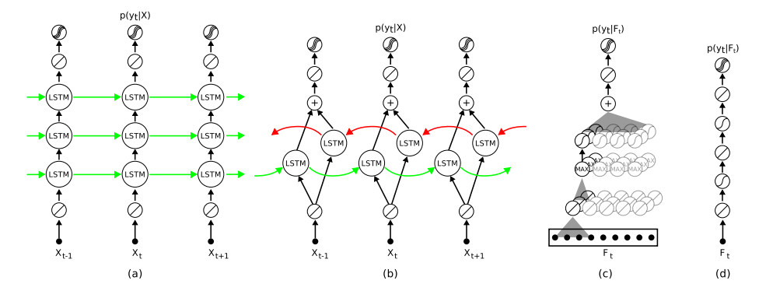
Detect freezing of gait in Parkinson’s patients (Hammerla et al., 2013)

Slide 25
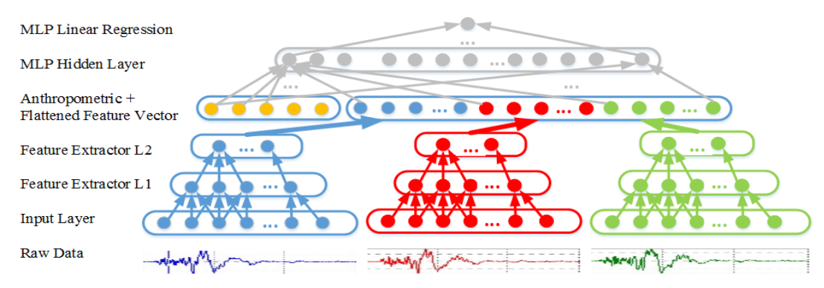
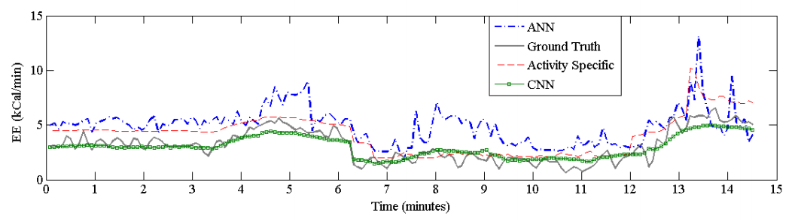
Estimate the Energy Expenditure (Zhu et al., 2015)

Slide 26
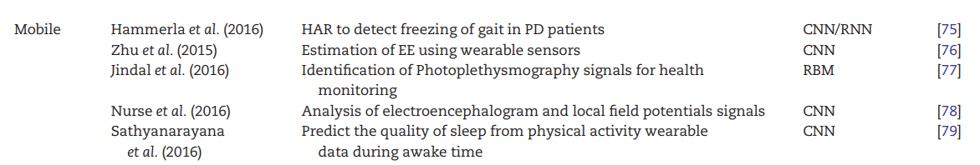
Other applications using wearables data

Slide 27
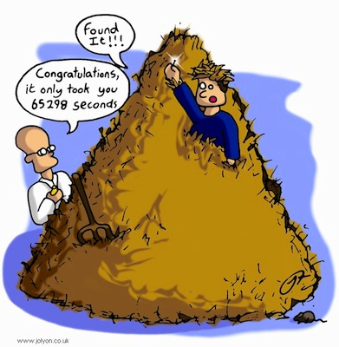
Challenges: Deep Learning needs Large Datasets

Slide 28
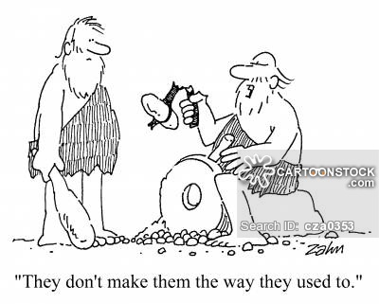
Challenges: Healthcare data is of poor quality

Slide 29
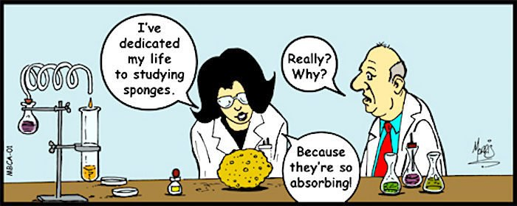
Challenges: Diseases are complex

Slide 30
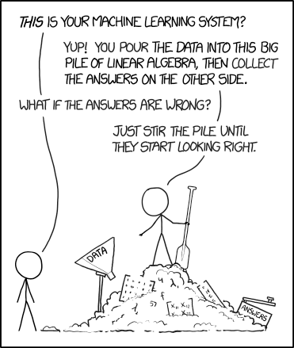
Challenges: Deep learning methods are not interpretable

Slide 31
Opportunities: Combine several sources of data
Imaging data
Electronic Health Records (EHRs)
Wearable
devices
+
+

Slide 32
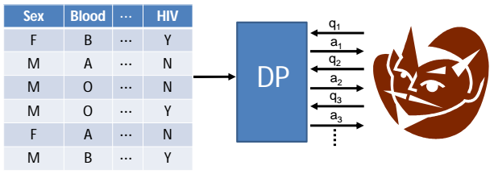
Opportunities: Data security through “differential privacy” and encryption schemes

Slide 33
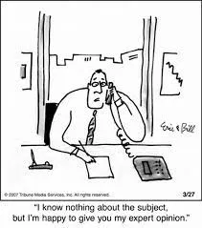
Opportunities: Incorporate expert knowledge into the model

Slide 34
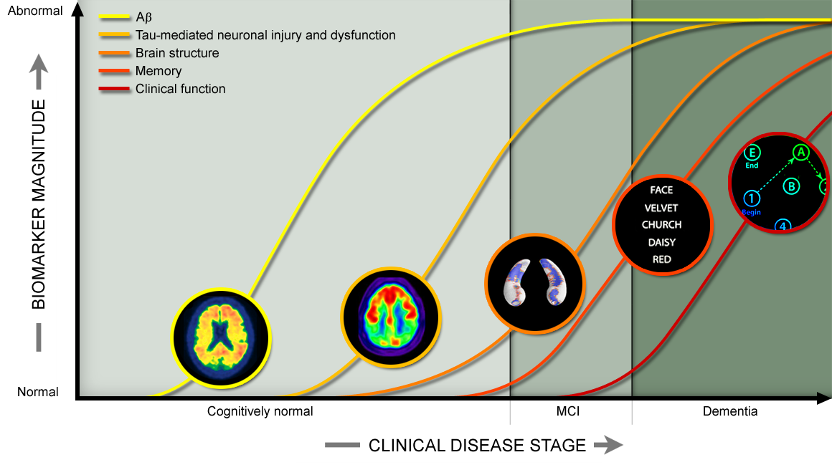
Opportunities: Extend networks to naturally handle temporal data

Slide 35
Opportunities: Increase interpretability of deep learning networks

