Slide 1
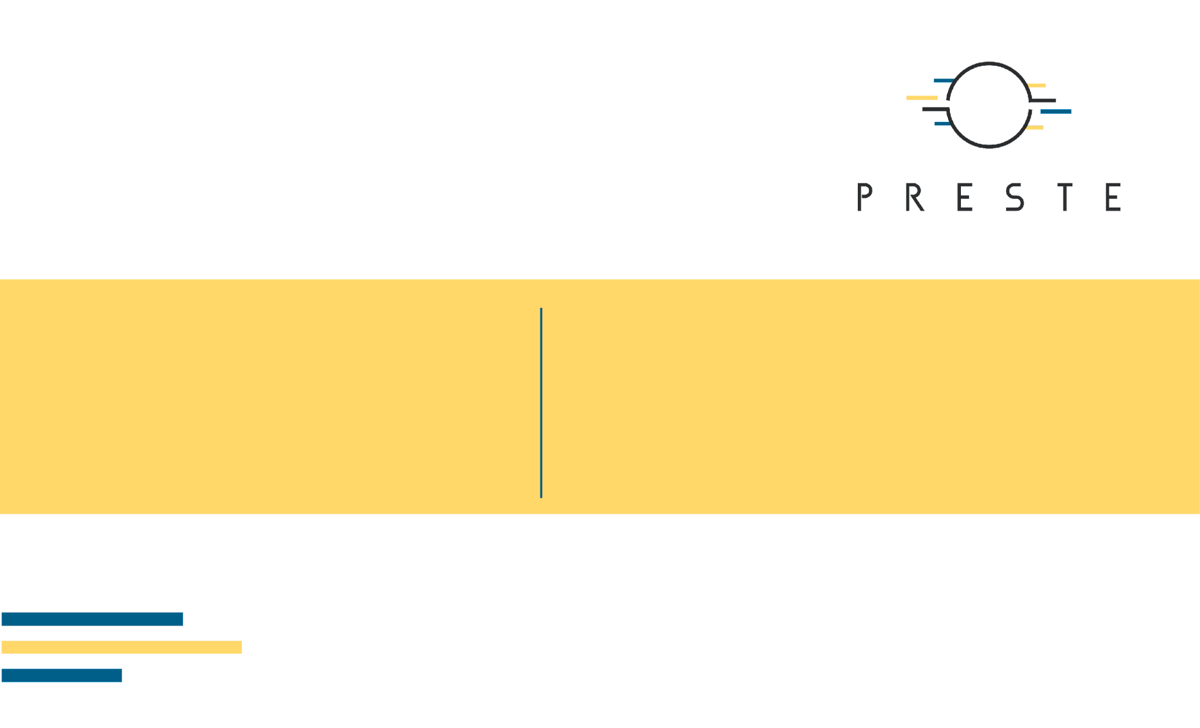
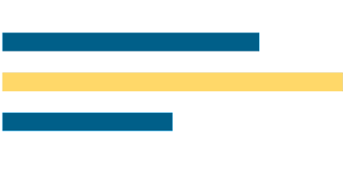
Sequence Models
and Biological
Foundation Models
RNN · LSTM · Attention · Transformers · Self-supervised learning · Foundation models

Slide 2
What's for today
Why biological sequences require models that understand order and context.
How recurrent neural networks, LSTMs and GRUs represent sequential information.
How attention removes the recurrent bottleneck and leads to Transformers.
How self-supervised pretraining turns Transformers into reusable foundation models.
How biological foundation models are used for proteins, DNA, molecules, images and omics.
When embeddings, fine-tuning, few-shot learning and parameter-efficient adaptation make sense.
2/53

Slide 3
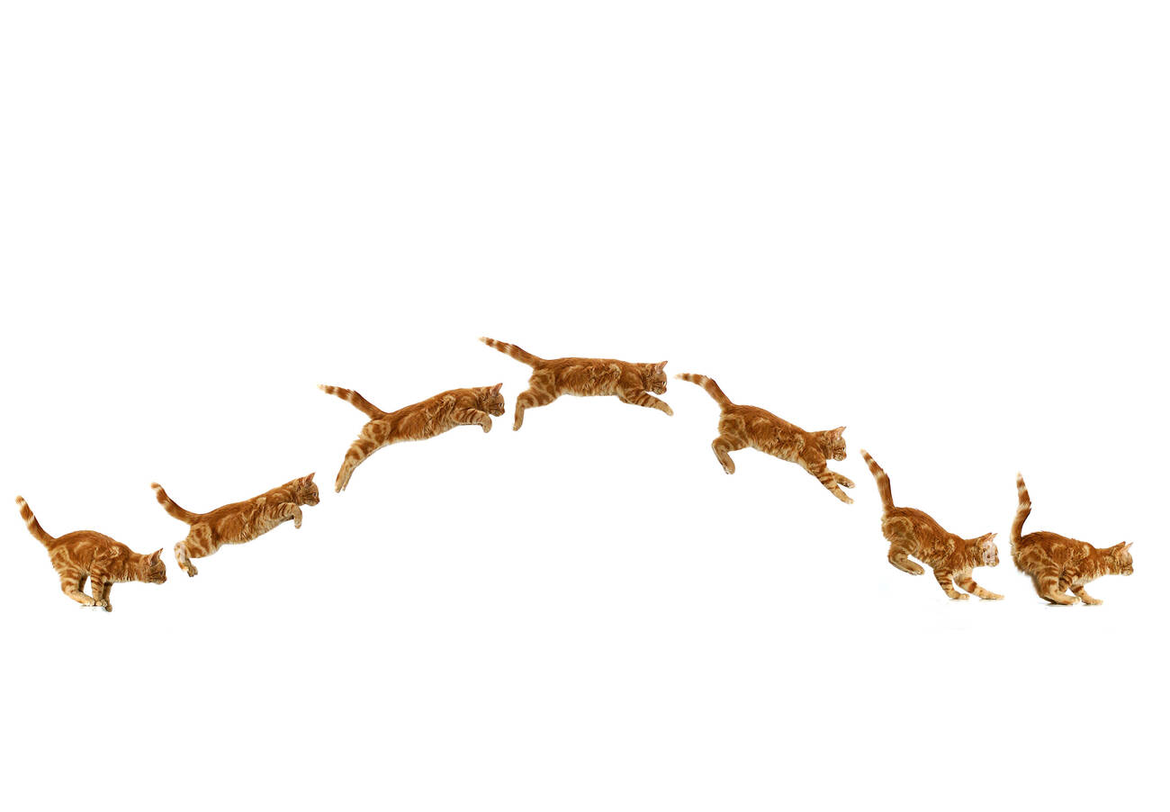
1. Biological data as sequences
Everything can be a sequence.
3/53

Slide 4
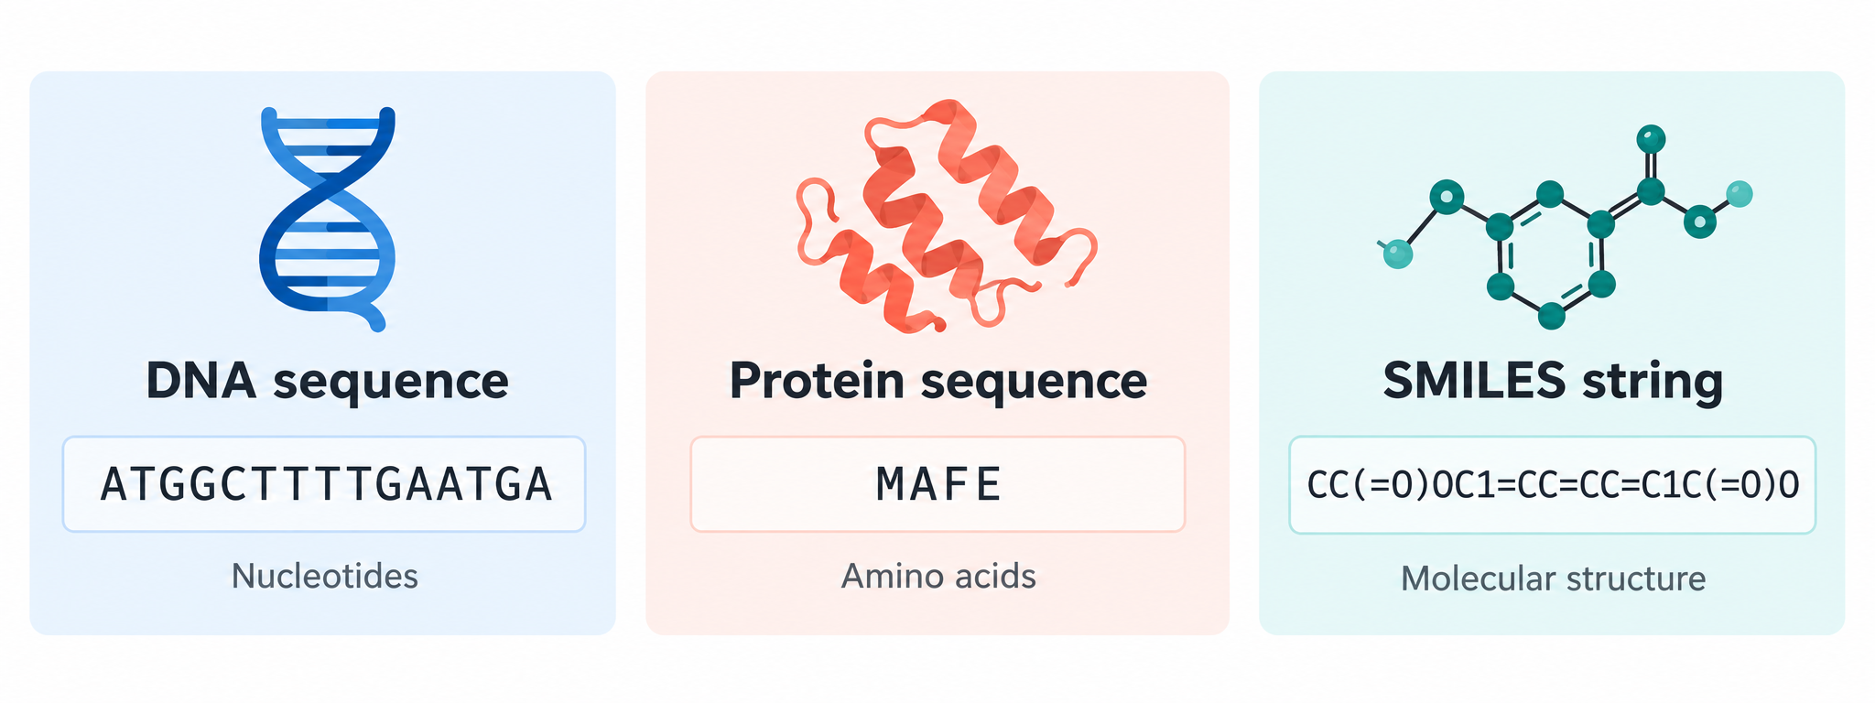
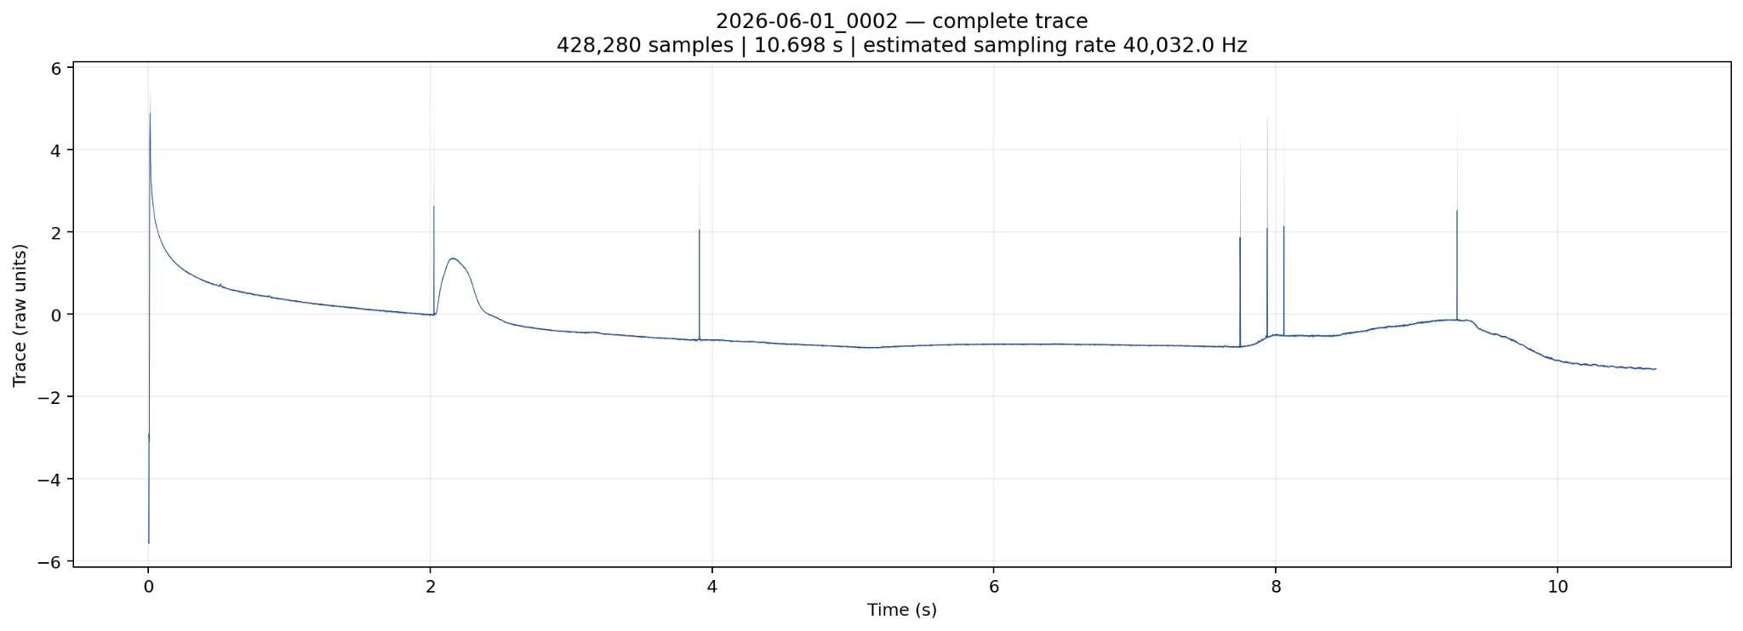
Biology contains many kinds of sequences
DNA and RNA are ordered nucleotide sequences.
Proteins are ordered amino-acid sequences.
SMILES can encode molecules as symbolic sequences.
Time-series experiments and physiological recordings are sequential as well.
The same token can mean different things depending on its context.
4/53

Slide 5
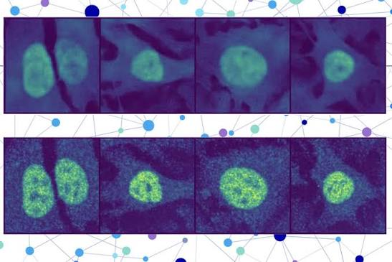
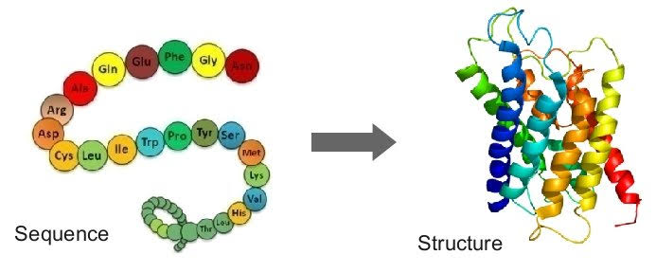
Common sequence-learning tasks
Sequence → one output
Sequence → many outputs
Protein localization or function.
Promoter / enhancer classification.
Antimicrobial peptide prediction.
Sequence-level property prediction.
Residue-level secondary structure.
Nucleotide-level annotation.
Sequence tagging.
Autoregressive next-token prediction.
5/53

Slide 6
Tokenization: converting symbols into model inputs
A sequence must first be divided into tokens.
DNA may use individual bases or k-mers.
Protein models commonly use amino-acid tokens.
Text and SMILES models may use characters, subwords or learned token vocabularies.
Tokenization determines sequence length and what the model treats as an elementary unit.
Symbols → tokens → IDs
DNA
A
C
G
T
0
1
2
3
PROTEIN
M
K
W
V
10
8
18
17
Illustrative vocabulary IDs; mappings depend on the tokenizer.
6/53

Slide 7
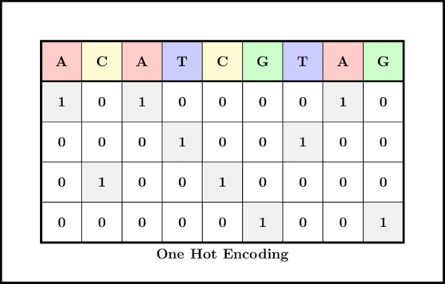
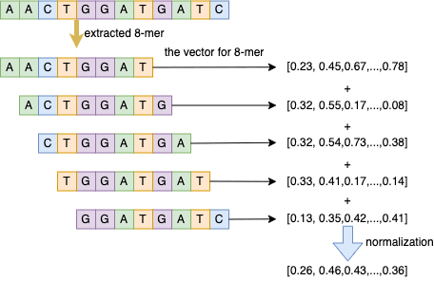
One-hot encoding vs learned embeddings
One-hot representation
Learned embedding
Sparse vector with one active position.
No learned similarity between tokens.
Dimensionality equals vocabulary size.
Useful conceptually, but limited.
Dense vector of dimension d.
Embedding values are learned during training.
Related contexts can acquire related representations.
Becomes the input representation for RNNs and Transformers.
7/53

Slide 8
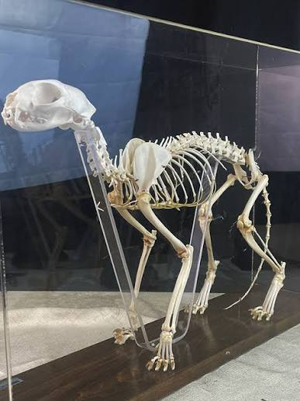
2. Recurrent neural networks
History matters.
8/53

Slide 9
The RNN idea: reuse the same cell at every position
At time/position t, the model receives the current token representation xₜ.
It also receives the previous hidden state hₜ₋₁.
The same parameters are reused across all sequence positions.
The hidden state acts as a compressed summary of previous context.
One cell, shared parameters
h1
h2
h3
RNN
RNN
RNN
h₀
x1
x2
x3
Each state combines its token with the previous state.
9/53

Slide 10
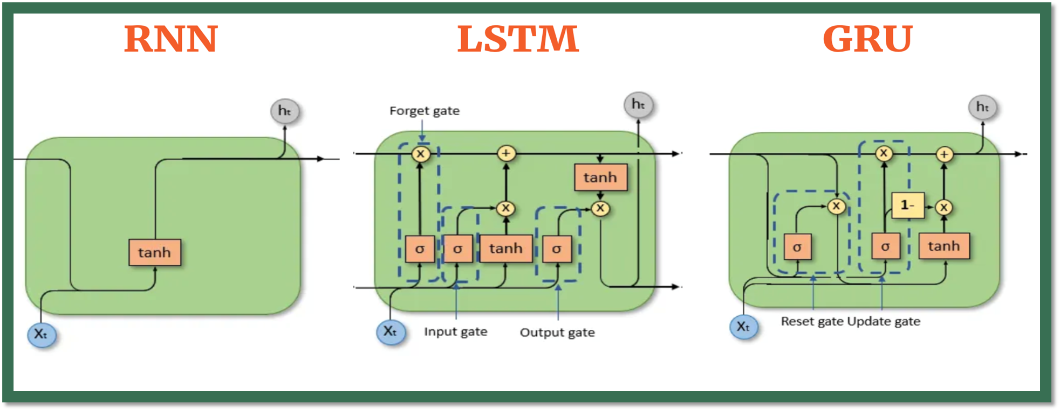
A minimal recurrent update
hₜ = f(Wₓxₜ + Wₕhₜ₋₁ + b)
Wₓ maps the current input into hidden space.
Wₕ propagates information from the previous hidden state.
f is typically a nonlinear activation.
The final hidden state can feed a classifier for many-to-one tasks.
10/53

Slide 11
RNN outputs can be organized in several ways
Many-to-one: sequence classification.
Many-to-many: label every residue / nucleotide.
Sequence-to-sequence: map one sequence to another.
Autoregressive generation: predict the next token repeatedly.
Four output patterns
Many → one
Many → many
y
y
y
y
x
x
x
x
x
x
Sequence → sequence
Next token
y₁
y₂
x₄
x
x
x
x
x
x
Outputs may summarize, label, translate or extend a sequence.
11/53

Slide 12
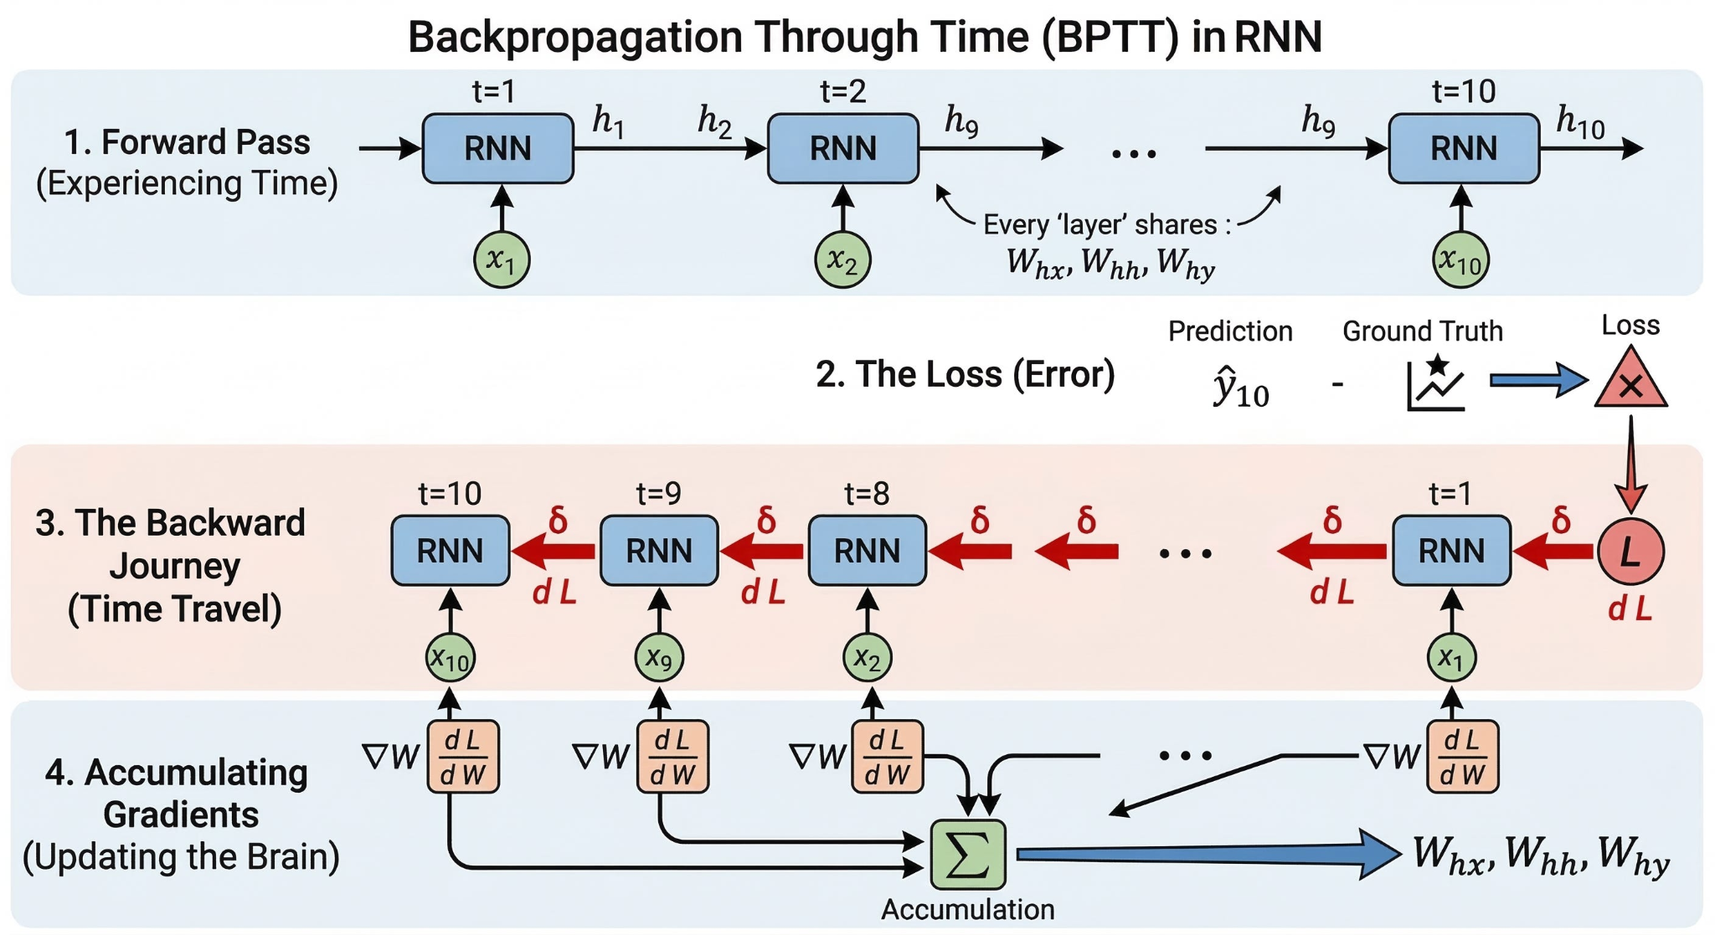
RNN training moves back in time
The recurrent cell is reused at many sequence positions.
During training, the computation graph is unfolded across the sequence.
Gradients pass through repeated hidden-state transformations.
Long dependency chains make optimization difficult.
12/53

Slide 13
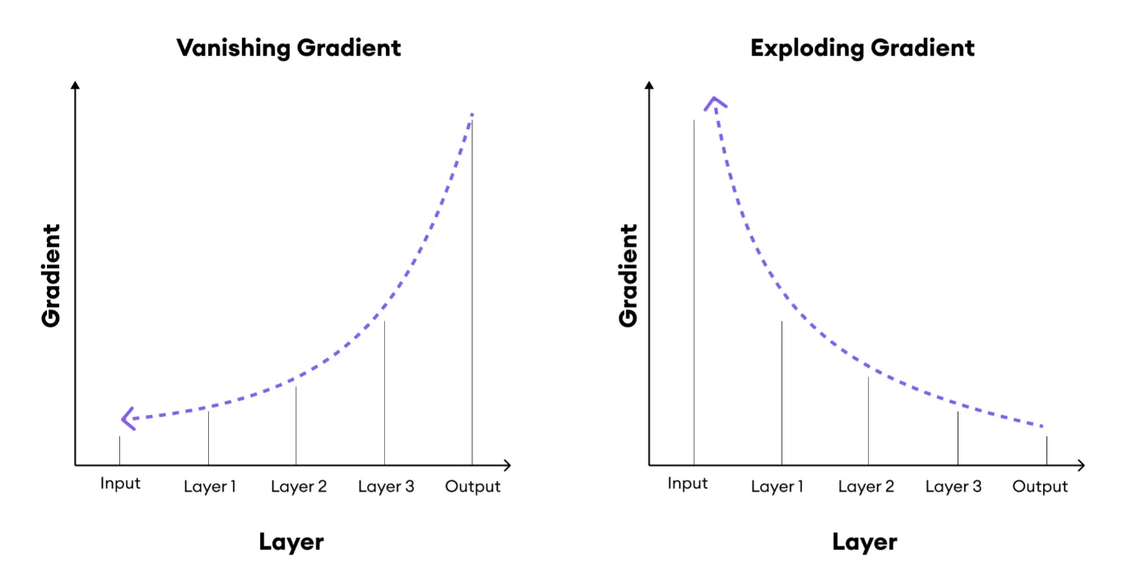
Why gradients can vanish or explode
Repeated multiplication by values below 1 can shrink gradients toward zero.
Repeated multiplication by large values can make gradients unstable.
This makes long-range dependencies difficult for a basic RNN.
Gradient clipping helps exploding gradients but does not solve memory by itself.
13/53

Slide 14
LSTM
Long Short-Term Memory introduces a separate cell state.
Gates regulate what should be forgotten, written and exposed.
The memory pathway helps preserve information across longer sequence distances.
LSTMs became a standard solution before attention-based models dominated large-scale sequence learning.
14/53

Slide 15
The LSTM gates
What each gate asks
What the model maintains
Forget gate: what old information should be removed?
Input gate: what new information should be written?
Output gate: what part of memory should influence the hidden state?
cₜ: cell state / long-term memory pathway.
hₜ: hidden state exposed to the next layer or prediction.
Both are updated at every sequence position.
15/53

Slide 16
GRU: a simpler gated recurrent unit
GRU
Uses update and reset gates.
Maintains one main hidden state rather than a separate cell state.
Usually has fewer parameters than an LSTM.
Designed to preserve useful information while simplifying recurrence.
16/53

Slide 17
Bidirectional recurrence uses context from both directions
Some tasks benefit from both upstream and downstream context.
A forward RNN reads left-to-right; a backward RNN reads right-to-left.
Their representations can be concatenated for each position.
Useful for sequence annotation when the entire sequence is available.
Read both directions
Forward hidden states →
M
K
W
V
T
F
← Backward hidden states
Concatenate forward and backward states at each residue.
17/53

Slide 18
When to use RNN/LSTM
Good fit
Data are inherently ordered or arrive as a stream.
Sequence lengths are moderate and compute is limited.
The labeled dataset is relatively small.
Online / causal inference matters.
A compact recurrent model is sufficient for the task.
18/53

Slide 19

3. Attention
Is all you need.
19/53

Slide 20
The recurrent bottleneck
In an RNN, information from distant positions must pass through many state transitions.
The model cannot directly compare every pair of sequence positions in one step.
Long sequences therefore create both optimization and computational bottlenecks.
Attention changes the information-routing mechanism.
Two routes to distant context
RNN: many transitions
1
2
3
4
5
6
Attention: direct connection
1
2
3
4
5
6
Attention lets a position access distant content directly.
20/53

Slide 21
Attention - which other positions matter right now?
For each position, the model forms a query.
Queries are compared with keys from other positions.
Similarity determines attention weights.
Values are combined using those weights to produce contextual information.
Context selected by attention
Query at W
M
K
W
V
T
F
0.08
0.12
0.10
0.15
0.10
0.45
Illustrative weights sum to 1.
21/53

Slide 22
Queries, keys and values
Intuition
Computation
Query: what information am I looking for?
Key: what kind of information do I contain?
Value: what information should I contribute if selected?
Q = XWQ
K = XWK
V = XWV
All are learned projections of the current representations.
22/53

Slide 23
Scaled dot-product attention
Attention(Q,K,V) = softmax(QKᵀ / √dₖ) V
Scores → weights → context
×
QKᵀ measures compatibility between positions.
softmax converts scores into normalized attention weights.
The weighted combination of V creates a contextualized representation.
Scaling by √dₖ stabilizes large dot products.
Q
Kᵀ
QKᵀ / √dₖ
×
row softmax
V
Context
23/53

Slide 24
Self-attention contextualizes every token
Context selected by attention
In self-attention, Q, K and V all come from the same sequence.
Each position can directly incorporate information from every allowed position.
A residue can therefore use distant sequence context without recurrent propagation.
The resulting representation depends on the surrounding sequence.
Query at W
M
K
W
V
T
F
A residue combines nearby and distant sequence context.
24/53

Slide 25
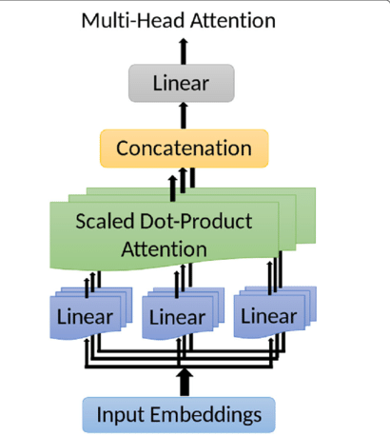
Multi-head attention: several relationship spaces
Each head has its own learned Q, K and V projections.
Heads can emphasize different patterns of contextual relationships.
Head outputs are concatenated and projected back into model space.
Multiple heads increase representational flexibility.
Attention heads are not automatically distinct biological mechanisms.
26/53

Slide 26

4. Transformers
Transformers combine self-attention, feed-forward networks, residual connections and normalization into scalable sequence models.
27/53

Slide 27
A Transformer encoder block
Input
embeddings
Multi-head
self-attention
Add + Norm
Feed-forward
MLP
Add + Norm
28/53

Slide 28
The feed-forward layer transforms each position independently
Mix positions, then transform each
After attention mixes information across positions, an MLP transforms each position.
The same feed-forward weights are reused at every sequence position.
Residual connections preserve the input while the block learns a correction.
Normalization helps stabilize deep stacked architectures.
Input representations
Self-attention
Add + Norm
Position-wise MLP
Add + Norm
Post-norm example; residual paths bypass each sublayer.
29/53

Slide 29
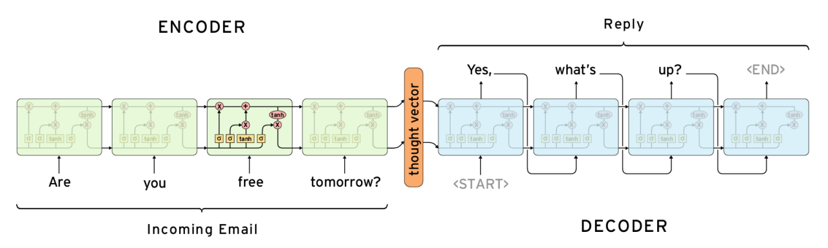
Encoder-style / decoder-style
Encoder-style
Decoder-style
Usually sees context on both sides.
Good for representation learning and classification.
Common for masked-token pretraining.
Produces contextual embeddings.
Uses causal masking: future tokens are hidden.
Naturally supports next-token generation.
Common for autoregressive modelling.
Can generate sequences step by step.
Machine Learning for Bioinformatics · Lecture 8–9
30/53

Slide 30
When to use Transformers
Transformers are needed when
Long-range context matters.
Large-scale pretraining can be reused.
You need contextual embeddings at many sequence positions.
Parallel training is valuable.
The task may later extend to generation or multimodal learning.
31/53

Slide 31

5. Foundation models
Size - matters.
32/53

Slide 32
Biology has far more unlabeled data than task-specific labels
Millions of biological sequences are available without experimental labels for every downstream task.
Supervised labels such as function, localization or phenotype are expensive.
Self-supervised learning creates training targets directly from the input data.
Pretraining can therefore exploit broad biological corpora before adaptation.
33/53

Slide 33
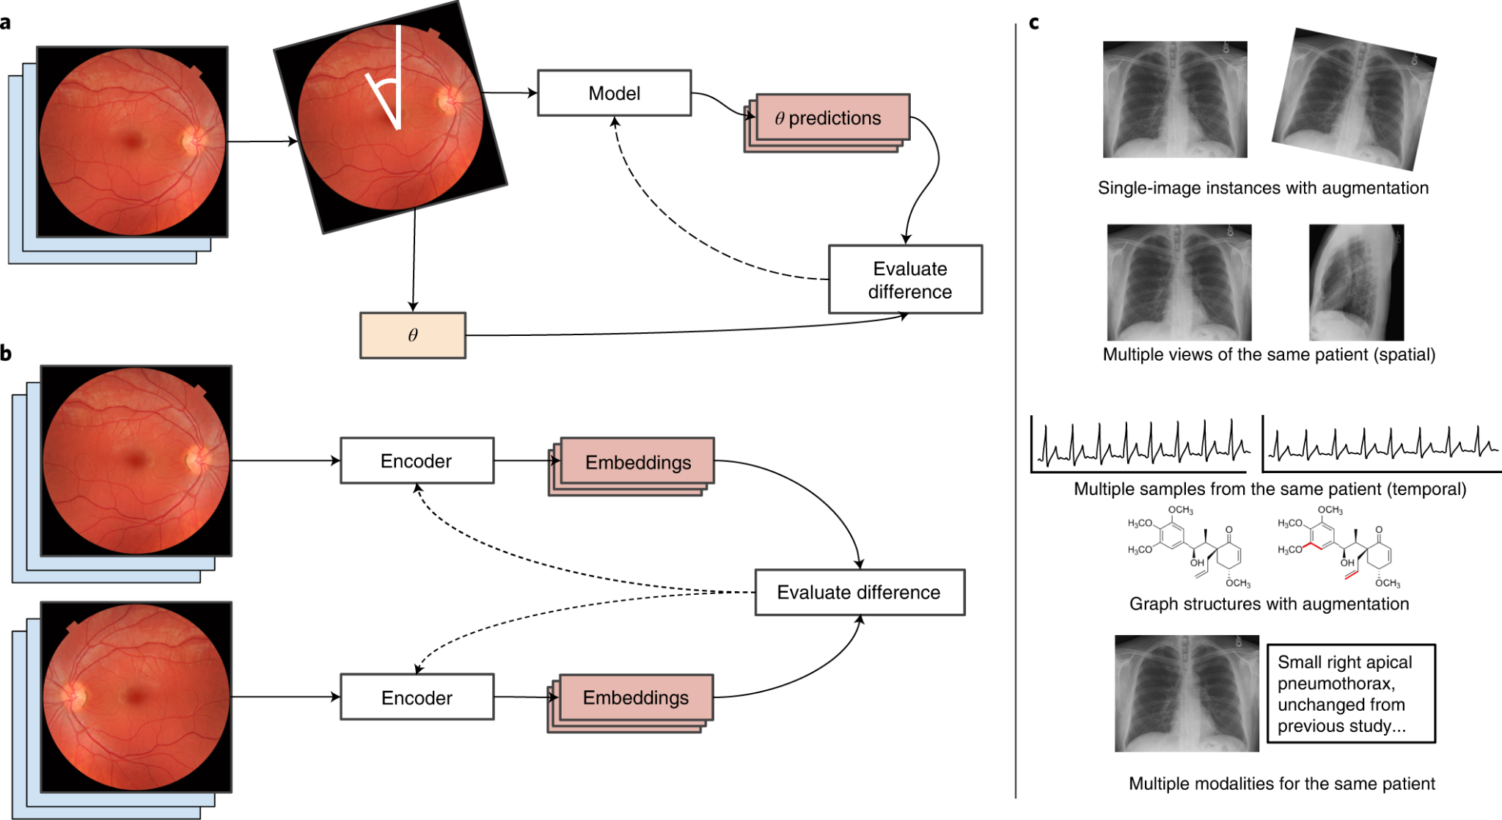
Self-supervised learning creates supervision from the data itself
The training target is generated from the original sequence rather than manual annotation.
The model must learn regularities that help reconstruct or predict missing information.
The representation is then reused for a different downstream biological task.
Pretraining and downstream evaluation are separate stages.
34/53

Slide 34
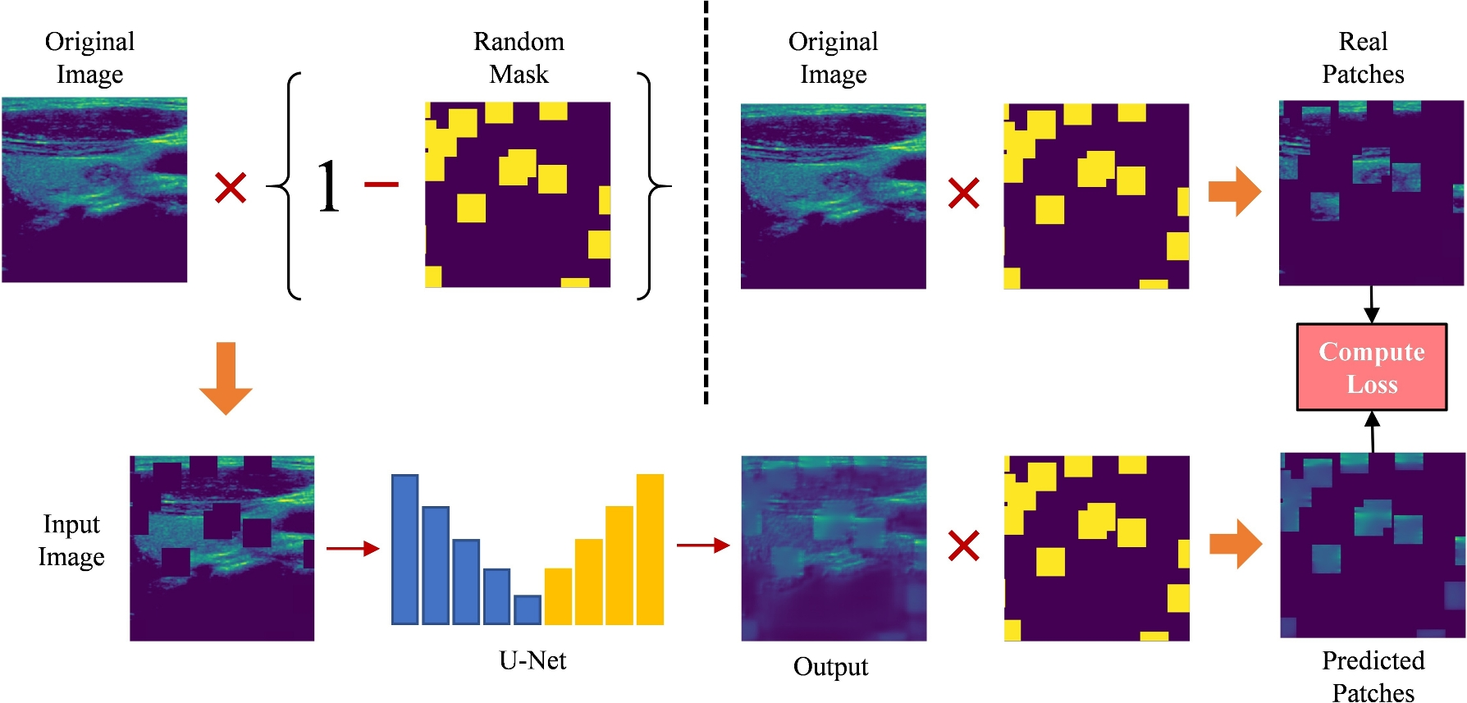
Masked pretraining
Selected sequence tokens are masked or otherwise corrupted.
The model predicts the original token/value using surrounding context.
Bidirectional context is naturally useful for protein and DNA representation learning.
Related objectives may use denoising, span corruption or other masking schemes.
Success requires learning statistical dependencies rather than task-specific labels.
35/53

Slide 35
Autoregressive pretraining
The model predicts the next token from previous tokens.
Causal masking prevents access to future positions.
Training can scale to very large sequence collections.
The same architecture can later generate new sequences or provide hidden-state embeddings.
Predict, append, repeat
M
K
W
V
Causal sequence model
Next: T 0.60 A 0.25 Other 0.15
M
K
W
V
T
Illustrative probabilities; future tokens remain hidden.
36/53

Slide 36
The foundation-model workflow
Broad
unlabeled data
Self-supervised
pretraining
Pretrained
model
Adapt to
downstream task
37/53

Slide 37
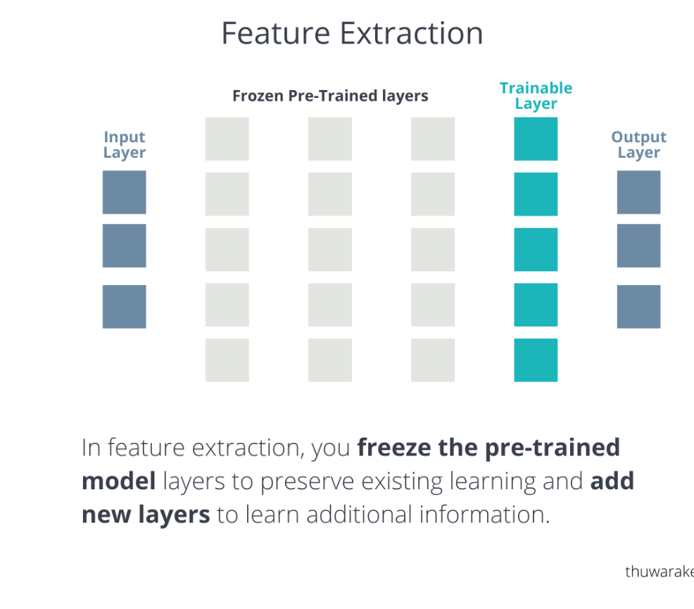
Option 1: use the model as a frozen feature extractor
Run each input through the pretrained model.
Extract embeddings.
Train a small classifier or regressor on top.
This is computationally cheap and clear.
39/53

Slide 38
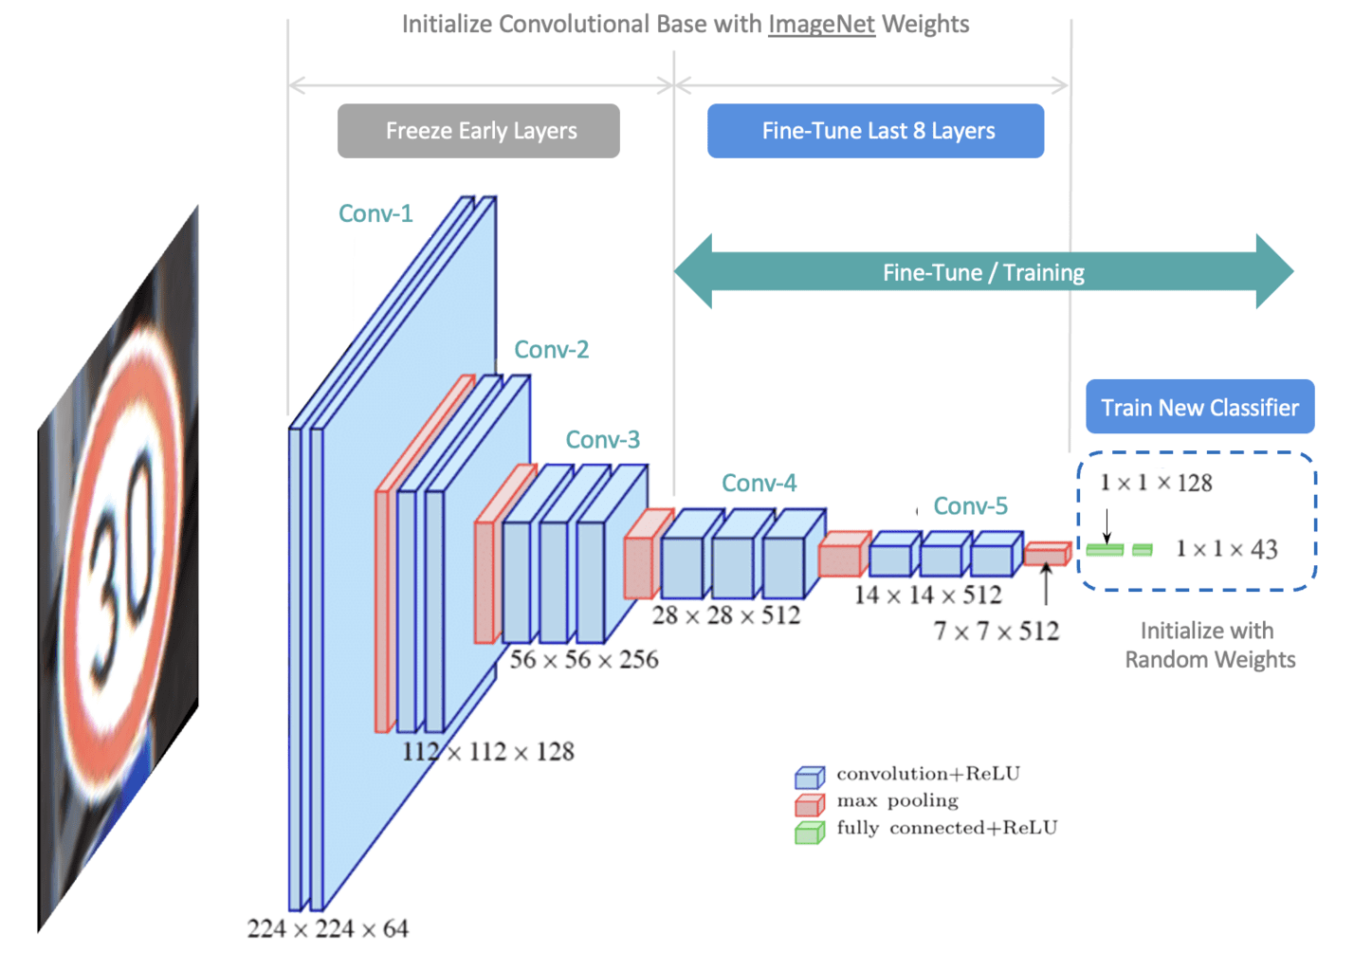
Option 2: fine-tune the pretrained model
Initialize with pretrained weights, then update them using task-specific labels.
Fine-tuning can adapt representations to the new domain or endpoint.
It requires more compute and careful learning-rate / validation control.
Small datasets increase the risk of overfitting or catastrophic forgetting.
40/53

Slide 39
What makes a model a foundation model?
It is pretrained on broad data rather than optimized only for one narrow task.
Its learned representation can be reused across multiple downstream tasks.
Adaptation may use embeddings, a new prediction head, fine-tuning or prompting.
Large parameter count alone does not automatically make a model a useful foundation model.
38/53

Slide 40
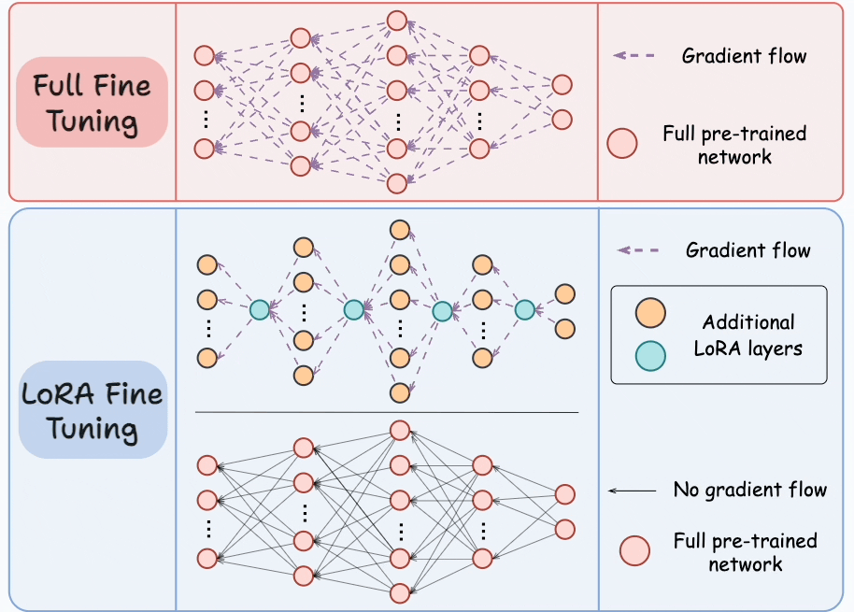
Parameter-efficient fine-tuning
PEFT methods adapt large pretrained models without updating every weight.
LoRA represents a weight update using small low-rank matrices.
Adapters and related methods add small trainable modules.
The aim is lower memory use, faster training and easier task-specific model storage.
41/53

Slide 41

6. Foundation models and biological modalities
There is a tool for everything.
44/53

Slide 42
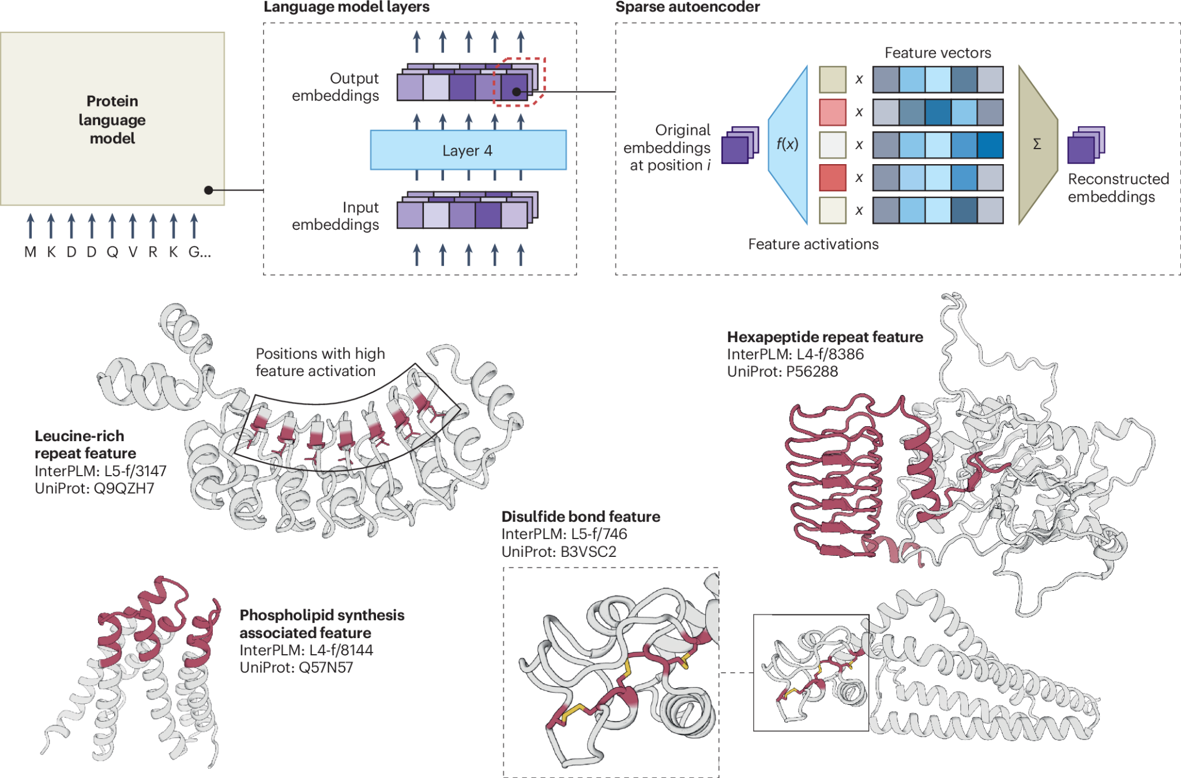
Protein language models
Input: amino-acid sequences.
Pretraining learns contextual representations from large protein-sequence corpora.
Embeddings can support localization, function, mutation and structure-related tasks.
Token-level embeddings describe residues; pooled embeddings describe whole proteins.
Examples: ESM-2, ProtT5, ProtBERT.
45/53

Slide 43
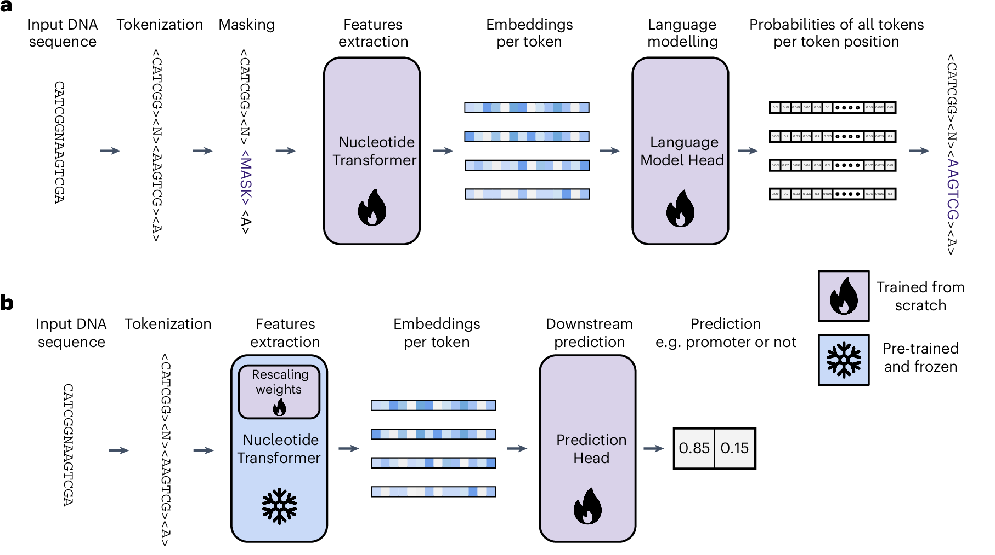
DNA and genome foundation models
Input sequences can be extremely long compared with typical proteins.
Models may tokenize bases, k-mers or learned subsequences.
Downstream tasks include regulatory prediction, sequence classification and variant-effect modelling.
Long context, strand orientation and genome-scale domain shift create additional challenges.
Examples: DNABERT, Nucleotide Transformers
46/53

Slide 44
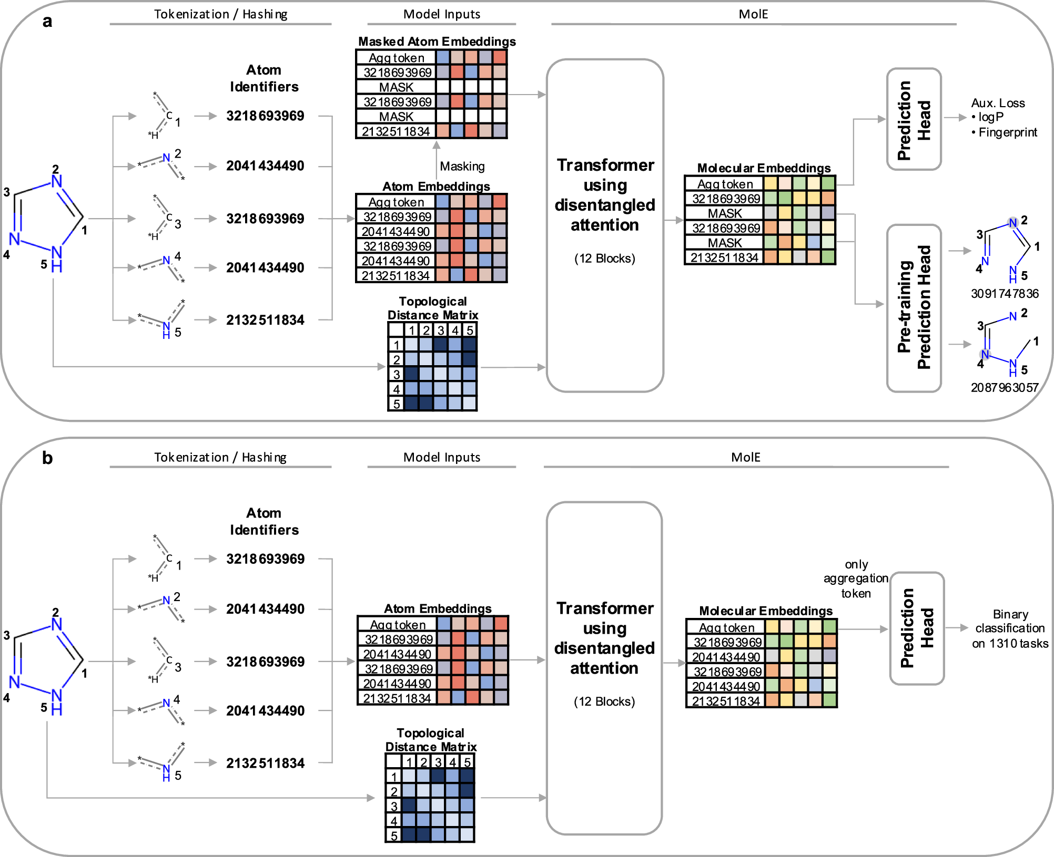
Molecular foundation models
Molecules can be represented as SMILES strings, graphs or multimodal combinations.
Sequence models can pretrain directly on molecular strings.
Graph models can learn atom/bond representations through self-supervised objectives.
We will return to molecular representations and GNNs in the next course block.
Examples: ChemBERTa, MolBERT, MolFormer.
47/53

Slide 45
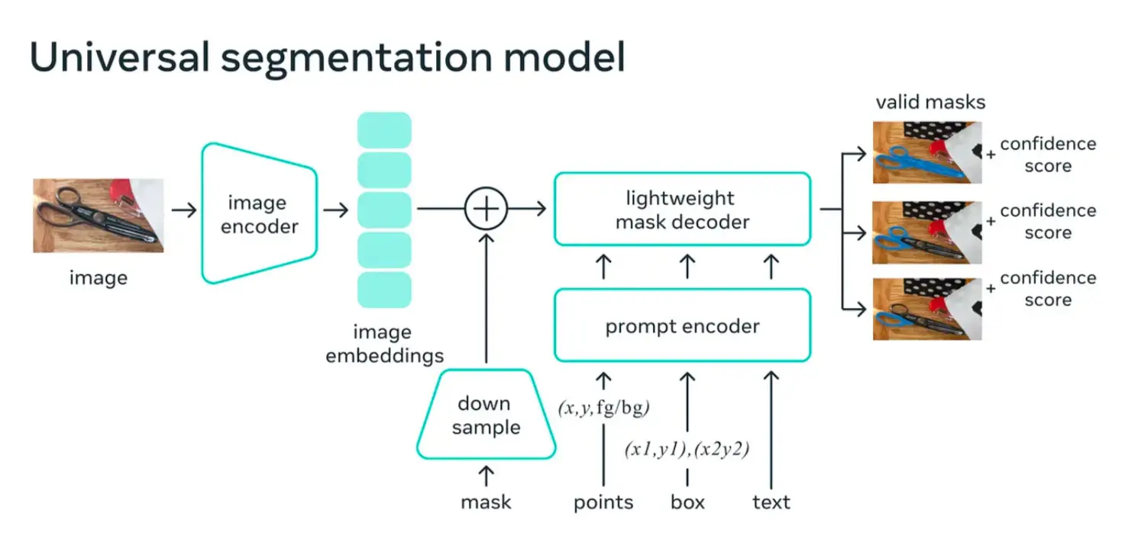
Visual foundation models
Broad visual pretraining can produce reusable image encoders and promptable models.
Embeddings can be adapted for classification, retrieval, detection or segmentation.
Examples: DINOv2, CLIP, SAM / SAM 2.
48/53

Slide 46
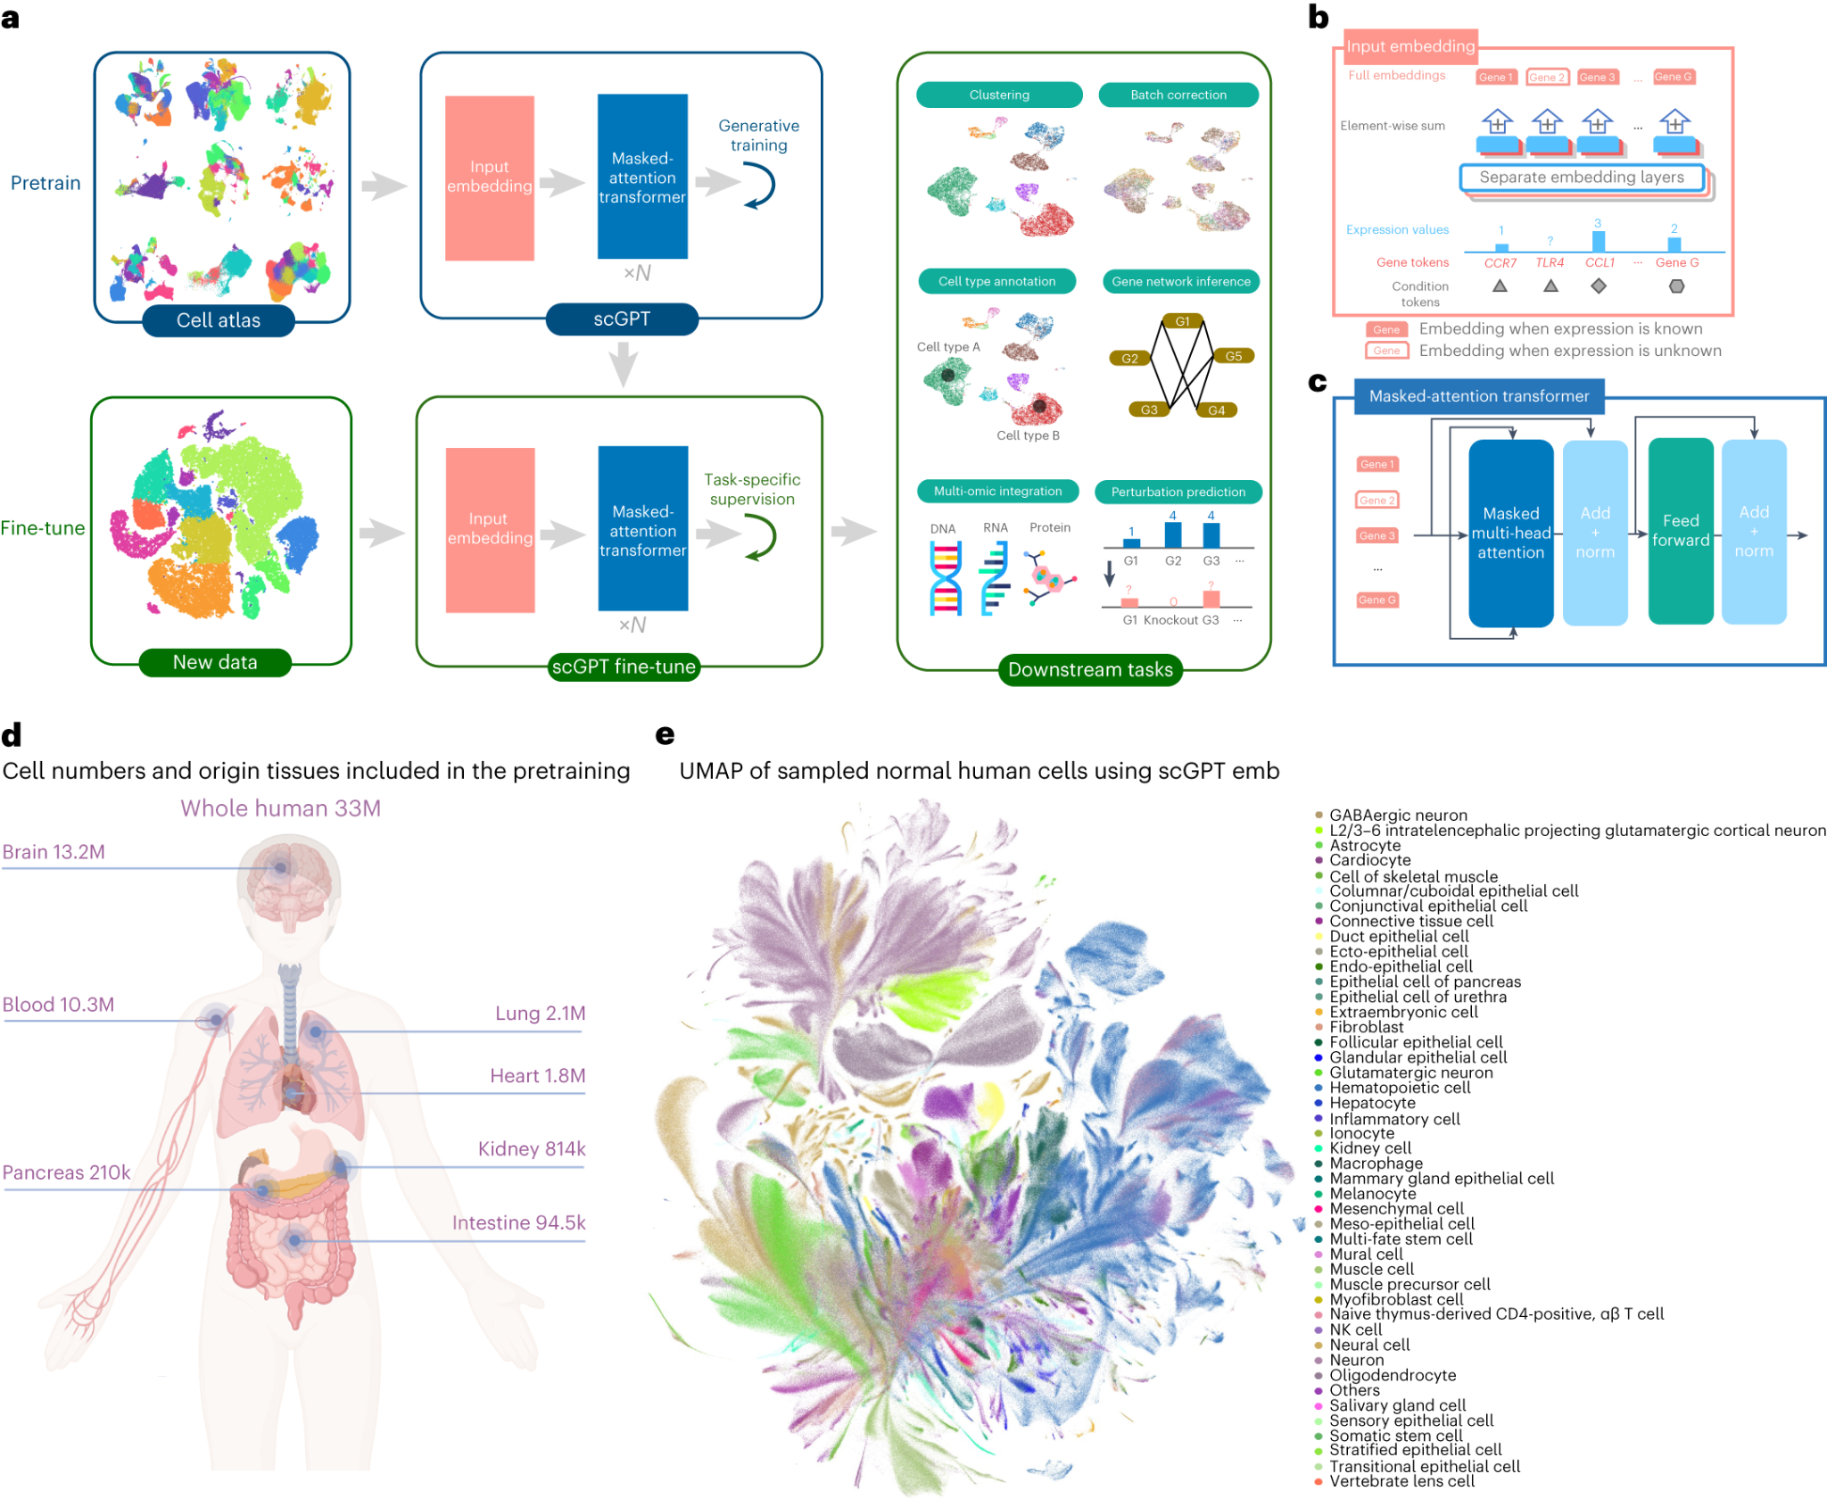
Single-cell foundation models
Input: gene-expression profiles from individual cells.
Large single-cell atlases provide broad pretraining data.
The model can produce cell- or gene-level embeddings.
Downstream tasks include cell-type annotation, perturbation response, integration and retrieval.
Examples: scGPT and Geneformer.
49/53

Slide 47
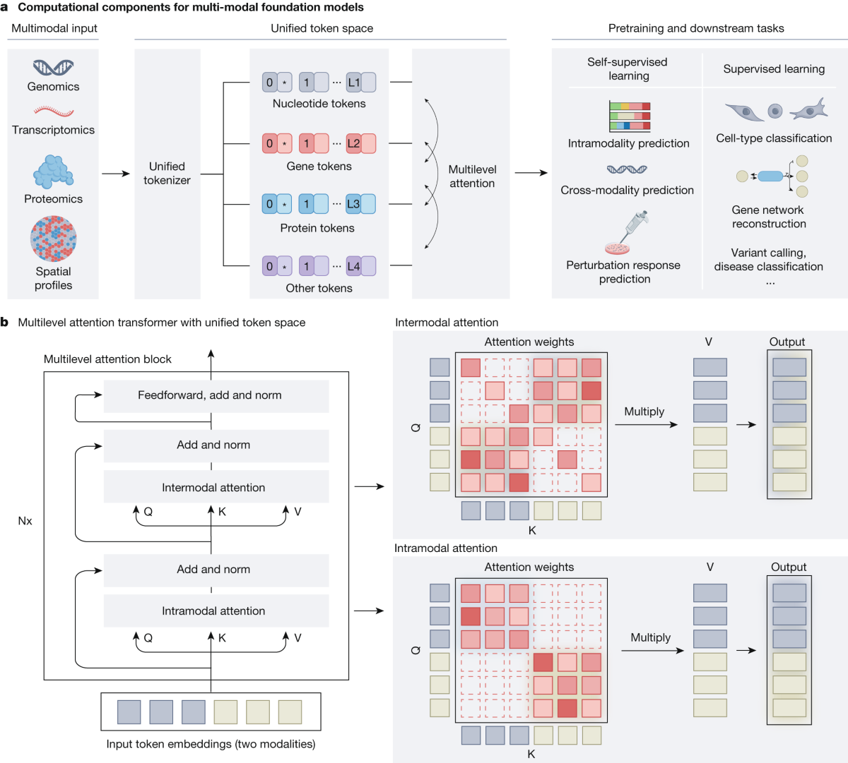
Multimodal biological foundation models
Many biological questions combine several data modalities rather than one sequence or image.
A multimodal model can align representations from sequence, structure, microscopy, text or assay data.
Shared latent spaces can support retrieval, prediction and cross-modal transfer.
The key challenge is not only model size, but alignment between modalities measured at different scales.
50/53

Slide 48
Foundation models do not remove the usual ML problems
Data leakage can still invalidate evaluation.
Pretraining and downstream data may overlap.
Batch effects and domain shift remain predictive shortcuts.
A larger model can overfit a small fine-tuning dataset.
Benchmark performance does not guarantee biological validity or interpretability.
51/53

Slide 49
Practical 8–9
Part A: learn the mechanics
Part B: use a foundation model
Prepare/tokenize a small biological sequence dataset.
Build Embedding → RNN/LSTM → classifier.
Compare vanilla RNN and LSTM.
Inspect sequence lengths, batches and hidden-state shapes.
Generate pretrained protein embeddings.
Train a small downstream classifier.
Compare with the from-scratch recurrent baseline.
52/53

