Slide 1
BRIDGING ANALYSIS TO DESIGN

Slide 2
AIM AND OBJECTIVES
Aim
To understand the move from analysis to design
Objectives
To understand
  Requirement analysis process
  Structured Natural Language specification
  Requirements document
  Requirements validation

Slide 3
REQUIREMENTS ENGINEERING
The process of establishing the services that the customer requires from a system and the constraints under which it operates and is developed

Slide 4
REQUIREMENTS ENGINEERING PROCESSES
There are a number of generic activities common to all Software Engineering processes
  Requirements elicitation and analysis
  Requirement specification
  Requirements validation

Slide 5
REQUIREMENTS ANALYSIS
Involves technical staff working with customers to find out about the application domain, the services that the system should provide and the system’s operational constraints.
May involve end-users, managers, engineers involved in maintenance, domain experts, trade unions, etc. These are called stakeholders

Slide 6
PROBLEMS OF REQUIREMENTS ANALYSIS
Stakeholders don’t know what they really want.
Stakeholders express requirements in their own terms.
Different stakeholders may have conflicting requirements.
Organisational and political factors may influence the system requirements.
The requirements change during the analysis process. New stakeholders may emerge and the business environment change.

Slide 7
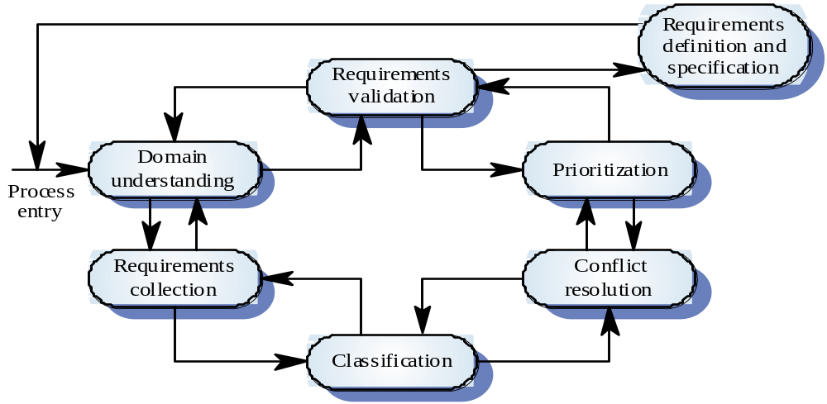
THE REQUIREMENTS ANALYSIS PROCESS

Slide 8
THE REQUIREMENTS ANALYSIS PROCESS
Domain understanding
  Analysts must develop their understanding of the application domain.
Requirements collection
  This is the process of interacting with stakeholders in the system to discover their requirements.
Classification
  This activity takes the unstructured collection of requirements and organises them into coherent clusters.

Slide 9
THE REQUIREMENTS ANALYSIS PROCESS
Conflict Resolution
  Inevitability, where multiple stakeholders are involved, requirements will conflict. This activity is concerned with finding and resolving these conflicts.
Prioritisation
  In any set of requirements some will be more important than others.
Requirements checking
  The requirements are checked to discover if they are complete, consistent and in accordance with what the stakeholders really want from the system.

Slide 10
REQUIREMENTS GATHERING
Facilitated Application Specification Techniques
Software
Customer
Engineering
Group
Group

Slide 11
FAST GUIDELINES
participants must attend entire meeting
all participants are equal
preparation is as important as meeting
all pre-meeting documents are to be viewed as “proposed”
off-site meeting location is preferred
set an agenda and maintain it
don’t get mired in technical detail
J. Wood & D. Silver

Slide 12
REQUIREMENTS SPECIFICATION
User requirements specification
  User requirements are defined using natural language, tables and diagrams
  Problems with natural language
    Lack of clarity
      Precision is difficult without making the document difficult to read
    Requirements confusion
      Functional and non-functional requirements tend to be mixed-up
    Requirements amalgamation
      Several different requirements may be expressed together

Slide 13
REQUIREMENTS SPECIFICATION
Example of requirements confusion:
Grid facilities To assist in the positioning of entities on a diagram,
the user may turn on a grid in either centimetres or inches, via an
option on the control panel. Initially, the grid is off. The grid may be
turned on and off at any time during an editing session and can be
toggled between inches and centimetres at any time. A grid option
will be provided on the reduce-to-fit view but the number of grid
lines shown will be reduced to avoid filling the smaller diagram
with grid lines.

Slide 14
REQUIREMENTS SPECIFICATION
Guidelines for specifying user requirements
  Invent a standard format and use it for all requirements
  Use language in a consistent way. Use shall for mandatory requirements, should for desirable requirements
  Use text highlighting to identify key parts of the requirement
  Avoid the use of computer jargon

Slide 15
REQUIREMENTS SPECIFICATION
System requirements
  System requirements are more detailed descriptions of the user requirements.
  They are used by software engineers as the starting point for system design
  Natural language is often used to write system requirements specifications - as we know this isn’t ideal.

Slide 16
ALTERNATIVE TO NL SPECIFICATION
Structured Natural Language
  A limited form of natural language may be used to express requirements.
  This Approach depends on defining standard forms or templates to express the requirements specification.
  This removes some of the problems resulting from ambiguity and flexibility and imposes a degree of uniformity on a specification

Slide 17
PDL-BASED SPECIFICATION
Requirements may be specified operationally using a language like a programming language but with more flexibility of expression
Most appropriate in two situations
  Where a requirement is specified as a sequence of actions and the order is important
  When hardware and software interfaces have to be specified

Slide 18
PDL DISADVANTAGES
PDL may not be sufficiently expressive to express the system functionality in an understandable way
Notation is only understandable to people with programming language knowledge
The requirement may be taken as a design specification rather than a model to help understand the system

Slide 19
THE REQUIREMENTS DOCUMENT
The requirements document is the official statement of what is required of the system developers
Should include both a definition and a specification of requirements
It is NOT a design document. it focuses on WHAT the system should do rather than HOW it should do it.

Slide 20
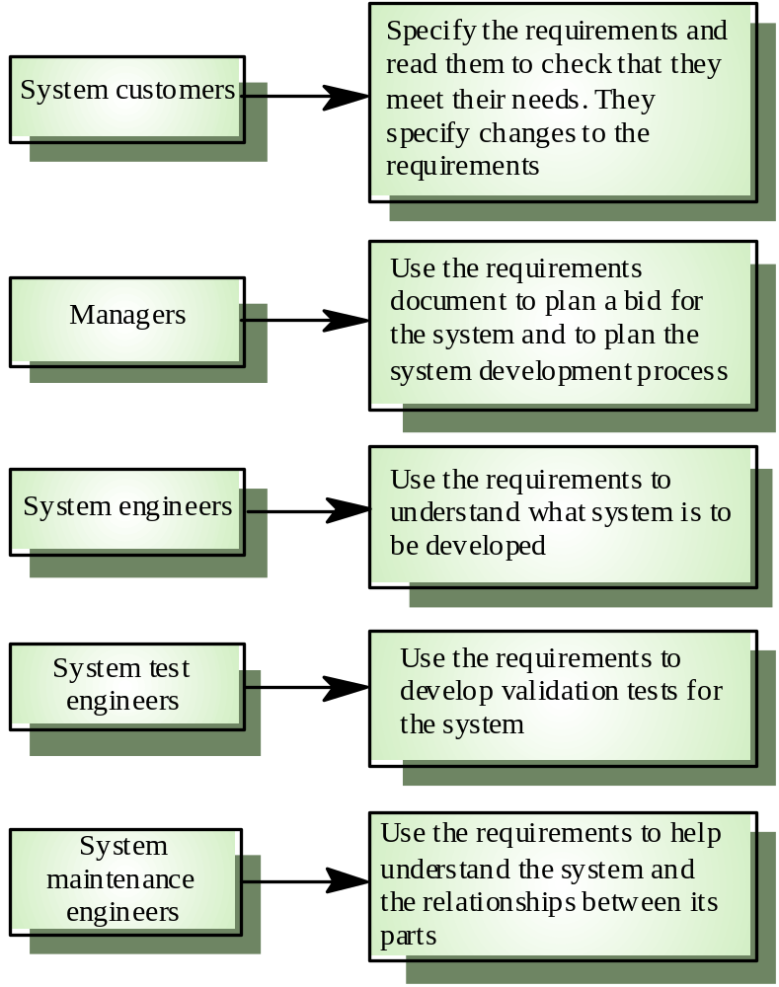
USERS OF A REQUIREMENTS
DOCUMENT

Slide 21
REQUIREMENTS DOCUMENT
Specify external system behaviour
Specify implementation constraints
Easy to change
Serve as reference tool for maintenance
Record forethought about the life cycle of the system i.e. predict changes

Slide 22
REQUIREMENTS DOCUMENT STRUCTURE
Introduction
Glossary
User requirements definition
System architecture
System requirements specification
System models
System evolution
Appendices
Index

Slide 23
REQUIREMENTS VALIDATION
Concerned with demonstrating that the requirements define the system that the customer really wants.
Requirements error costs are high so validation is very important:
  Fixing a requirements error after delivery may cost up to 100 times the cost of fixing an implementation error

Slide 24
REQUIREMENTS CHECKING
During the requirements validation process, different types of checks should be carried out on the requirements document:
  Validity checks: Does the system provide the functions which best support the customer’s needs?
  Consistency: Are there any requirements conflicts?
  Completeness: Are all functions required by the customer included?
  Realism: Can the requirements be implemented given available budget and technology
  Verifiability: Can the requirements be checked?

Slide 25
REQUIREMENTS VALIDATION TECHNIQUES
Requirements reviews
  The requirements are analysed systematically by a team of reviewers.
Prototyping
  Using an executable model of the system to check requirements.
Test-case generation
  Developing tests for requirements to check testability

Slide 26
SUMMARY
  Requirement analysis process
  Domain understanding, Requirements collection, Classification, Conflict Resolution, Prioritisation, Requirements checking
  Structured Natural Language specification
  Defining standard forms or templates to express the requirements specification. Removes problems resulting from ambiguity and flexibility and imposes a degree of uniformity on a specification
  Requirements document
  Introduction, Glossary, User requirements definition, System architecture, System requirements specification, System models, System evolution, Appendices and Index
  Requirements validation
  Requirements reviews, Prototyping, and Test-case generation

