Slide 1
The good, the bad, and the ugly
The early 1970s

Slide 2
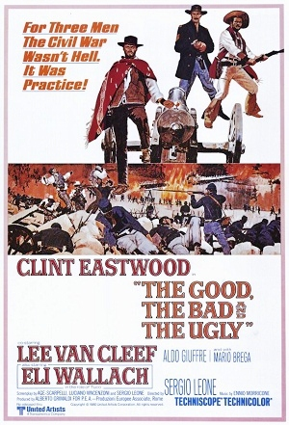
The Good, the Bad, and the Ugly Sergio Leone (director), 1966-67
Spaghetti Western
Ennio Morricone, sound track
Budget: 1.2 million usd
Revenue: over 25 million usd
More realistic depiction of violence
No real heroes, money as the goal
Amazing soundtrack:
https://www.youtube.com/watch?v=loFfBvN_q8k

Slide 3
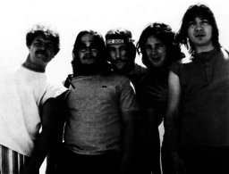
The Guess Who, 1965->
Chad Allen (lead vocals, guitar), Bob Ashley (keyboards), Randy Bachman (guitars, vocals), Jim Kale (bass), Gary Peterson (drums).
First hit “Shakin all over”, 1965, marketed as “Guess Who?” [link], got to No. 1 in Canada, no. 22 in USA.
Jan 1966: Ashley left, Burton Cummings joined, soon Allen left.
Based in Winnipeg, but toured a lot.
After UK tour flopped, returned in debt.
Became house band for CBC show Let’s Go [link]
1969: Canned Wheat, “No time” (co-written by Bachman and Cummings) [link]
1970: American Woman, only US No. 1.

Slide 4
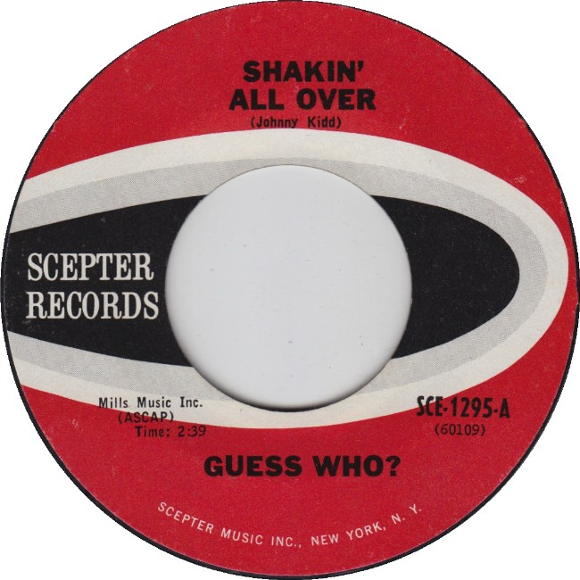

Slide 5
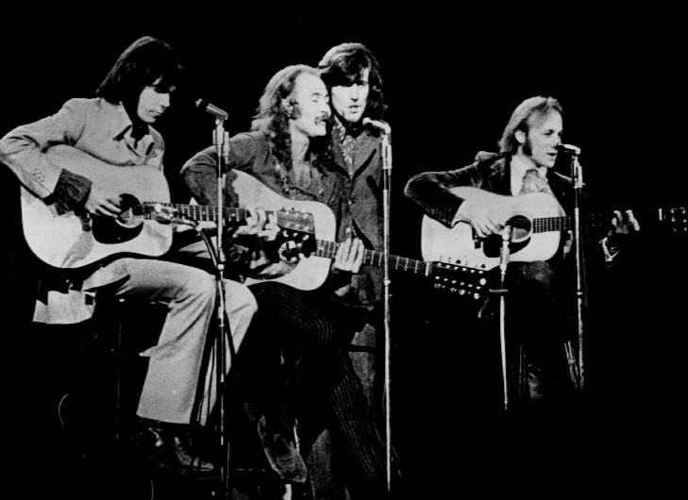
Crosby, Stills, Nash, and Young, 1968-74
David Crosby (The Byrds)
Stephen Stills (Buffalo Springfield)
Graham Nash (The Hollies)
Neil Young (Buffalo Springfield and Crazy Horse): only semi-committed.
Ahmet Ertegun (Atlantic Records)
“Woodstock” (written by Joni Mitchell)
“Ohio” (Young) about Kent State shootings (Cambodia and draft change)
https://www.youtube.com/watch?v=g2UBQX7fwBQ
Banned from AM radio; became counter-culture anthem.

Slide 6
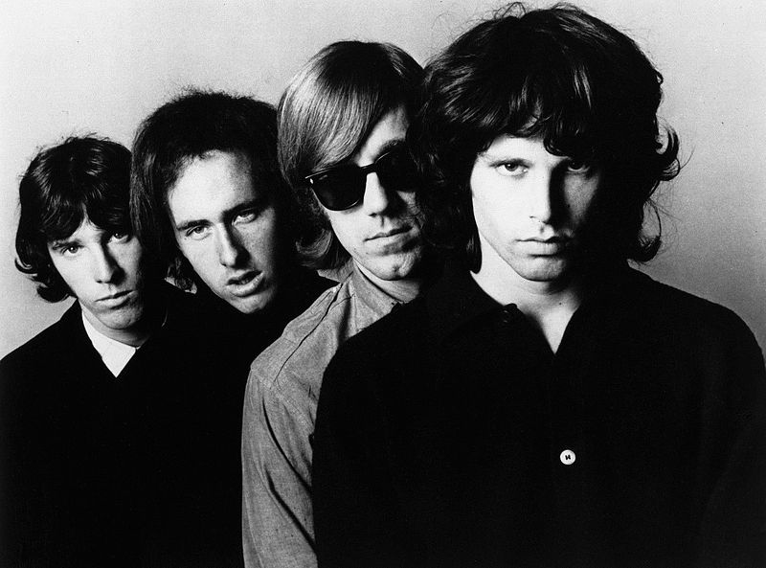
The Good, and Bad
The Doors, 1965-1973 (really 1967-1971)
John Densmore (drums), Robby Krieger (guitars), Ray Manzarek (keyboard), and Jim Morrison (vocals)
By 1972, the Doors had sold 4,190,457 albums and 7,750,642 singles in USA.
“The End” was their beginning (LA’s Whisky a Go Go)
Also, 20 Gold, 14 Platinum and 5 Multi-Platinum album awards in USA alone.
Biggest hits: "Light My Fire“ (1967), "Hello, I Love You“ (1968), and "Touch Me“ (1968)
“People are strange” (Sept. 1967): https://www.youtube.com/watch?v=ZRAr354usf8
“Hello, I love you” (1968): https://www.youtube.com/watch?v=D4o46HKMdL0

Slide 7
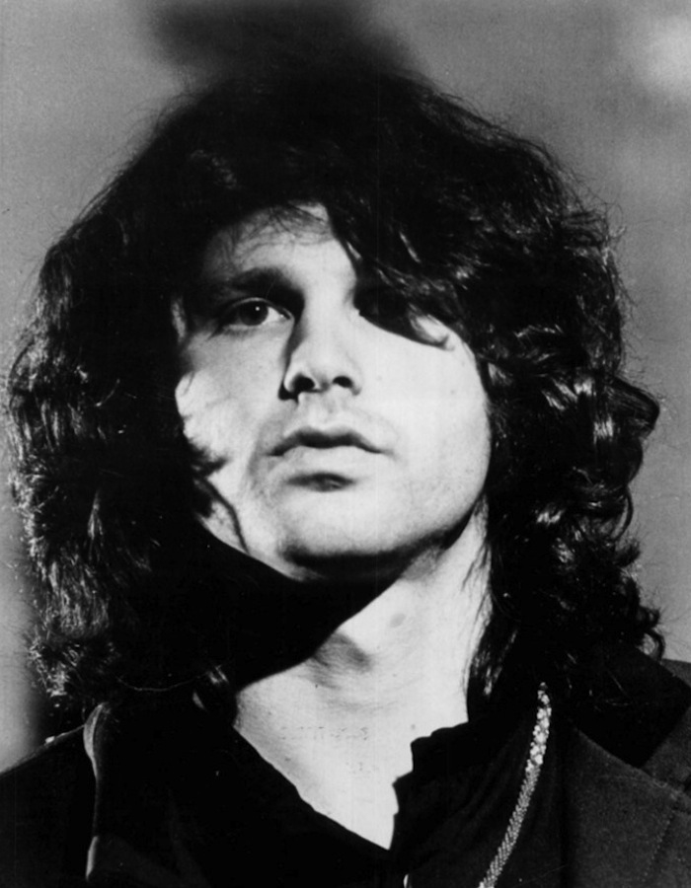
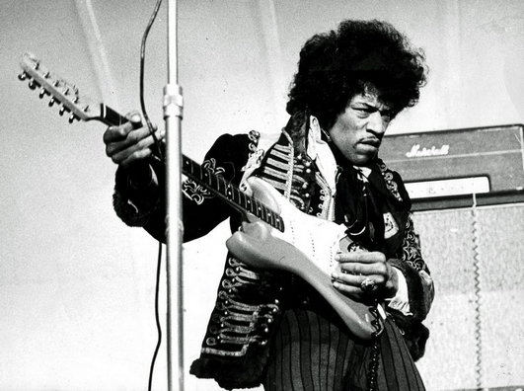
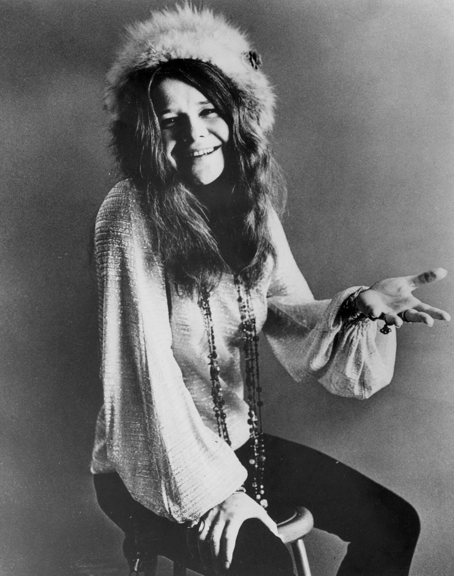
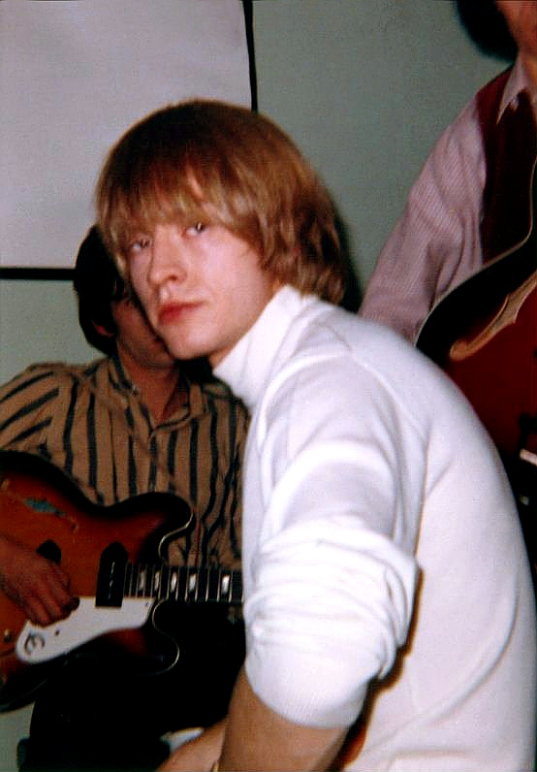
27 Club?
Jim Morrison, 1943-1971
Jimi Hendrix, 1942-1970
Janis Joplin, 1943-1970
Brian Jones, 1942-1969
Kurt Cobain, 1967-1994

Slide 8
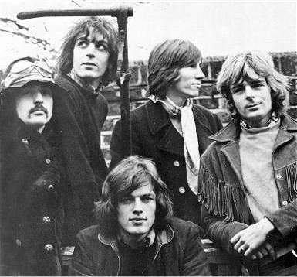
The Good, Pink Floyd, 1965-1994
Nick Mason (drums), Syd Barrett (song-writer, left 1968), Roger Waters (bass guitar, vocals, song-writer), Richard Wright (keyboards), David Gilmour (lead guitar, joined 1967)
Originally the “Tea Set”, then “Pink Floyd”, after Pink Anderson and Floyd Council.
Waters did most of the writing.
Created four incredible concept albums:

Slide 9
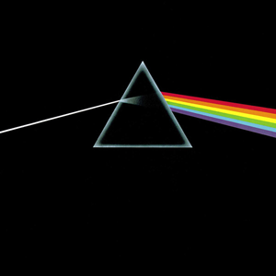
The Dark Side of the Moon, 1973
Waters wrote most of the music
Alan Parsons engineered.
Continuous music, not singles strung together
Greed, time, death, insanity
Second highest selling album of all time
A Side: “Speak to me”, “Breathe”, “On the Run”, “Time”, “The Great Gig in the Sky”
B Side: “Money”, “Us and Them”, “Any Colour You Like”, “Brain Damage,” “Eclipse”

Slide 10
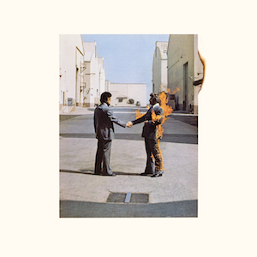
Pink Floyd, after Dark Side
Wish You Were Here (1975)
Animals (1977)
The Wall (1979): perhaps greatest concept album of all time.
The Final Cut (1983)

Slide 11
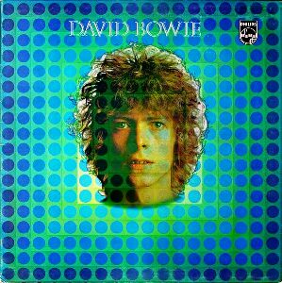
David Bowie (David Robert Jones, b. 1947)
“Space Oddity,” July 1969
Nine days before Apollo 11 landed on the moon.
Stanley Kubrick’s 2001: A Space Odyssey (April 1968)
Bowie’s first top five UK hit.
Commercially very perceptive, theatrical, adventurous, and at times experimental.
Original version: https://www.youtube.com/watch?v=D67kmFzSh_o
Re-released version: https://www.youtube.com/watch?v=iYYRH4apXDo

Slide 12
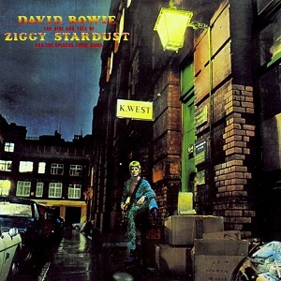
The Rise and Fall of Ziggy Stardust and the Spiders from Mars, 1971-1972
Glam Rock
Science Fiction, Rock and Roll, Glamour, Bi-sexuality
Name from Ziggy the tailor, all about clothes
Clockwork Orange, 1971-72
Concept Album
Mick Ronson, guitarist
“Five Years”: https://www.youtube.com/watch?v=yYwpnG-rkHI
“Ziggy Stardust”: https://www.youtube.com/watch?v=G8sdsW93ThQ

Slide 13
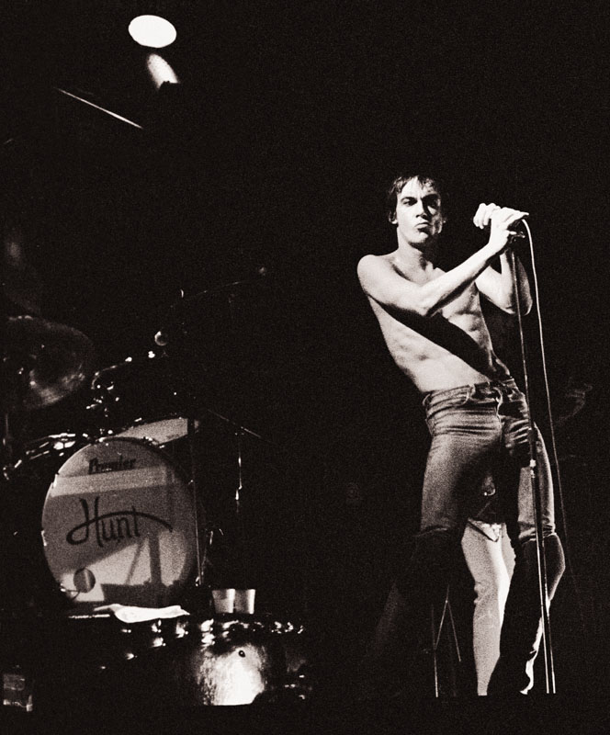
Iggy Pop (born, 1947, as James Newell Osterberg, Jr.)
From Michigan, played in high school bands.
Psychedelic Stooges, then The Stooges, 1968-1974
Inspired by Jim Morrison’s confrontational stage presence.
Raw Power, 1973: “Search and Destroy”
https://www.youtube.com/watch?v=LflK6HoILB0
Serious heroin addiction and infighting, broke up.
Met David Bowie in NYC, and they went to Berlin to get off it.
Co-wrote “The Idiot” and “Lust for Life.”
https://www.youtube.com/watch?v=VDU6TJcrZdA

Slide 14
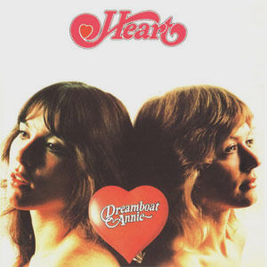
Heart, Ann and Nancy Wilson
Started in Seattle, WA, but Fisher brothers (Mike and Roger) escaped draft to Vancouver, Canada.
Ann joined before the move abroad.
Nancy (lead guitar) joined in 1974.
Also: Roger Fisher (guitar), Howard Leese (keyboardist), Steve Fossen (bassist), and Michael Derosier (drums).
First album, Dreamboat Annie, 1975
Sold 30,000 copies in a few months (Canadian content rule); sold 2.5 million by 1977.
“Magic Man”, 1975
https://www.youtube.com/watch?v=mXOO7QVHgXs

Slide 15
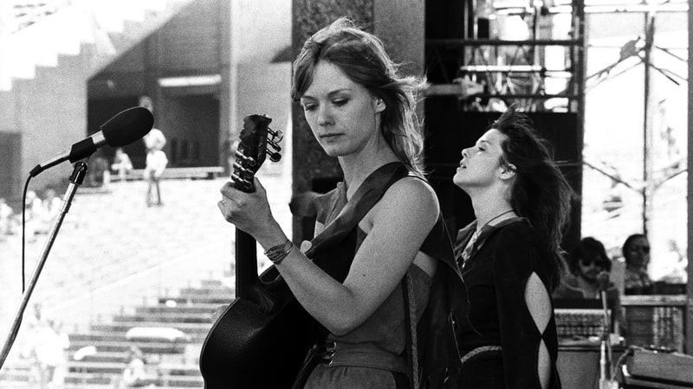
Heart, 1977
Rolling Stone article:
https://www.rollingstone.com/music/features/the-wilson-sisters-talk-heart-to-heart-19770728

Slide 16
Billboard Year-End Hot 100 singles, 1970s
Year | Song | Artist
1970 | “Bridge over Troubled Water” | Simon and Garfunkel
1971 | “Joy to the World” | Three Dog Night
1972 | “The First Ever I Saw Your Face” | Roberta Flack
1973 | "Tie a Yellow Ribbon Round the Ole Oak Tree" | Tony Orlando and Dawn
1974 | “The Way We Were” | Barbara Streisand
1975 | "Love Will Keep Us Together" | Captain and Tenille
1976 | “Silly Love Songs” | Wings (McCartney)
1977 | "Tonight's the Night (Gonna Be Alright)" | Rod Stewart
1978 | "Shadow Dancing" | Andy Gibb
1979 | “My Sharona” | The Knack

Slide 17
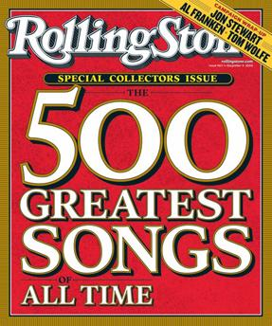
Rolling Stone’s 500 Greatest Rock and Roll Songs
2004 version
2010 version
Decade | Number of songs | Percentage
1940s | 1 | 0.2%
1950s | 72 | 14.4%
1960s | 204 | 40.8%
1970s | 141 | 28.2%
1980s | 57 | 11.4%
1990s | 22 | 4.4%
2000s | 3 | 0.6%
Decade | Number of songs | Percentage
1940s | 1 | 0.2%
1950s | 70 | 14%
1960s | 195 | 39%
1970s | 131 | 26.2%
1980s | 55 | 11%
1990s | 22 | 4.4%
2000s | 26 | 5.2%
Notes:
Source: https://en.wikipedia.org/wiki/Rolling_Stone%27s_500_Greatest_Songs_of_All_Time

Slide 18
Top 10 positions from Rolling Stone's "500 Greatest Songs of All Time"
Rank | Song | Artist | Year
1 | “Like a Rolling Stone” | Bob Dylan | 1965
2 | “Satisfaction” | The Rolling Stones | 1965
3 | “Imagine” | John Lennon | 1971
4 | “What’s Going On” | Marvin Gaye | 1971
5 | “Respect” | Aretha Franklin | 1965
6 | “Good Vibrations” | The Beach Boys | 1966
7 | “Johnny B. Goode” | Chuck Berry | 1958
8 | “Hey Jude” | The Beatles | 1968
9 | “Smells Like Teen Spirit” | Nirvana | 1991
10 | “What I’d Say” | Ray Charles | 1959

Slide 19
Songs from 1970s in top 50 Songs from Rolling Stone's "500 Greatest Songs of All Time"
Rank | Song | Artist | Year
3 | “Imagine” | John Lennon | 1971
4 | “What’s Going on” | Marvin Gaye | 1971
20 | “Let it be” | The Beatles | 1970
21 | “Born to Run” | Bruce Springsteen | 1975
27 | “Layla” | Derek and the Dominos | 1970
31 | “Stairway to Heaven” | Led Zeppelin | 1971
37 | “No Woman, No Cry” | Bob Marley | 1975
46 | “Heroes” | David Bowie | 1977
48 | “Bridge over Troubled Water” | Simon and Garfunkel | 1970
49 | “Hotel California” | The Eagles | 1976
Notes:
Source: http://www.rollingstone.com/music/lists/the-500-greatest-songs-of-all-time-20110407/the-eagles-hotel-california-20110525

