Slide 1
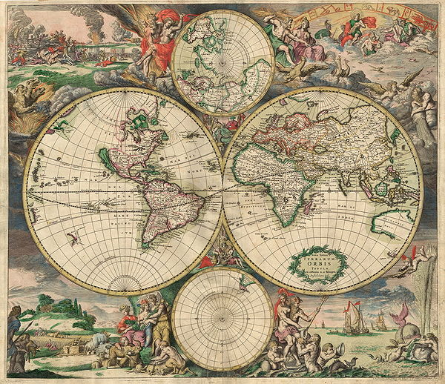
Setting the World Scene, chronological bias, etc.
HUMS 101
Setting the World Scene, chronological bias, etc.

Slide 2
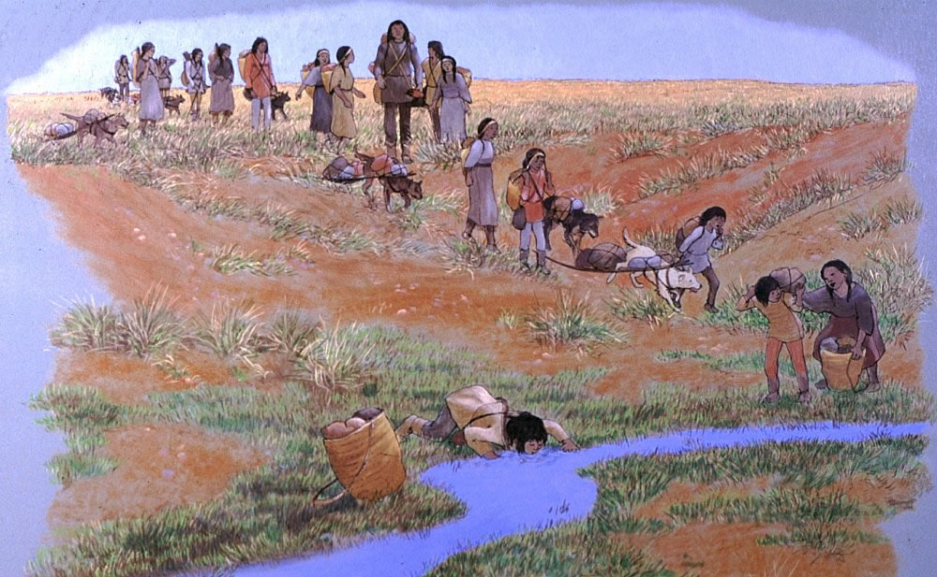
Chronological bias
Starting at the end?
1,000,000 y.a.: human migration began
150,000 y.a.: occupied all of Africa
100,000-70,000 y.a.: spread in waves out of Africa
40,000 BCE: spread across Asia, Europe, Australia
20,000-15,000 BCE: occupied Americas

Slide 3
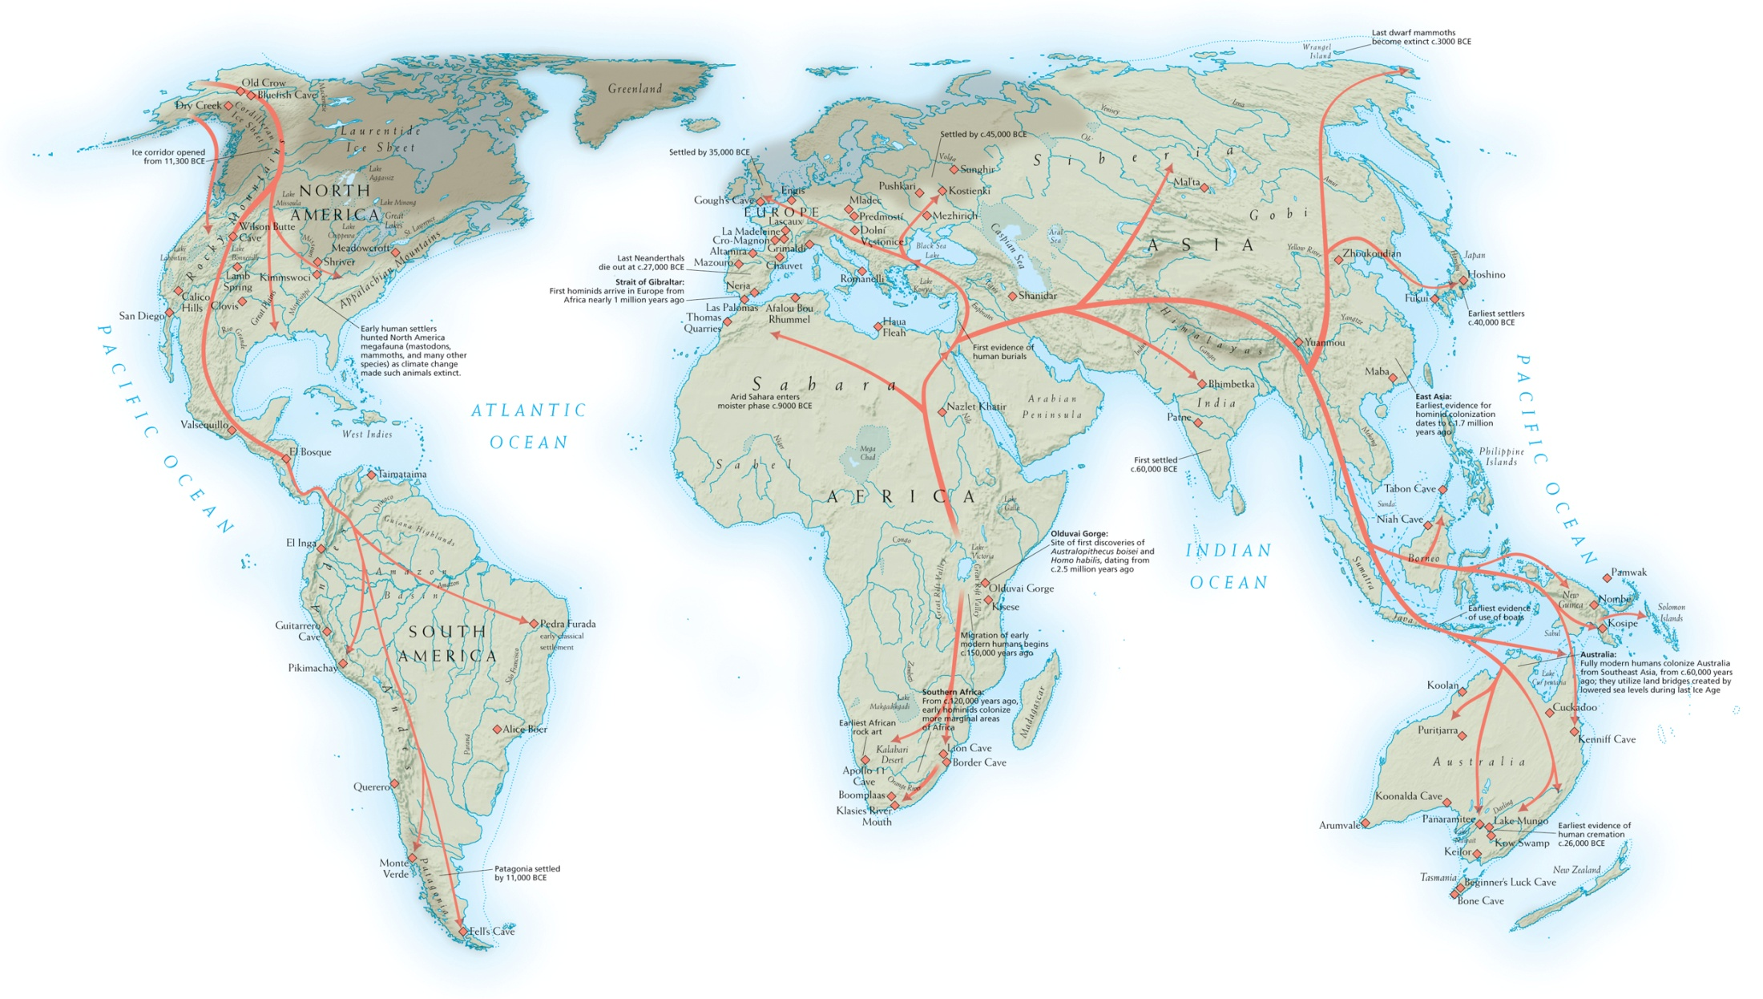
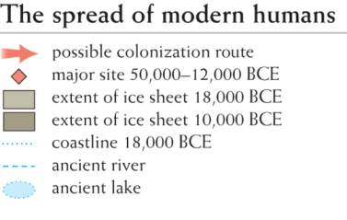
Map 1–1. Early Human Migrations.
Notes:
Map 1–1. Early Human Migrations.

Slide 4
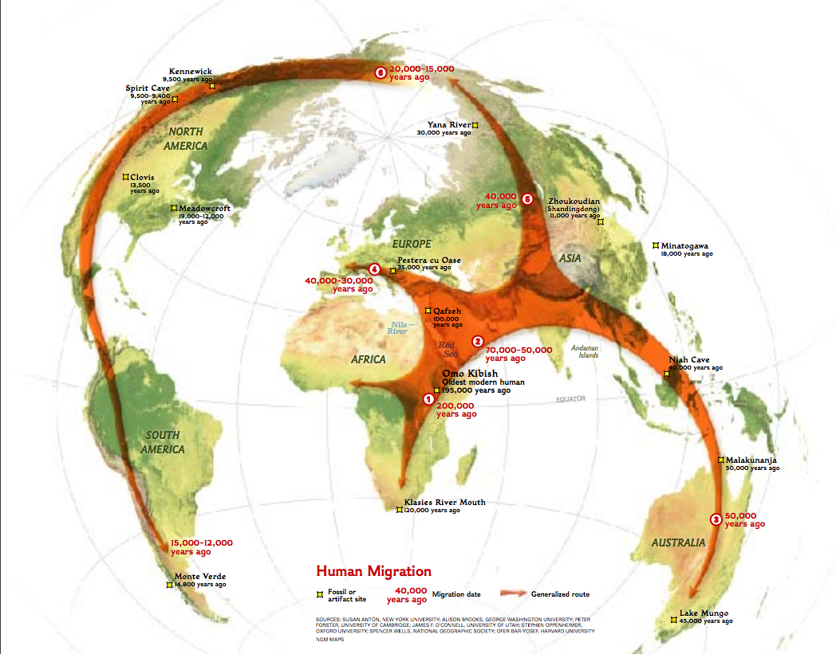

Slide 5
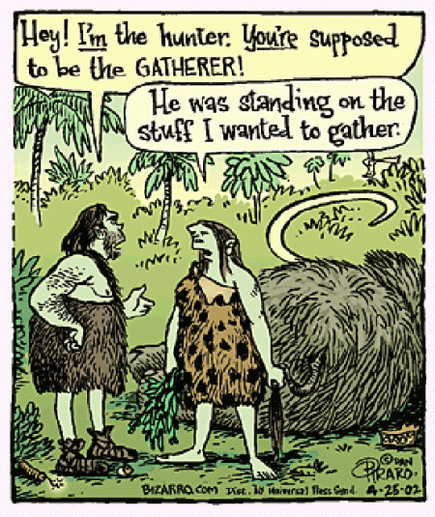
Old Stone Age 1,000,000-10,000 B.C.E.
No plant cultivation
Hunter-gatherers
Small nomadic tribes
Little control over nature
Some evidence of religious faith and use of magic
Division of labor by sex

Slide 6
Neolithic Age, from 10,000 BCE
Agriculture
Domestication of animals
Transition from nomadic lifestyle to a more settled agricultural existence
Greater control over nature
Led to increasingly large urban settlements
More hierarchical society
Large-scale war
New diseases

Slide 7
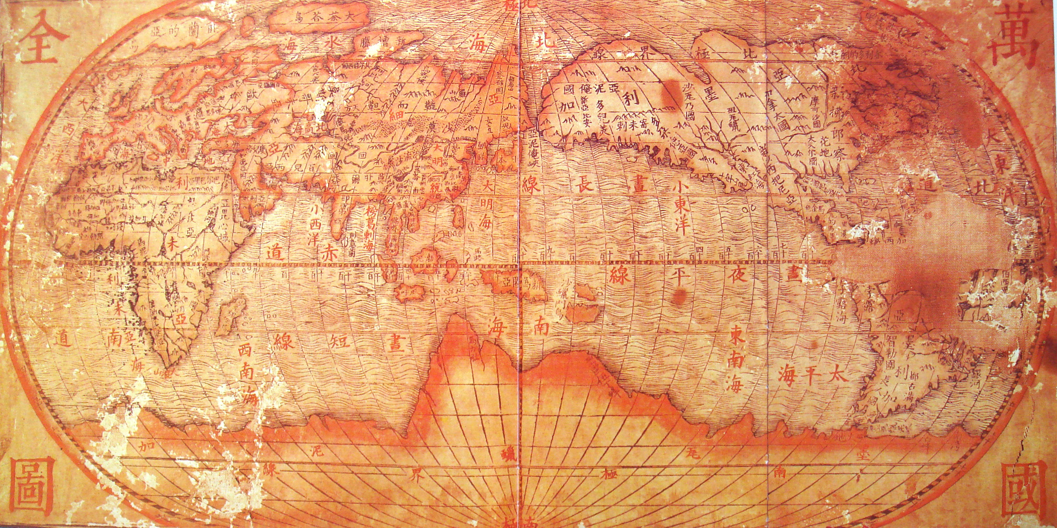
The World in 1700 CE

Slide 8

China, began about 1600 BCE
For a long time dominant in Eurasia
Qing Dynasty, 1644-1912
Why did it fail to adapt to rise of west?
Confucianism was reluctant to encourage merchants
Bureaucratic suspicion of change
Had no use for European changes
Saw no reason to imitate European innovations

Slide 9
Islamic World
Ottoman Empire
Safavid Empire
Founded 1290s
Officially Sunni, but tolerant.
1453 conquered Constantinople
1520s-1560s was high point of power
Ruled over:
Anatolia
Syria–Palestine
Egypt
most of North Africa
Yemen
western Arabia
Mesopotamia
Iraq
Kurdistan
Georgia
Hungary
Contracting gradually in 1600s
1683 pushed out of Hungary
Began in 1300s
Shi’ite Islam
High point was 1500s, but east of Ottomans
Declined in 1600s
Legacy of Shi’ite Islam and Persian culture.
Collapsed in 1722

Slide 10
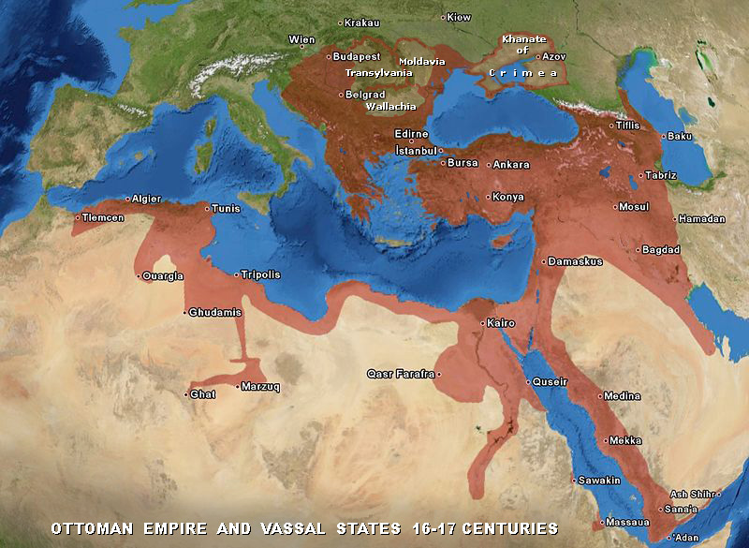
Ottoman Empire, 1600 CE

Slide 11
The Americas
Pre-Columbian, 20,000 BCE – 1492 CE
Conquest, and Columbian Exchange
Andean Civilization (Chimu, Incas)
Meso-American Civilization: Olmecs, Mayans, Aztecs
North American cultures (Clovis, etc.)
The more we learn, the more we realize we have lost.
Spaniards and Portuguese conquered
But disease decimated: about 80-85% of total population over two centuries, 1500-1700
“Cleared the way”
European-African contact with Americas
Europeans prospered greatly from resources and American innovations, such as corn, tomatoes, potatoes, (as well as silver).

