Slide 1
Bob Dylan, 1941-?
Protest voice, folk music, rock and roller, person

Slide 2

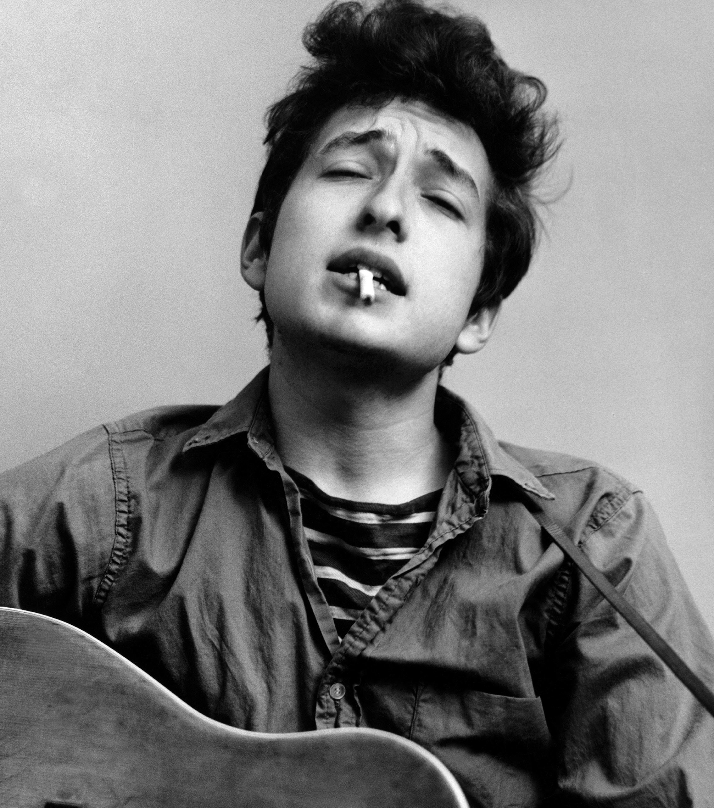

Young Bob DYlan
Born, Robert Allan Zimmerman, 24 May 1941 in Duluth, Minn., but grew up in Hibbing, Minn.
Family origins were Jewish immigrants from Odessa (father) and Lithuania (mother), but maternal grandmother, Florence, was Turkic (Kirghiz), Kars region of Turkey.
Grew up listening to hill-billy music and blues, then folk (Woody Guthrie) and early rock and roll (Little Richard, Chuck Berry).
Struggled to keep band members from leaving, pointing to WASP privilege and access.
Saw Buddy Holly three days before his death.

Slide 3
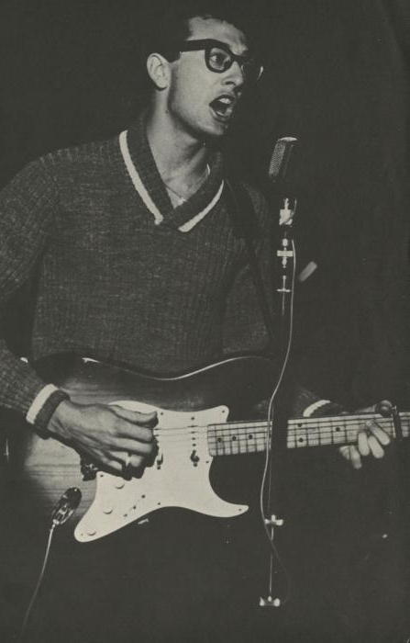
Dylan(2017): “[Holly] looked me right straight dead in the eye, and he transmitted something. Something I didn’t know what. And it gave me the chills.“ (Nobel Prize Speech, 2016)
But Dylan’s Chronicles focus on folk influences early on: Woodie Guthrie, Dave van Ronk, Ramblin’ Jack Elliot, Odetta, Fred Neil, and the New Lost City Ramblers.
Moved to NYC, hung out at Café Wha?, and then the Folklore Center in Greenwich Village (Izzy Young).
Met van Ronk (“Mayor of MacDougal Street”), and he invited Dylan to the Gaslight.
Became studio musician, harmonica and piano, mostly.

Slide 4
John Hammond
Dylan played harmonica on Carolyn Hester’s third folk album.
Hammond listened, and then met with him.
Fall 1961: Signed a contract with Columbia Records.
First album, Bob Dylan, March 1962, mostly folk, blues and gospel standards, two of his own songs, especially “Song to Woody” [link].
Sold only 5000 copies in first year; some said “Hammond’s Folly”.
Johnny Cash and Hammond supported him.
Dylan kept writing and working.

Slide 5
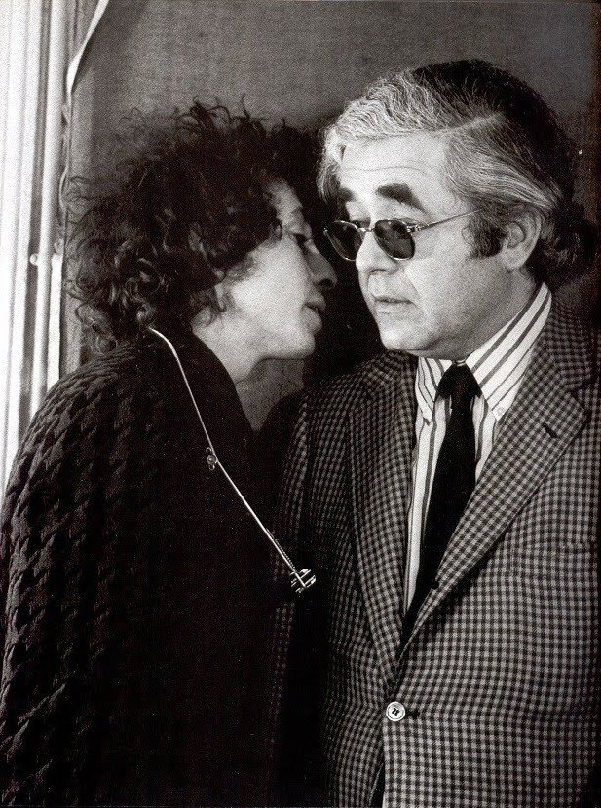
Bob Dylan
August 1962: changed his legal name to Robert Dylan.
Albert Grossman became his manager.
Grossman paid Roy Silver $10,000 to clear all his rights.
Dylan: "He was kind of like a Colonel Tom Parker figure ... you could smell him coming.”
Tensions with Hammond led to his replacement as Dylan’s producer by Tom Wilson.
Dec. 1962-Jan 1963: Dylan visited UK, played in folk clubs, played “Blowin’ in the Wind.”

Slide 6
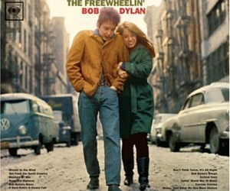
Free Wheelin’ Bob Dylan, May 1963
"Girl from the North Country"
"Masters of War"
"Down the Highway"
"Bob Dylan's Blues"
"A Hard Rain's a-Gonna Fall"
"Don't Think Twice, It's All Right“
Album topped at #22 on US charts.
Reach number one on UK charts.

