Slide 1
Motown, 1959-1972
Another rock and roll

Slide 2
Detroit, a.k.a. Motown
Detroit, MI: centre of African-American urban culture
Headquarters of the Big Three: Ford, GM, Chrysler
1950 US census: Detroit fifth largest population: 1,849,568
WWII encouraged large-scale migration to the city, including about 50,000 African-Americans, as well as a large number of southern whites.
Led to 1943 race riot: provoked by Packard’s efforts to integrate workers: 34 died, 25 were African-Americans.

Slide 3
Berry Gordy jr, 1929-
Seventh of eight children
Father, Berry Gordy II, was son of plantation owner and female slave, moved to Detroi for manufacture jobs.
Gordy Jr dropped out of high school, became a boxer.
1950: drafted into army, served in Korea until 1953.
Opened 3-D Record Mart; considered working at Lincoln-Mercury, then met Jackie Wilson
1957: co-wrote “Reet Petite” and “Lonely Teardrops,” big hits for Wilson.
1958: co-wrote “All I could do was cry” for Etta James (Chess)

Slide 4


motown
Berry Gordy Jr.
Tamla Records, Jan 12, 1959
Motown Records, April 1960
Racially integrated
Cross-over: soul and pop
Goal: market African-American music to largely white audience.
“The Voice of Young America”

Slide 5
Motown: “Hitsville USA”
1957: Gordy met Robinson.
Began producing and co-writing songs.
1959: borrowed $800 from family to start Tamla Records.
Barret Strong’s “Money (that’s what I want),” charted on Anna Records label.
Followed by many hits:
Smokey Robinson and the Miracles, “Shop Around,” “You’ve really got a hold on me,” “I’ll try something new,” etc.
The Marvelettes, “Please Mr Postman,” hit the top of R&B and Pop charts.

Slide 6
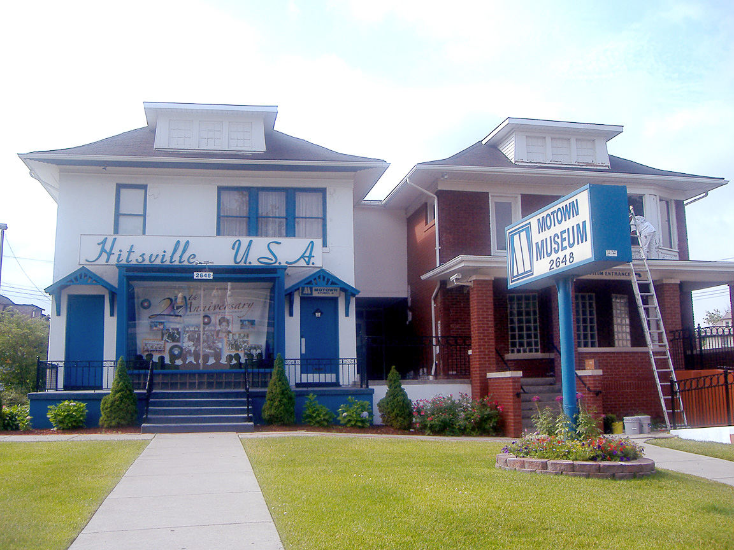
Hitsville, usa

Slide 7
Gordy found the talent
The Supremes
Marvin Gaye
The Temptations
Jimmy Ruffin
The Contours
The Four Tops
Gladys Knight & the Pips
The Commodores
The Velvelettes
Martha and the Vandellas
Stevie Wonder
The Jackson Five

Slide 8
Motown Hits
For the complete list: https://en.wikipedia.org/wiki/Motown_discography#Number_One_Singles
Highlights: Between 1960-1969: 79 singles in Top Ten of Billboard Hot 100
Late Nov 1963: Billboard discontinued its Black Music Chart, because it no longer reflected African-Americans’ tastes.
1963: Motown’s breakthrough: had nine Top Ten Hits.
1964: George Harrison said that his favourites groups are the Miracles and Martha and the Vandellas.
Became the most successful record producing company in USA: 1966: Billboard reported that 75% of Motown recorded songs entered the Billboard Top 100, while industry average was 10%.
1960-1969: put a new single onto the charts every 1.5 weeks.

Slide 9
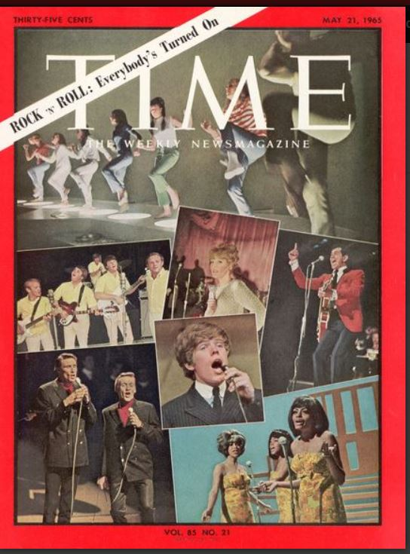
Time Magazine cover, May 21, 1965

