Slide 1
Rock and Roll in the late1970s in USA
Country Rock, Jersey Shore Rock,
and
John Lennon

Slide 2
The Eagles, 1971-1980
Began as Linda Ronstadt’s band: Don Henley (drums) and Glenn Frey (guitar).
Toured on Ronstadt’s Silk Purse tour.
Randy Meisner (bass), Bernie Leadon (guitar)
Peyote and Tequila, Mojave desert, Hopi Indians: The Eagles
Country rock
Mainstream
Sometimes edgy lyrics
First hit: “Take it easy,” written by Frey and Jackson Browne, 1971
“Witchy Woman,” “Peaceful Easy Feeling”

Slide 3
The Eagles, 1971-1980
1974: Don Felder “Fingers” joined the band on steel and electric guitar.
One of These Nights, nominated from a Grammy.
1975: Leadon left, replaced by Joe Walsh (guitar, vocals, keyboard).
1976: Their Greatest Hits 1971–1975: highest-selling album in U.S. history: 29 million copies sold in USA; 42 million copies worldwide.
Dec. 1976: Hotel California: “New Kid in Town” and “Hotel California” huge hits.
“Hotel California” has been variously interpreted.
https://www.youtube.com/watch?v=iqODbP1T3nk
“The Last Resort,” surprisingly critical of USA and Christians.

Slide 4
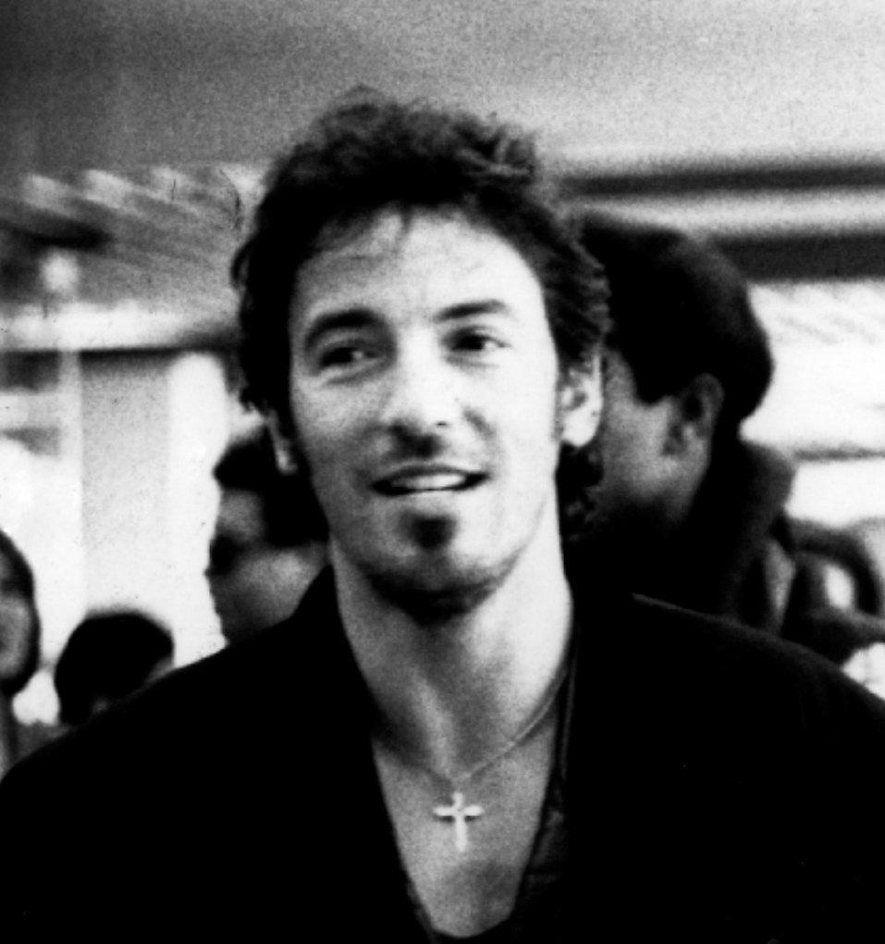
Bruce Springsteen, 1965 to present
New Jersey born (and sound)
Father, Dutch-Irish descent, worked as bus driver, often unemployed.
Mother, Adele Zerilli, Italian, legal secretary, main bread-winner.
Catholic born and raised, “loner, who wanted nothing more than to play his guitar.”
Mom bought him a guitar for $16.
Managed to get a 4F and avoid Vietnam War.
Notes:
Source: Springsteen. Robert Hilburn, 1985, p. 28.

Slide 5
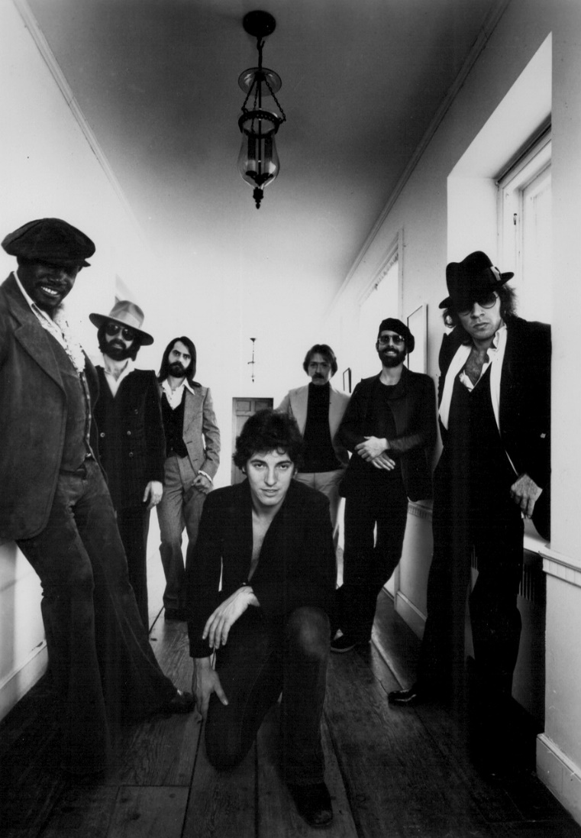
Bruce Springsteen, 1965 to present
Lead guitar, vocals, became “The Boss”
Gathered gradually the E Street Band.
Prolific writer, more words in one song than others’ whole albums.
Rock and Folk, mostly, poetic lyrics.
Sometimes very mainstream, other times adventurous.
Columbia Records signed in 1972, next Bob Dylan, but they wanted more popular music.

Slide 6
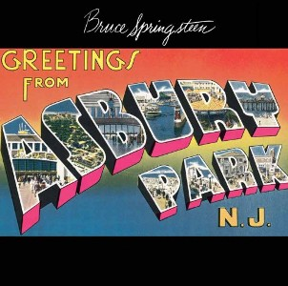
Bruce Springsteen, 1965 to present
First album, Greetings from Asbury Park, N. J., 1973
One of those that grew on you:
“Blinded by the Light” (later, huge hit for Manfred Mann’s Earthband, 1977)
“For You,” “Growin’ Up,” “Lost in the Flood,” “Spirit in the Night,” “It’s Hard to be a Saint in the City”.
“Lost in the Flood”: https://www.youtube.com/watch?v=qLZu0OF_D7c

Slide 7
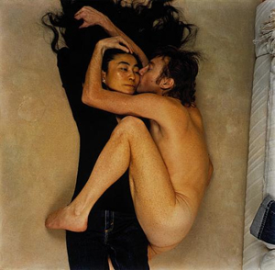
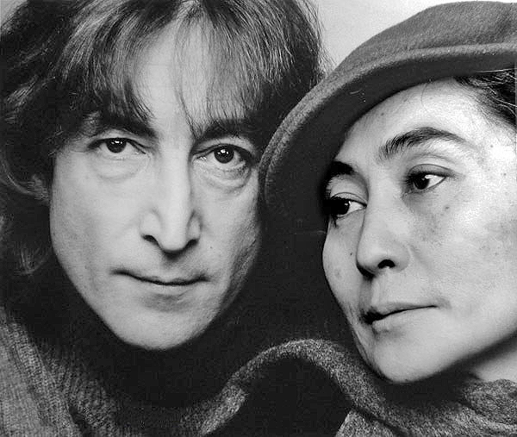
John Lennon, 1940-1980
Post Beatles career was interesting, but subdued.
Imagine, 1971
“Working Class Hero” (released 1971 [USA], 1975 [UK])
https://www.youtube.com/watch?v=ziwsjE1O4Ow
May Pang, lover and experiment, 1971-1975
Rock and Roll, 1975
Retired to raise Sean (b. 1975).

Slide 8
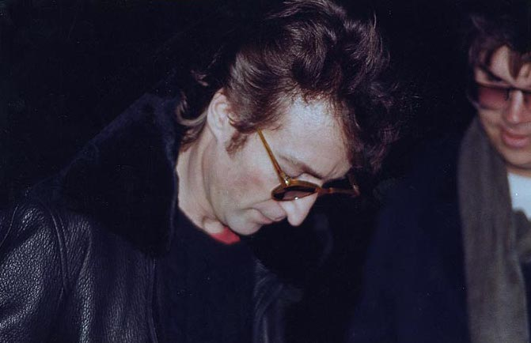
Lennon’s death, 8 December 1980
Double Fantasy, 17 November 1980
Annie Liebovitz photo
Last interview: “I still believe in love, peace. I still believe in positive thinking. … And I consider that my work won't be finished until I'm dead and buried, and I hope that's a long, long time.“
Mark David Chapman: Had Lennon sign his copy of Double Fantasy.
Chapman pleaded guilty, sentenced to 20 years to life, still serving….
David Bowie was next?
Notes:
Source: http://www.cbsnews.com/news/john-lennon-remembered-08-12-2005/

