Slide 1
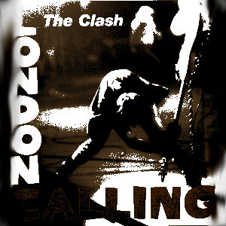
HSTR 121: History, Music and the American Century (counter-culture and capitalism)
Mark R. Baker

Slide 2
Introduction
What is history?
The past
history
What is music?
What is Rock and Roll music?
Noises organized together with creative intent.
Electric guitar and strong beat
Challenges existing ideas and even the current idea of what it is.
Why do we like it?

Slide 3
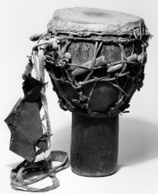
Where did Rock and Roll come from?
West African Culture, mostly from Senegal and Gambia
African drums, repeated rhythms, and dancing.
Drum talk
Form of communication and entertainment

Slide 4

Traditional Senagalese Djembe Drummers

Slide 5
Where did Rock and Roll come from?
Slavery:
ancient institution
American slavery particularly oppressive, brutal, and crucial to the cash crop economy of new world (cotton gin).
Embedded racism in the minds of European settlers and offspring.
Trans-Atlantic Slave Trade:
1525-1866: 12.5 million slaves shipped to the “New World”.
10.7 million survived the voyage: “Middle Passage”
Only 388,000 shipped to North America (3.63%).
Another 60-70,000 migrated from central America.
But there were four million slaves by 1860.

Slide 6
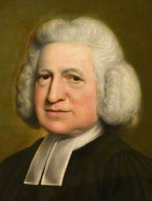
Where did Rock and Roll come from?
Slaves were converted to Christianity.
Adopted Christian hymns.
Written by Charles Wesley (1707–1788), about 5000 songs.
“Bard of Methodism”

Slide 7
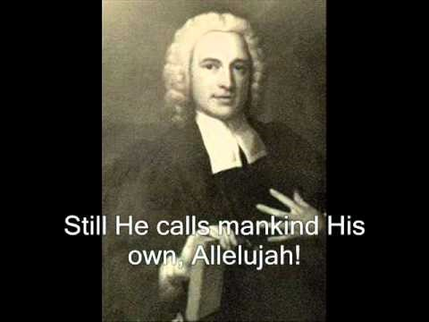
Charles Wesley, “Hail The Day That Sees Him Rise,” 1739

Slide 8
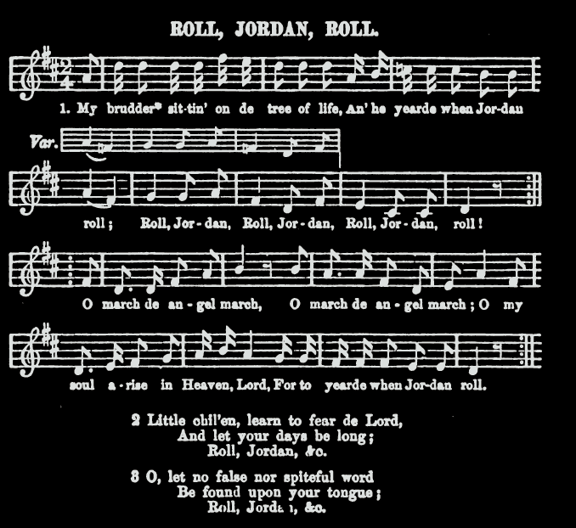
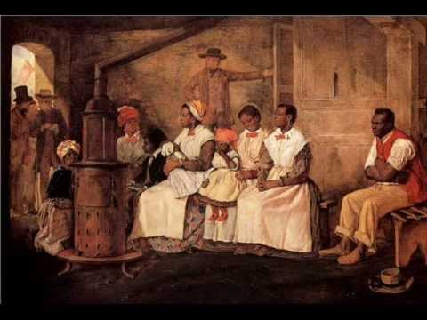
Where did Rock and Roll come from?
Slavery changed African slaves’ music: no drums allowed, so slapping, clapping, and singing.
Christian music dramatically changed by African American singers.
Led to Negro spiritual: ‘Roll, Jordan, Roll’ [link].

Slide 9
F. S. Hoyt, “Introduction,” in Marshall w. Taylor, A Collection of Revival hymns and Plantation Melodies (Cincinnati: Marshall W. Taylor and W. C. Echols Publishers, 1882), p. 11.
“These were sung in the white congregations of the South, and were found in old religious song-books, which, though published by individual enterprise rather than upon denominational authority, had considerable circulation. These stirring devotional hymns, with their well adapted tunes, the colored people attendant upon the white congregations memorized, loved, and adopted. Not being able to read, and, therefore, unable to correct their recollections by reference to the printed page, they often confused both the sense and the verses — thus bringing these "revival songs" of their adoption to partake more or less of the character of those which were entirely of their own invention.”

Slide 10
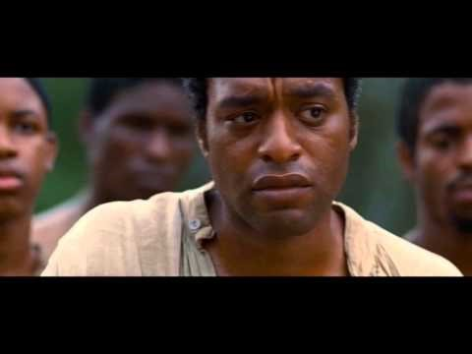
‘Roll, Jordan, Roll!” as performed in Twelve Years a Slave (written by C. Wesley, mid-1700s)

Slide 11
Fanny Kemble (1809-1893), Journal of a residence on a Georgian plantation in 1838-1839 (New York : Harper & Bros., 1863), p. 218.

Slide 12
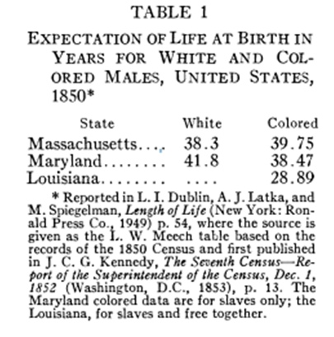
Where did Rock and Roll come from?
Slavery was brutal:
Life expectancy was low.
Corporal punishment was common.
Families were broken up at slave auctions.
Rape of slave women was frequent and rarely punished.
Children of mixed parents took the status of the mother.

Slide 13
United States Civil War, 1861-1865
Fought mainly over slavery.
Southern states saw as a states’ rights issue versus federal government.
Confederate States of America left the union, following Abraham Lincoln’s November 1860 election as US President.
625,000-850,000 died in the war.
Despite efforts during reconstruction, African-Americans, though no longer slaves, became second-class citizens.

Slide 14
Slave Songs of the United States (1867)
W. F. Allen, C. P. Ware, and L. M. Garrison, Slave Songs of the United States (New York: Peter Smith, 1867), p. VI.

Slide 15
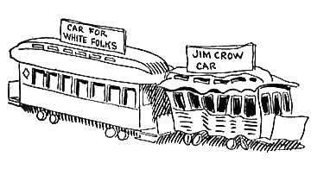
Jim Crow Laws, 1870s-1960s
State and local laws focused on segregation.
De jure racial segregation in southern states: “separate but equal”
Public schools, public spaces, transportation, restaurants, restrooms, drinking fountains, etc.

Slide 16
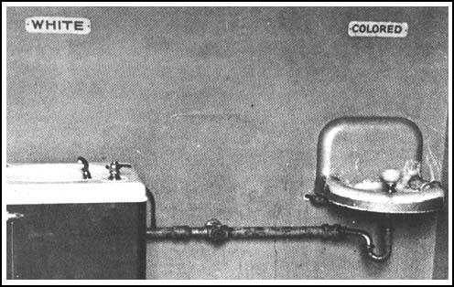
Jim Crow Laws, 1870s-1960s

Slide 17
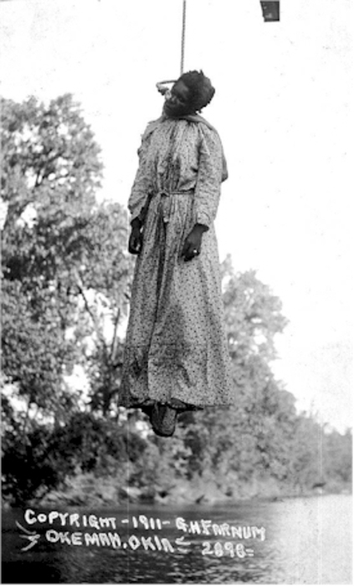
Jim Crow Laws, 1870s-1960s
Ku Klux Klan
Lynchings
Began before civil war.
Tuskugee Institute survey, 1882-1968:
1297 whites lynched
3446 blacks lynched

Slide 18
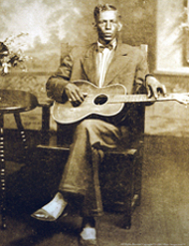
The Blues
Out of these great difficulties emerged the blues:
Charley Patton, 1891-1934
Father of the Delta Blues
Mixed heritage: white, black, native
Dockery Plantation
https://www.youtube.com/watch?v=DJpd24zANAE
Eddie “Sun” House, 1902-1988
“Death letter blues”: https://www.youtube.com/watch?v=NdgrQoZHnNY
Taught Robert Johnson
Only known photo of Patton
Notes:
Photo source: http://www.harmonytalk.com/archives/2005_12.html

Slide 19
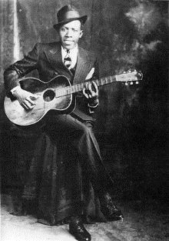
The Blues
Robert Johnson (1911-1938) :
Itinerant, tragic personal life
Lots of legends
Juke joints performer
“Crossroads”, “Sweet Home Chicago”
King of the Delta Blues Singers (compiled and released in 1961).
Died young, poisoned at a Juke Joint.

Slide 20
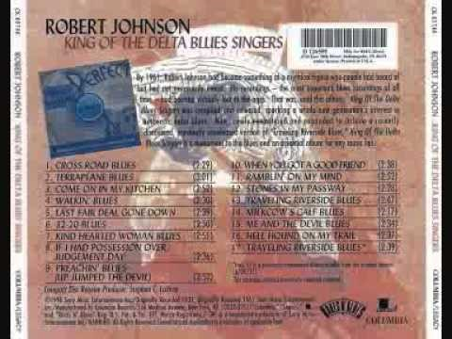
The Blues: Robert Johnson, King of the Delta Blues Singers, 1961

Slide 21
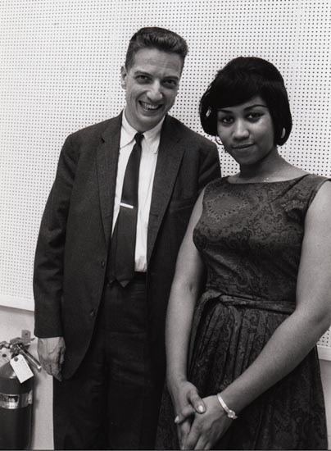
John Henry Hammond II, 1910-1987
Record producer
Columbia Records
Talent scout
Civil rights activist
1938: Carnegie Hall: “From Spirituals to Swing”
Robert Johnson
Aretha Franklin
Pete Seeger
Bob Dylan
Bruce Springsteen
Leonard Cohen
Stevie Ray Vaughn
And many others

Slide 22
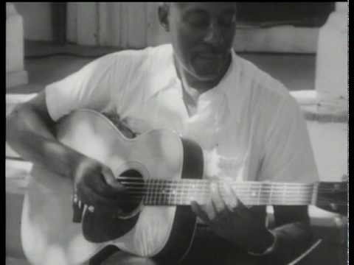
The Blues: The legacies of the Blues
Came from Negro Spirituals
Crucial to the emergence of:
Jazz
Electric Blues
Rhythm and Blues
Soul
Rock and Roll
Big Bill Broonzy, 1957, link

Slide 23
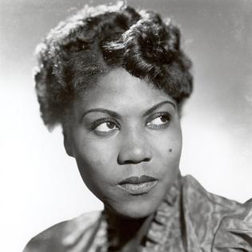
Sister Rosetta Tharpe, 1915-1973
Gospel rhythm and blues
Raised in the Church of God in Christ, founded by Charles Harrison Mason.
Encouraged rhythmic expression in church and female preachers.
Began performing at age 6.
Crossed over to playing in clubs, for which she was criticized.
1938: First hit was “Rock me” [link]
Carnegie Hall
Notes:
Image source: http://www.biography.com/people/sister-rosetta-tharpe-17172332

Slide 24
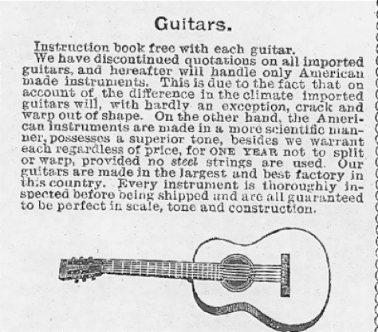
Rise of Popular Music
Capitalism!
1877: Phonograph first invented
1894: Sears, Roebuck & Co. catalogue begins selling guitars: price $4.50 to $26.00
African Kora – banjo
Increased travel and migration, especially southern blacks to northern cities (Chicago).

Slide 25
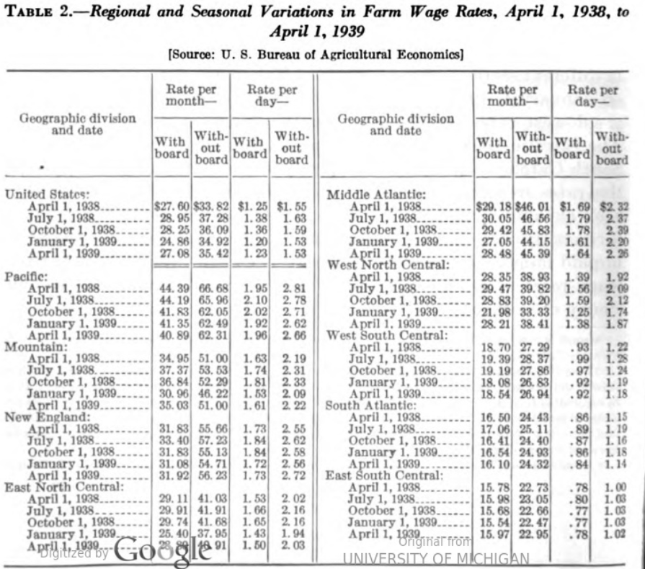

Slide 26
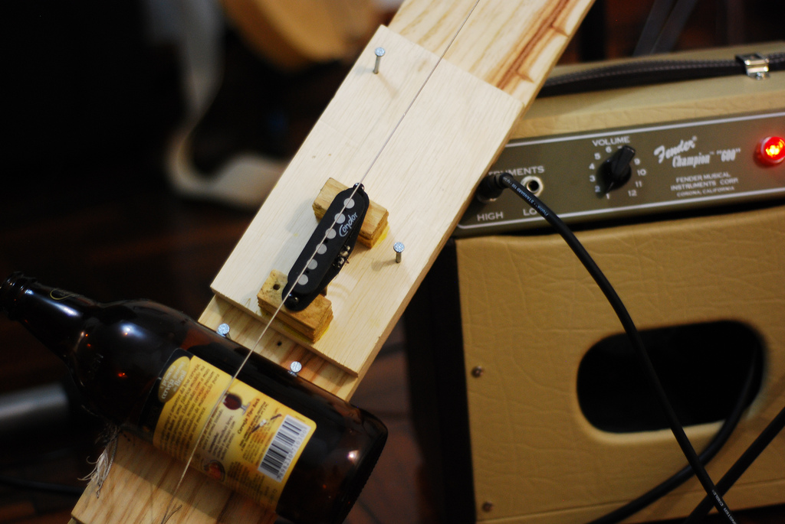
Some made their own guitars
Lonnie Pitchford
Diddley bow
https://www.youtube.com/watch?v=sSrIZevf44Q
Notes:
Image source: By Beraldoleal - Own work, CC BY 3.0, https://commons.wikimedia.org/w/index.php?curid=11836468

