Slide 1

The 1970s Rock and Roll Band

Slide 2
The "New Yardbirds" became "Led Zeppelin", 1968
Toured instead of real band.
Jimmy Page (studio musician) recruited Robert Plant, who suggested drummer John Bonham.
John Paul Jones applied to become bassist.
Keith Moon and John Entwistle suggested "Lead Balloon".
New manager, Peter Grant, suggested "Led Zeppelin".
Nov. 1968, Grant obtained a $143,000 deal with Atlantic Records, not having heard them yet: got tons of autonomy.

Slide 3
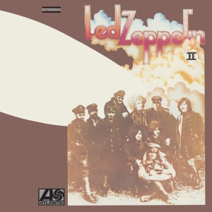
Four Albums in Three Years!
Led Zeppelin I (1969):
"Dazed and Confused"
"Good Times, Bad Times"
https://www.youtube.com/watch?v=1ppjI6KZHlE
Led Zeppelin II (1969):
"Whole Lotta Love"
"The Lemon Song"
"Heartbreaker"
"Ramble On"
https://www.youtube.com/watch?v=2bgKb45DBG0

Slide 4
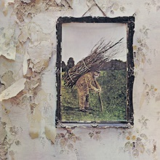
Four Albums in Three Years!
Led Zeppelin III (1970):
"Immigrant Song"
https://www.youtube.com/watch?v=17CsLvJS4cc
"Since I’ve Been Loving you"
"Tangerine"
Led Zeppelin IV (1971; no title, actually):
"Black Dog"
"Rock and Roll"
https://www.youtube.com/watch?v=mwFqRB2FQu4
"Stairway to Heaven"
"Going to California"
"When the Levee Breaks"

Slide 5
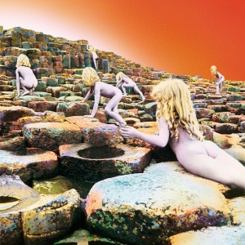
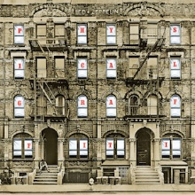
Later work
Houses of the Holy (1973):
First with only originally composed music
"The Song Remains the Same"
"The Rain Song," "No Quarter"
"Over the Hills and Far Away"
"D'yer Mak'er"
https://www.youtube.com/watch?v=LTYLz49ALhE
Physical Graffiti (1975):
"Trampled Underfoot"
https://www.youtube.com/watch?v=TZsqcXHuLWU

Slide 6
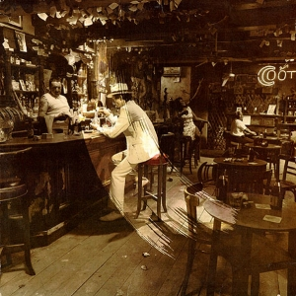
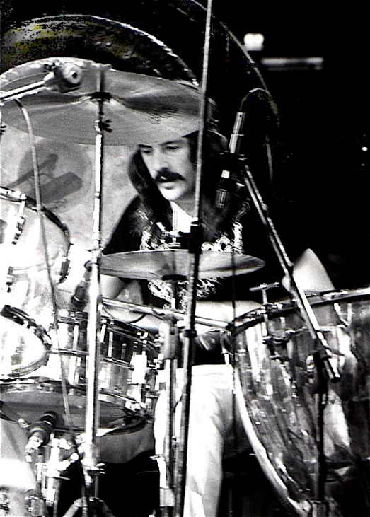
The END, 1980
Toured less as the decade went on.
Robert Plant and wife Maureen in car accident, Rhodes, 1975
July 1977: Plant’s son Karac died at age five, while he was away on tour.
Last big album: In Through the Out Door (1979):
"Fool in the Rain“: https://www.youtube.com/watch?v=I57nIP0vc44
"All of My Love"
https://www.youtube.com/watch?v=-NoMn5tRlAg
September 1980: John Bonham died
Band decided not to continue.

