Slide 1
Punk Rock
Rage and Message

Slide 2
Some Origins of Punk
Music industry: contracts, content control, distribution
Television
Mainstream, middle-class culture
“Sell out” of many leading bands
Rejection of musicality
Rejection of the establishment
Rejection of well-trained musicians, of professionals
Rejection of 1960s free love, idealistic approach

Slide 3
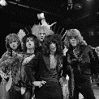
New York Dolls, 1971-1977
David Johansen (vocals)
Johnny Thunders (guitars)
Arthur Kane (bass)
Sylvain Sylvain (Mizrahi; guitar and keyboards)
Jerry Nolan (drums)
“Jet Boy”, 1973: https://www.youtube.com/watch?v=_Y8-CBXfzhE
Glam Rock?
Punk?
“Who are the mystery girls?”: https://www.youtube.com/watch?v=chd_JUkec8M

Slide 4
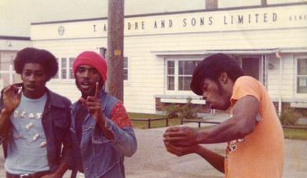
Death, 1971-1977
David, Bobby and Dannis Hackney
Detroit
Father introduced them to rock and roll.
Father died.
Band tried to be successful without changing name.
“Politicians in My Eyes”:
https://www.youtube.com/watch?v=rl3FstCc_OY

Slide 5
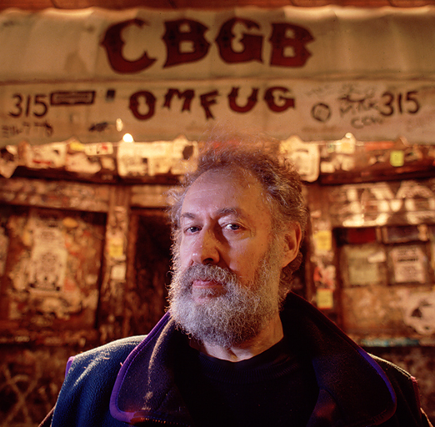
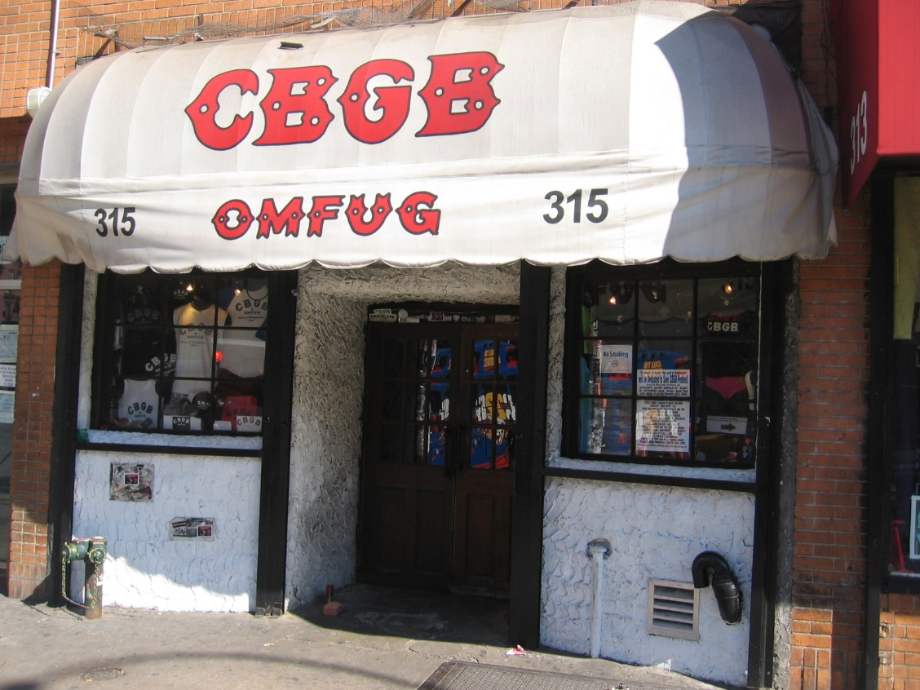
CBGB OMFUG: Country, Blue Grass, Blues, Other Music For Uplifting Gormandizers
Hilly Kristal’s Blues club
Center of early punk music, 1973-2006
Patti Smith
Television
The Ramones
Blondie
Mink DeVille
Talking Heads
Max’s Kansas City

Slide 6
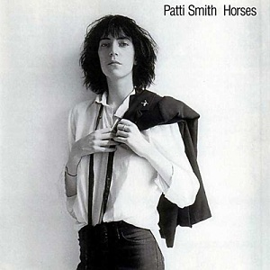
Patti Smith and the CBGB
Patti Smith, born Patricia Lee Smith, 30 December 1946, in Chicago.
Raised in working-class, bible educated household: “I, the country mouse.”
Rejected these as a teenager; mother was Jehovah’s Witness, but gave her a classic Bob Dylan LP.
Robert Mapplethorpe (1946-1989): photographer, lover (Just Kids).
CBGB, performed long before contract
Debut album: Horses (1975)
Them’s “Gloria”: https://www.youtube.com/watch?v=TNQtz6Ajvfg

Slide 7
the Ramones, 1974-1996
Formed in Queens, NY; all original members attended Forest Hills High School.
Douglas Colvin became Dee Dee Ramone (after Paul McCartney): bass
John Cummings became Johnny Ramone: lead guitar
Jeffrey Hyman became Joey Ramone: drums, then guitar
Thomas Erdelyi became Tommy Ramone: drums
Later Marc Bell became Marky Ramone: drums
Music was very fast and brief:
https://www.youtube.com/watch?v=IwsVWZ-c8Eo

Slide 8
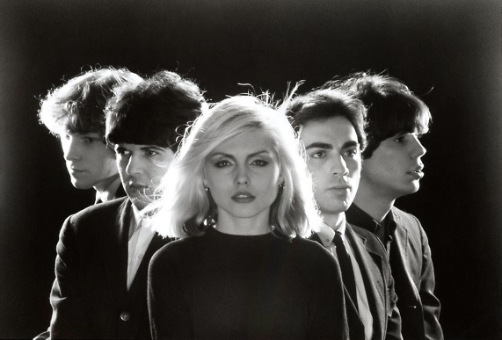
Blondie, 1974-1982
Deborah Harry
Chris Stein
“Rip her to shreds” at the CBGB:
https://www.youtube.com/watch?v=qNSLPLkGQF0
First popular in Australia: “In the Flesh”
UK: "(I'm Always Touched by Your) Presence, Dear" reached British top ten.
USA, Canada: commercial success, but not punk: Sept 1978 album Parallel Lines: single “Heart of Glass”: https://www.youtube.com/watch?v=AsYbMnQd6c8

Slide 9
Talking Heads, 1975-1991
Met at Rhode Island School of Design
David Byrne (guitar, vocals)
Tina Weymouth (transportation, emotional support, and then bass guitar)
Chris Frantz (drums)
Jerry Harrison (guitar, keyboards)
Punk, art rock, funk, dance, post punk, new wave, but always avant-garde.
First big hit: “Psycho Killer” (1975, released 1977): https://www.youtube.com/watch?v=xNGutllSRsA
Martin Scorcese’s film Taxi Driver (1976)
“Son of Sam” killer terrorized NYC.

Slide 10
Punk Rock, the British Variety
Old England was dying (Waterboys, “Old England”, 1985)
1974-1977: unemployment from 3.4 to 6.0%, grew by 200% amongst youths.
1976: inflation rate of 22.7%
1977: inflation rate of 16.7%
1976: UK government applied and received a 3.6 billion pound loan from IMF.
Dying empire: de-colonization
Youth unemployment
High inflation

Slide 11
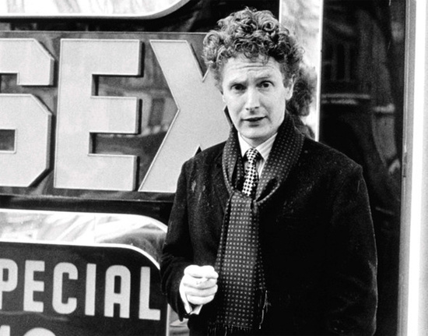
Sex Pistols, 1975-1978
Malcolm Maclaren
Attended various art colleges
Became a revolutionary “Situationist” (consumption destroys real life)
Owned a clothing store with Vivienne Westwood, called “Too Fast to Live, Too Young to Die,” later “Sex”, in Chelsea district of London.
1975: Maclaren began to manage the New York Dolls, but they soon disbanded.
Encouraged formation of Sex Pistols from his store’s customers: style over content.

Slide 12
Sex Pistols, 1975-1978
Formed from the Strand: Steve Jones (vocals, then switched to guitar), Paul Cook (drums), and Wally Nightingale (guitar)
Working class, played stolen instruments
Nightingale was pushed out.
Glen Matlock added as bass guitarist.
Bernie Rhodes and McLaren happened on John Lydon: green, short hair, anti-Pink Floyd t-shirt: “Johnny Rotten”
Melody Maker advert: “Whizz Kid Guitarist. Not older than 20. Not worse looking than Johnny Thunders”!
Acquired a key fashion following group: Bromley Contingent: Billy Idol, Siouxsie Sioux.

Slide 13
Sex Pistols, 1975-1978
Started to get a lot of gigs in London, especially after the Nashville incident: 23 April 1976
Warmed up for The 101-ers, led by Joe Strummer. Saw Punk as the future.
Westwood started a fight, McLaren and Rotten soon dove in.
Cook later said, "That fight at the Nashville: that's when all the publicity got hold of it and the violence started creeping in.... I think everybody was ready to go and we were the catalyst."

Slide 14
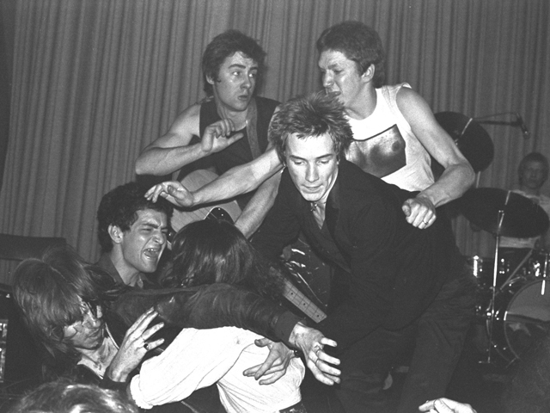
The Nashville, 23 April 1976: https://www.youtube.com/watch?v=xqbXqYdafi8

Slide 15
Sex Pistols, 1975-1978
4 June 1976: performed at Lesser Free Trade Hall in Manchester.
https://www.youtube.com/watch?v=3bZ9yToi-JE
Tony Wilson (TV “So It Goes”):
https://www.youtube.com/watch?v=rrjcsMidMNY
20 July 1976, second performance:
Howard DeVoto and Pete Shelley: The Buzzcocks
Peter Hook and Bernard Sumners: formed Warsaw, then Joy Division.
Steven Patrick Morrissey: The Smiths
Mark E. Smith: The Fall

Slide 16
Sex Pistols, 1975-1978
26 November 1976: “Anarchy in the UK”: https://www.youtube.com/watch?v=cBojbjoMttI
Sid Vicious replaced Matlock, who liked the Beatles and did not want to be a “fascist”.
“God Save the Queen”: https://www.youtube.com/watch?v=NQbfTAWe3no
Record companies loved and hated them: EMI, the A&M, then Virgin.
Virgin released Never Mind the Bollocks- Here’s the Sex Pistols, October 1977
Broke up the next year at end of USA tour in San Francisco.

Slide 17
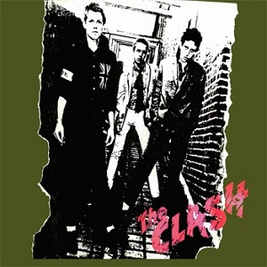
Many other bands followed
The Buzzcocks, “Boredom”: https://www.youtube.com/watch?v=BTiHp6XYm2E
The Damned
Siouxsie and the Banshees
Generation X
The Clash, “White Riot”: https://www.youtube.com/watch?v=8kEZHMP-ei8

