Slide 1
Rock’n’Roll emerging
the 1950s

Slide 2
The term “Rock and Roll,” earlier versions
1934: Boswell Sisters, “Rock and Roll” appeared in the film Transatlantic Merry-Go-Round.
1938: Sister Rosetta Tharpe recorded “Rock Me” for Decca Records [link].
Her music tried to cross-over from gospel to rhythm and blues.
Tharpe had a huge influence on Little Richard, Chuck Berry, Johnny Cash, and Elvis Presley.
1942: Maurie Orodeneker began to call more upbeat recordings such as Tharpe's "Rock Me“ as rock and roll: "It's Sister Rosetta Tharpe for the rock-and-roll spiritual singing.”
1949: Goree Carter, “Rock Awhile” [link]
1950: Muddy Waters, “Rollin’ Stone” [link] (first recorded by Chess Records).
Notes:
Orodeneker quote is from Larry Birnbaum, Before Elvis: The Prehistory of Rock 'n' Roll (Rowman & Littlefield, 2013).

Slide 3
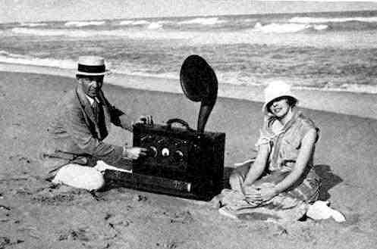
Rise of popular music
Early 1920s: Radio broadcasting
One of the first portable radio receivers, 1923

Slide 4
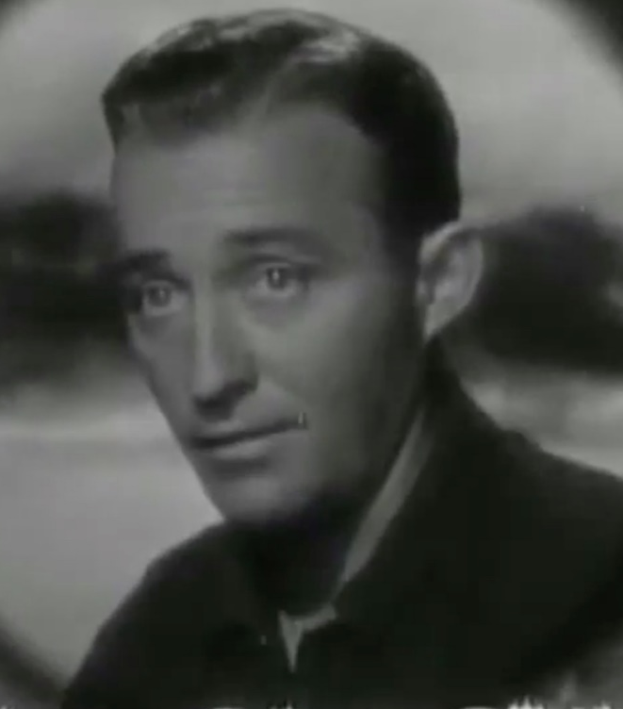
Magnetic Tape
Long history, began 1877, patented in 1930s
Bing Crosby, actor, singer
Used to broadcast live on NBC radio
Tired of live performances: 39 weeks per year
Discs poor quality sound
October 1947: first taped broadcast
Thanksgiving 1947 recording
Bing Crosby, 1903-1977

Slide 5
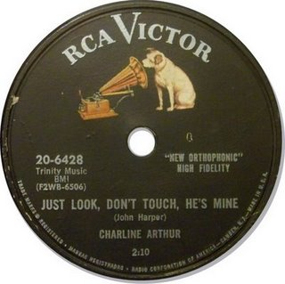
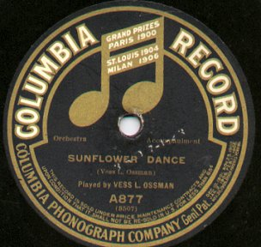
Rise of popular music
1930s: vinyl begins to be used for recording music.
WWII cut of shellac supplies from India.
1948: Columbia Records introduced the long-playing 33¹⁄₃ rpm microgroove vinyl record, or "LP“.
1949: RCA Victor countered with the short-playing but convenient 7-inch 45 rpm microgroove vinyl single.

Slide 6
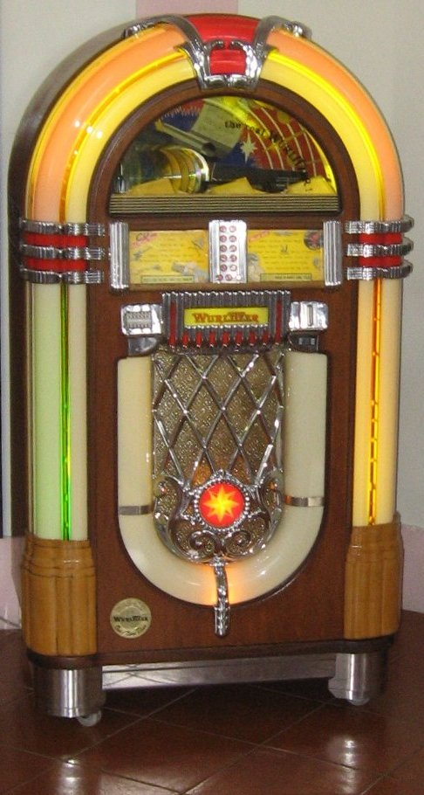
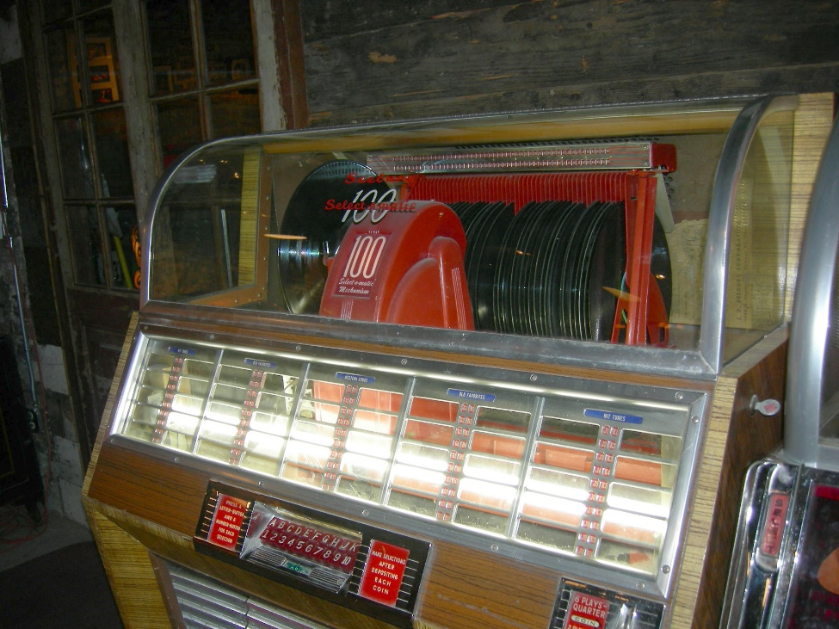
Jukebox, arose in 1950s
1952: Seeburg M100c: could play 50 different records, 100 choices
1946: Wurlitzer 1015, a selection of 24 (45 rpm) records

Slide 7
Great Migration, African-Americans migrate to the north, 1916-1970
Six million migrated to northeast, Midwest, and California
Started during WWI, but accelerated after the Great Mississippi Flood of 1927
Memphis Minnie (and Kansas Joe), “When the Levee Breaks,” 1929 [link]
630,000 people affected by the flood in Mississippi, Louisiana, and Arkansas.
200,000 African-Americans lost their homes, lived in relief camps.
Nothing to go home to, so…
Chicago, New York, Boston
Accelerated again after WWII
By 1970, 47% of AA lived in north, whereas only 10% in 1910.

Slide 8
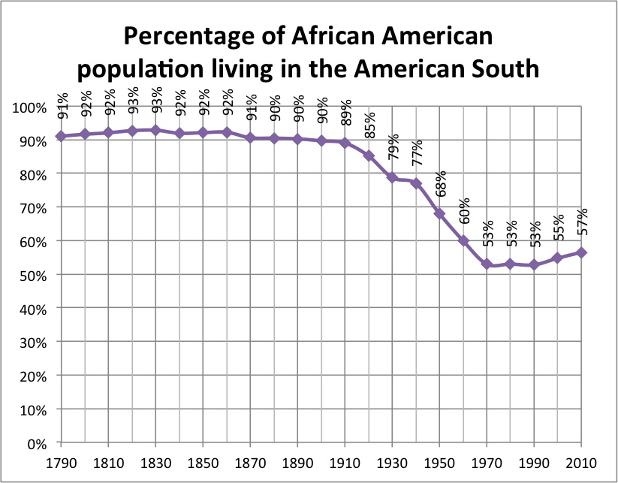
Notes:
Source: https://upload.wikimedia.org/wikipedia/commons/8/8b/Percentage_of_African_American_population_living_in_the_American_South.png

Slide 9
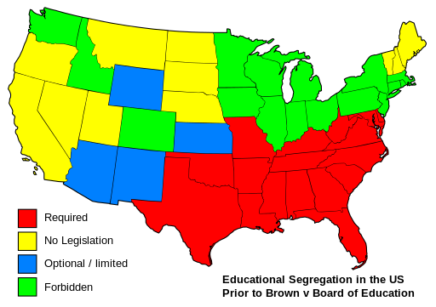
Brown versus Board of Education, 1954
Separate but equal did not work (Plessy vs Ferguson, 1896).
17 May 1954, Chief Justice Earl Warren Court unanimously (9–0) decided that "separate educational facilities are inherently unequal.“
Victory for Civil Rights Movement
Fight was just beginning.
Led gradually to greater acceptance of A-A culture.
Notes:
https://commons.wikimedia.org/wiki/File%3AEducational_separation_in_the_US_prior_to_Brown_Map.svg
By User:King_of_Hearts [GFDL (http://www.gnu.org/copyleft/fdl.html) or CC-BY-SA-3.0 (http://creativecommons.org/licenses/by-sa/3.0/)], via Wikimedia Commons

Slide 10
The audience
Growing and prospering middle class, especially after WWII (1939-1945)
More disposable income
Spread of leisure, the near necessity to enjoy life
Records became cheap and widely available.
The city: noisy, light, busy, young

Slide 11
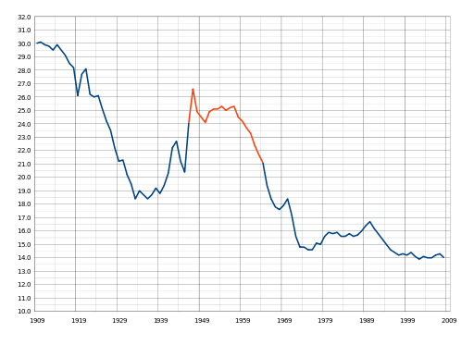
Post World War II Baby Boom, the last
Notes:
https://commons.wikimedia.org/wiki/File%3AUS_Birth_Rates.svg
By Saiarcot895 (Own work) [CC0], via Wikimedia Commons
US Birth Rates from 1909-2008. The number of births per thousand people in the United States. The red segment is known as the Baby Boomer period. The drop in 1970 is due to excluding births to non-residents.

Slide 12
The audience
Electricity
Artificial light
Television, the new medium, ate up radio demand, provided images of biggest stars.
Independent radio stations turned to other markets, especially teenagers.
Generational: rock and roll as the primary mode of rebellion during the Cold War

Slide 13
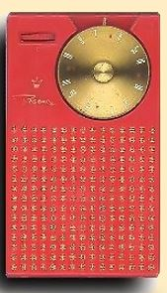
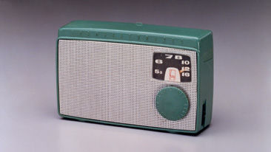
Transistor Radios
Highly portable, small
more than car radios
First: Regency TR-1, October 1954
Sony then made them fast and cheaper.
Japanese low wages drove down cost to consumers (by 1962: $15)
1955: Sony TR-55
Price: $39.95
1954: Regency TR-1
Price: $49.95

Slide 14
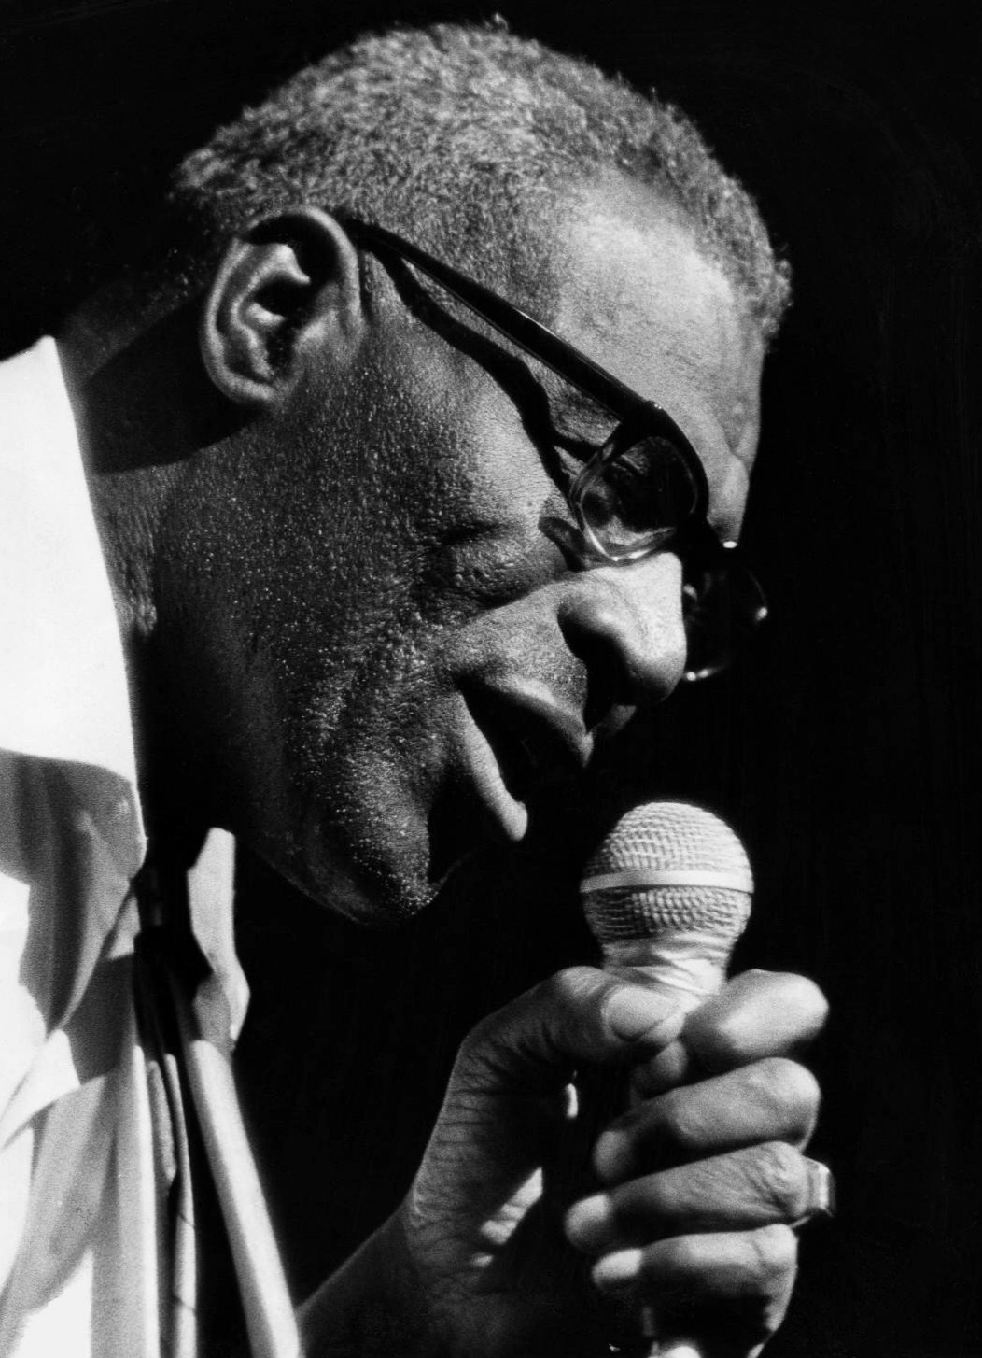
Howlin’ Wolf
Chester Arthur Burnett (1910-1976)
Charlie Patton taught him guitar and the blues.
Already playing an electric guitar in 1941
1951: Sam Phillips recorded him at the Memphis Recording Service: “How many more years” [link]
1952: moved to Chicago and signed contract with Chess Records.
Waters initially helped him out, but later they became rivals.

Slide 15
Muddy Waters
McKinley Morganfield (1913-1983)
Father of Chicago Electric Blues
1941: Alan Lomax recorded him for Library of Congress: link
1943: moved to Chicago to become a professional musician.
1945: first electric guitar, to be heard over the city’s noise.
1946: started recording with Aristocrat Records (Chess brothers).
1954: Hoochie Coochie Man (written by Willie Dixon): link
Waters essentially brought the Delta Blues to Chicago and electrified it.

Slide 16
Chuck Berry
Charles Edward Anderson "Chuck" Berry (born 1926, St. Louis)
Wild kid: armed robbery in high school, prison, 1944-1947
After, worked in an automobile plant, married.
Early 1953, influenced by T-Bone Walker’s guitar playing, joined the Johnnie Johnson Trio.
Moved to Chicago, May 1955
Muddy Waters introduced him to the Chess brothers.
1955: Bob Wills’s “Ida Red,” became “Maybellene” [link].

Slide 17
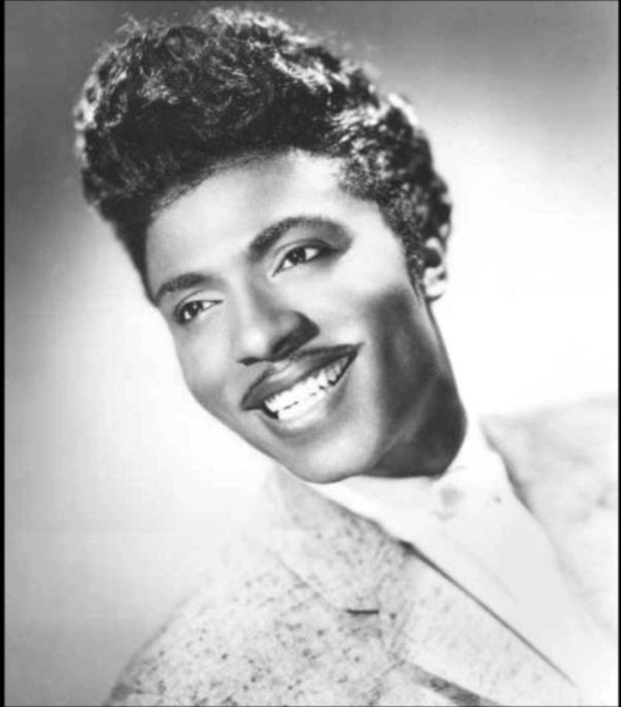
Little Richard
Richard Wayne Penniman (born 1932, Macon, Georgia), third of 12 kids.
Began as a gospel singer, mother at New Hope Baptist Church
Father owned a nightclub: Tip In Inn
1945 or 1947: Sister Rosetta Tharpe invited him on stage.
Played in various bands, often in drag.
1951: “Taxi Blues” [link]
1956: “Long, Tall Sally” [link]

Slide 18
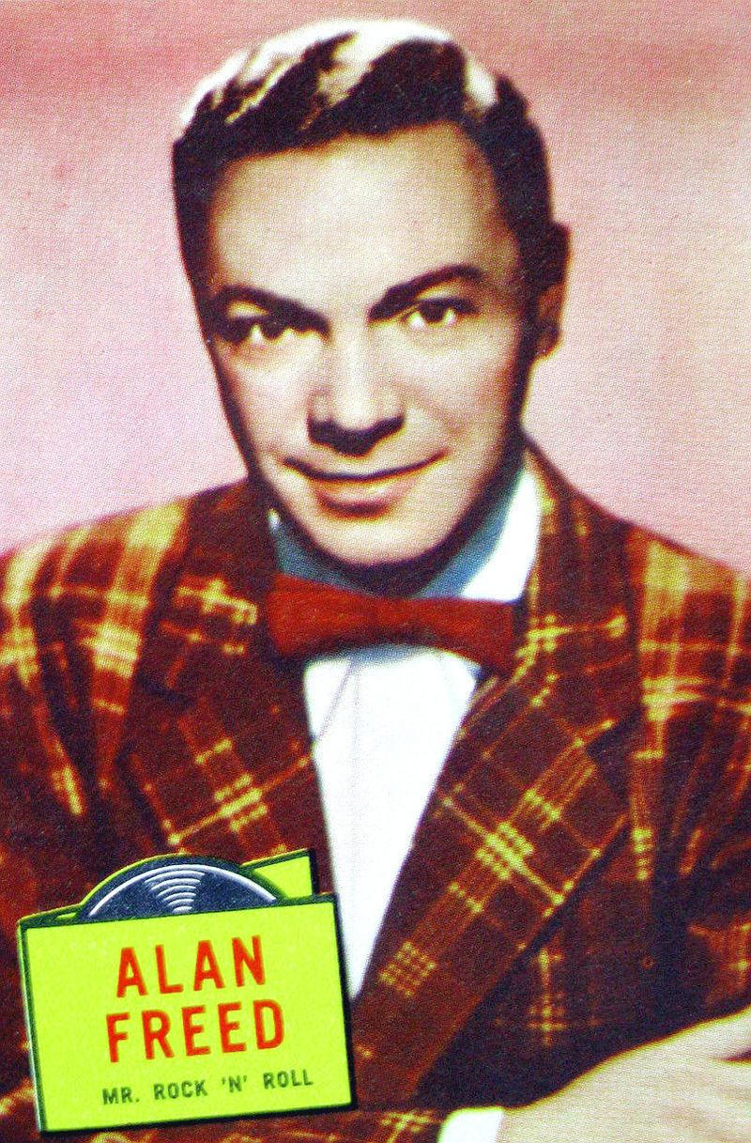
Alan Freed (1921-1965), “Rock ‘n’Roll”
First important Rock “Disc Jockey” (DJ)
High School band: Sultans of Swing
DJ on Armed Forces Radio (WWII)
“Old King of the Moondoggers”
Leo Mintz, Cleveland, Ohio record store owner
WJW (Cleveland): worked the night shift
Brought black hot jazz and rhythm and blues to white teenagers.
21 March 1952: “Moondog Coronation Ball”
Popularized “Rock’n’Roll”
6 April 1954 broadcast: link

Slide 19
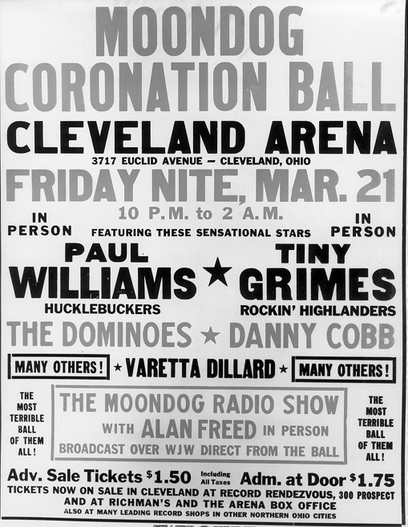

Slide 20
Race and Payola
1959: Freed began hosting “The Big Beat” on ABC; popular, but lasted only four episodes.
Here is why: fourth episode featured “Frankie Lyman and the Teenagers”
Freed then faced conflict of interest charges for promoting songs in which he had a financial interest Chuck Berry’s “Maybellene”.
Common practice, very unevenly enforced.

Slide 21
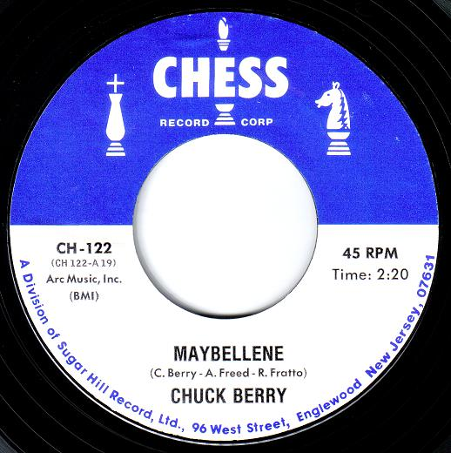
Chuck Berry shared the royalties: Maybellene, 1955

