Slide 1
Elvis, Sun Records, and Rockabilly
1954-1958

Slide 2
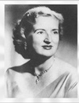
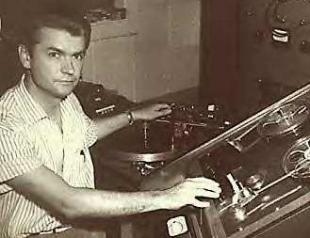
Elvis Presley
Memphis Recording Service
Sun Records, 1952-
Sam Phillips, 1923-2003
Marion Keisker (radio personality, “Meet Kitty Kelly”, 1946)
Elvis Aaron Presley, 1935-1977

Slide 3
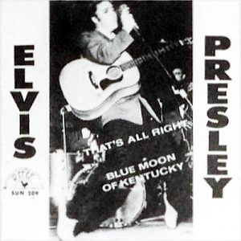
“That’s All Right, Mama!” July 1954
Crudup, 1946: link
Elvis, 1954: link
Scotty Moore
Bill Black
“Blue Moon of Kentucky,” country roots

Slide 4
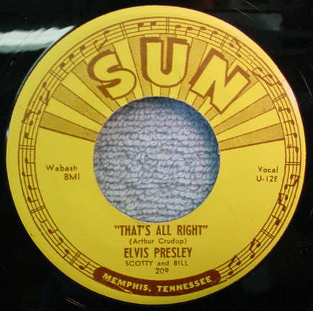

Slide 5
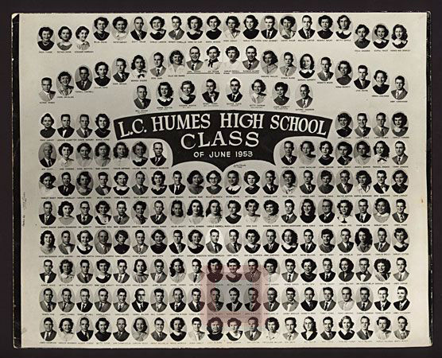
Elvis’s high school graduating class, 1953

Slide 6
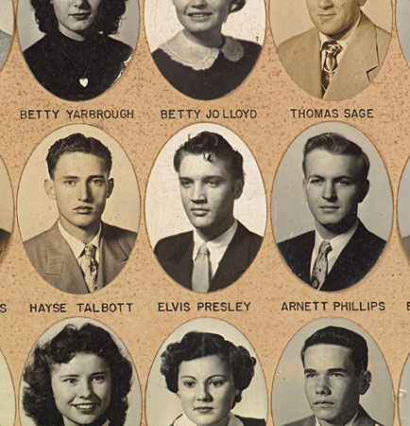
Close up of Elvis’s grad class

Slide 7
Hound Dog, 1956
Milton Berle show, 5 June 1956:
https://www.youtube.com/watch?v=MMmljYkdr-w
Critics were horrified: Jack Gould of the New York Times: “Mr. Presley has no discernible singing ability. ... His phrasing, if it can be called that, consists of the stereotyped variations that go with a beginner's aria in a bathtub. ... His one specialty is an accented movement of the body ... primarily identified with the repertoire of the blond bombshells of the burlesque runway.”
Steve Allen Show, 1956:
https://www.youtube.com/watch?v=oMN-1nSQv3U

Slide 8
Elvis on Crudup (June 1956)
"The colored folks been singing it and playing it just like I'm doin‘ now, man, for more years than I know. They played it like that in the shanties and in their juke joints, and nobody paid it no mind 'til I goosed it up. I got it from them. Down in Tupelo, Mississippi, I used to hear old Arthur Crudup bang his box the way I do now, and I said if I ever got to the place where I could feel like old Arthur felt, I'd be a music man like nobody ever saw."

Slide 9
“Heartbreak Hotel”, January 1956
First recording for RCA records [link]
Written by Tommy Durden and Mae Boren Axton.
Blue Moon Boys: S. Moore and B. Black
Chet Atkins: guitar
Floyd Cramer: piano
Most producers hated the recording.
Seven weeks number 1 on Billboard’s Top 100
Six weeks number 1 on Cashbox’s pop singles
Seventeen weeks top of C and W chart
Reached number 3 on R&B chart.
First million-dollar record for Elvis

Slide 10
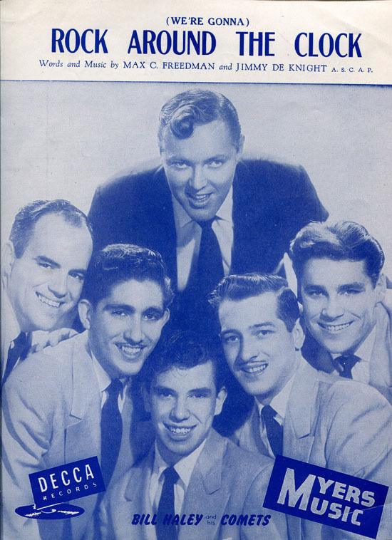
Rock around the Clock
Bill Haley and the Comets, 1954
Written by Max Freedman and James Meyer in 1952.
Blackboard Jungle, 1955, led to its popularity.
Caused Teddy Boy riots in London.
1958: Notting Hill race riots

Slide 11
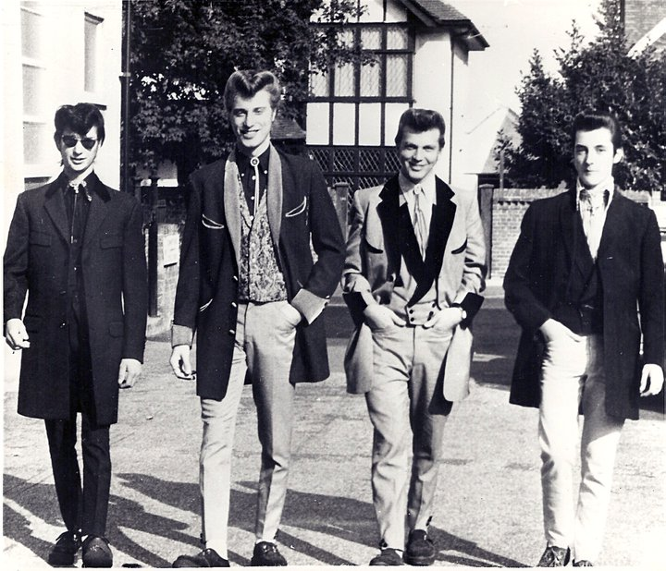
Teddy Boys, Chelmsford, UK, 1950s

Slide 12
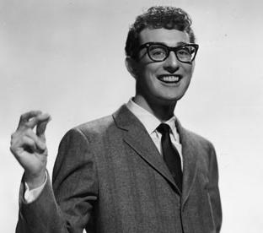
Buddy Holly, 7 Sep. 1936 –3 Feb. 1959
Charles Hardin Holley
Lubbock, Texas
First group: Buddy and Bob
June 1955: opened for Elvis Presley.
Moved from country to rock.
Ordinary guy, glasses, goofy.

Slide 13
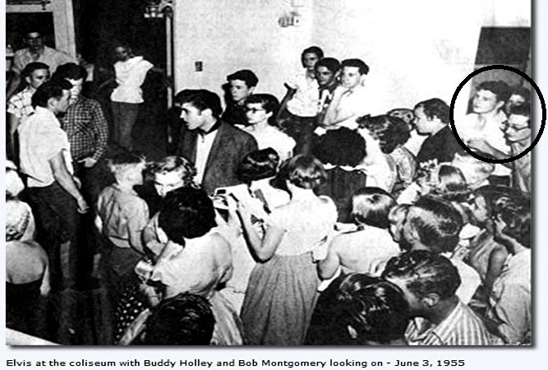
Buddy meets Elvis, 3 June 1955

Slide 14
Buddy Holly and the Crickets
First signed with Decca Records in Nashville, TN
Producer Owen Bradley, disagreed about control.
Norman Petty, Clovis, NM (Brunswick Records), “The Crickets”
1957: “That’ll be the day” (John Wayne, The Searchers) https://www.youtube.com/watch?v=9nrInsANB8Q
July 1957: “Peggy Sue”
Pioneered the rock band line up: two guitars, drums, bass.

Slide 15
The day the music died, 3 February 1959 (Don Maclean)
Winter Dance Party tour
Travelling conditions were terrible
Holly hired a plane to fly from Clear Lake Iowa, to Moorhead, Minn.
Invited
Jiles Perry "J. P." Richardson, Jr. (“the Big Bopper”)
Ritchie Valens (“La Bamba”)
Crashed minutes after take off.

