Slide 1

Data Visualization on Employees Data - Using R Studio
Department of Urban and Regional Planning, BUET
Bangladesh University of Engineering and Technology
(Box Plot, Pie Chart with Legend, Line Graph and Histogram)
Faizan Shabir, MURP Student
Student ID 0422152029
Multivariate Data Analysis (PLAN 6291)
Submitted to
Niaz Mahmud Zafri, Assistant Professor
On 26/01/2022

Slide 2
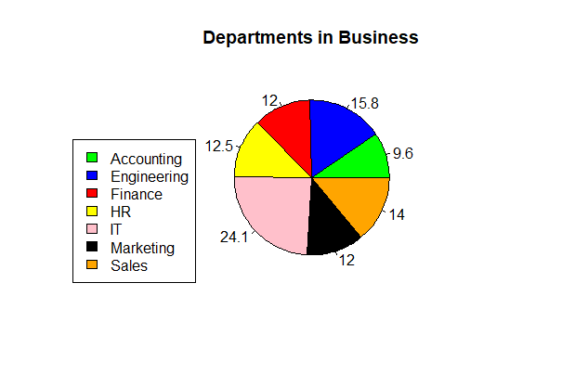

Slide 3
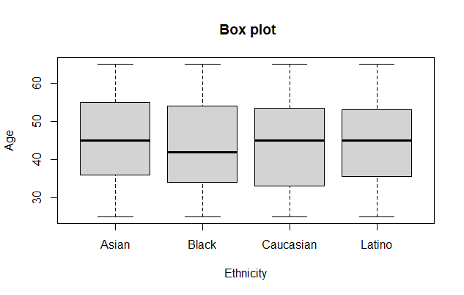

Slide 4
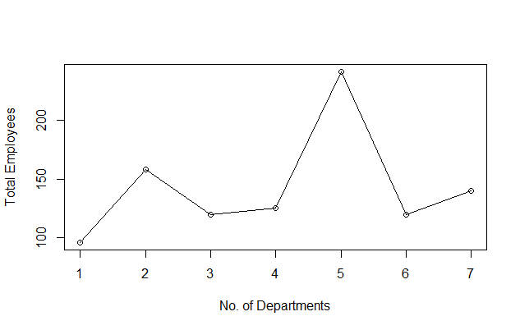

Slide 5
