Slide 1
Agenda
Background
Conceptual Approach
Implementation
Product or Service Code and North American Industry Classification System bucketing
Socio-economic factor screening
Low frequency signature screening
Addressability signature augmentation.
Comparative analysis of proposed method against:
Product or Service Code addressability
Product or Service Code and North American Industry Classification
Product or Service Code and North American Industry Classification w/ contract selection.
Conclusion
Recommendation

Slide 2
Background
Initial Addressable Market Calculations
Driven by coarse grained PSC only bucketing of transactions
Varied inputs across differing contract solutions
Transaction history
Category targets for markets within a contract solution
Problem:
*Inconsistent implementation across differing contract solutions
Due to course nature of PSC based internal markets within contract solutions, addressable obligations inherently over-estimated.
Initial Government-Wide Addressable Market Calculations
Decomposed markets within a contract solution in to PSC-NAICS bindings.
Two versions emerged:
Pure PSC-NAICS based addressable market calculation
PSC-NAICS with duplicate addressable market attribution going to the largest of the contract solutions that obligations are addressable to.
These observations led to collaboration between GWCM, CASE and Contract Solution representatives to produce a more robust methodology that could be consistently applied to GSA and Government-Wide Best In Class contract solutions.

Slide 3
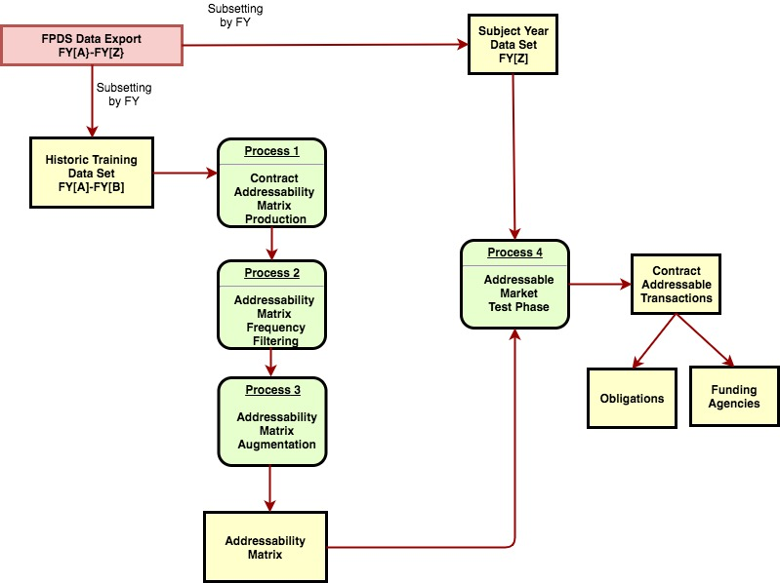
High Level Model Overview
X

Slide 4
Conceptual Approach
Requirements:
Demonstrate applicability to internal GSA contracts as well as BICs
Apply PSC-NAICS bucketing as the minimum level of granularity when mapping transactions to markets
Extend the definition of a market to encompass socio-economic factors
Mitigate the impact of erroneous transaction coding errors due to data entry
Provide mechanism for augmenting transaction history in the generation of the addressability matrix such that internal contract solution market initiatives are observed.
a) contract solution venture in to new or untapped market
b) new contract solution

Slide 5
The Addressability Matrix
List of unique transaction type specific signatures used characterize the internal markets of a contract solution
Tabular attribute based characterization of a contract solutions market.
Used to generalize addressable obligations against a subsequent subject year to produce addressable obligations.
Uses FPDS transaction attributes to identify the market in which a transaction lies
FPDS attributes selected for this proposal can and should be adjusted as necessary by acquisition SMEs.
Pilot factors: PSC, NAICs, small business goaling flag, women_owned_flag, veteran_owned_flag, minority_owned_business_flag, foreign_government
The addressability key serves as the filtering element that is unique to each factor combination within a contract solution

Slide 6
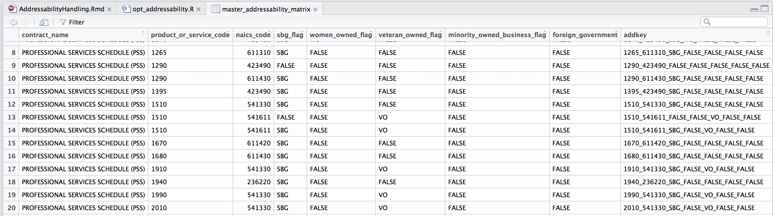
The Addressability Matrix (Cont’d)

Slide 7
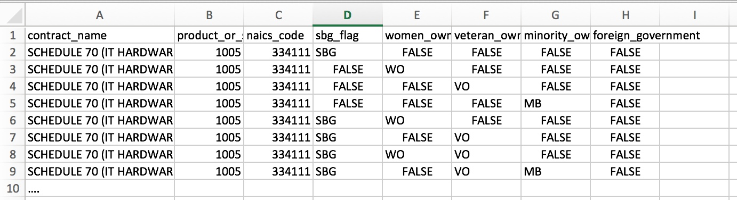
Addressability Matrix Augmentation
Use-Case 1: Contract Solution history does not support adequate training of model.
New contract solution
Use-Case 2:
Contract solution initiative to expand in to new market space for which not addressability can be built from the transaction history
Input Format:

Slide 8
Addressability Matrix Frequency Filtering
Use-Case: When using PSC/NAICS as the only FPDS coding attributes, erroneous addressability signatures can be introduced.
Results in creation of addressability signature that should not exist
Addressability projection for subject year will be over-inflated.
Alternatives:
Identify low frequency psc/naics buckets as erroneous and filter from the addressability matrix.
Increase the number of attributes that represent the bucket or market space by n attributes.
A truly unique combination of these attributes can remain in the addressability calculation and is n^2 times less likely to generalized from in the testing phase.
Due to the fact the the attribute combinations identify a market space n^2 = 25 times more specific than psc naics, a high volume of signatures have low test data set frequencies.
Omission of these signatures would produce an erroneous result.

Slide 9
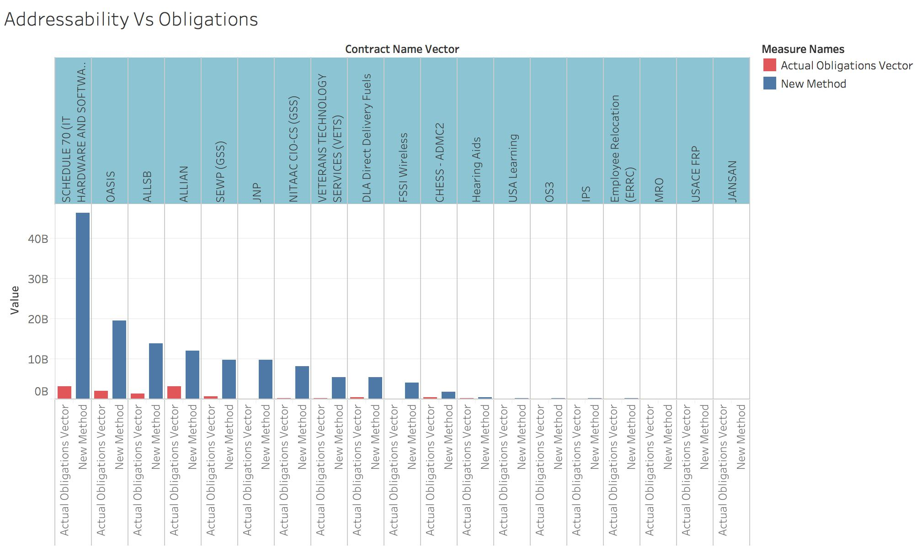
BIC Addressability vs Obligations

Slide 10
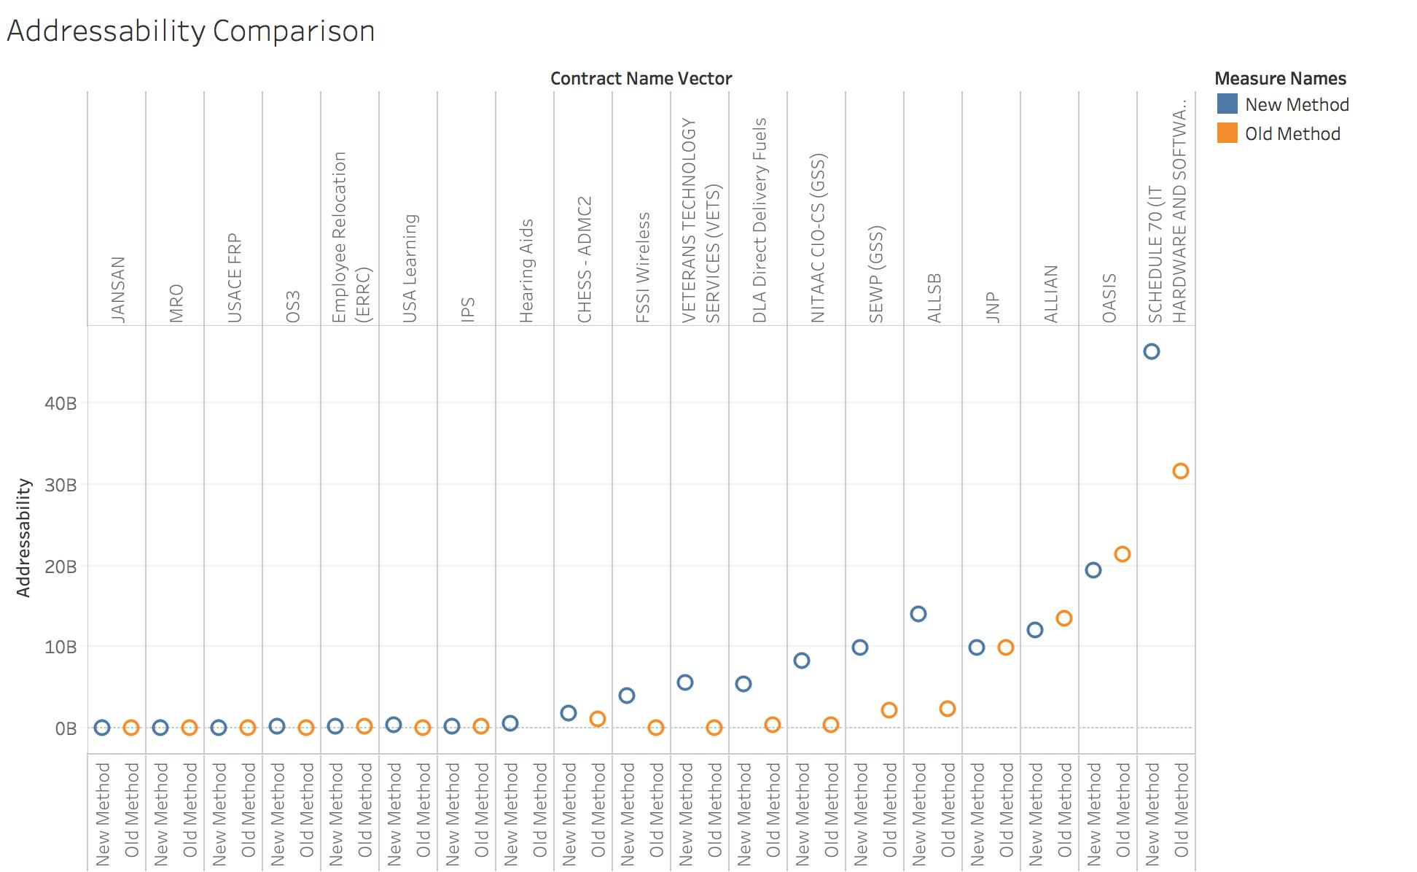
BIC Addressability Comparison
Observations:
IT contracts impacted by prior addressability flaw.
New method corrects
DLA Fuels anomalous. More investigation required.
Conjecture that FSSI Wireless requires further constraint based on reference_piid.

Slide 11
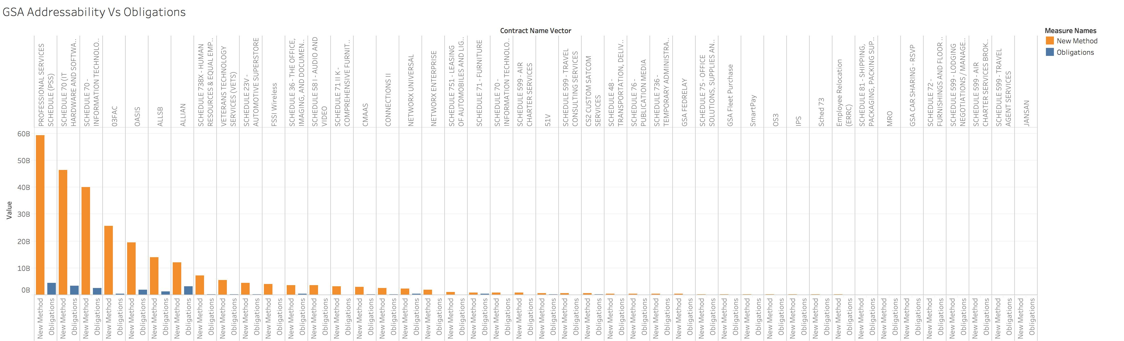
GSA Addressability vs Obligations

Slide 12
Agency/Bureau Level Addressability
X

