Slide 1
Contract Addressability Methodology
Clifton Best
Beck Giesy
19OCT17

Slide 2
Agenda
Background
Conceptual Approach
Implementation
Product or Service Code and North American Industry Classification System bucketing
Socio-economic factor screening
Low frequency signature screening
Addressability signature augmentation.
Comparative analysis of proposed method against:
Product or Service Code addressability
Product or Service Code and North American Industry Classification
Product or Service Code and North American Industry Classification w/ contract selection.
Summary
Recommendation

Slide 3
Background
Initial Addressable Market Calculations
Driven by coarse grained PSC only bucketing of transactions
Varied inputs across differing contract solutions
Transaction history
Category targets for markets within a contract solution
Problem:
*Inconsistent implementation across differing contract solutions
Due to coarse nature of PSC based internal markets within contract solutions, addressable obligations inherently over-estimated.
Initial Government-Wide Addressable Market Calculations
Decomposed markets within a contract solution in to PSC-NAICS bindings.
Two versions emerged:
Pure PSC-NAICS based addressable market calculation
PSC-NAICS with duplicate addressable market attribution going to the largest of the contract solutions that obligations are addressable to.
These observations led to collaboration between GWCM, CASE and Contract Solution representatives to produce a more robust methodology that could be consistently applied to GSA and Government-Wide Best In Class contract solutions.

Slide 4
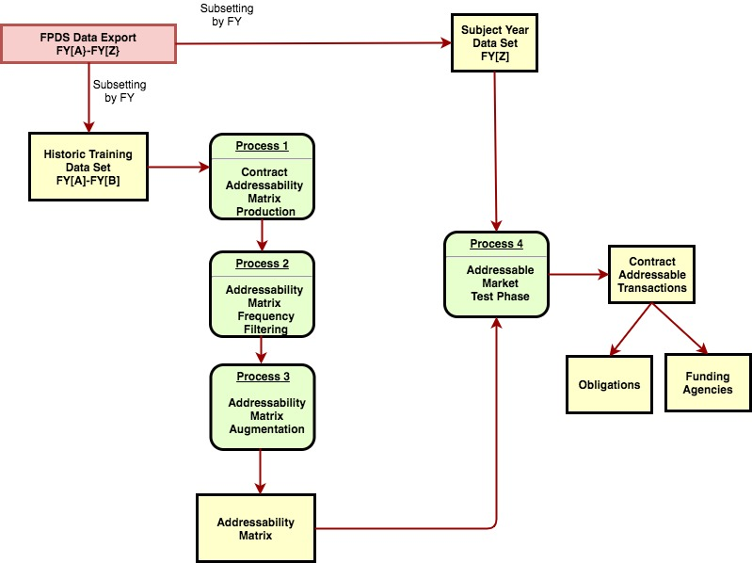
High Level Model Overview
X

Slide 5
Conceptual Approach
Requirements:
Demonstrate applicability to internal GSA contracts as well as BICs
Apply PSC-NAICS bucketing as the minimum level of granularity when mapping transactions to markets
Extend the definition of a market to encompass socio-economic factors
Mitigate the impact of erroneous transaction coding errors due to data entry
Provide mechanism for augmenting transaction history in the generation of the addressability matrix such that internal contract solution market initiatives are observed.
a) contract solution venture in to new or untapped market
b) new contract solution

Slide 6
The Addressability Matrix
List of unique transaction type specific signatures used characterize the internal markets of a contract solution
Tabular attribute based characterization of a contract solutions market.
Used to generalize addressable obligations against a subsequent subject year to produce addressable obligations.
Uses FPDS transaction attributes to identify the market in which a transaction lies
FPDS attributes selected for this proposal can and should be adjusted as necessary by acquisition SMEs.
Pilot factors: PSC, NAICs, small business goaling flag, women_owned_flag, veteran_owned_flag, minority_owned_business_flag, foreign_government
The addressability key serves as the filtering element that is unique to each factor combination within a contract solution
Notes:
Recommendation: CASE verify socio-economic factors

Slide 7
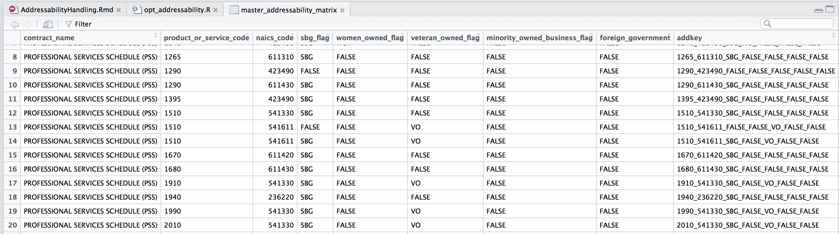
The Addressability Matrix (Cont’d)

Slide 8
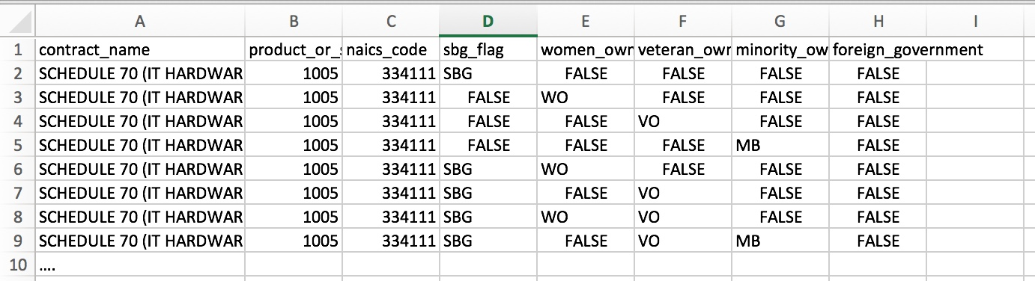
Addressability Matrix Augmentation
Use-Case 1: Contract Solution history does not support adequate training of model.
New contract solution
Use-Case 2:
Contract solution initiative to expand in to new market space for which not addressability can be built from the transaction history
Input Format:
Notes:
Recommendation: For those addressability values that require adjustment of the matrix, request CASE provide list of psc’s naics that should be added
As a baseline we intend to use: https://hallways.cap.gsa.gov/app/#/solutionsfinder/21

Slide 9
Addressability Matrix Frequency Filtering
Use-Case: When using PSC/NAICS as the only FPDS coding attributes, erroneous addressability signatures can be introduced.
Results in creation of addressability signature that should not exist
Addressability projection for subject year will be over-inflated.
Alternatives:
Identify low frequency psc/naics buckets as erroneous and filter from the addressability matrix.
Increase the number of attributes that represent the bucket or market space by n attributes.
A truly unique combination of these attributes can remain in the addressability calculation and is n^2 times less likely to generalized from in the testing phase.
Due to the fact the the attribute combinations identify a market space n^2 = 25 times more specific than psc naics, a high volume of signatures have low test data set frequencies.
Omission of these signatures would produce an erroneous result.
Notes:
If we want to incorporate factors into definition of a market, it makes little sense to address contract frequency by a different definition of market
Consistency in definition is important
Including factors increases number of unique combinations and transactions are distributed across larger number of add_keys
Allows for more precise elimination of 5% quantile.
Allows us to determine which combination of factors and psc_naics are not being appropriately covered by contract soln currently.
Rather than eliminating entire psc_naics grouping, only eliminate portions based on contract soln coverage of factors within grouping.

Slide 10
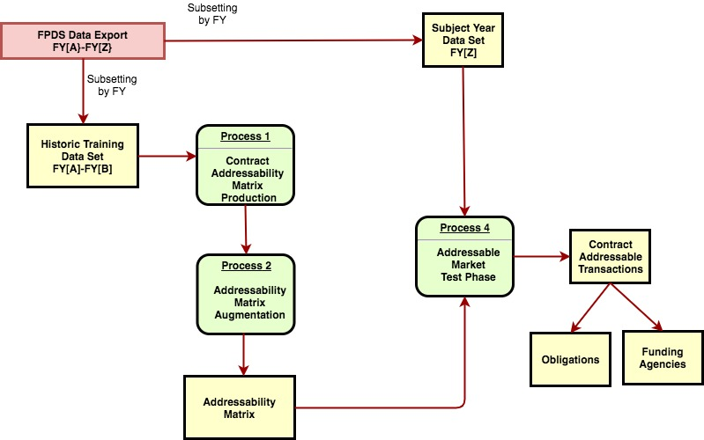
Revised Model Overview

Slide 11
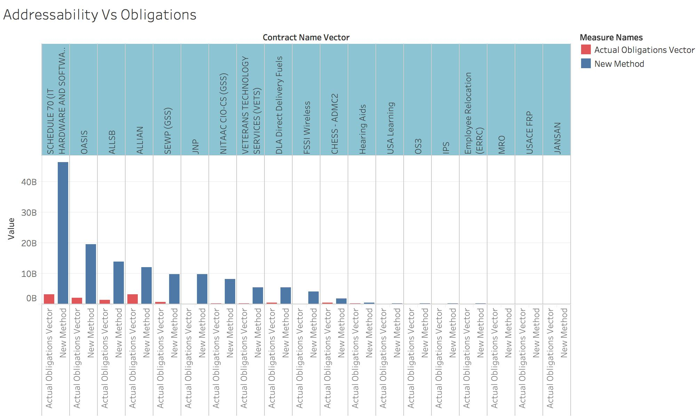
BIC Addressability vs Obligations

Slide 12
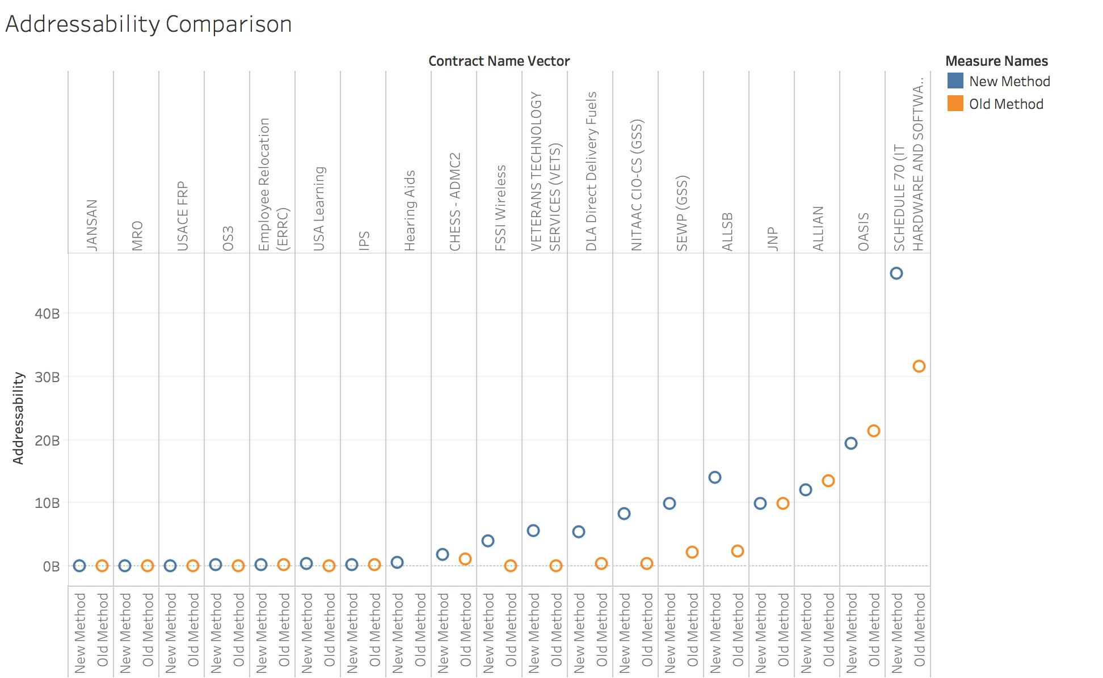
BIC Addressability Comparison
Observations:
IT contracts impacted by prior addressability flaw.
New method corrects
DLA Fuels anomalous. More investigation required.
Conjecture that FSSI Wireless requires further constraint based on reference_piid.

Slide 13
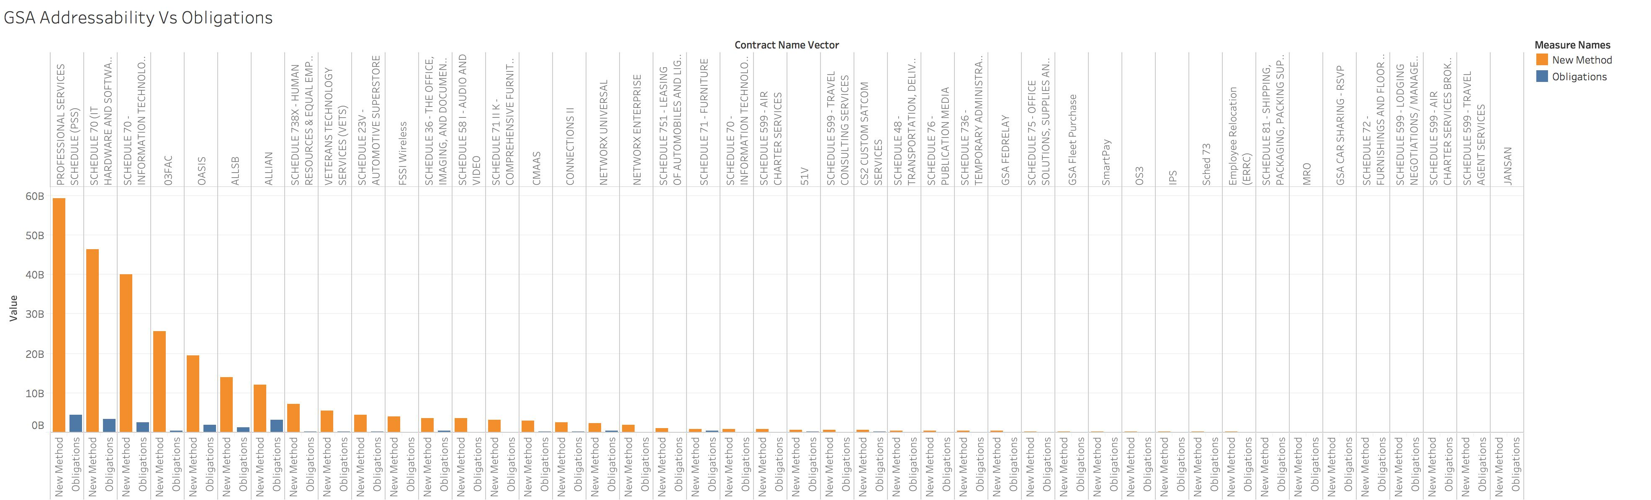
GSA Addressability vs Obligations
Notes:
GS + 5th char is an F or P

Slide 14
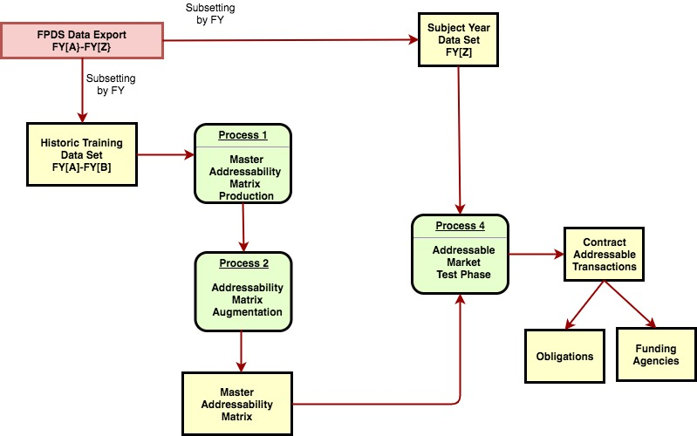
Agency/Bureau Level Addressability
Load_Spark_CSV()
Pre: FPDS Extract
Post: Write to parquet
Limit the incoming data set to only required agency/bureau domain.
Load_Spark_Parquet()
Pre: none
Post: ETL
process_gsa_contracts()
Pre: ETL
Post: 1. Master addressability
Matrix
2. Contract addressability
process_bic_contracts()
Concatenation
of all matrices in the
required contract domain
Pre: ETL
Post: 1. Master addressability
Matrix
2. Contract addressability
Notes:
Avoids the pitfalls of erroneous values that come from summing individual solution addressability

Slide 15
Architecture Ramifications:
Contract Inventory is embedded each row of GWCM data set
Joined from GWCM contract inventory
GWCM contract inventory built upon CART inventory and Agency data calls and updates.
GWCM and CART contract inventory must become unified in its implementation and maintenance.
Recommendation:
CASE participate in GWCM’s FY18 contract inventory activity to ensure seamless merging of CART contract inventory with existing GWCM and new Agency inputs.
GWCM PMO expose resulting contract inventory in LDE for CART utilization.

Slide 16
Architecture Ramifications Cont’d
Key enabling product
Master addressability matrix
Can be ingested in to any system
Tableau
Micro-strategy
Development platforms: R, Python, Scala, Java
Can then subsequently be used to calculate addressability for any scope of transactions.

Slide 17
Summary
We have defined a framework which:
Allows the production of an ”addressability matrix”
Supports addressability matrix tuning based on acquisition SME observation of intended addressability
Tuning can occur in terms of pilot addressability factors or others that may be deemed more appropriate
Provides the addressability matrix as a product which can be easily imported in a variety of tools for addressability calculation… ie Tableau, Micro-Strategy
The final calculation is carried out as a filtering operation in the platform from which end users consume specific business unit products.
Provides flexible organizational scopes for addressability calculation.

Slide 18
Recommendations
CASE verify socio-economic factors for use in addressability matrix construction.
For those addressability values that require adjustment of the matrix, request CASE provide list of psc’s naics that should be added
As a baseline we can use the standards presented at: https://hallways.cap.gsa.gov/app/#/solutionsfinder/21
CASE developers work with GWCM on unified contract inventory

