Slide 1
Agenda
Background
Conceptual Approach
Implementation
  Product or Service Code and North American Industry Classification System bucketing
  Socio-economic factor screening
  Low frequency signature screening
  Addressability signature augmentation.
Comparative analysis of proposed method against:
  Product or Service Code addressability
  Product or Service Code and North American Industry Classification
  Product or Service Code and North American Industry Classification w/ contract selection.
Conclusion
Recommendation

Slide 2
Background
Initial Addressable Market Calculations
  Driven by course grained PSC only bucketing of transactions
  Varied inputs across differing contract solutions
    Transaction history
    Category targets for markets within a contract solution
  Problem:
    *Inconsistent implementation across differing contract solutions
    Due to course nature of PSC based internal markets within contract solutions, addressable obligations inherently over-estimated.
Initial Government-Wide Addressable Market Calculations
  Decomposed markets within a contract solution in to PSC-NAICS bindings.
  Two versions emerged:
    Pure PSC-NAICS based addressable market calculation
    PSC-NAICS with duplicate addressable market attribution going to the largest of the contract solutions that obligations are addressable to.
These observations led to collaboration between GWCM, CASE and Contract Solution representatives to produce a more robust methodology that could be consistently applied to GSA and Government-Wide Best In Class contract solutions.

Slide 3
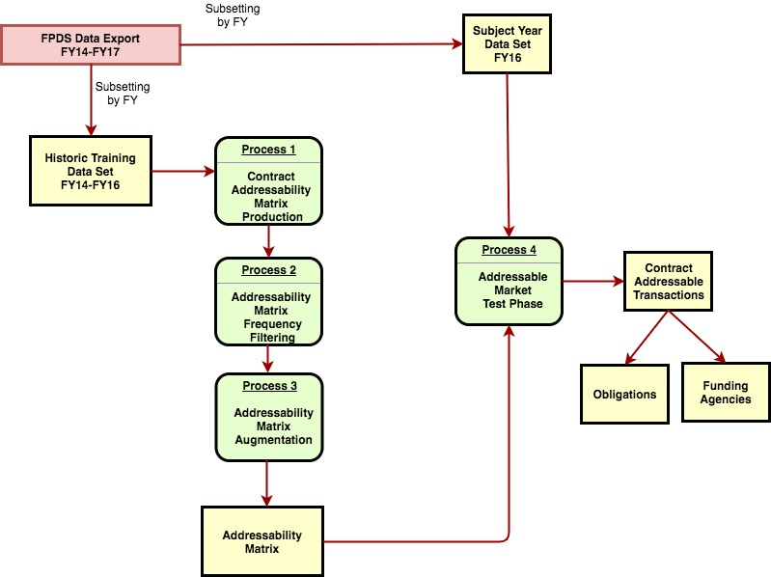
High Level Model Overview

Slide 4
Conceptual Approach
Requirements:
  Demonstrate applicability to internal GSA contracts as well as BICs
  Apply PSC-NAICS bucketing as the minimum level of granularity when mapping transactions to markets
  Extend the definition of a market to socio-economic factors
  Mitigate the impact of erroneous transaction coding errors due to data entry
  Provide mechanism for augmenting transaction history in the generation of the addressability matrix such that internal contract solution market initiatives are observed.

Slide 5

Process for the Addressability Model

Slide 6
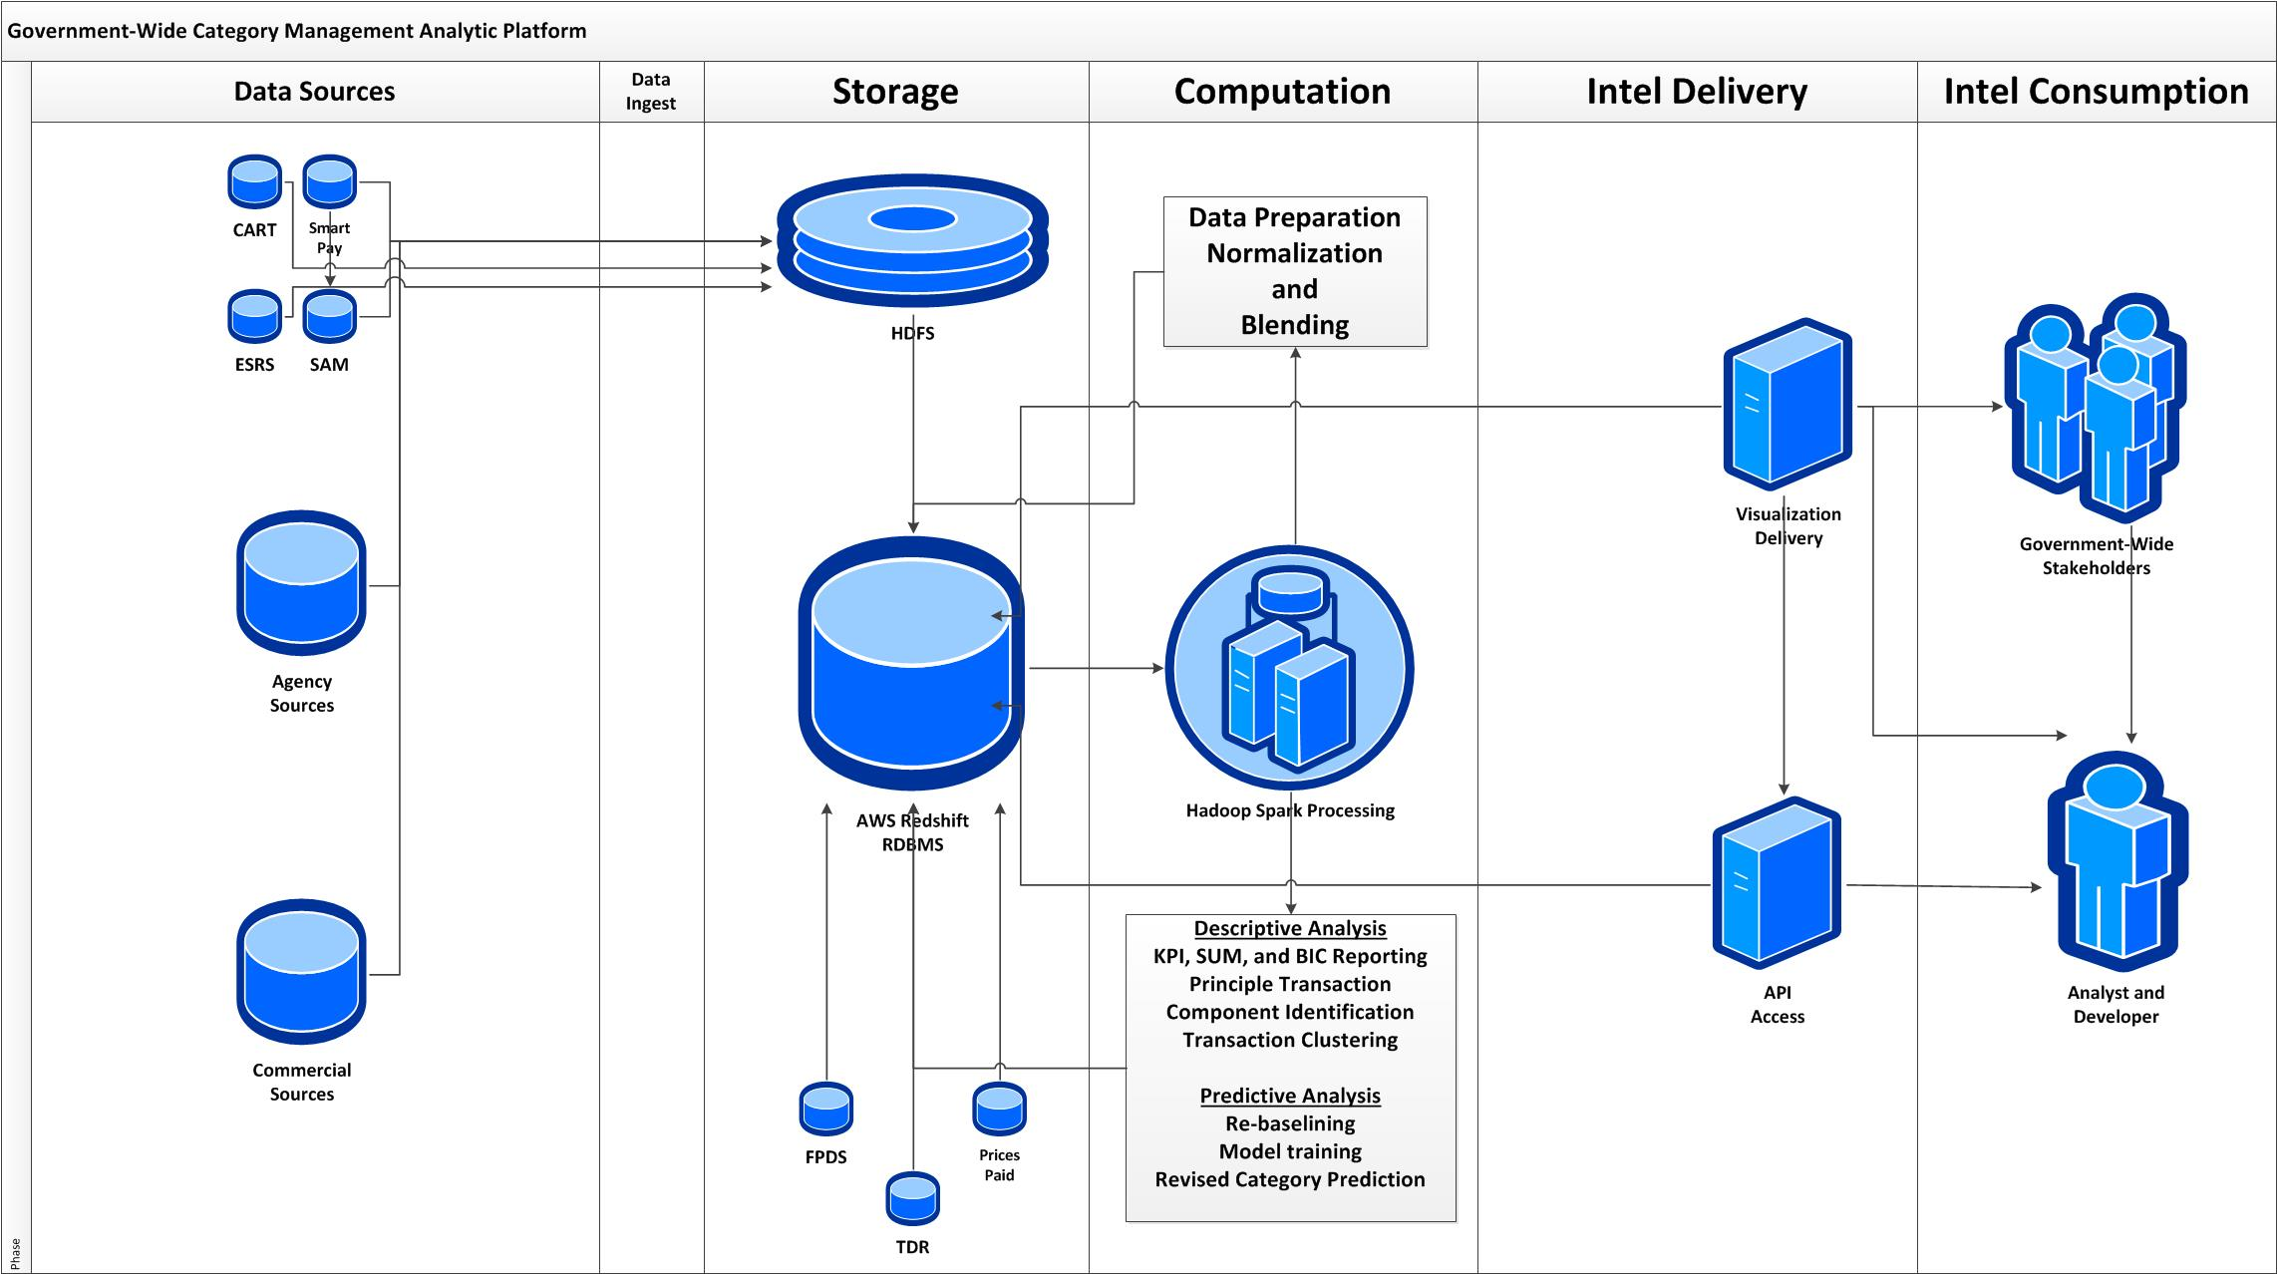
Shared Analytic Pipeline Logical Architecture

