Slide 1
Gender Imbalance Online
A field experiment

Slide 2
Women Contribute Online Less Than Men
Only 13% women contributors on Wikipedia
Wikipedia entries about women are less likely to be complete
Less than 5% women contributors on Stack Overflow
Reasons are poorly understood
Open platforms have no discriminatory policies
Incentives and differences in preferences between the genders
Important implications for platforms, individuals, and society

Slide 3
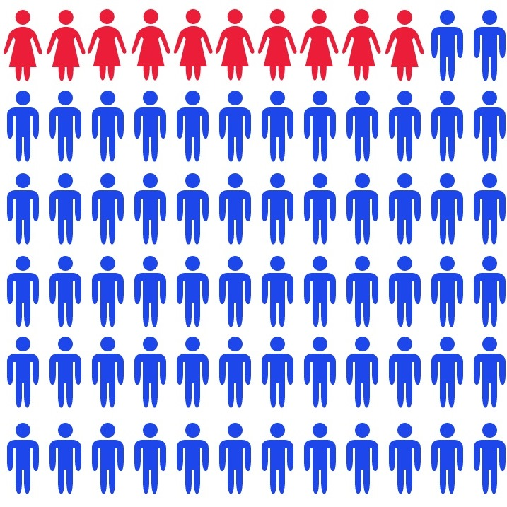

In this study, we explore two mechanisms
Gender composition
Role models

Slide 4

Empirical context:
HeroX
>60,000 users
Incentive competitions about space, education, health care
Incentives ranging from $5000 to $1M.
Experimental design
Sending personalized solicitations featuring most active members
Randomize gender composition (more or less women)
Randomize profile information (more or less “role model”)

Slide 5
Results
Experimental intervention will take place by end of April
Experimental results should be available by end of May

