Slide 1
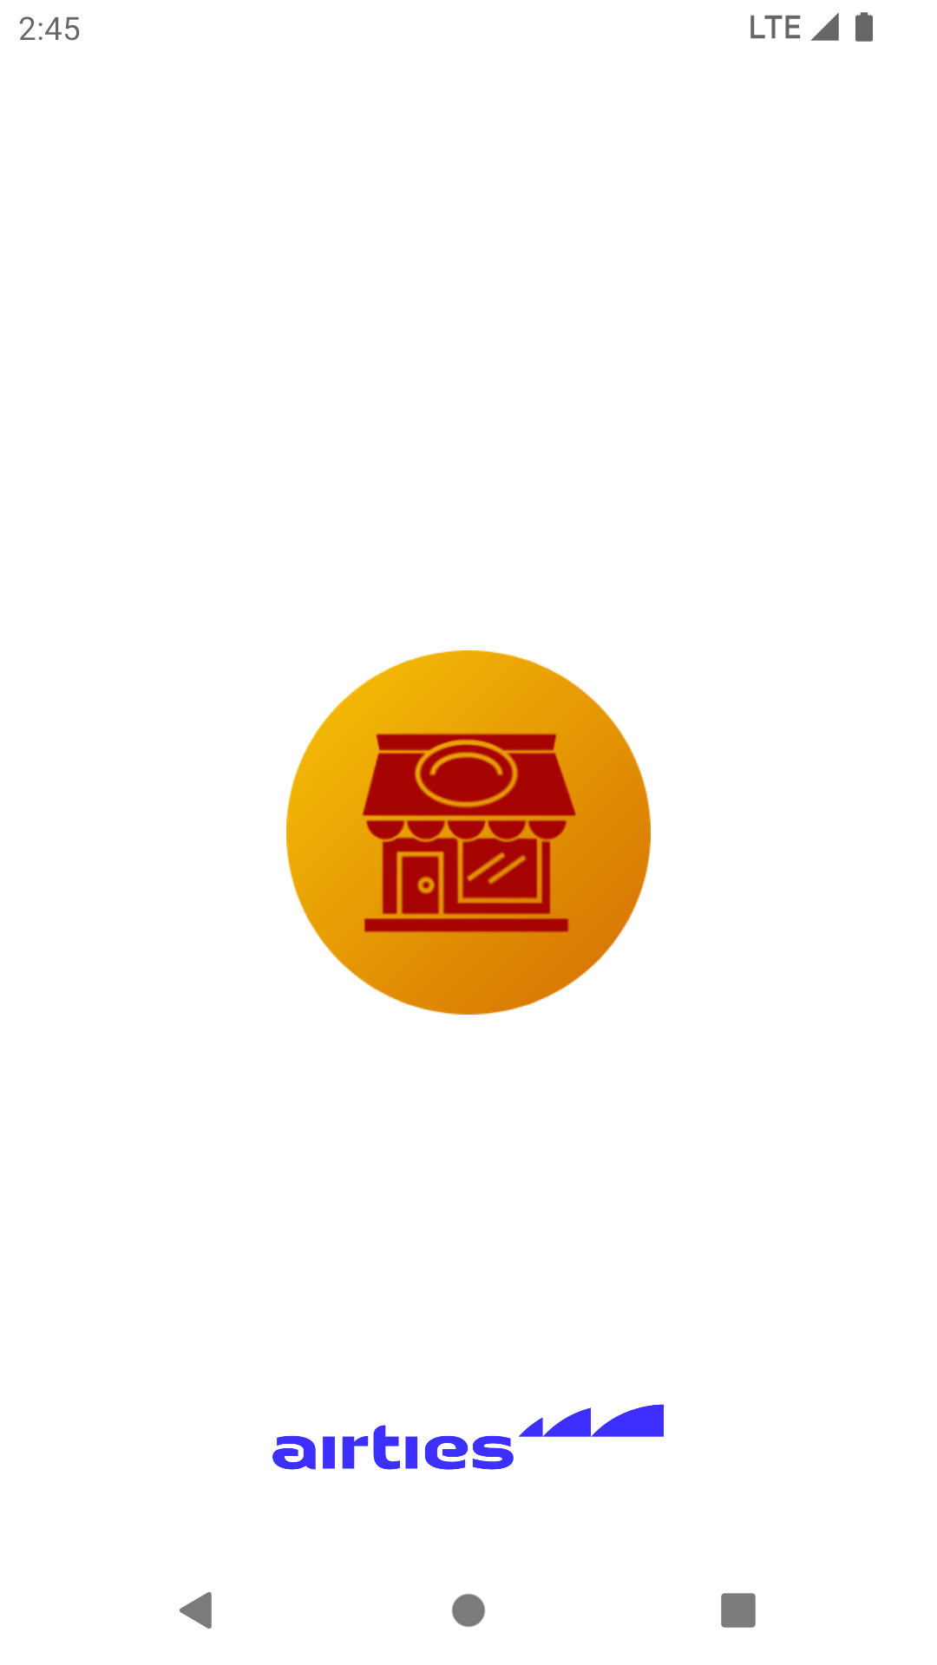

Omer’s Place
Presenter – Omer Bilal Yay

Slide 2
Contents
Used Technologies
MotionLayout
Lifecycle
UML
Exceptions
References
Q&A

Slide 3
Used technologies
MVVM - a software architectural pattern
LiveData - an observable data holder class
View Binding - a feature that allows you to more easily write code that interacts with views
Web service - a standardized method for propagating messages between client and server applications
Retrofit - a type-safe HTTP client for Android
LottieFiles - an open source animation file format that’s tiny, high quality, interactive, and can be manipulated at runtime

Slide 4
MotionLayout
Tags | Description
<StateSet> | Describes states supported by the system (optional)
<ConstraintSet> | Describes a constraint set
<Transition> | Describes a transition between two states or ConstraintSets
<ViewTransition> | Describes a transition of a View within a states or ConstraintSets

Slide 5
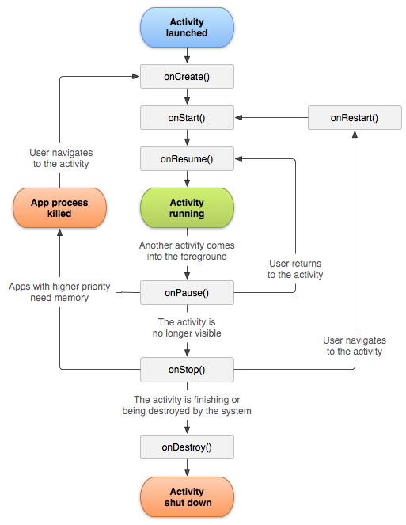
https://developer.android.com/guide/components/activities/activity-lifecycle

Slide 6
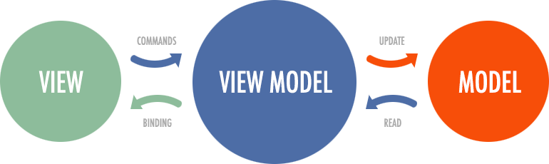

Slide 7
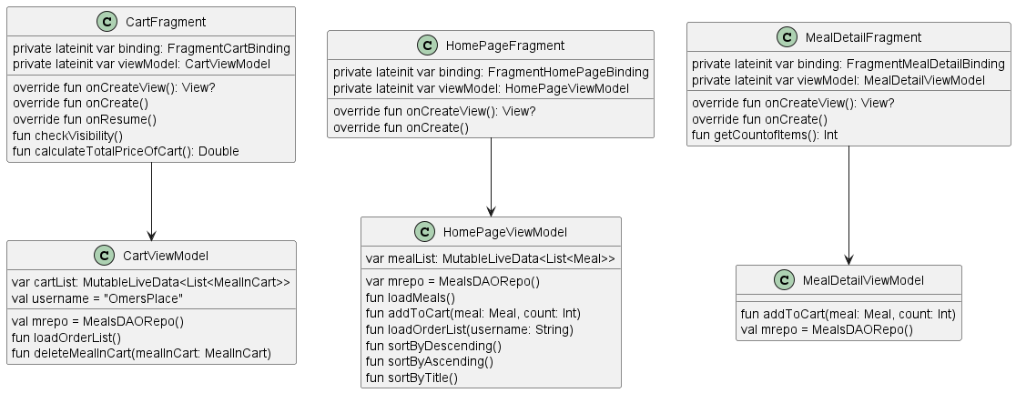
UML

Slide 8
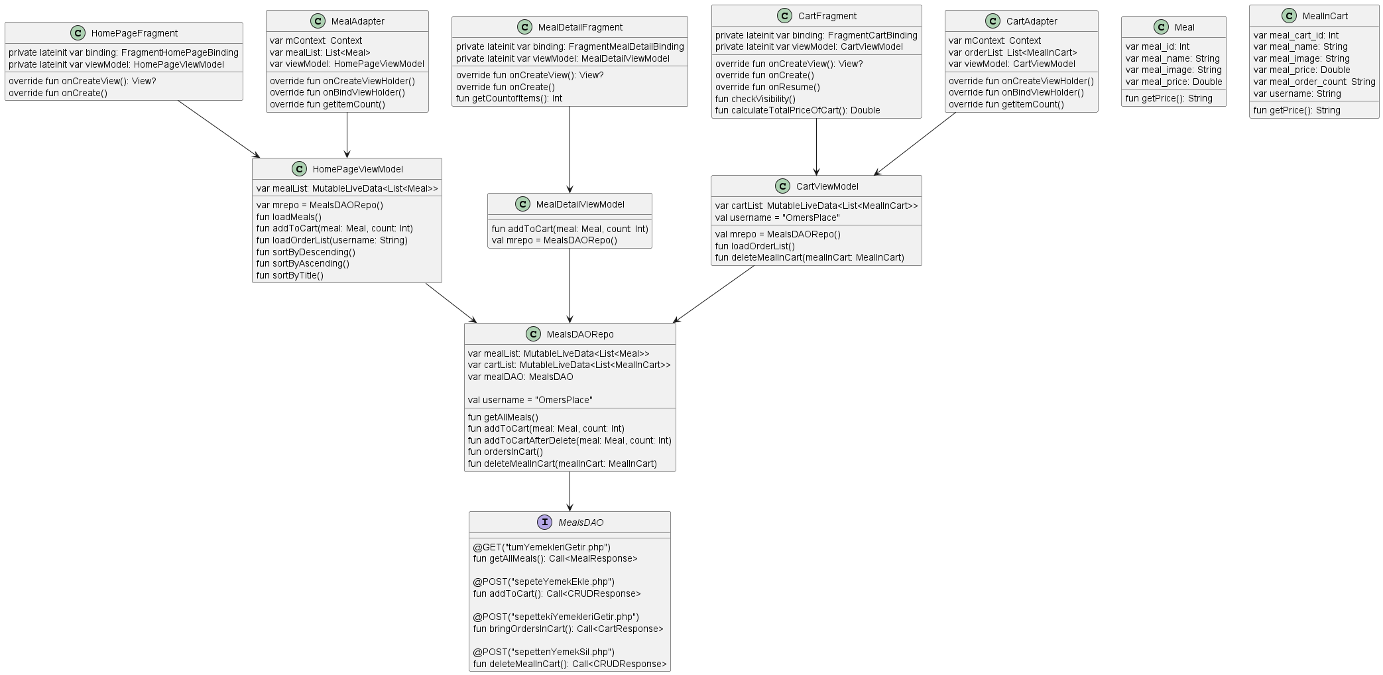

Slide 9
Exceptions
android.os.NetworkOnMainThreadException
java.lang.NullPointerException
java.lang.IllegalStateException

Slide 10
References
http://kasimadalan.pe.hu/yemekler/
https://developer.android.com/guide/
https://stackoverflow.com/questions/
https://play.google.com/store/apps/
https://icon.kitchen/
https://kotlinlang.org/docs/
https://plantuml.com/
https://github.com/mrbllyy/OmersPlace/

Slide 11
