Slide 1
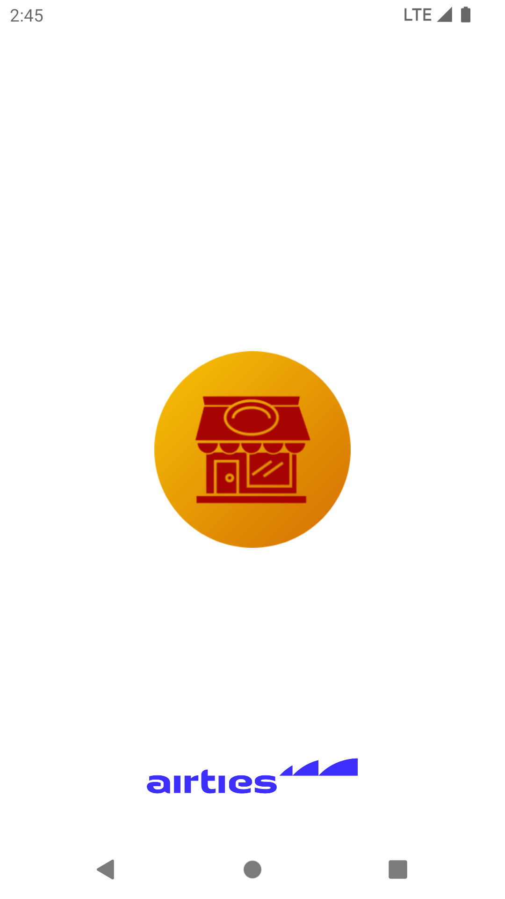
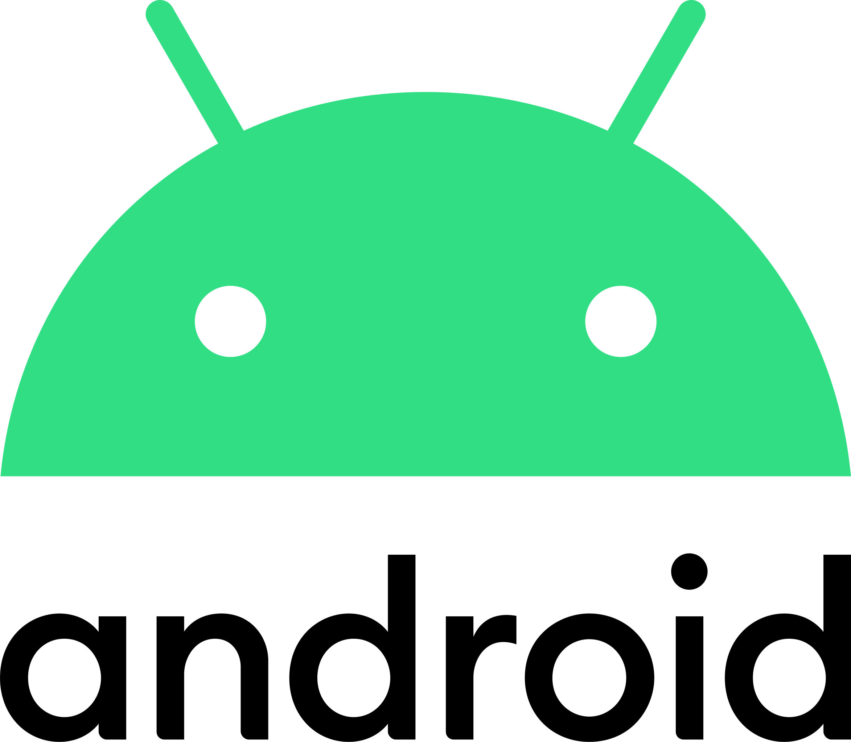
Omer’s Place
Presenter – Omer Bilal Yay

Slide 2
Contents
Used Technologies
Kotlin
Coroutines
Lifecycle
MotionLayout
UML
Exceptions
Q&A
References

Slide 3
Used technologies
MVVM - a software architectural pattern
LiveData - an observable data holder class
View Binding - a feature that allows you to more easily write code that interacts with views
Web service - a standardized method for propagating messages between client and server applications
Retrofit - a type-safe HTTP client for Android
LottieFiles - an open source animation file format that’s tiny, high quality, interactive, and can be manipulated at runtime

Slide 4
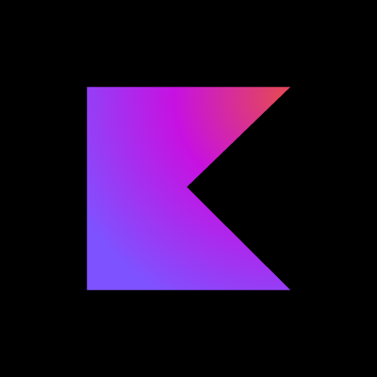
Kotlin

Slide 5

Coroutines

Slide 6
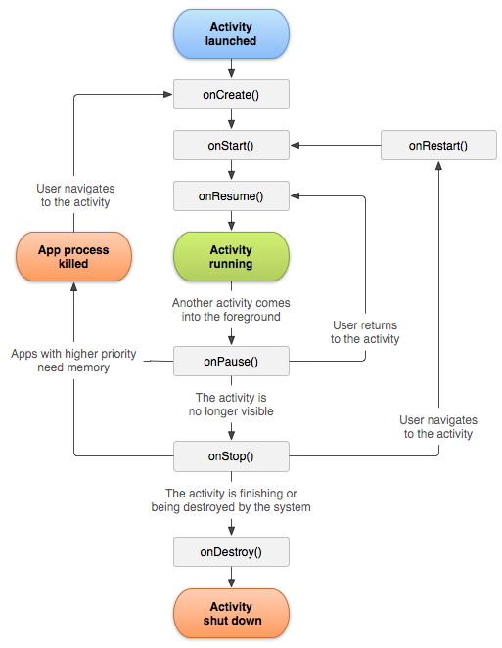
https://developer.android.com/guide/components/activities/activity-lifecycle

Slide 7
MotionLayout

Slide 8
UML

Slide 9
https://stackoverflow.com/questions/35810229/how-to-display-and-set-click-event-on-back-arrow-on-toolbar

Slide 10
Exceptions
android.os.NetworkOnMainThreadException
java.lang.NullPointerException

Slide 11
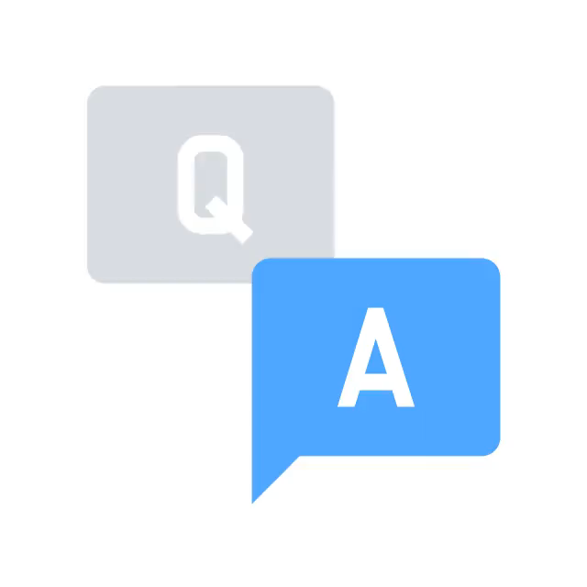

Slide 12
References
http://kasimadalan.pe.hu/yemekler/
https://developer.android.com/guide/
https://stackoverflow.com/questions/
https://play.google.com/store/apps/
https://icon.kitchen/
https://kotlinlang.org/docs/
https://github.com/mrbllyy/OmersPlace/

