Slide 1
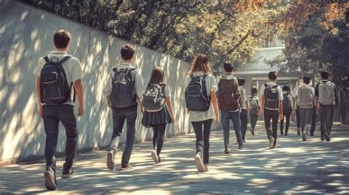
Safety at the heart of student life. A protective environment for every student
Baptiste Bossuet
Estelle Girault

Slide 2
Contents
Introduction
Development : - School travel - Intrusion security - Fire safety - Food/hygiene safety - Mental health
Conclusion

Slide 3

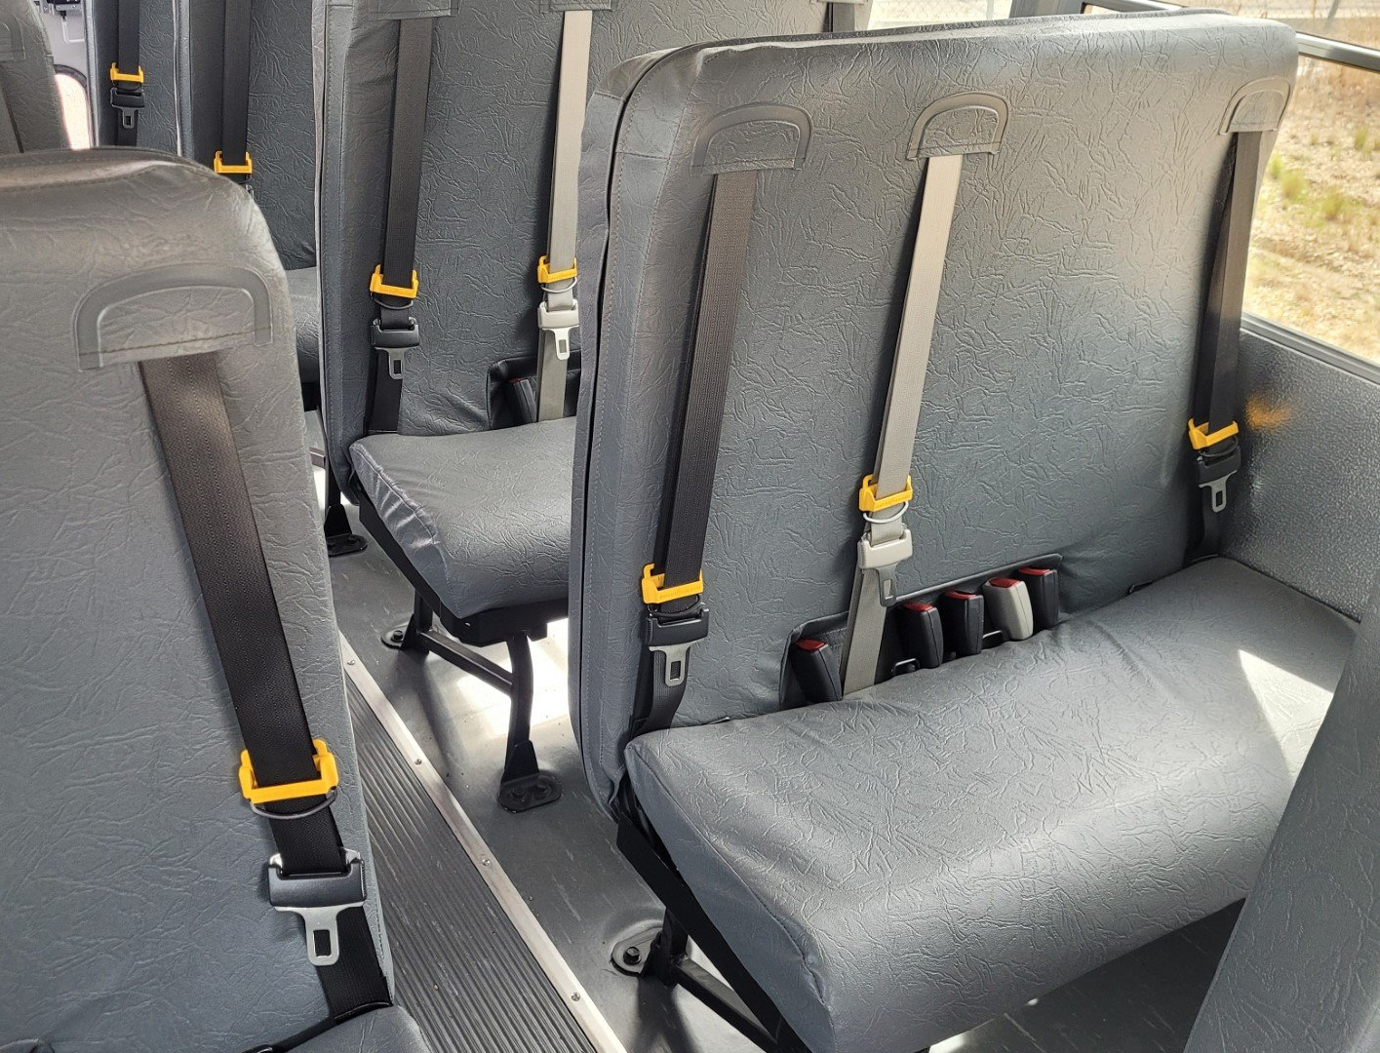
School travel
Teachers ensure safety
Students must follow instructions
Students travel by bus, car, bike or on foot
Daily trips can be dangerous Safety rules are essential !

Slide 4

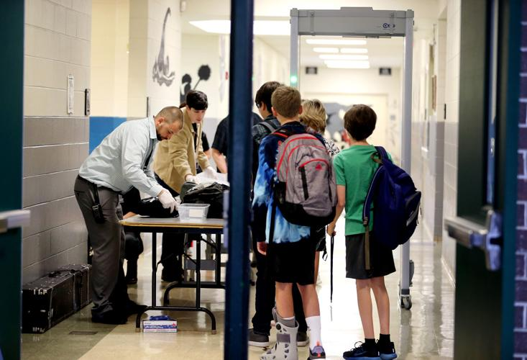
Intrusion security
Security
Visual inspection of bags
1. Vigilance 2. Prevention 3. Protection

Slide 5
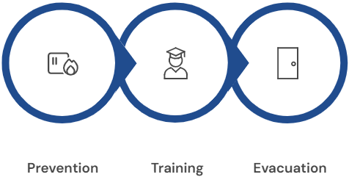
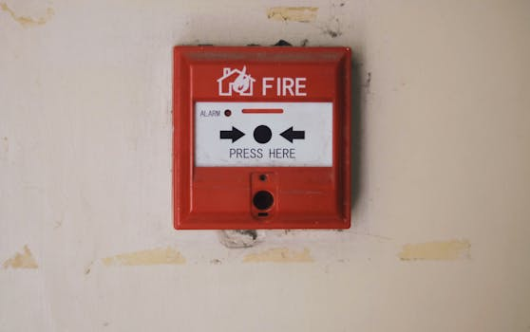

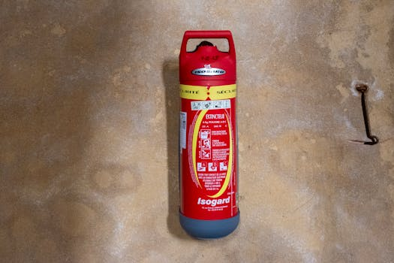
Fire safety

Slide 6

Food/hygiene safety
Active Awareness and Strict Controls

Slide 7

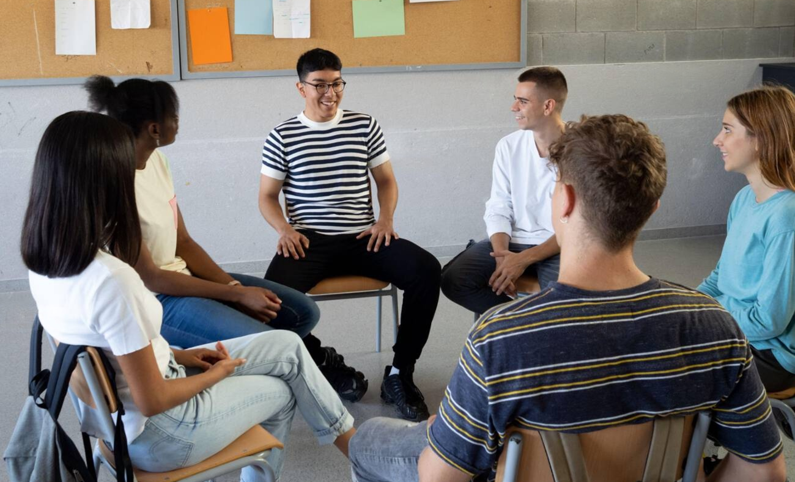
Mental health
1/5 Students are affected
- Awareness campaigns - Listening spaces ..
Exams, pressure to succeed, ..

Slide 8

Conclusion
Safety is omnipresent,
- mentally : mental health - physically : travel, security, intruders, …
How can schools guarantee safety in all aspects of school life without negatively affecting student’s well-being ?

