Slide 1
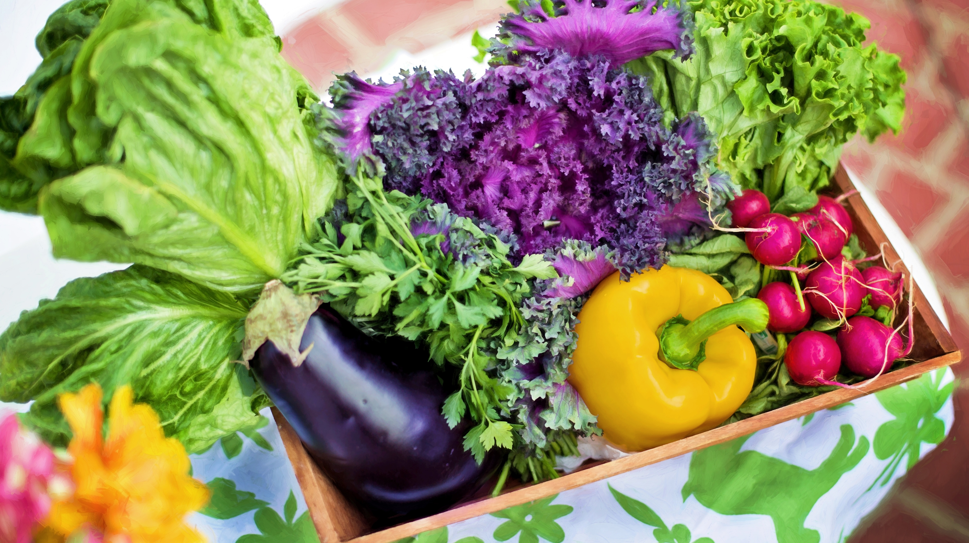


Project: Shopping with “Helpee”
COMPETITIVE “BTEC BEST CODER”
Group: Covid Warriors - TPDNQ
Execution time:
04/09/2021 - 12/09/2021.

