Slide 1
MIB Cars Analysis
Commercial prioritization and forecasting from sales opportunity data Strategic Analysis Group

Slide 2
Executive Summary
This analysis examines an auto-parts sales opportunity pipeline, identifying structural inefficiencies (i.e. CRM input errors, lack of prioritization, and inaccurate forecasting) that drive a structurally low 22.7% conversion rate.
We propose two models: a win/loss classifier (AUROC 0.88) for opportunity prioritization, and a regression model for deal sizing and aggregate forecasting (reliable at portfolio level, not per deal).
Focusing on the top 20% of opportunities lifts conversion from 22.7% to ~67%; the top 10% captures ~44% of total pipeline value.
We recommend embedding scores in the CRM at opportunity creation, piloting via A/B test, and setting clear thresholds to operationalize prioritization in sales workflows.
We also simulate strategic levers such as pipeline optimization and salesforce adjustments to show how model-driven prioritization can improve commercial efficiency.

Slide 3
Agenda
Business framing and process assumptions
Dataset and target overview
EDA findings that matter for prioritization and forecasting
Modelling approach and model outputs
Application simulations
Conclusions and next steps

Slide 4
Business framing

Slide 5
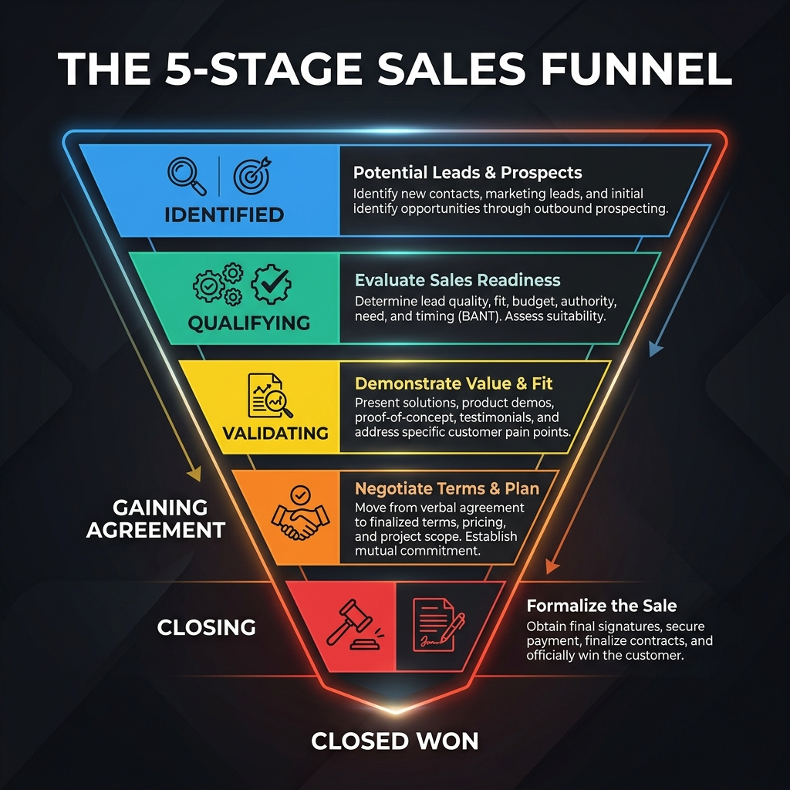
The sales process is non-linear, and the data captures its current state
The current sales process tracks auto-parts opportunities across both new leads and existing customers.
Opportunities transition between the stages Data entry → Identified / Qualifying → Qualified / Validating, and Validated / Gaining Agreement → Closed (Win/Loss).
Opportunities can move between stages in either direction, and they can also stall within a stage for extended periods.
Each opportunity ultimately resolves as either a win or a loss.
Sales teams maintain an estimated deal value, which is updated as the opportunity progresses.

Slide 6
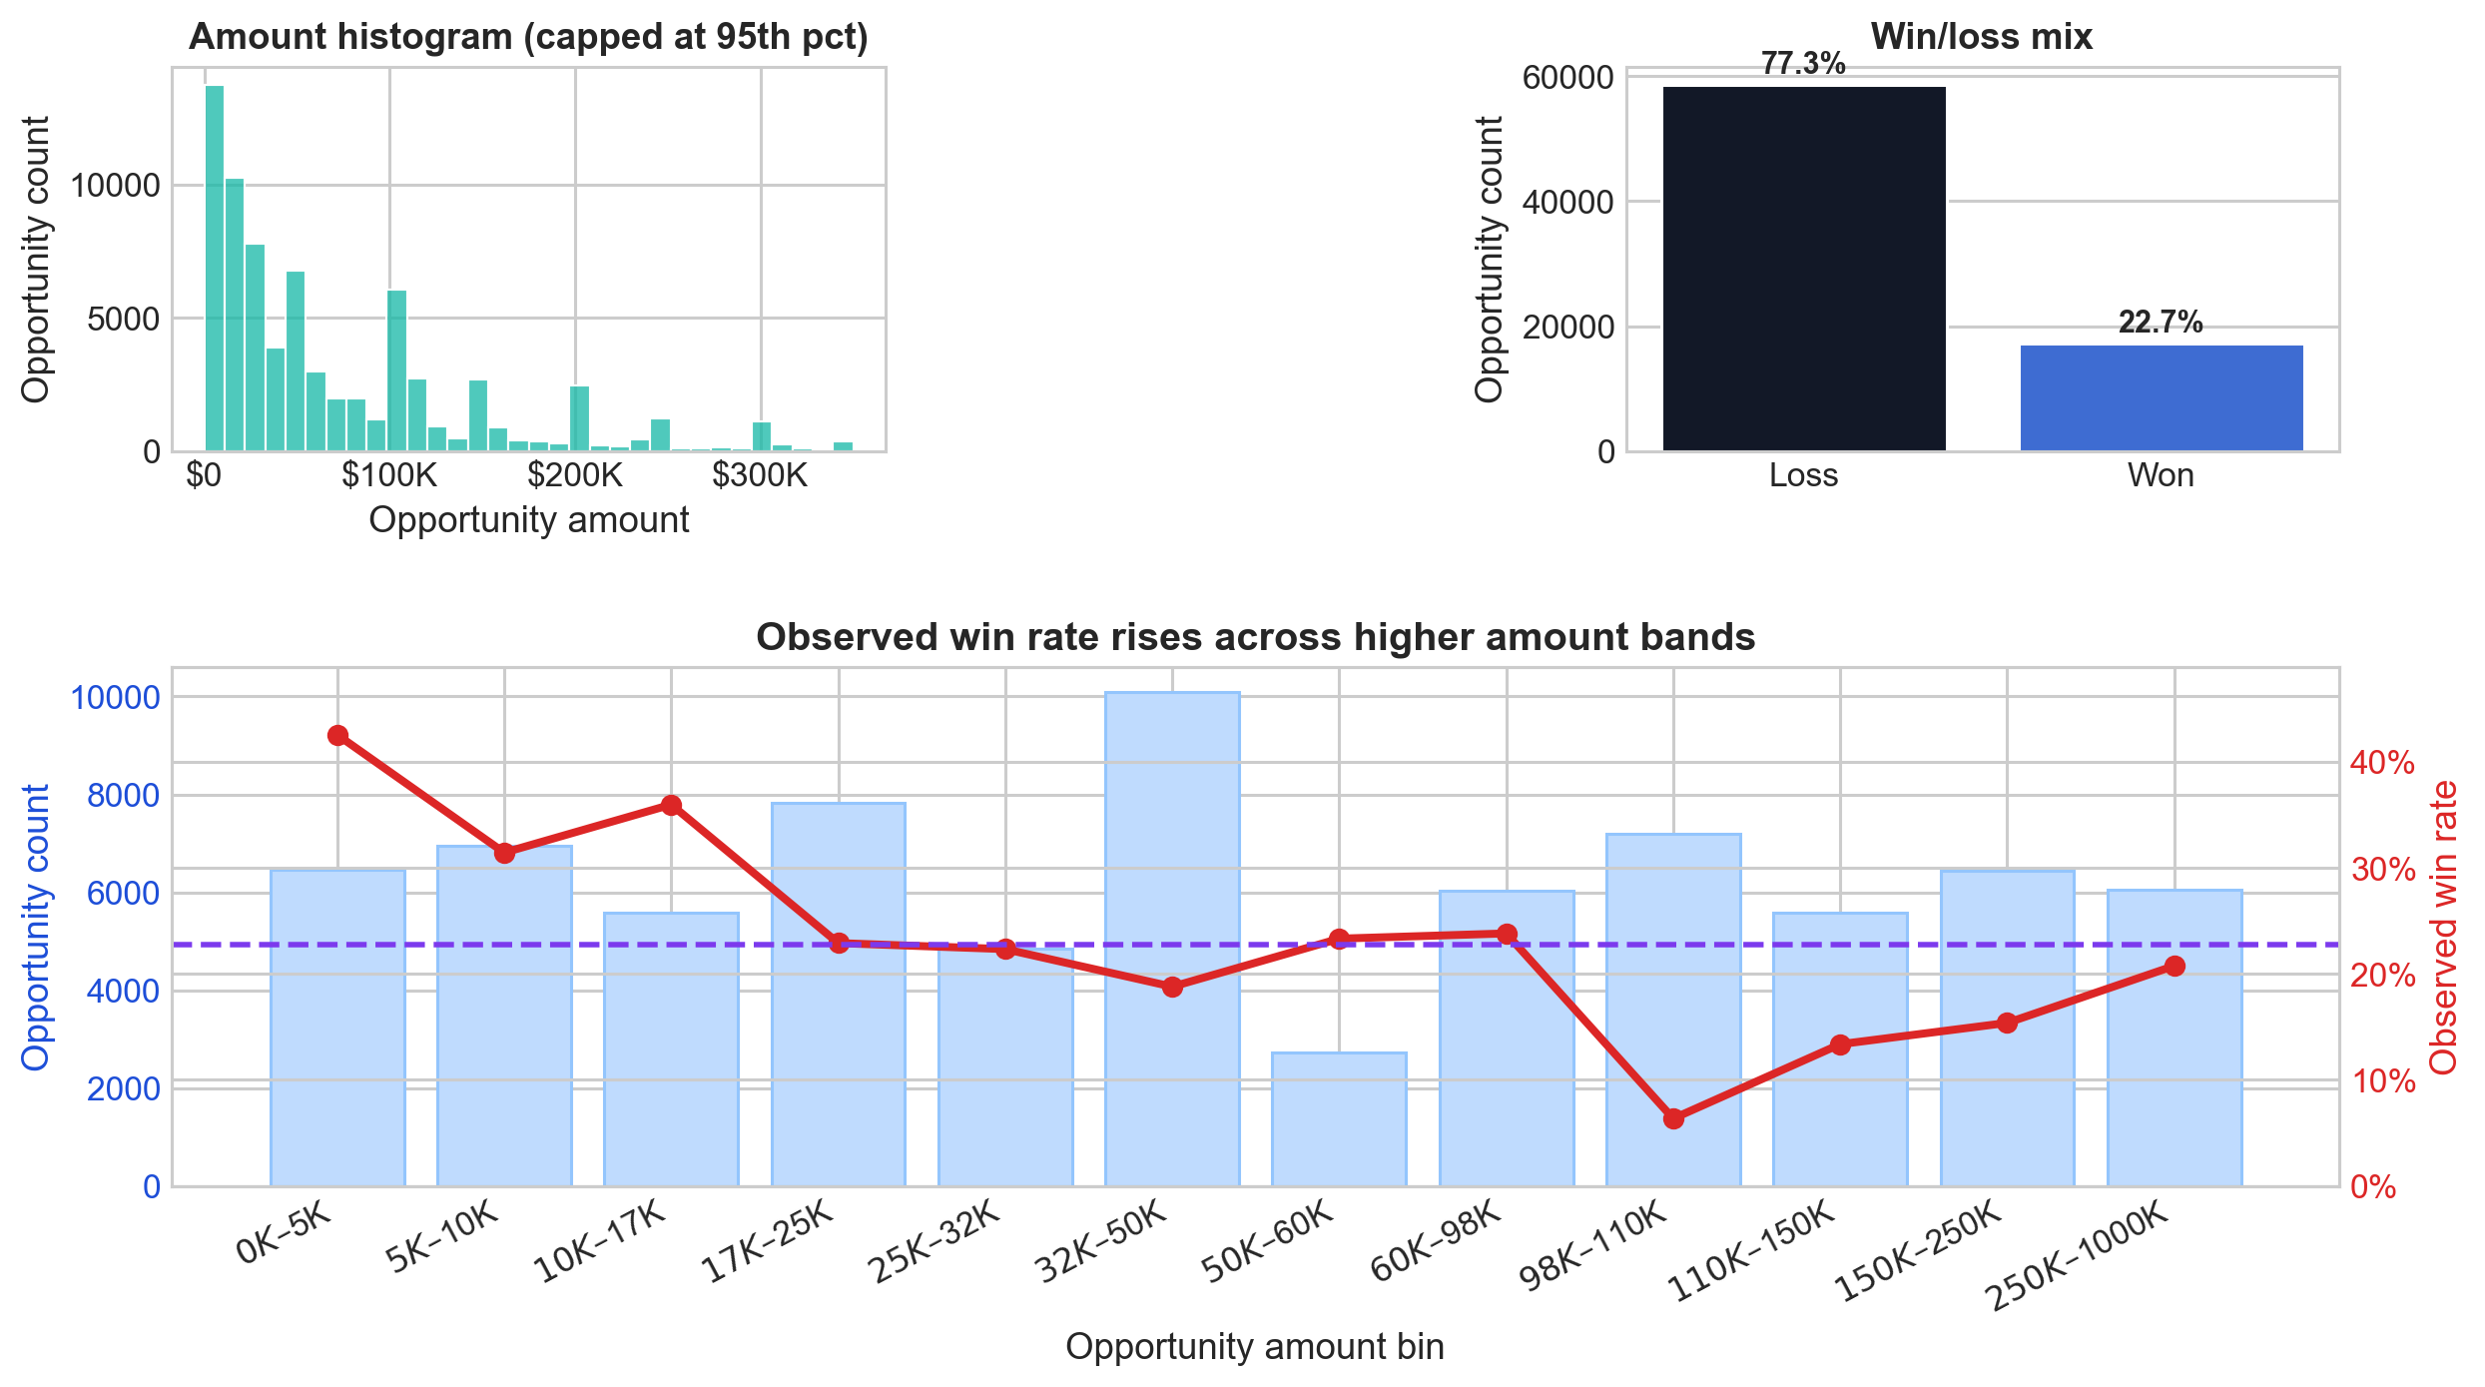
Most value sits in a small share of opportunities making prioritization an important growth lever
The pipeline is high-volume but low-yield: only 22.7% of opportunities convert, meaning most effort is currently misallocated.
Value is highly concentrated: the majority of opportunities are low-amount, but win rates increase materially with deal size, signaling where commercial focus should shift.
This creates a clear opportunity: → Move from volume-driven selling to value-driven prioritization, combining win propensity + deal size.
The implication is direct: → Not all opportunities should be pursued equally — targeting the right deals can lift conversion and revenue without increasing pipeline size.

Slide 7
Therefore, we propose two modelling use cases: prioritization and forecasting, plus additional data-driven commercial opportunities.
Selected for this project
Process prioritization: rank opportunities by win propensity and support decisions on where sales effort should focus first.
Opportunity sizing & forecasting: estimate deal value and aggregate expected sales for planning, prioritization, and budget visibility.
Additional opportunities identified in the data
Channel optimization: test what-if scenarios around route-to-market and engagement model choices.
Secondary market segmentation: create actionable commercial segments from predicted value and conversion potential.
Early warning systems: flag opportunities that are likely to deteriorate or stall.
Budget allocation: guide sales effort and product-focus decisions across segments, regions, and product lines.

Slide 8
Exploratory data analysis

Slide 9
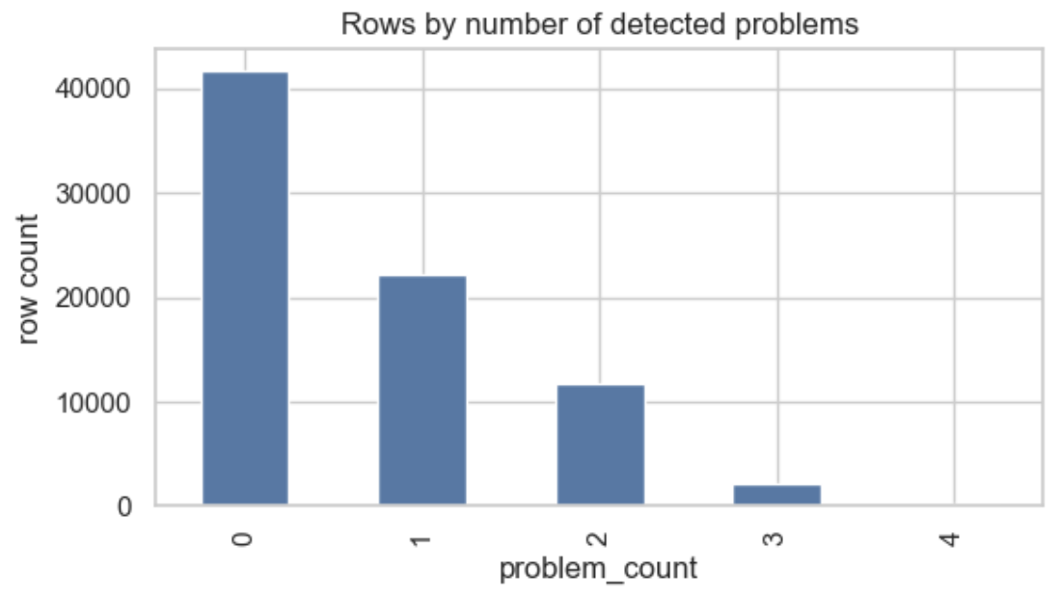
The dataset was analyzed and prepared with the two use cases in mind, which shaped the EDA focus and modelling choices
Scale: 78,025 sales opportunities and 19 variables like:
at-start information: client size, opportunity type, product category, region, etc.
sales process details: elapsed time, stage changes, stage ratios, etc.
targets like amount and win/loss status.
Validation checks flagged duplicates and process-consistency issues before modelling. Key preparation findings:
196 duplicated opportunity IDs (removed)
2047 zero amount opportunities (removed)
12,921 rows where stage ratios do not sum closely to 1 (kept)
Other problems were identified.
For the modelling experiments shown here, the sample used 75,819 eligible rows out of 78,025 total rows with valid targets.
Problems identified in the data

Slide 10
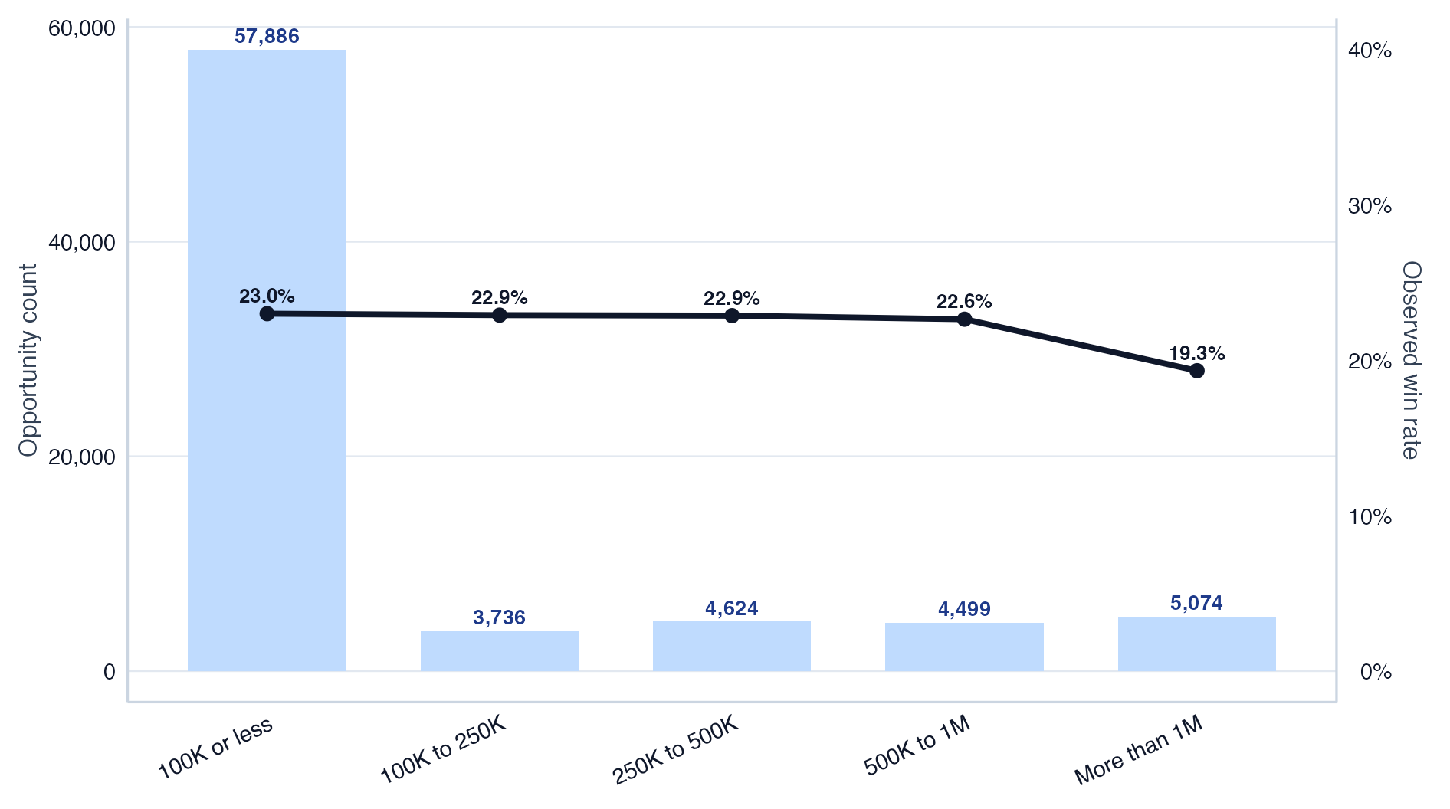
Align coverage and service models to client size, focusing scalable playbooks on small clients and dedicated effort on high-value accounts.
The portfolio is heavily concentrated in 100K or less clients, so this segment should drive base operating playbooks and coverage models.
Conversion is relatively similar across most size bands, which means client size is more useful for commercial treatment and value management than for win-rate targeting alone.
Larger accounts still matter because deal economics improve materially with size, so client-size segmentation should inform account prioritization, service model, and sales effort allocation.

Slide 11
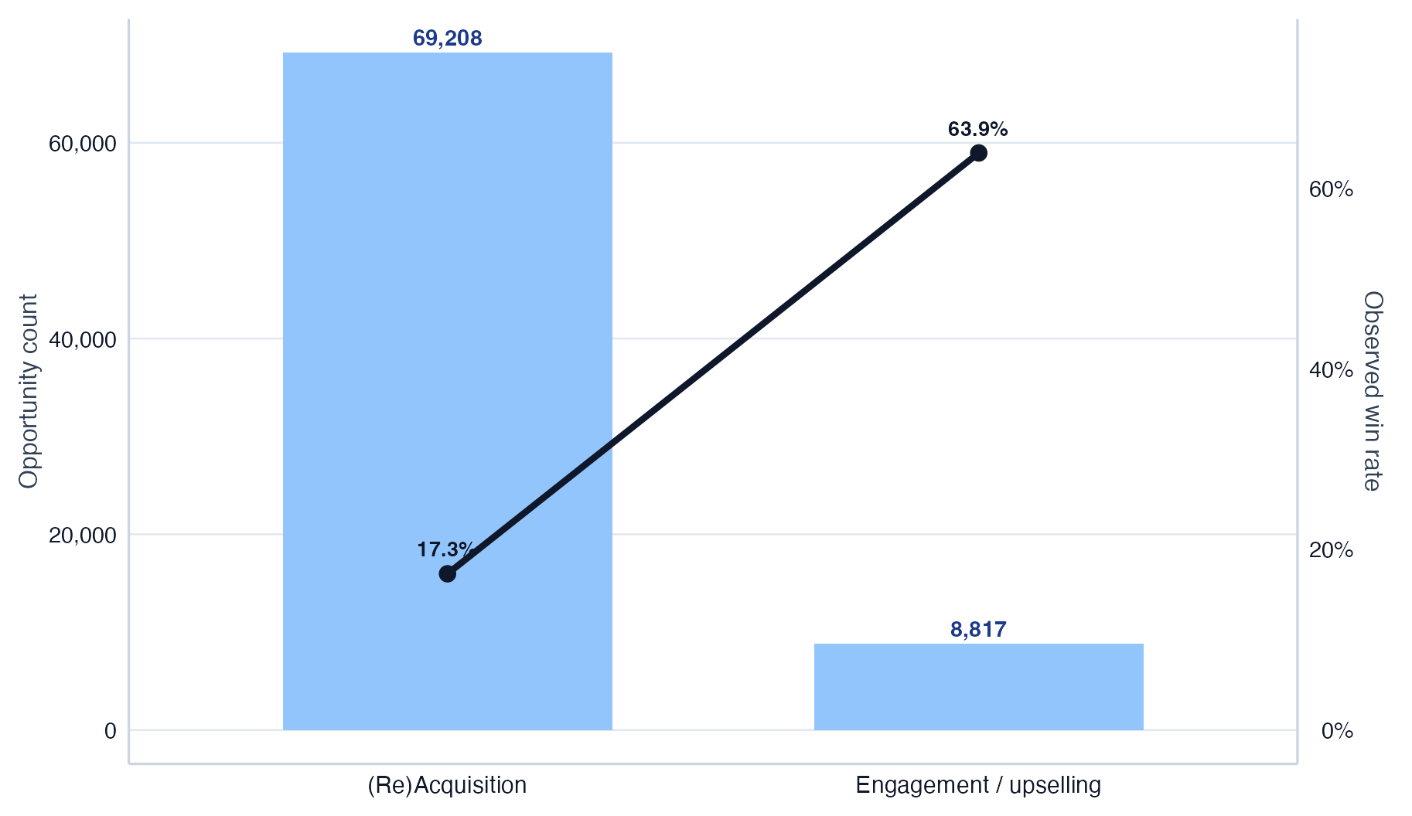
Treat acquisition and expansion as distinct growth engines, each with its own playbook and resource model.
(Re)Acquisition / no business in the past two years: 69,208 opportunities with a 17.3% observed win rate.
Engagement / upselling: 8,817 opportunities with a 63.9% observed win rate.
This is a practical first-layer funnel split for go-to-market operations because it separates low-history acquisition work from higher-propensity expansion opportunities.

Slide 12
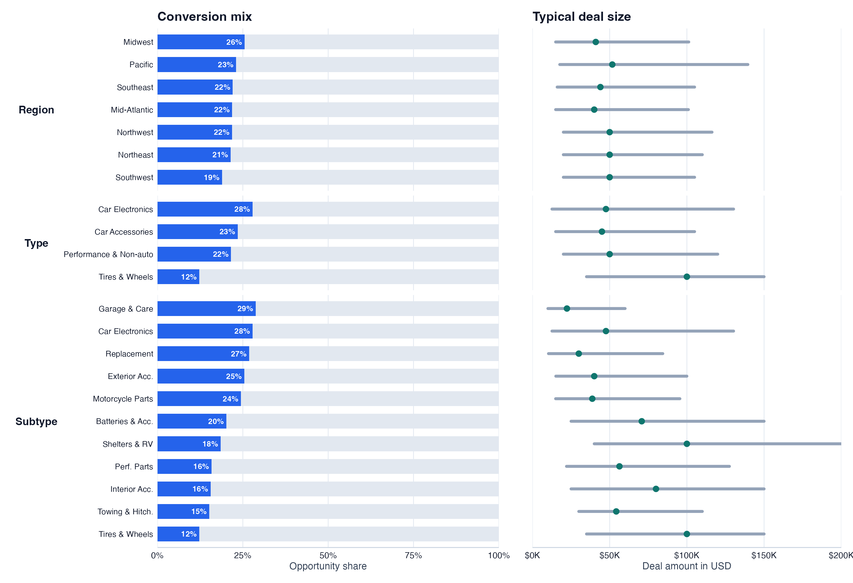
Performance differences are driven by product mix, not geography
Region is not a strong driver of conversion or deal size
Type and subtype drive meaningful variation in both outcomes
Prioritization should be product-driven, not geography-driven
Challenging experiments should be run because this may reflect historical sales focus rather than true underlying demand differences.

Slide 13
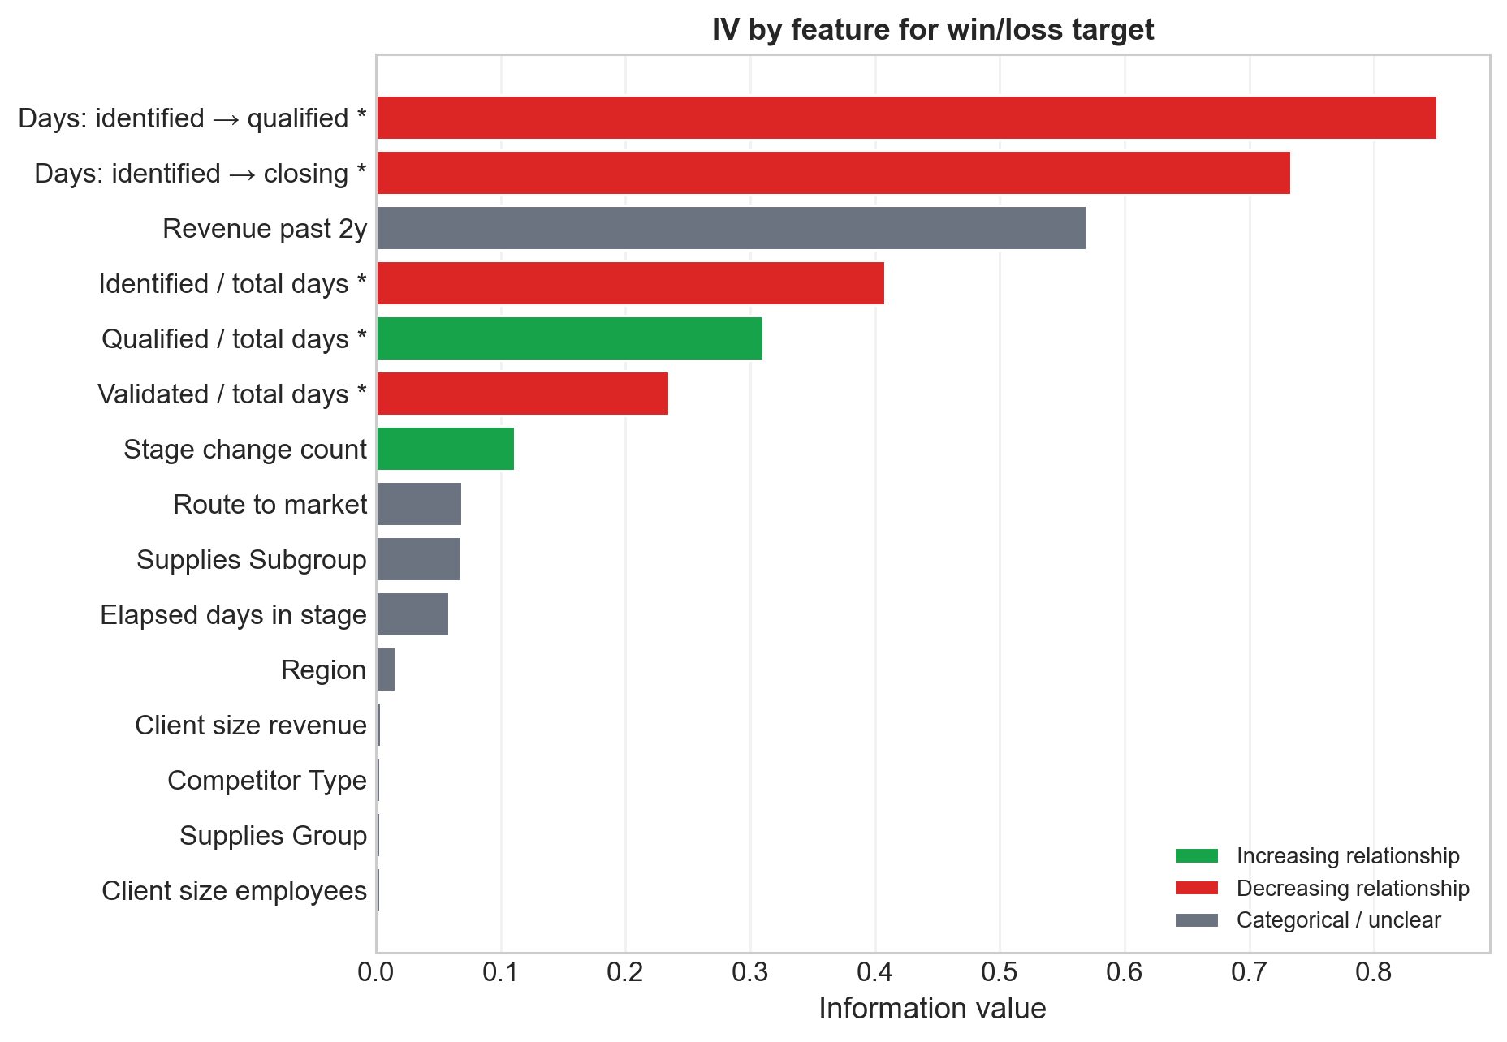
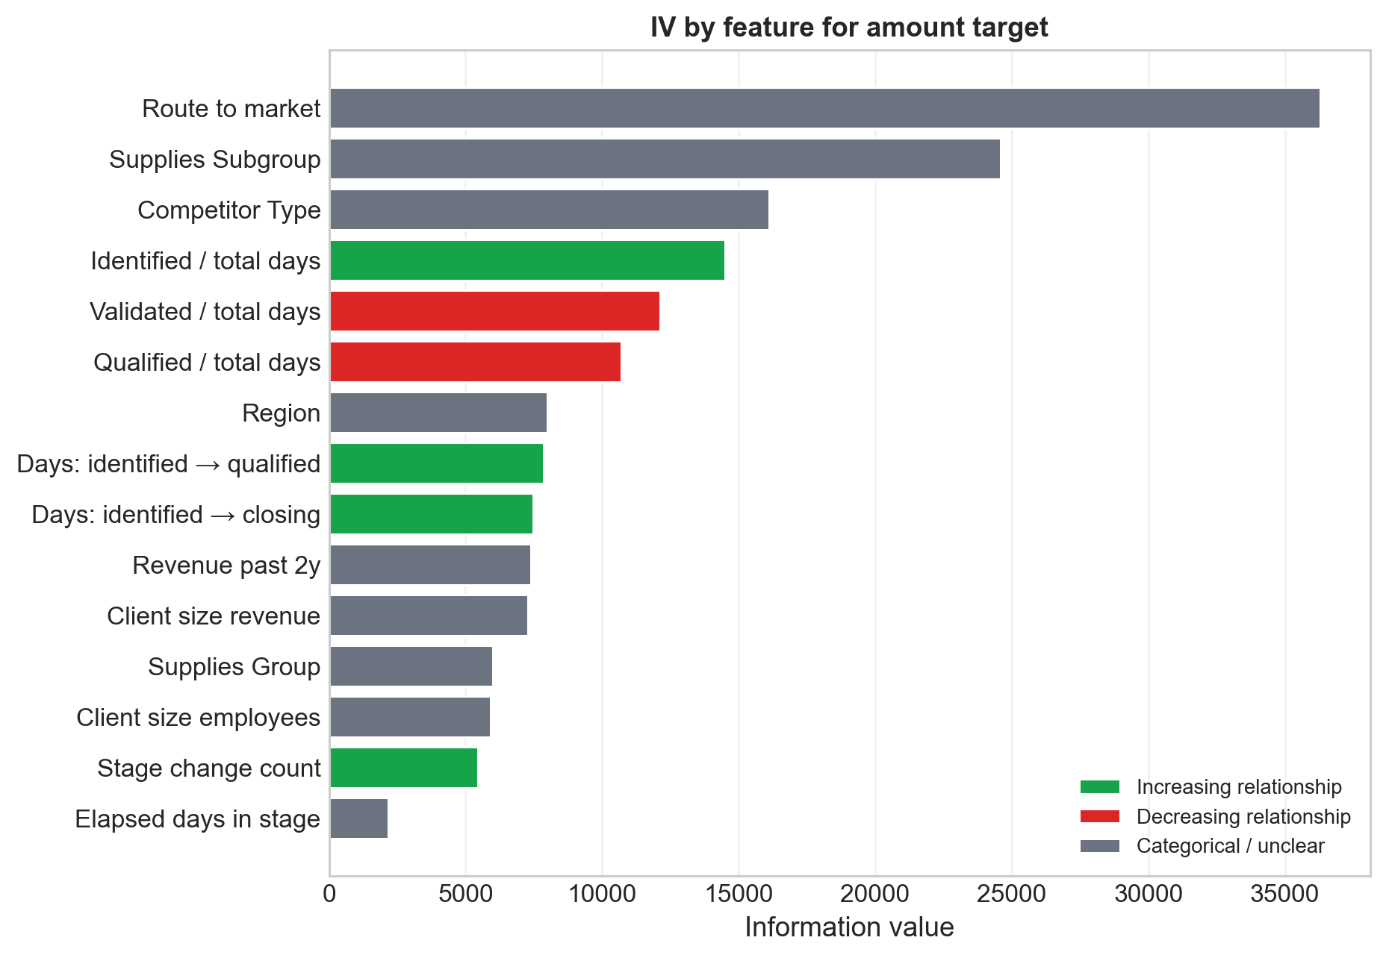
Eventually an automated IV ranking was ran to identify the strongest predictors for both win/loss and amount

Slide 14
The left chart shows IVs against the win/loss target, while the right chart shows IVs against the amount target, using the full set of variables that enter the models.
Process-time variables and stage-ratio features remain among the strongest signals for classification, while the amount target keeps a broader but still process-heavy IV profile.
IVs were calculated running a binning analysis over the training set based on the methodology explained in the next section.

Slide 15
Modelling

Slide 16
We have two modelling setups in mind for different stages of the sales process but just the most complete one is shown here
Static / pre-sales process model
Used for early decisions at opportunity creation especially around prioritization and sizing.
Uses only at-creation variables: product / route / region / client-size / past-revenue descriptors.
Best for early triage before any stage history exists.
Dynamic / during sales process model
Used for ongoing re-prioritization and re-sizing during the process.
Uses the static variables plus process-state variables: elapsed time, stage changes, cumulative timing, and stage ratios.
This is the setup used here.

Slide 17
Both setups would improve with better historical covariates, especially prior outcomes from similar process runs.

Slide 18
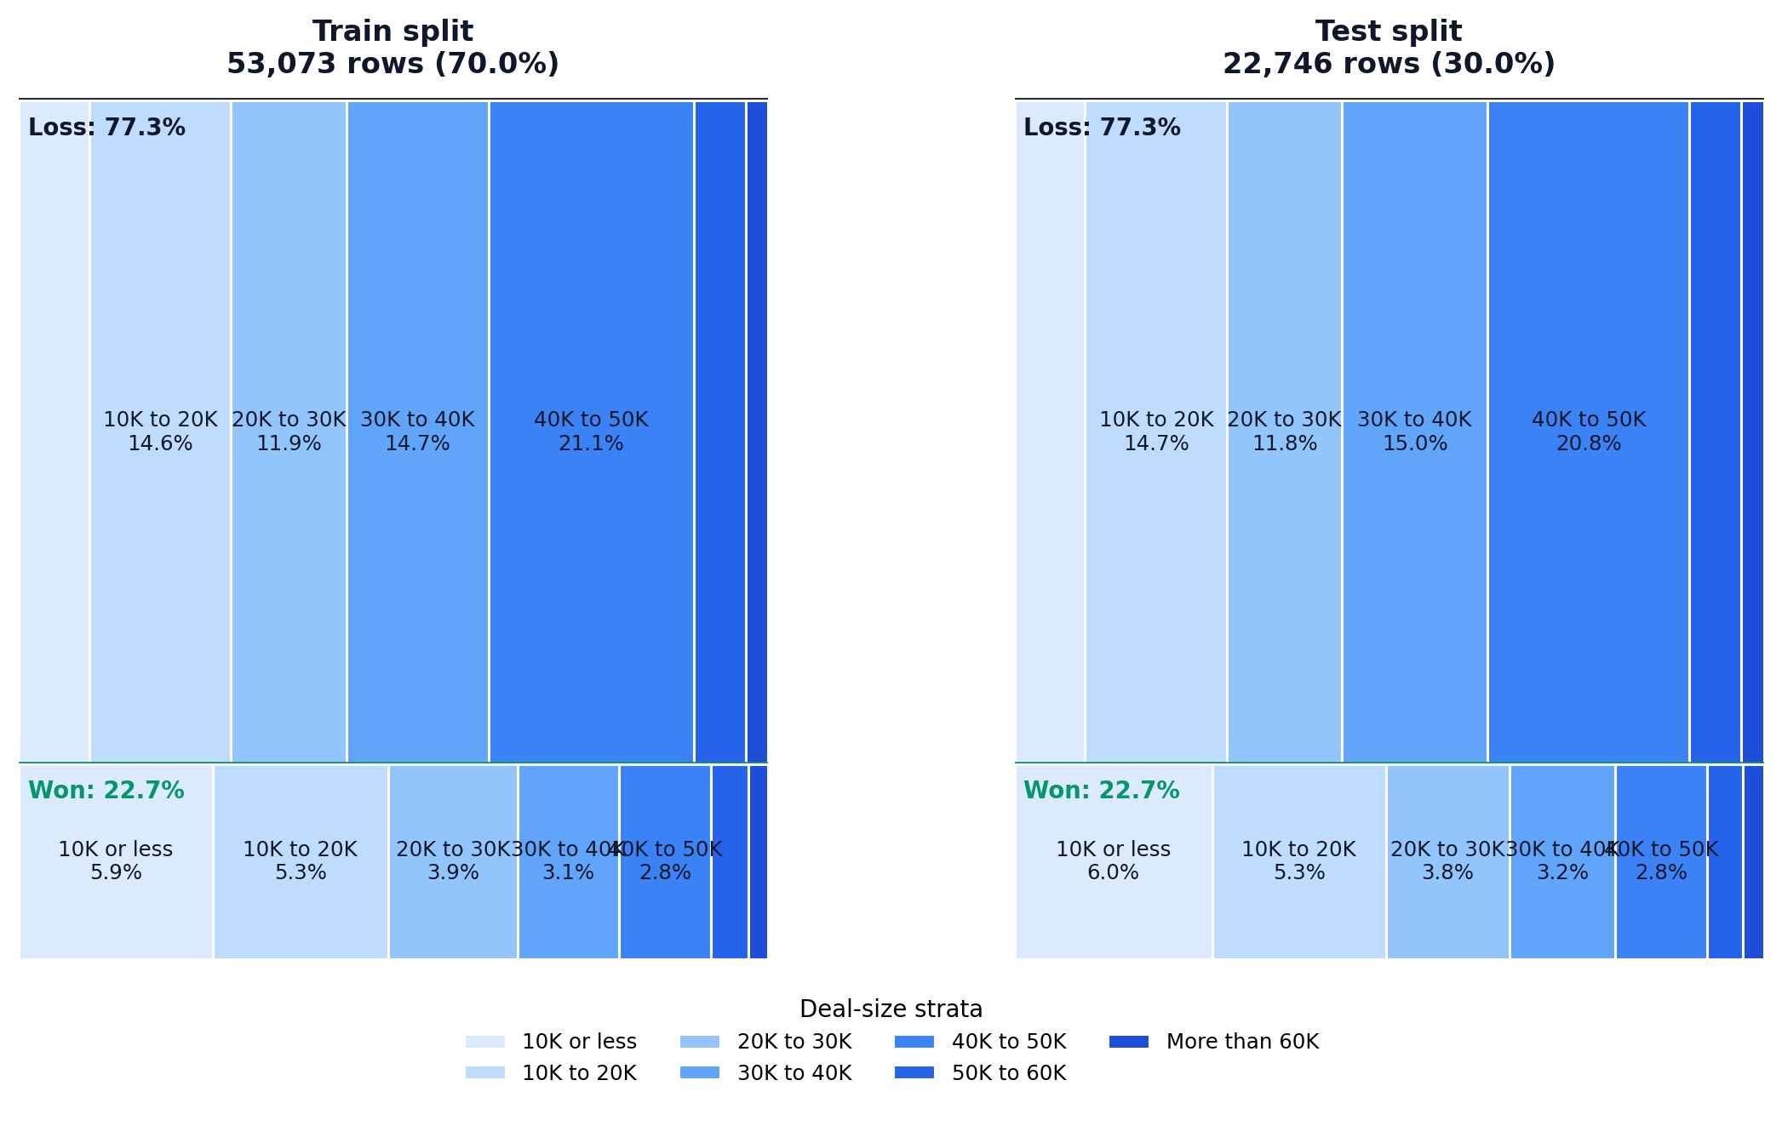
For both classification and regression, we used an stratified train/test split to ensure realistic evaluation
Train / test split: 70% / 30%
Train: 53,073 rows
Test: 22,746 rows
The split was stratified jointly on:
win/loss target
amount buckets
This keeps both outcome balance and deal-size mix stable across train and test.
In the final models, regression uses standardized numeric inputs, while the selected logistic classifier uses supervised binning plus one-hot encoding.

Slide 19
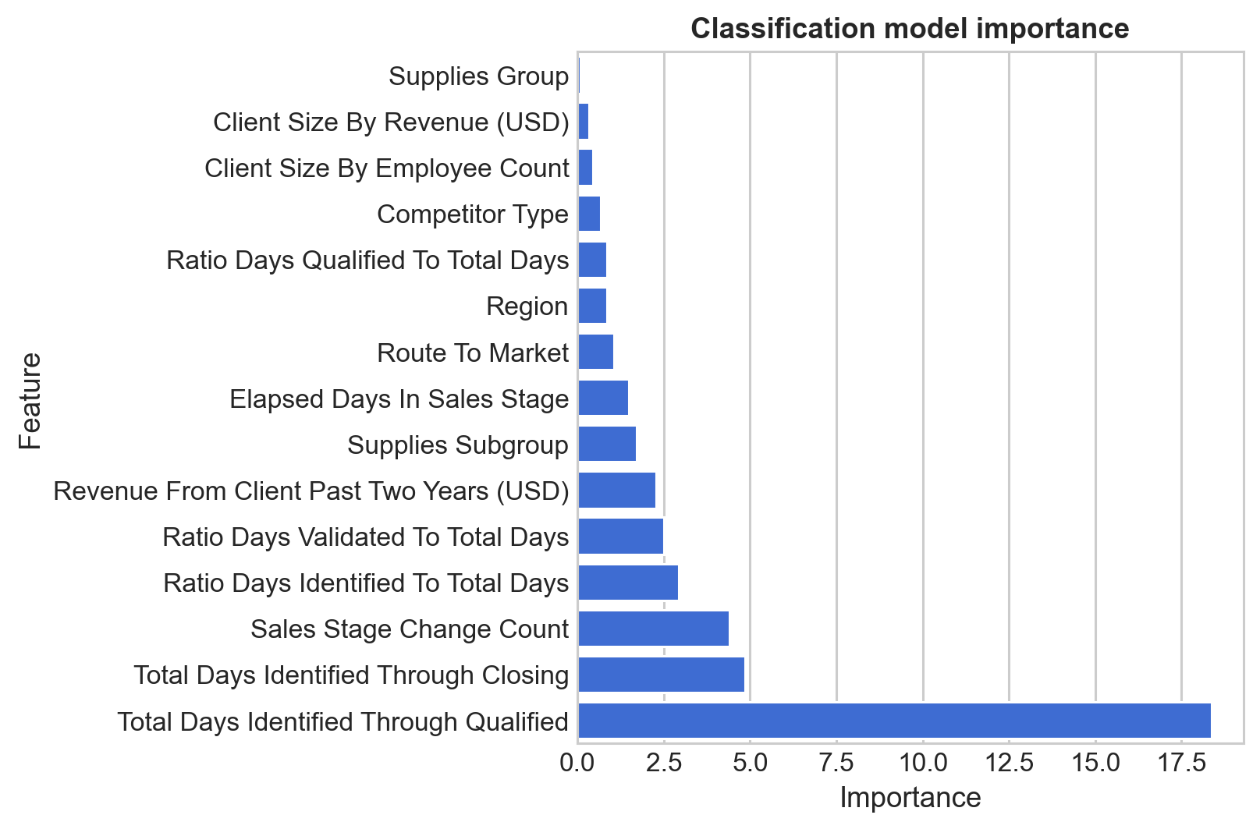
Prioritization classification model enables immediate and precise reallocation of sales effort
Target: Opportunity Result.
Business use: process prioritization and ranking the pipeline by win propensity.
Therefore we focused on ranking metrics such as ROC AUC and PR AUC.
We used all the variables except for the amount target and deal size.
Selected final logistic model: Calibrated Logistic Regression over supervisedly binned and one-hot encoded features with balanced class weights (logit_binned_ohe_balanced_calibrated).
This model has strong performance (AUROC 0.88, Accuracy 0.825 @ 31.4% threshold) versus the baselines (AUROC 0.5, Accuracy 0.773 @ base win rate for all false classifier).

Slide 20
We did not use the higher-scoring tree-based variants because we thought the marginal performance lift did not justify the loss in interpretability for this use case.

Slide 21
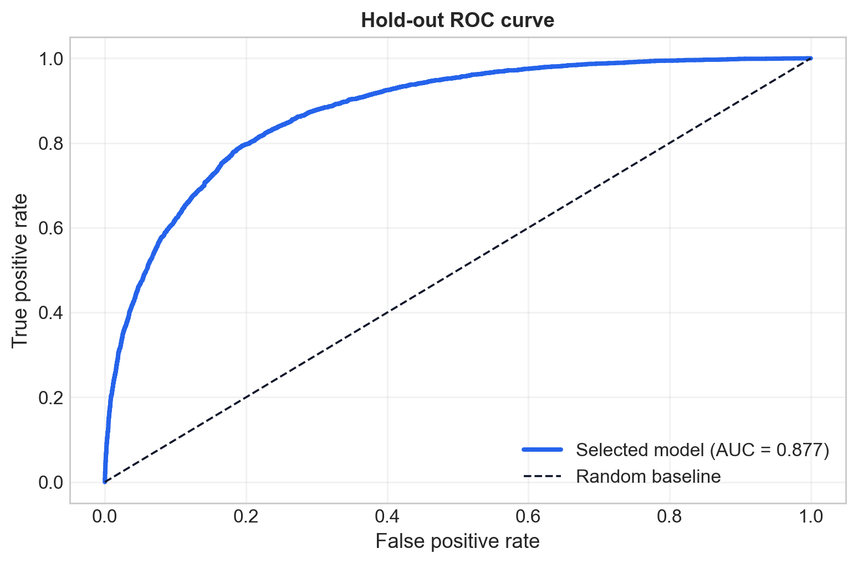
Prioritization classification model enables immediate and precise reallocation of sales effort (cont., with performance metrics)
We ran a battery of metrics on the selected model considering:
Best threshold for the selected model = 31.4%, chosen on train out-of-fold predictions.
Baselines are computed at the observed base win rate.
The following table shows the selected model’s performance on both CV and held-out test, compared to random and simple baselines:

Slide 22
The annex contains more details about model selection, calibration, threshold selection, and the full classification report at the selected threshold.

Slide 23
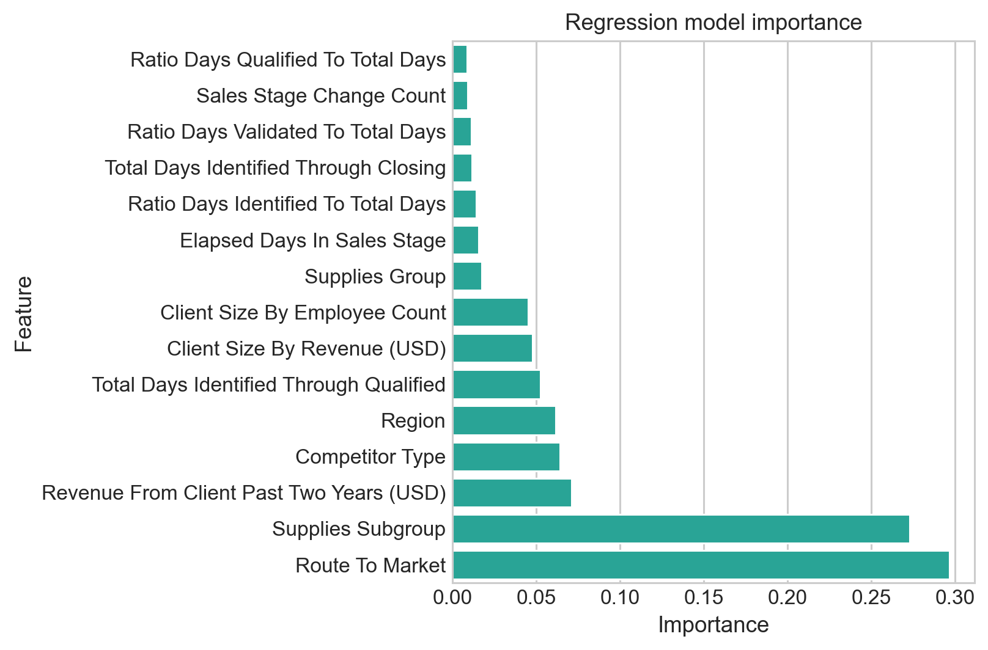
Use the amount model for per-opportunity sizing and ranking, not deal-level precision
Target: Opportunity Amount USD.
Business use: sizing and directional forecasting.
Therefore we focused on error metrics such as MAE and especially MAPE since it is scale-invariant and better captures the relative error across the wide deal-size distribution.
We used all the variables except for the win/loss target and the deal-size descriptors.
Selected final regression model: Box-Cox transformed XGBoost regressor (xgboost_boxcox), selected by lowest CV Median APE.
The model beats simple baselines on MAPE and MAE, but with R² ≈ 0.06, MAE ≈ 65k USD, and Median APE ≈ 62%, deal-level precision remains weak, so the best use case is for directional sizing and ranking rather than exact deal-level forecasts.

Slide 24
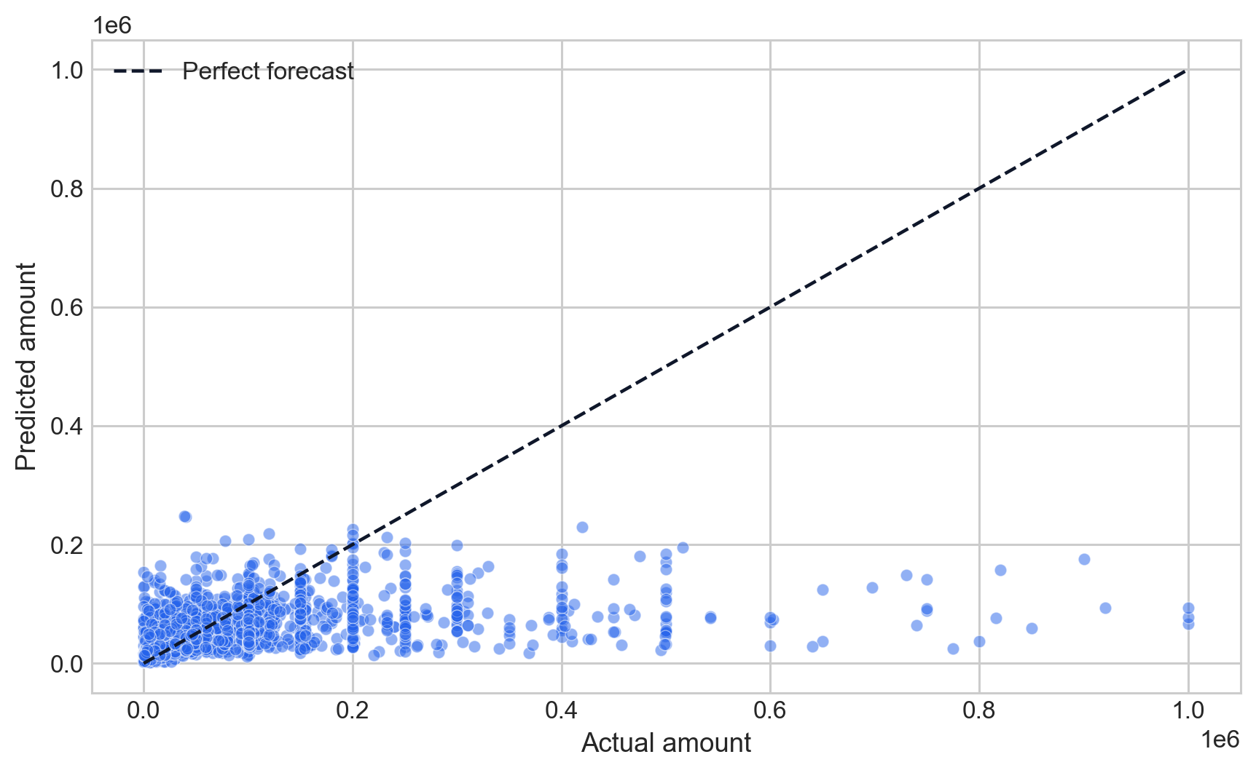
Use the amount model for per-opportunity sizing and ranking, not deal-level precision (cont., with performance metrics)
We ran a battery of metrics on the selected model and the baselines. The following table shows the selected model’s performance on both CV and held-out test, compared to random and simple baselines:

Slide 25
The annex contains more details about model selection, and per bin performance metrics.

Slide 26
Applications

Slide 27
The following simulations are subject to constraints and are intended as a demonstration of potential business uses and impacts
No true pre-process static model is shown here: due to time constraints, current models used in the simulation use evolving lifecycle features; an early-stage model is still needed.
Potentially relevant covariates are missing: the dataset lacks important drivers such as richer account history, rep behavior, pricing context, and external market conditions.
Snapshot data limits process interpretation: the dataset reflects a single recorded state, without full event history or detailed timing of interactions.
Simulations are based on held-out observational predictions, results are based on held-out predictions, so they are weaker than an actual backtest and/or experiment and they cannot capture the full causal impact of acting on model outputs.
Missing business context: factors like sales capacity, operational constraints, and CRM integration are not missing and we’re not able to consult them to business stakeholders, affecting real-world applicability.

Slide 28
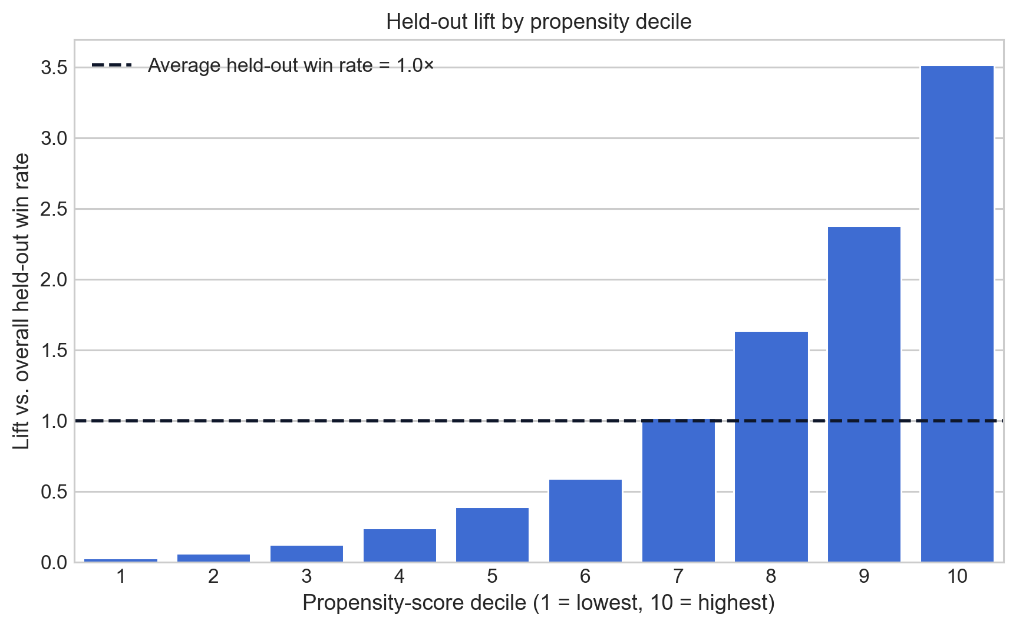
Tripling conversion is achievable by focusing on the top 20% of opportunities, without increasing pipeline size
Sales effort is currently spread across low-probability deals → concentrating on top deciles can triple conversion efficiency.
Top decile: 3.52× lift.
Ninth decile: 2.38× lift.
Eight decile: 1.66× lift.
We propose to automatically embed this in the CRM at opportunity creation to prioritize high-propensity deals (e.g. top 1-2 deciles) and set clear thresholds for pipeline reviews and resource allocation.
This simulation is based on held-out test-set predictions.

Slide 29
Use the amount model for directional sizing and ranking, not committed aggregate forecasting
Model is more useful for relative sizing than for exact portfolio totals, which is the tradeoff from selecting by Median APE.
Aggregate actual amount: 2.138B USD on the held-out test set.
Aggregate predicted amount: 1.309B USD on the held-out test set.
Mean absolute error per opportunity: 65.0k USD.
We propose using this prediction as a sizing input for prioritization and scenario analysis, but not as a committed portfolio forecast without a separate bias-correction step.

Slide 30
This simulation is based on held-out test-set predictions. Previous simulations with linear regression showed almost non-existant aggregate error but much worse directional ranking, which is why we selected the XGBoost Box-Cox model for this use case.

Slide 31
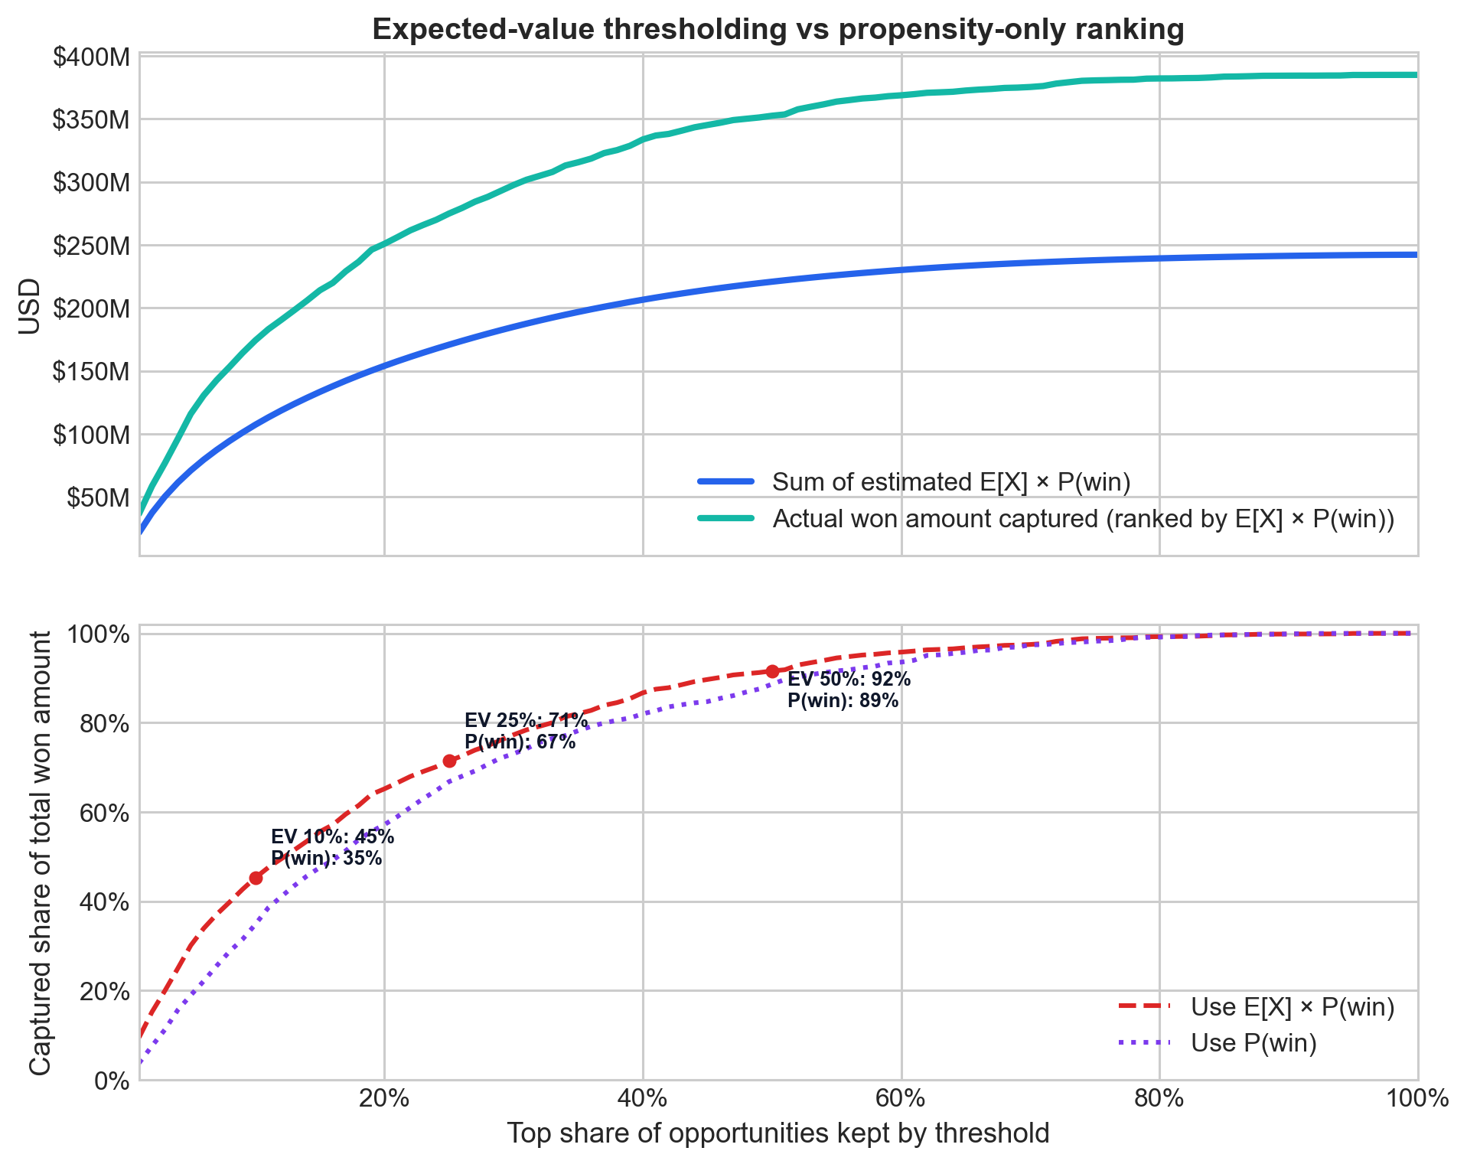
Concentration (~45% value capture at top 10%) makes expected-value prioritization a key revenue lever
Rank the pipeline using expected value (E[Amount] × P(Win)), not just propensity especially under limited sales capacity.
At top 10%, expected-value ranking captures 45.3% of won revenue vs 34.8% with propensity-only.
Because the selected amount model under-forecasts the total portfolio, this expected-value ranking should be read as a directional prioritization tool rather than a revenue commitment.
We propose to set clear thresholds (e.g., top 10% = high priority) and embed in the CRM to guide sales focus with a more economically relevant ranking than win propensity alone.

Slide 32
This simulation is based on held-out test-set predictions. This analysis assumes that the opportunity amount is actually related to the final deal amount, which is not necessarily the case.

Slide 33
Put model outputs to work in the CRM
Operational flow
Opportunity created → score + expected value generated
As soon as a new opportunity enters the CRM, the workflow generates:
win-propensity score
predicted amount
expected value = E[Amount] × P(Win)
CRM displays
Priority tier: Top 10%, Top 25%, Top 50%, etc.
Suggested action: focus / monitor / deprioritize
This gives frontline teams a simple operating signal without exposing model internals.
Weekly pipeline reviews
Review only opportunities above agreed propensity or expected-value thresholds.
Use those cutoffs to focus rep attention, escalation, and follow-up.
Management view
Directional forecast = sum of predicted values across the active pipeline.
Management can compare it by region, route to market, owner, or priority tier.

Slide 34
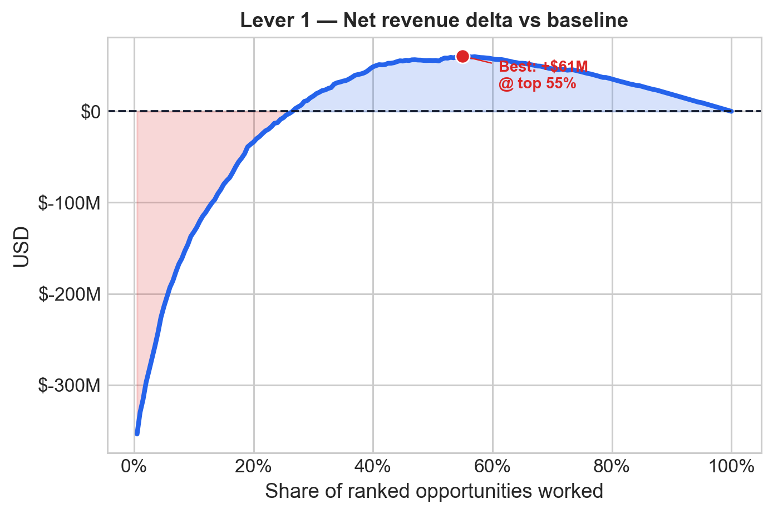
From tactical use of model outputs to commercial strategy
Focus the team: Assuming higher effort on top-ranked opportunities improves conversion, we might achieve better results per deal. Best simulated point is top ~55% of the ranked pipeline, reaching $446M in revenue, or +$61M vs. baseline.
Optimize salesforce size: With better prioritization, we might achieve higher efficiency. Best simulated point is 168 reps, retaining $380M of revenue (98.8%) and improving net margin by +$6M vs. full staffing.

Slide 35
Both simulations use held-out test-set predictions. Lever 1 assumes a focus-gain multiplier that decays from λ_max = 1.5× at the smallest slice to 1.0× at the full pipeline; Lever 2 uses $120K OTE as the label, $180K fully-loaded cost per rep in the economics and assumes a rep can do 100 opportunities from the holdout set.

Slide 36
Conclusions

Slide 37
Key takeaways for commercial decision-making
Prioritization is the highest-impact use case
Win/loss model (AUROC 0.88) improves sales focus.
Top 20% of opportunities → conversion ~22.7% → ~67%.
Use the amount model as a directional sizing layer, not as a committed forecast
Amount model is not reliable per deal, and it under-forecasts the held-out portfolio by roughly 39%, so it needs bias correction before forecast use.
Expected value is the strongest prioritization lever
Combines win propensity × deal size.
Value is concentrated: ~44% in top 10%, ~68% in top 25%.
Recommendation
Pilot prioritization first (embed in CRM).
Use the amount model for sizing and ranking first.
Then combine into expected-value prioritization to guide focus and resource allocation.
Post-pilot, consider strategic levers such as pipeline optimization and salesforce adjustments to improve commercial efficiency.

Slide 38
Next steps: how to operationalize model-driven sales
Pilot deployment (4–6 weeks):
Embed prioritization scores into CRM workflows
Run A/B test vs. current sales process and measure lift in conversion and revenue
Define operating model (after pilot early results):
Incorporate funnel/client segmentation into the process
Potentially include product-level segmentation if it makes sense.
Set clear thresholds and actions (e.g., top deciles = sales focus)
Align sales forces with incentives and pipeline reviews to make sure model outputs are used effectively
Monitor performance (starting after deployment):
Track conversion lift, cycle time, and revenue per opportunity
Continuously recalibrate thresholds and retrain models
Scale and integrate (after pilot success):
Extend to full pipeline and embed in forecasting cadence
Incorporate into commercial planning and resource allocation
Explore applying strategic levers such as pipeline optimization and salesforce adjustments based on model insights

Slide 39
Thank you

Slide 40
Questions, comments, and feedback are welcome!

Slide 41
Annex

Slide 42
Annex: classification CV leaderboard
Selected model in main deck: logit_binned_ohe_balanced_calibrated.

Slide 43
Annex: how to read IV charts
Information Value (IV) is a score used to rank how much predictive signal a variable carries against a target.
In this deck:
left IV chart = signal against win / loss
right IV chart = signal against amount
Colors add direction, because IV itself is only a strength score:
green = increasing relationship
red = decreasing relationship
gray = categorical or unclear direction
Asterisk (*) = strictly monotonic relationship across bins.
Very high IV values for process variables can reflect genuinely strong signal, but they should always be checked for timing leakage.
IV is derived from Weight of Evidence (WoE): it compares how differently wins vs losses are distributed across the bins of a variable.

Slide 44
Annex: regression CV leaderboard
Selected model in main deck: xgboost_boxcox by CV Median APE, tie-broken by MAE.

Slide 45
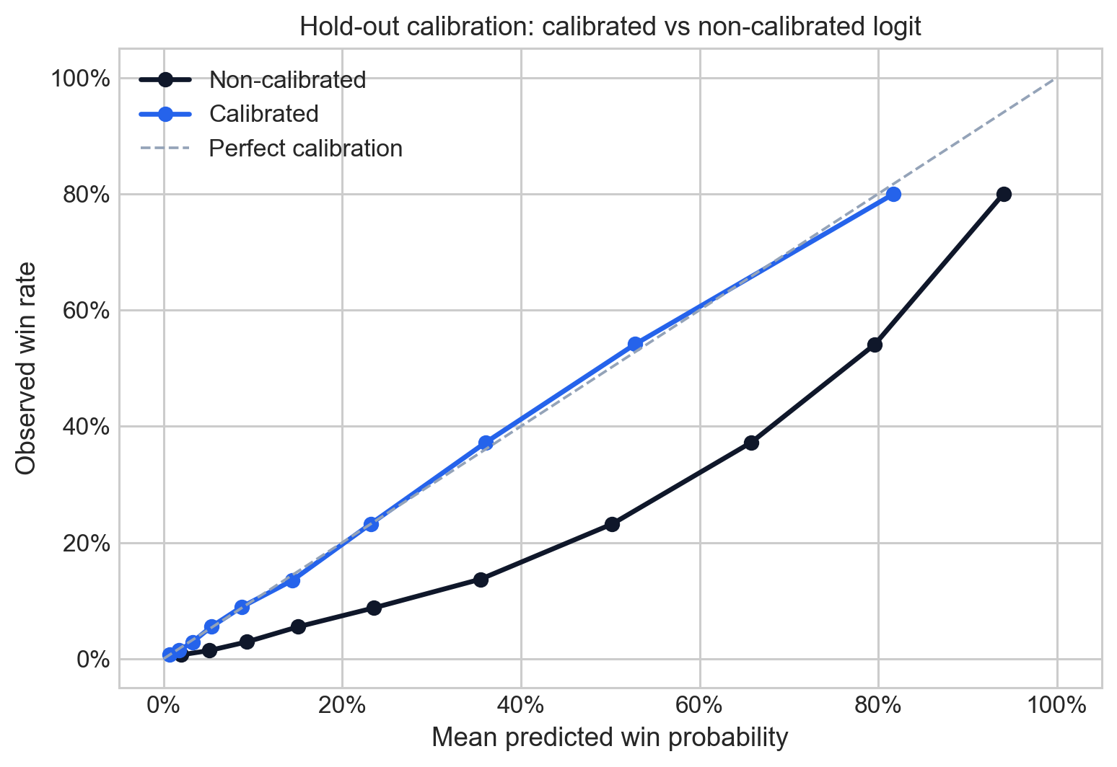
Annex: calibration comparison for the selected classifier
The calibrated and non-calibrated variants have almost identical ROC / PR ranking performance, but calibration changes how raw probabilities line up with observed win rates.
The calibrated curve tracks the 45-degree reference more closely through the middle probability range, which is the part used most often for thresholding and expected-value calculations.
This is why the calibrated model is now the deployment candidate: the ranking stays strong, while the probabilities are more usable downstream.

Slide 46
Annex: hold-out classification report at the selected model’s optimal threshold
Threshold chosen on training out-of-fold predictions by maximizing F1 for the selected model: 31.4% predicted win probability.
Diagnostic note: the threshold is selected on train-side OOF predictions, then evaluated once on the untouched hold-out set shown here.

Slide 47
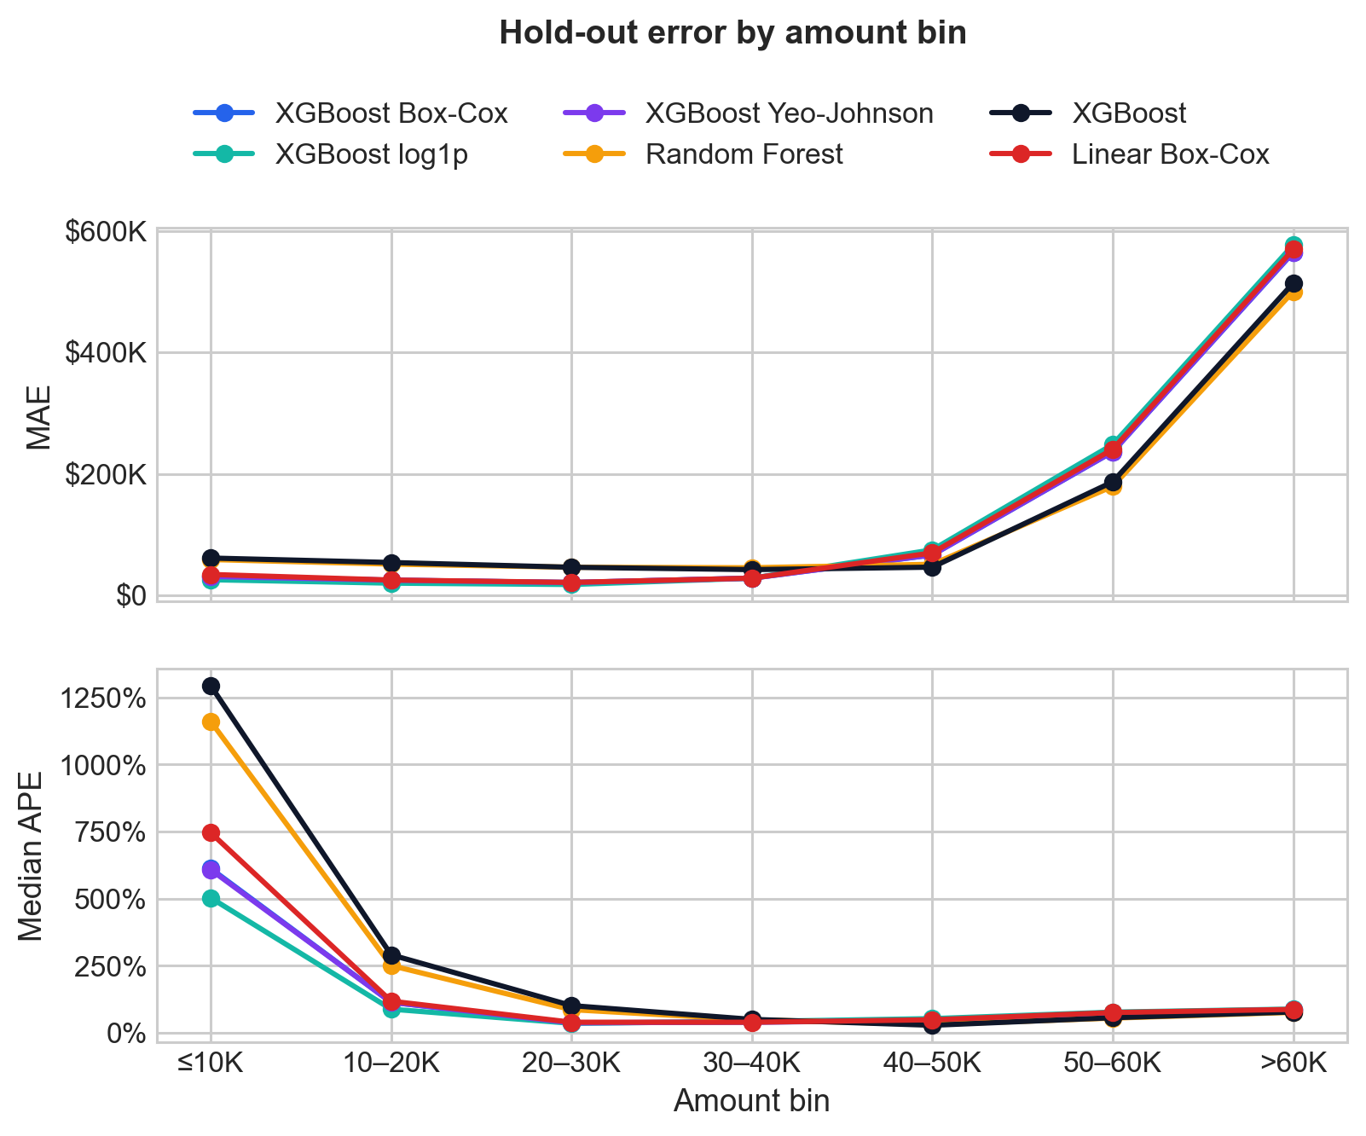
Annex: regression error by amount bin on the hold-out set
The comparison shows where model error changes most across deal-size bands, instead of averaging everything into one MAE figure.
The transformed XGBoost variants dominate the relative-error ranking, with XGBoost Box-Cox narrowly leading overall.
The main gain comes from reducing typical proportional error, while the largest opportunities still drive a gap between per-deal accuracy and total-portfolio forecasting.

Slide 48
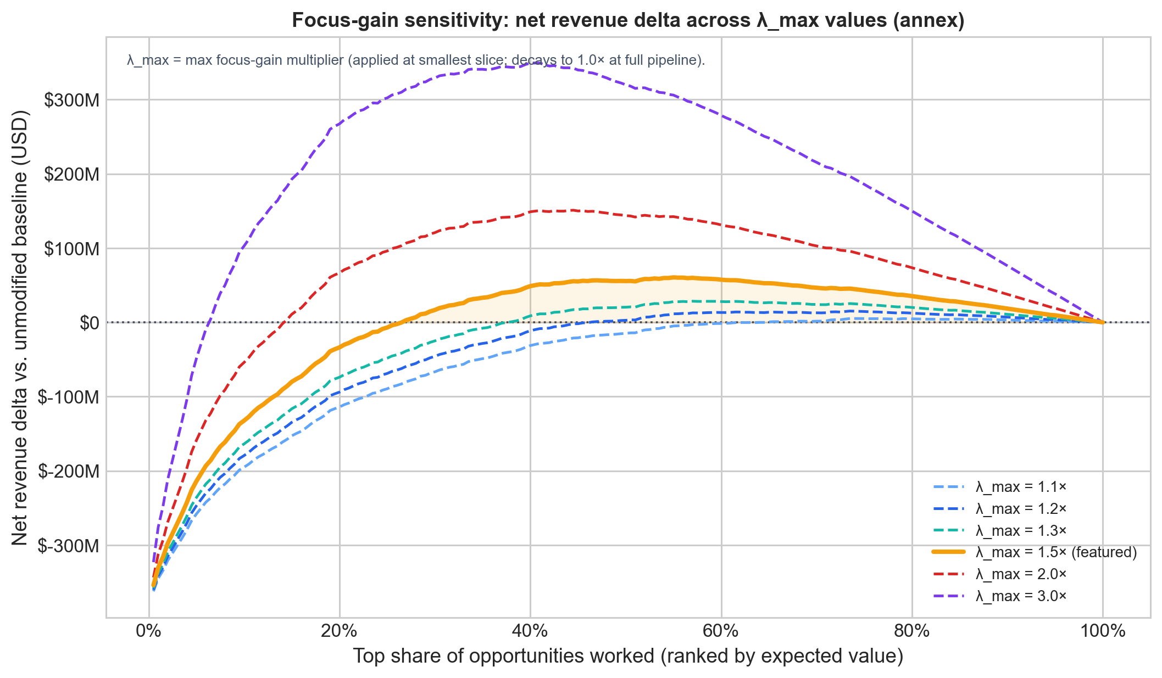
Annex: focus-gain sensitivity across λ values
Each curve shows the net revenue delta in USD vs. the full-pipeline baseline for a given λ_max — dropped deals are simply unworked (zero revenue from them), so the only gain is the focus uplift on worked deals.
λ decays linearly to 1.0× at the full pipeline — so the gain is highest when the team is most concentrated.
Break-even shifts left as λ_max increases: at λ_max = 1.5 the top ~27% of the pipeline already matches full-pipeline revenue; at λ_max = 3.0 even a very small slice generates a large surplus.
The main deck uses λ_max = 1.50 as the base scenario.

Slide 49
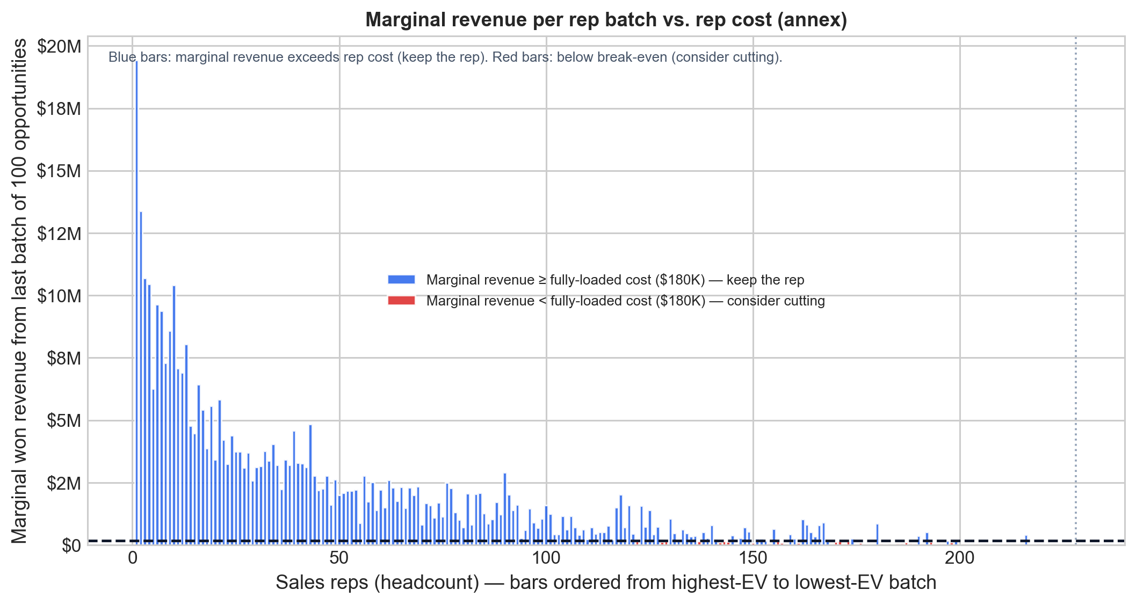
Annex: salesforce reduction — marginal revenue per rep batch
Each bar shows the marginal revenue contributed by a batch of ~12 reps (one 100-opp increment), sorted from highest- to lowest-value batch.
The dashed line marks the cost of one rep batch (~$1.44M at $120K OTE).
Blue bars are ROI-positive: the batch earns more than it costs. Red bars are ROI-negative: cutting those reps improves net margin.
The crossover point is around rep #216 — reps beyond that generate less revenue than their fully-loaded cost ($180K), making reduction unambiguously value-accretive.

Slide 50
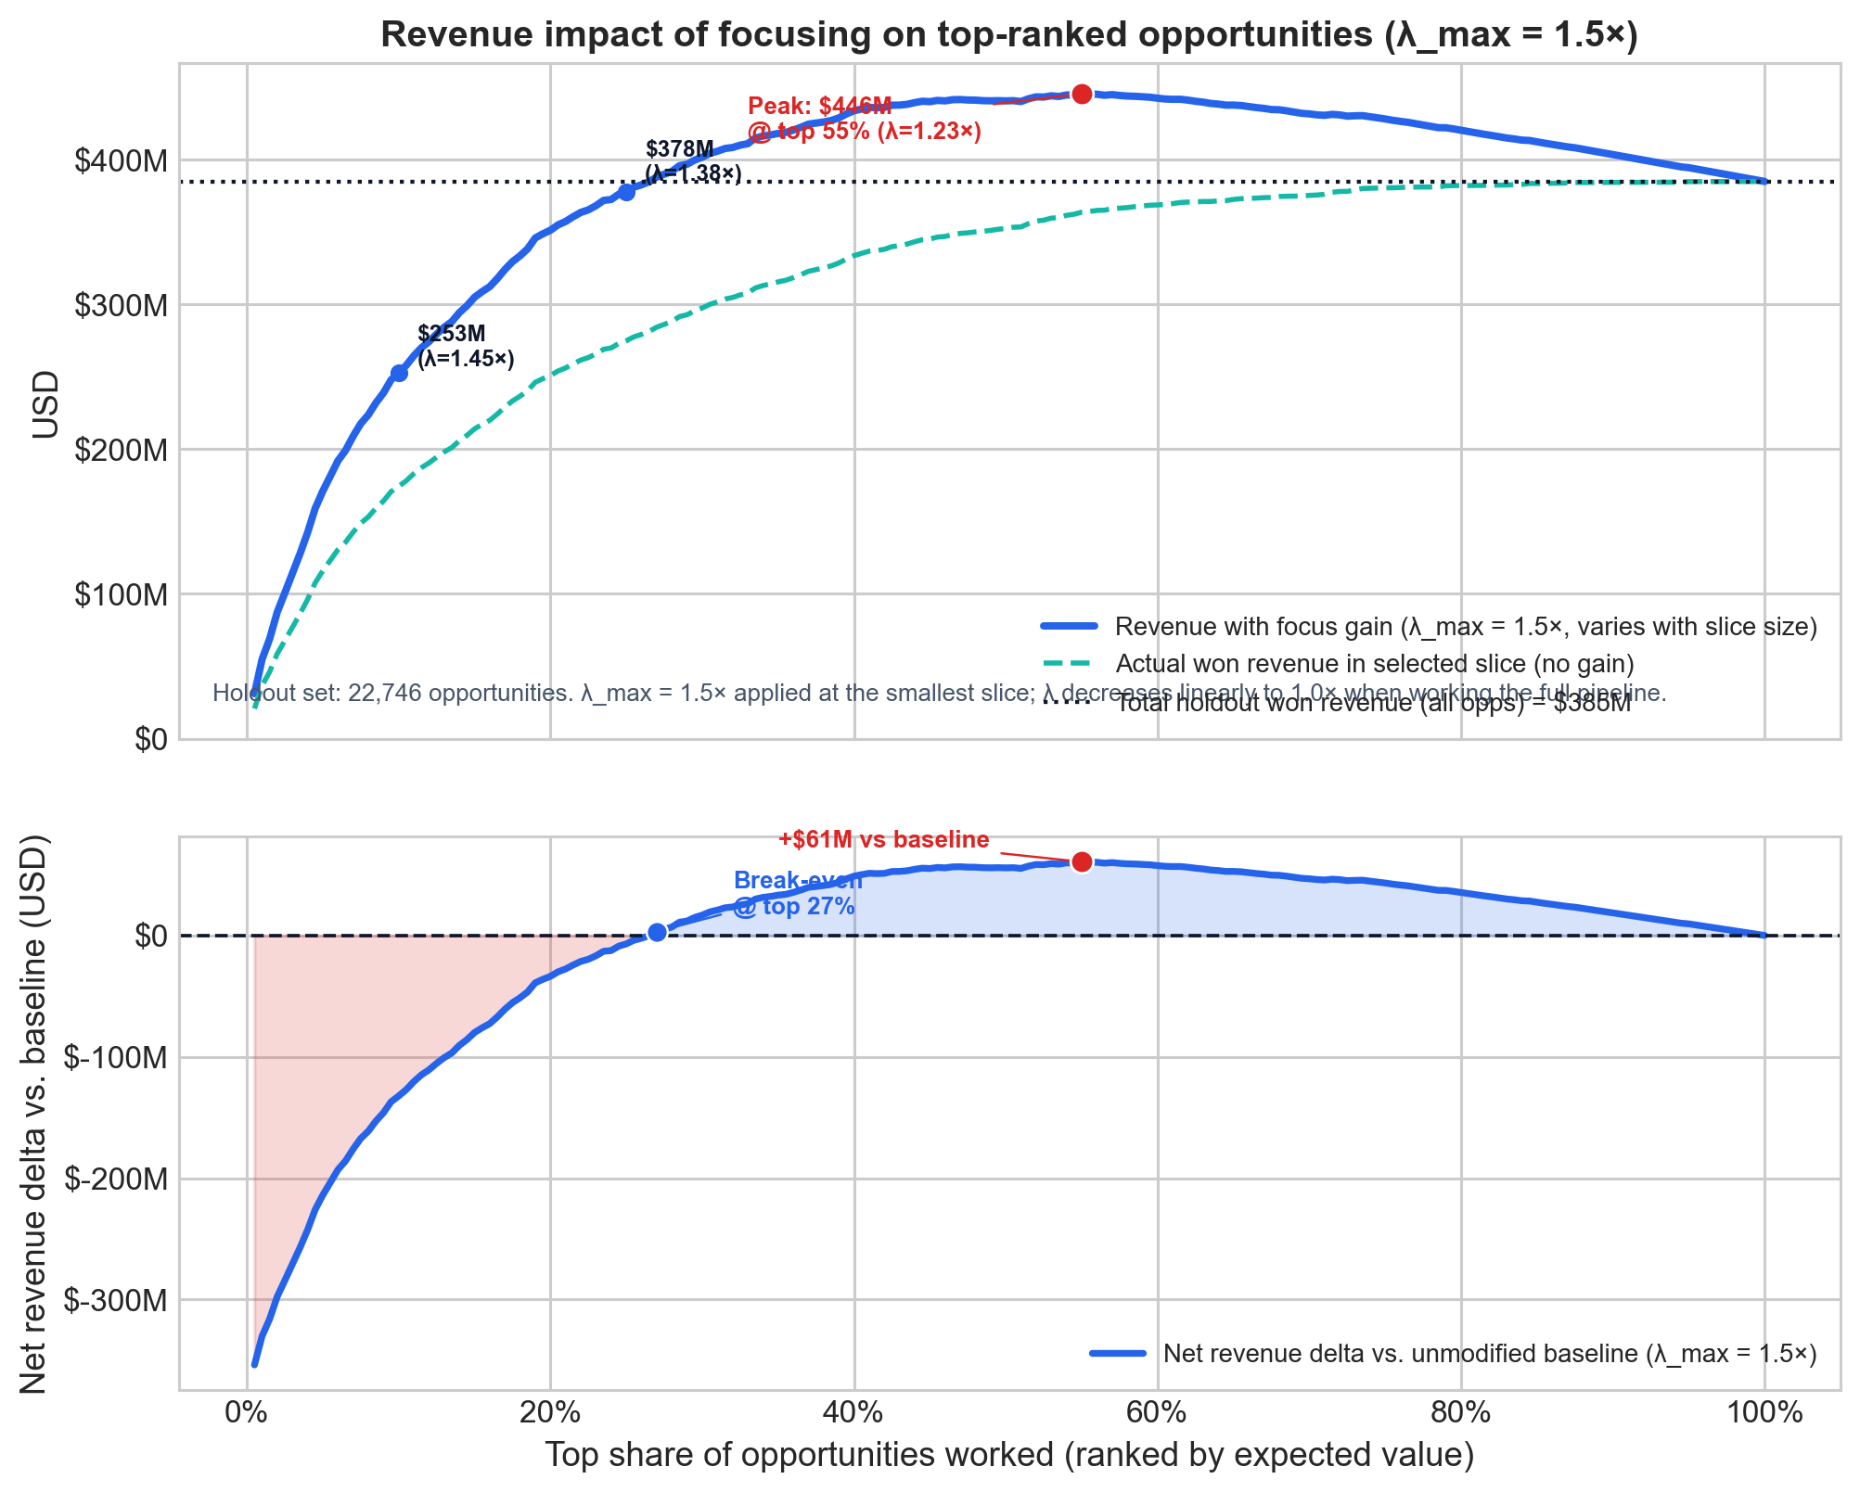
Annex: strategic lever 1 — focus the same team on fewer, better-ranked deals
Same salesforce, fewer deals — dropped opportunities go unworked.
Focus gain grows as the slice shrinks (λ_max = 1.5× at top slice → 1.0× at full pipeline).
Break-even at top ~27%; optimal at top ~55% → $446M (+$61M vs. baseline).

Slide 51
Focus-gain λ_max is a scenario assumption, not an empirically estimated causal effect. λ decays linearly from λ_max at the smallest slice to 1.0× at the full pipeline. Simulation uses held-out test-set predictions.

Slide 52
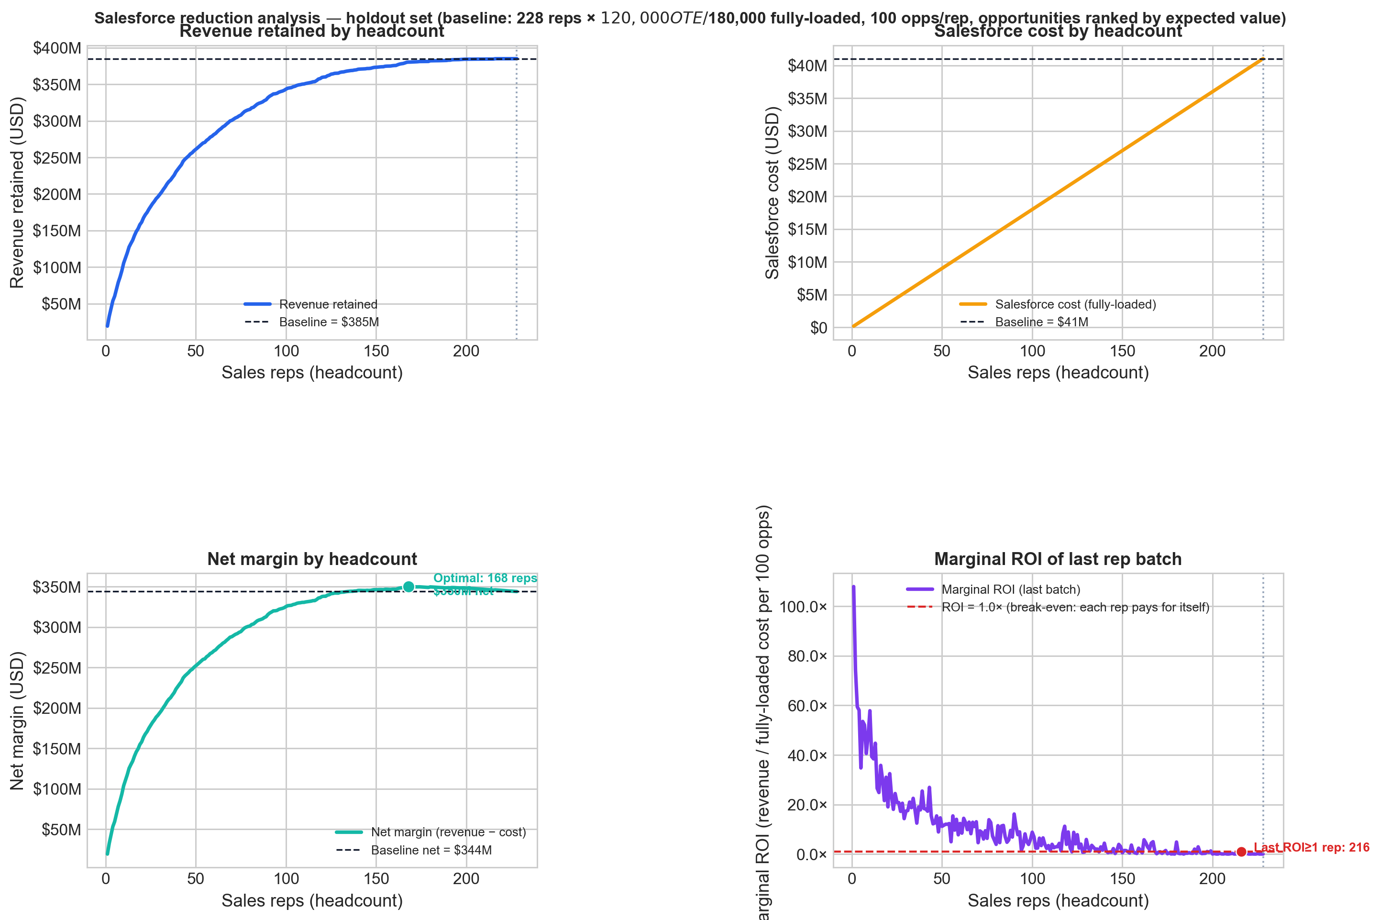
Annex: Strategic lever 2: Reduce the salesforce and let the model pick the best opportunities
Baseline: 228 reps × $120K OTE = $41M fully-loaded salesforce cost, covering 22,746 opportunities.
Model ranks all opportunities by EV; each rep cut drops the lowest-ranked batch they covered.
Optimal headcount: 168 reps → $380M revenue retained (98.8%) at $30M cost → net margin +$6M vs. full staffing.
Last individually break-even rep batch: rep #216 — reps 217–228 generate less revenue than their fully-loaded cost.

Slide 53
Headcount model assumes 100 opps/rep/period. $120K OTE per rep; fully-loaded cost estimated at $180K (1.5× OTE, including benefits, payroll taxes, tech stack, and overhead). Simulation uses held-out test-set predictions.

