Slide 1
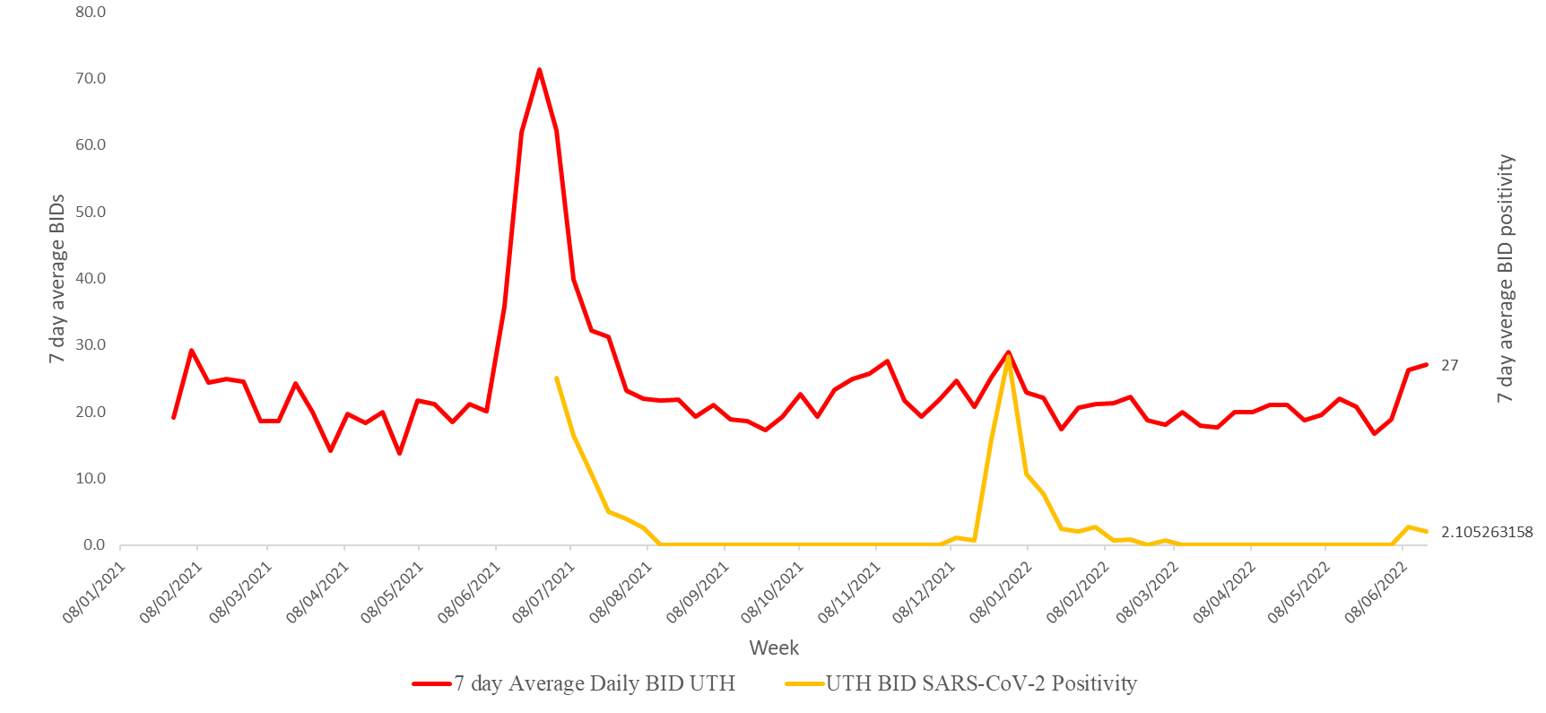
7 day average BID UTH vs 7 day average BID COVID-19 percent positivity: through to June 18th , 2022

Slide 2
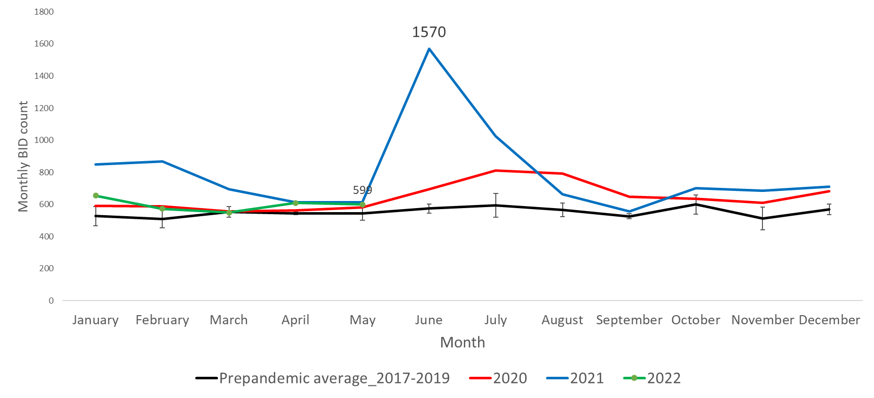
UTH monthly number of BID Vs Pre-pandemic monthly BID (2017-2019)

Slide 3
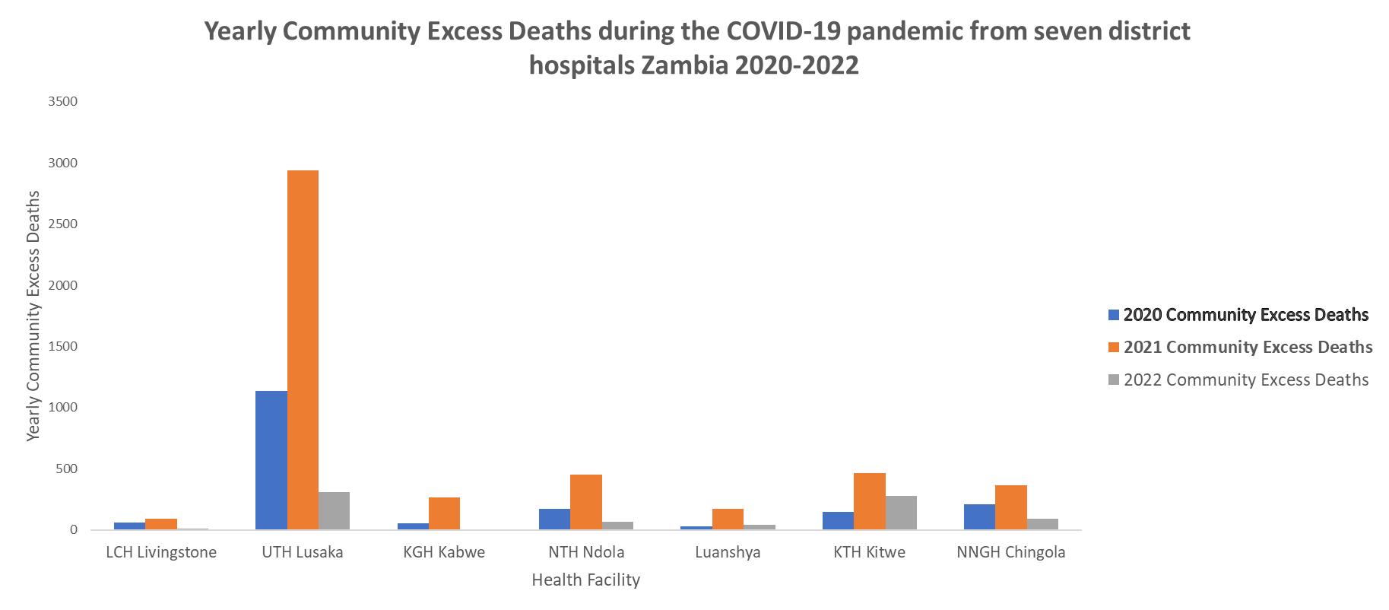
COVID-19 Pandemic Yearly Community Excess Deaths by facility

