Slide 1


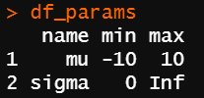
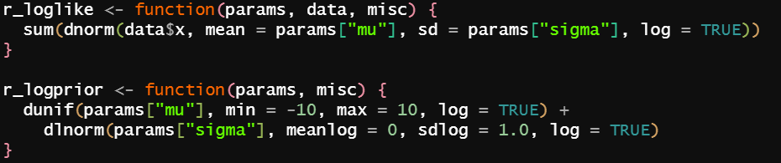
run_mcmc(
data = data_list,
df_params = df_params,
loglike = r_loglike,
logprior = r_logprior
)

