Slide 1
Visualizing model fit
Bob Verity, Pete Winskill

Slide 2


My ice cream shop
Model Comparison
Model Testing
Me:
Do you want chicken korma or frogspawn flavour? You have to choose one
Me:
Do you want a chicken korma ice cream?
You:
No
You:
Chicken korma I guess

Slide 3
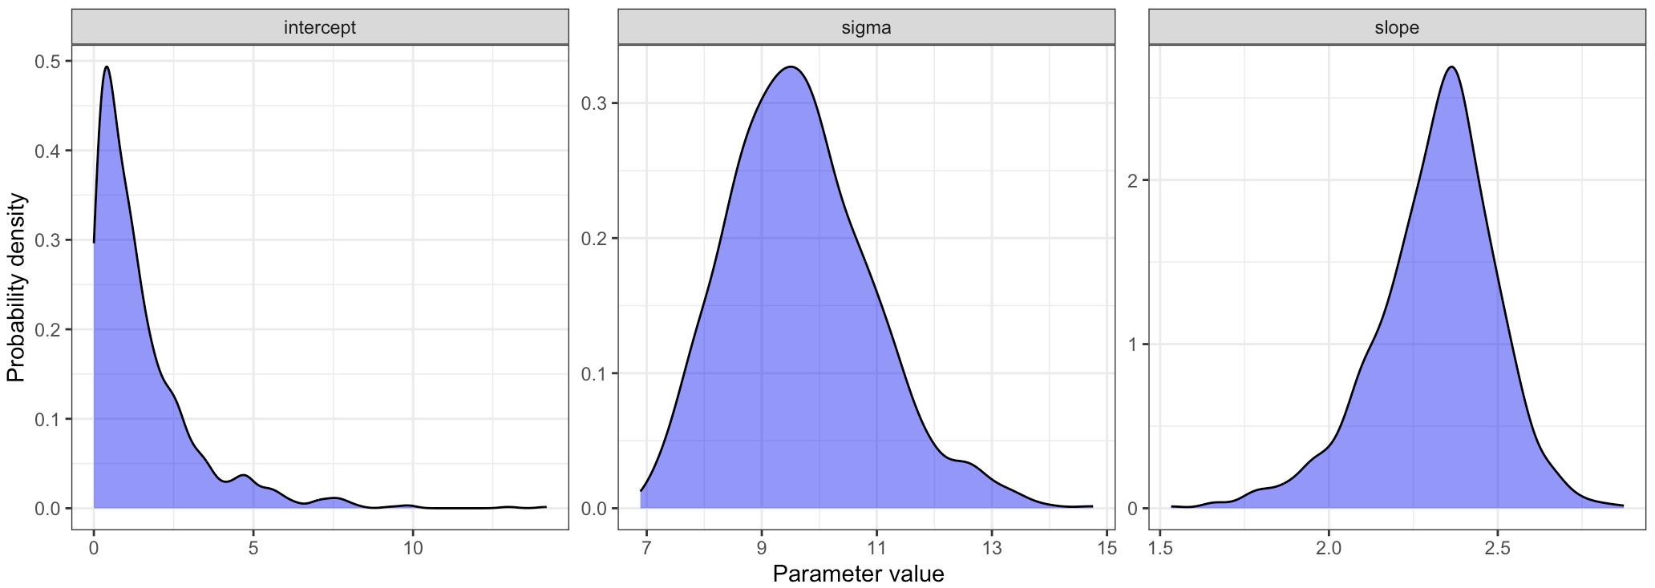
Raw posterior distributions
OK, but is my model fit any good?

Slide 4
Credible intervals of fitted relationship
We assumed the following linear model:
Volume = intercept + slope*Girth + error
The “linear prediction” is the same formula without the error term
Volume_pred = intercept + slope*Girth
This is the relationship we are trying to capture

Slide 5
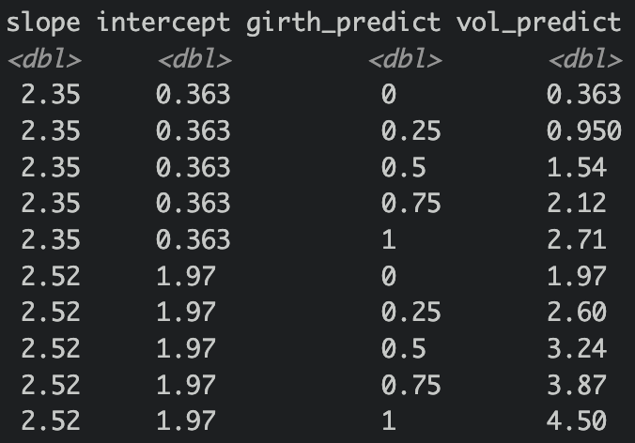
Credible intervals of fitted relationship
Volume_pred = intercept + slope*Girth
Predicted volume given our first posterior draw
Predicted volume given our second posterior draw
We can make a series of straight lines, each drawn from the posterior

Slide 6
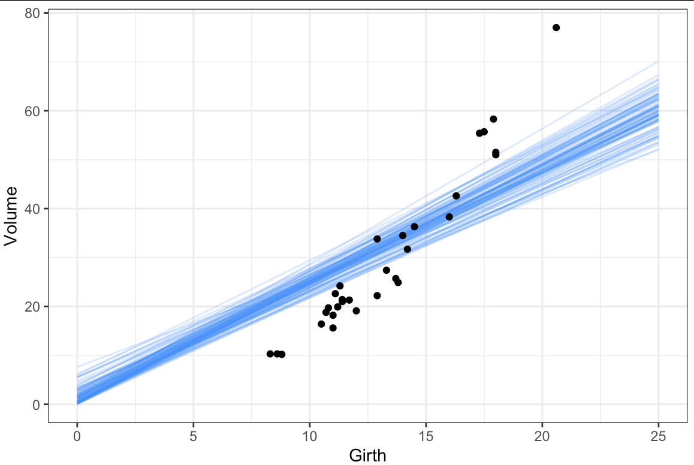
Credible intervals of fitted relationship

Slide 7
Posterior predictive intervals
Did we at least capture the error distribution well?
Volume = intercept + slope*Girth + error
If we substitute in our parameter estimates, we get the predictive distribution
This is the distribution that we expect new data to follow
By taking a range of parameter values drawn from the posterior, we can marginalize over our uncertainty in these parameters when making predictions.

Slide 8
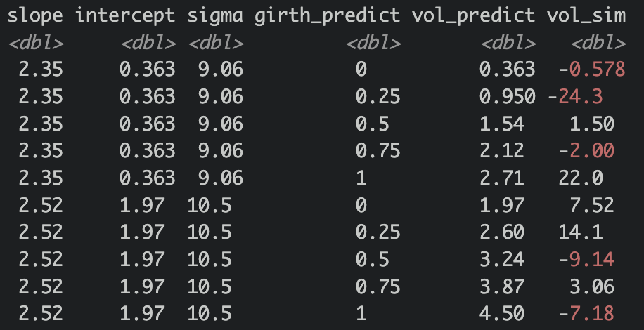
Posterior predictive intervals
Simulated volume given our first posterior draw
Simulated volume given our second posterior draw
We can make a series of simulated points, and can summarize these via quantiles

Slide 9
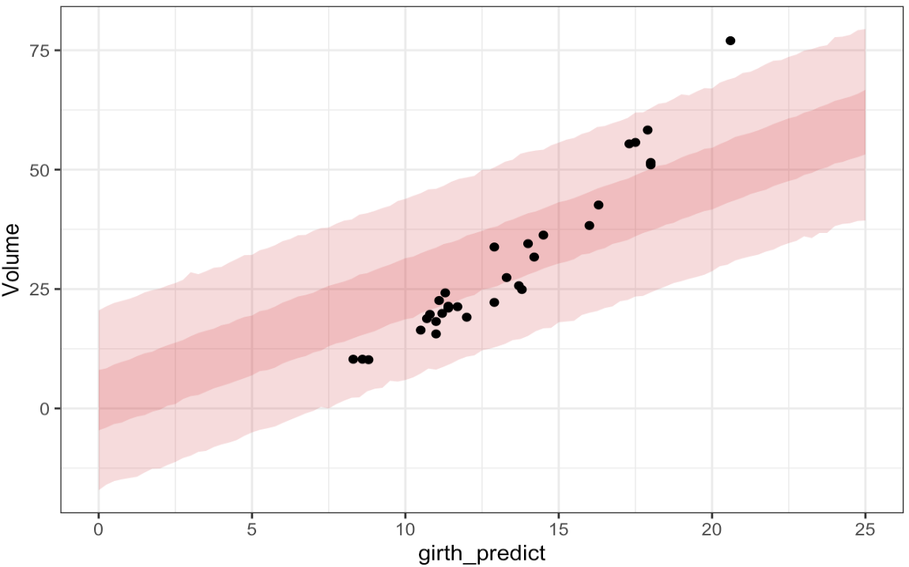
Posterior predictive intervals

Slide 10
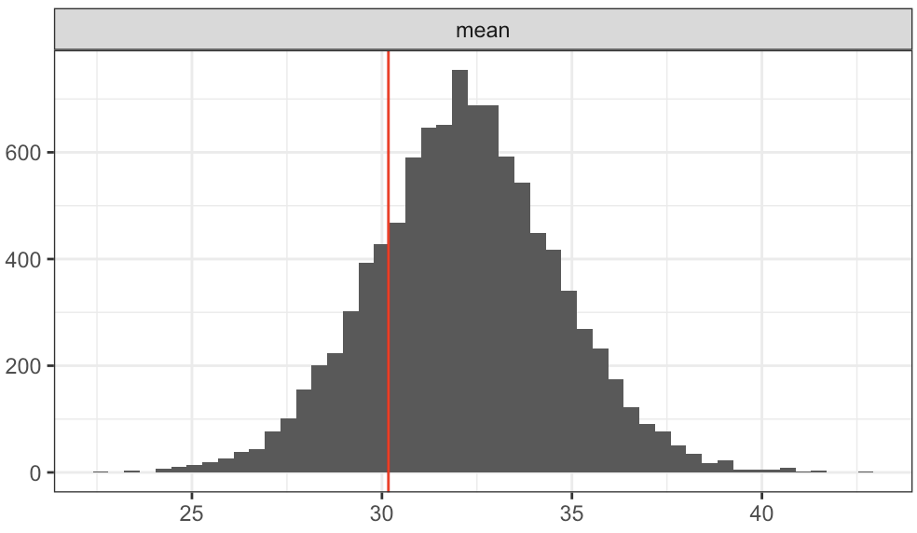
Posterior predictive checks
Come up with some measure that you can calculate on the real data
Simulate datasets with the same dimension as the observed data by drawing from the predictive distribution. Do this many times
Calculate the same measure on the simulated datasets. Look at the distribution of this measure compared to the real data
Does the real data match the predictive distribution in terms of this measure?

Slide 11
Posterior predictive checks
Advantages
Rooted in reality. A series of important “sanity checks”
Flexible and straightforward to implement
Can pick up subtle patterns in the data

Slide 12
Results

Slide 13
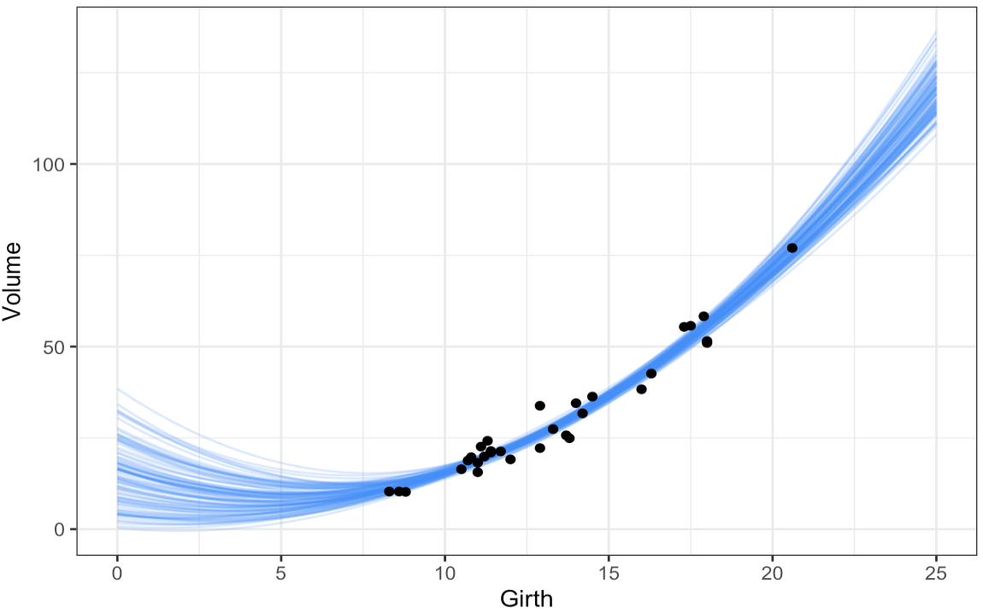
Credible intervals of fitted relationship

Slide 14
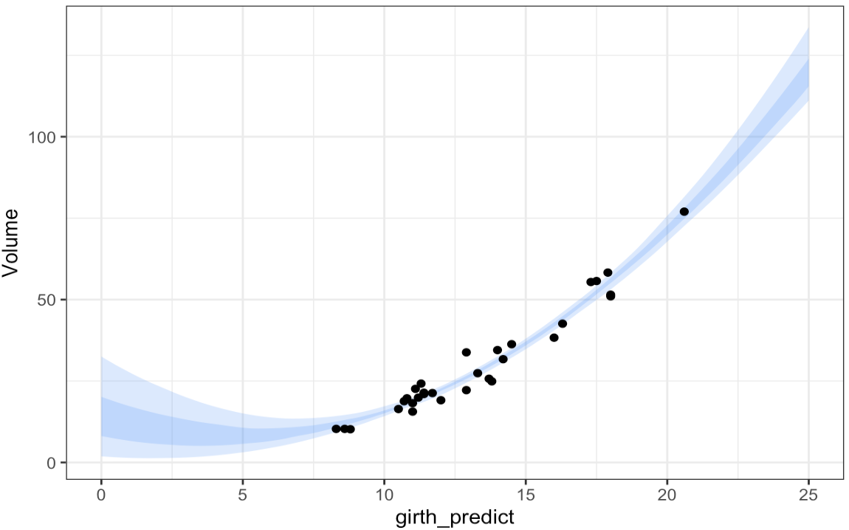
Credible intervals of fitted relationship

Slide 15
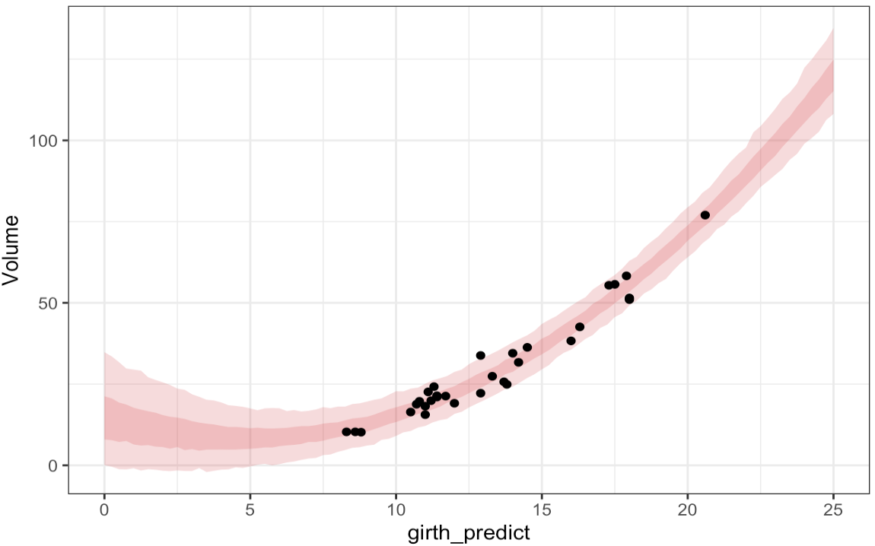
Posterior predictive intervals

Slide 16
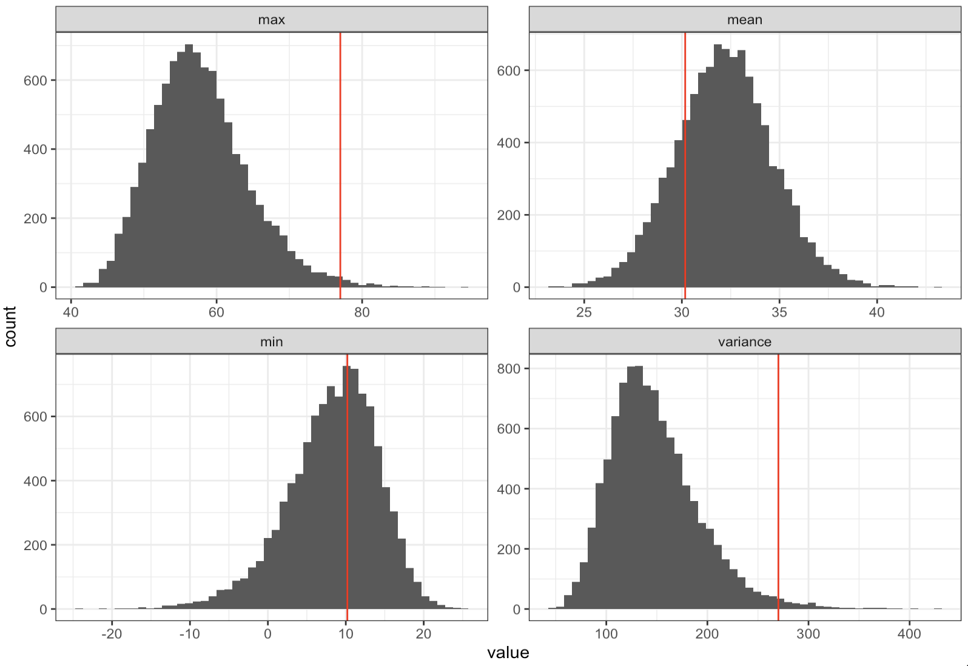
PPCs for linear model

Slide 17
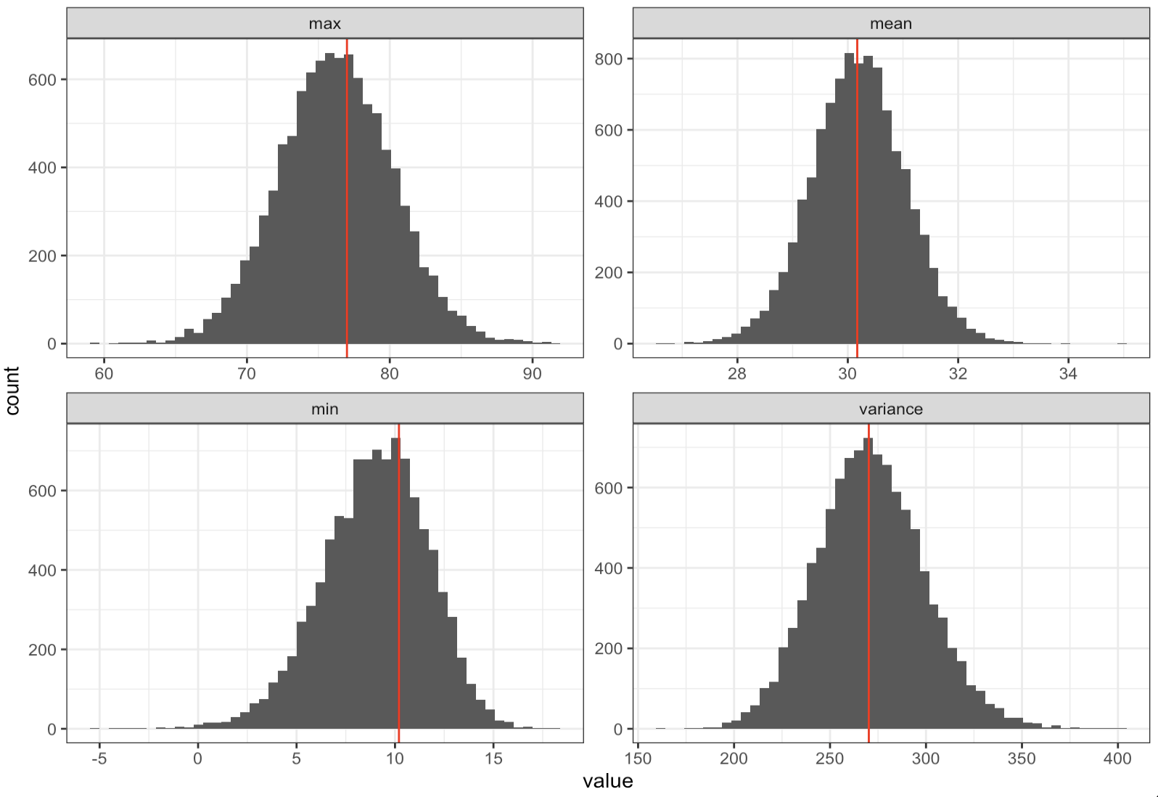
PPCs for quadratic model

