Slide 1
Improving mixing via parallel Tempering
Bob Verity, Pete Winskill

Slide 2
Reasons for using PT
MCMC is very sluggish, mixing very poorly
Revisit quadratic regression
Posterior may contain distinct peaks that are well-separated
Gaussian process model

Slide 3
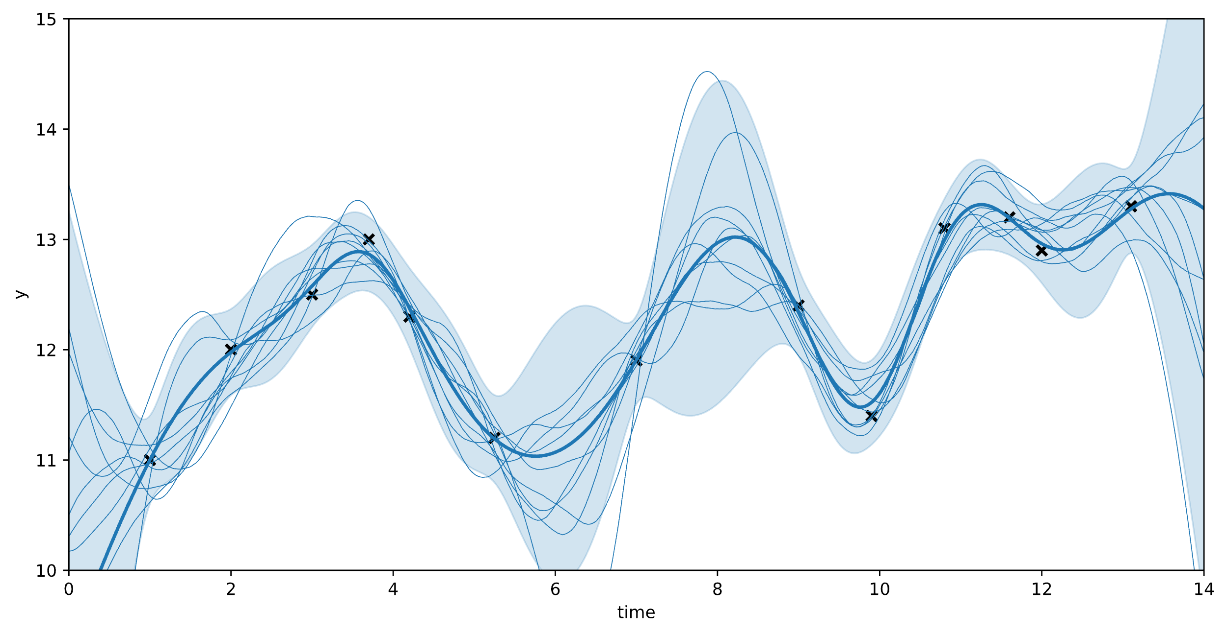
Gaussian Process (GP)
Underlying function has high autocorrelation
Capture this autocorrelation in a “kernel”
Data has some additional noise
Can we estimate all the parameters of a GP?

Slide 4
Results

Slide 5
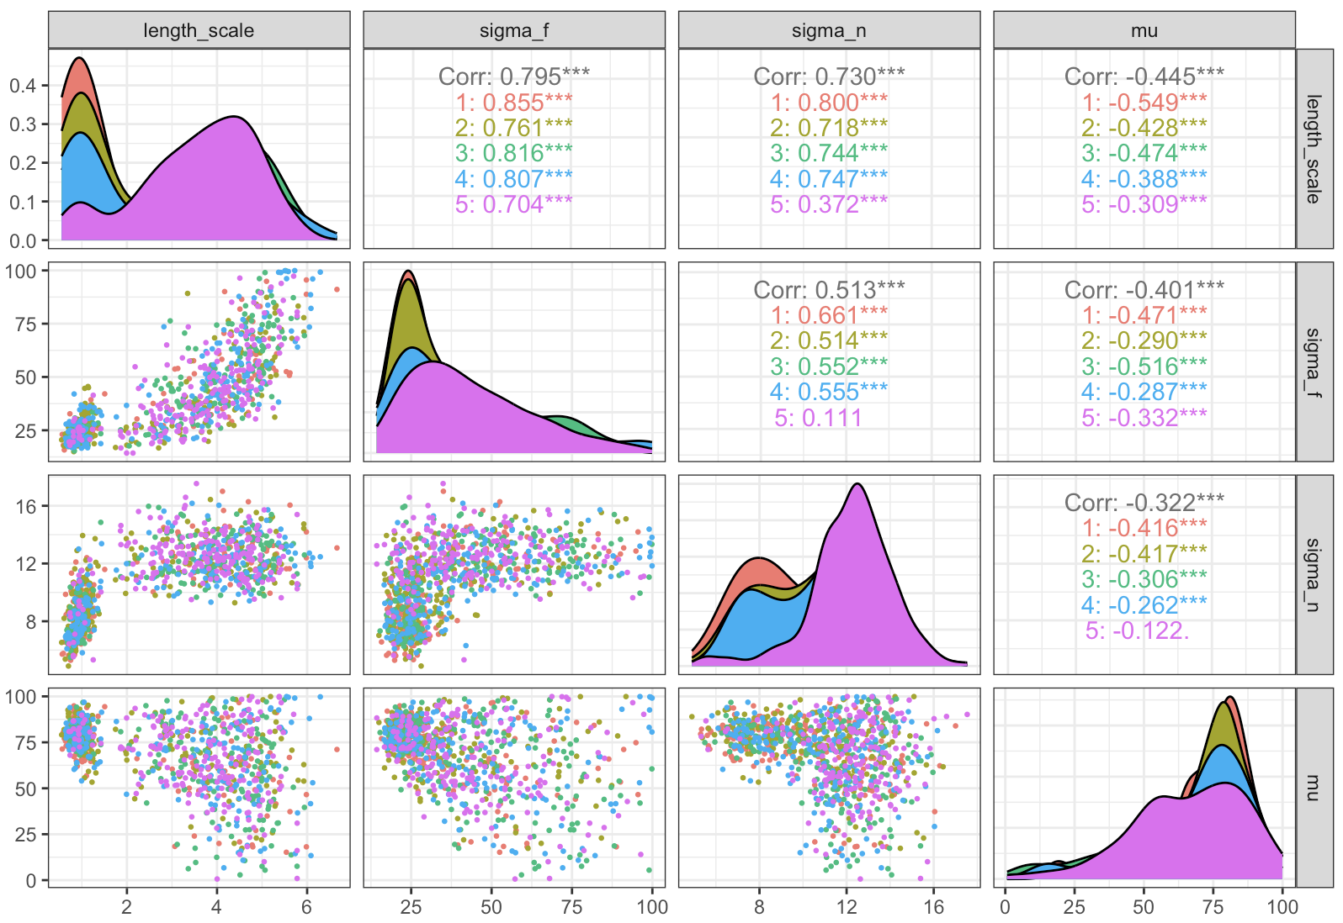
What’s causing the bad mixing?

Slide 6
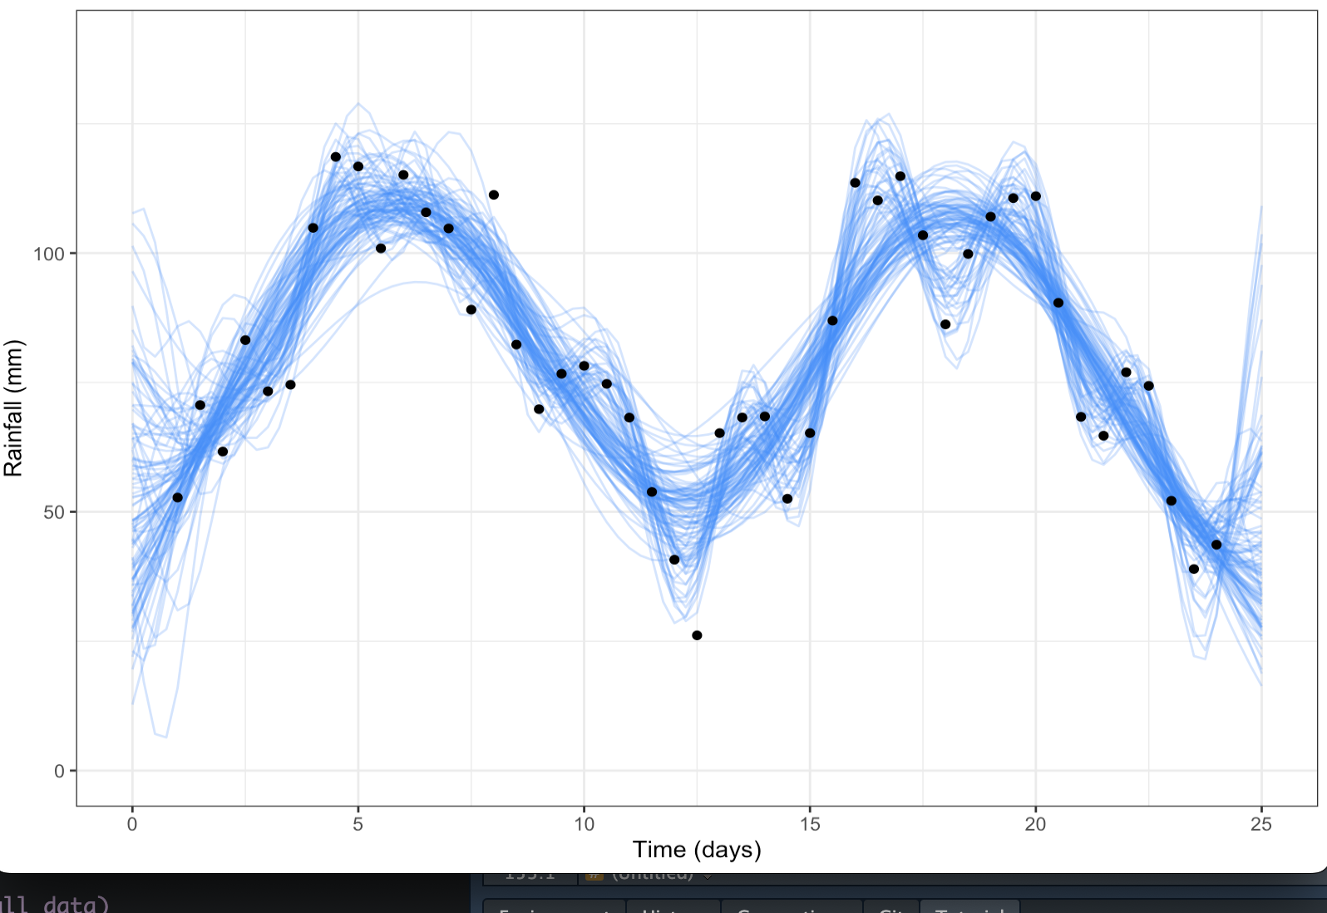
Why are we getting this problem?

