Slide 1
Linking with other packages:
Compartmental modelling in Odin
Bob Verity, Pete Winskill

Slide 2
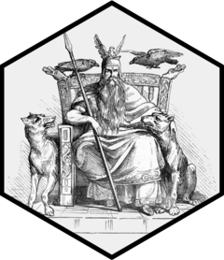
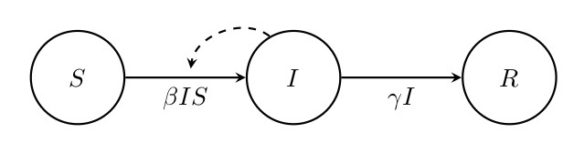
Linking with other packages
Your likelihood and prior functions have access to any other packages and functions that are loaded in your environment
The Odin package makes it easy to solve systems of differential equations. It can handle both deterministic systems and stochastic systems. It is therefore great for compartmental modelling.

Slide 3
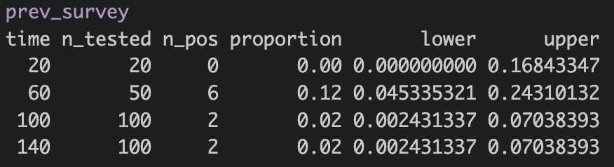
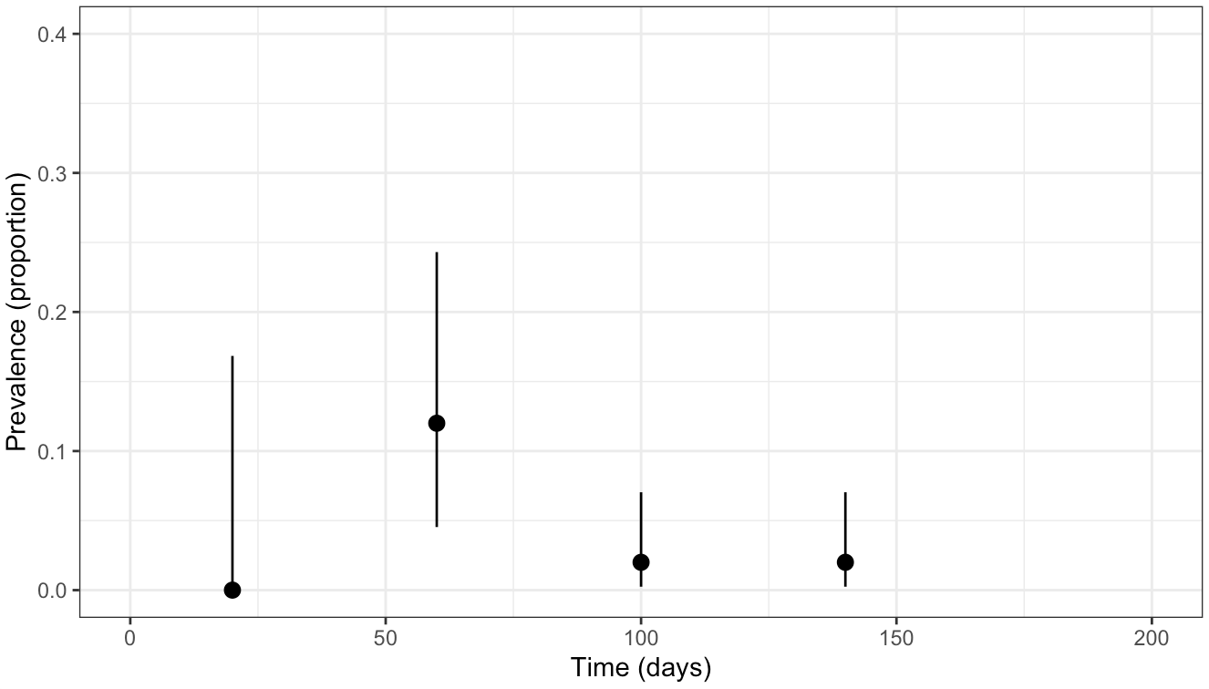
Flu prevalence survey data

Slide 4
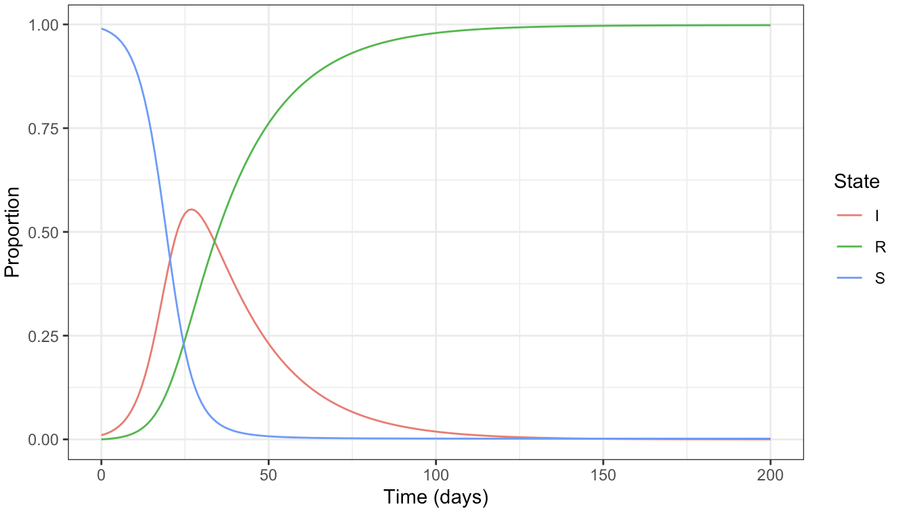
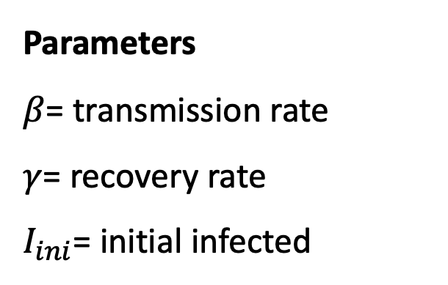
The SIR model
Parameters
$β$= transmission rate
$γ$= recovery rate
$I_{ini}$= initial infected
Can we estimate all three parameters via MCMC?

Slide 5
Results

Slide 6
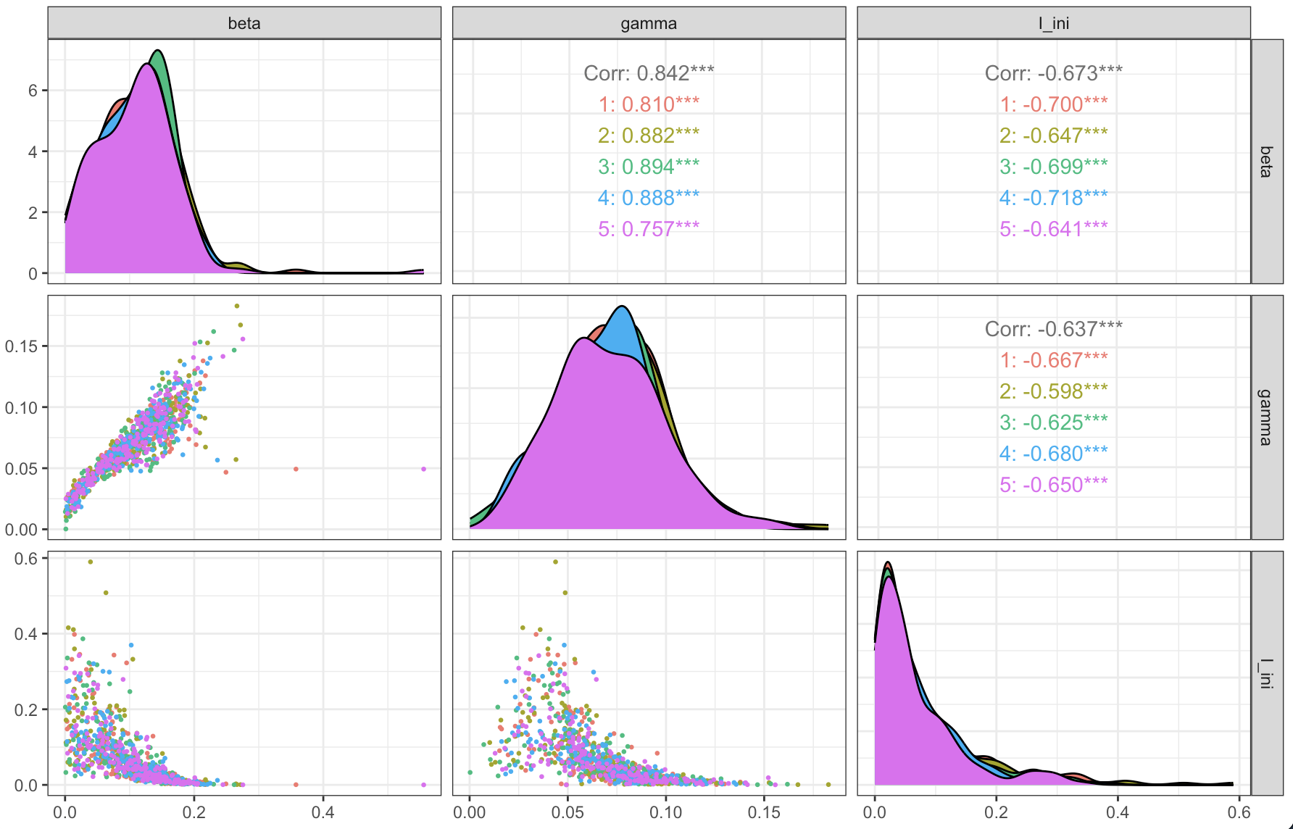
Scatterplots

Slide 7
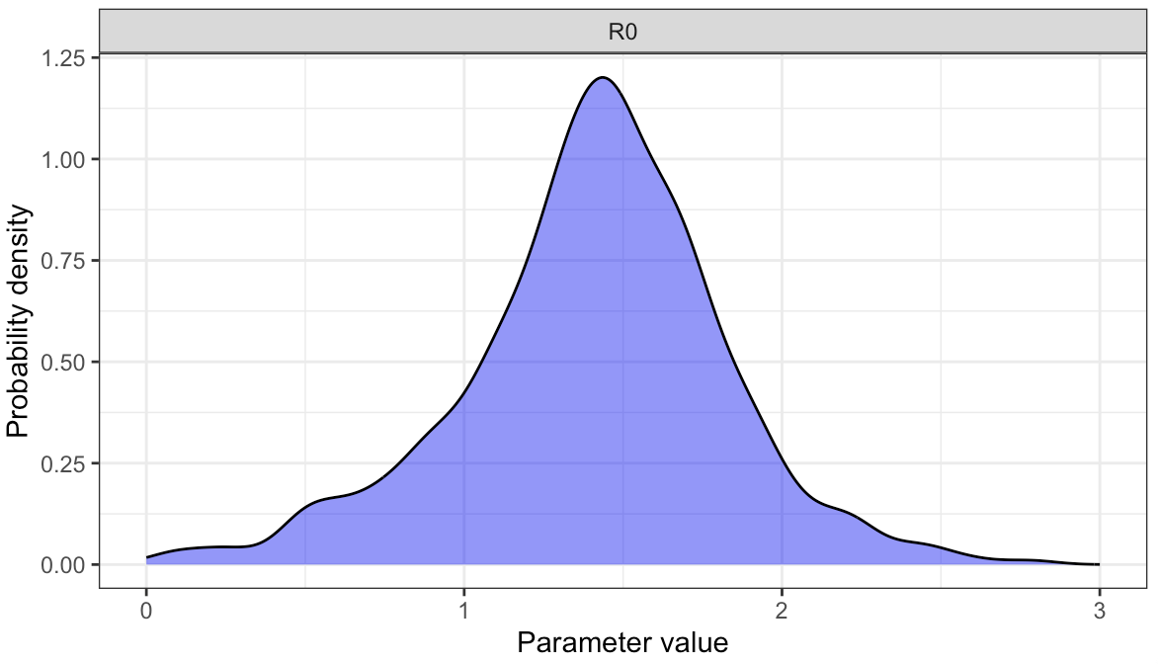
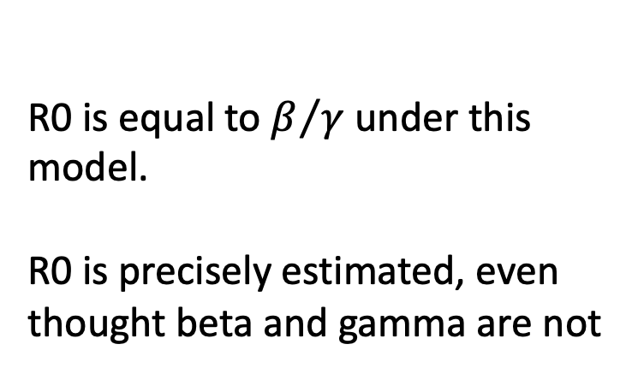
R0
R0 is equal to $β/γ$ under this model.
R0 is precisely estimated, even thought beta and gamma are not

Slide 8
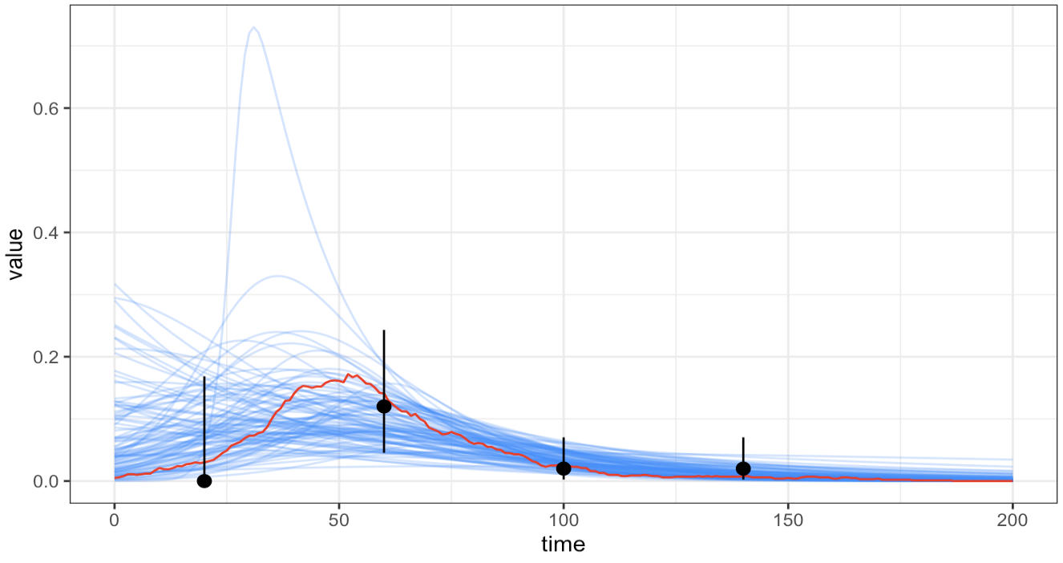
Model fit from the survey

Slide 9
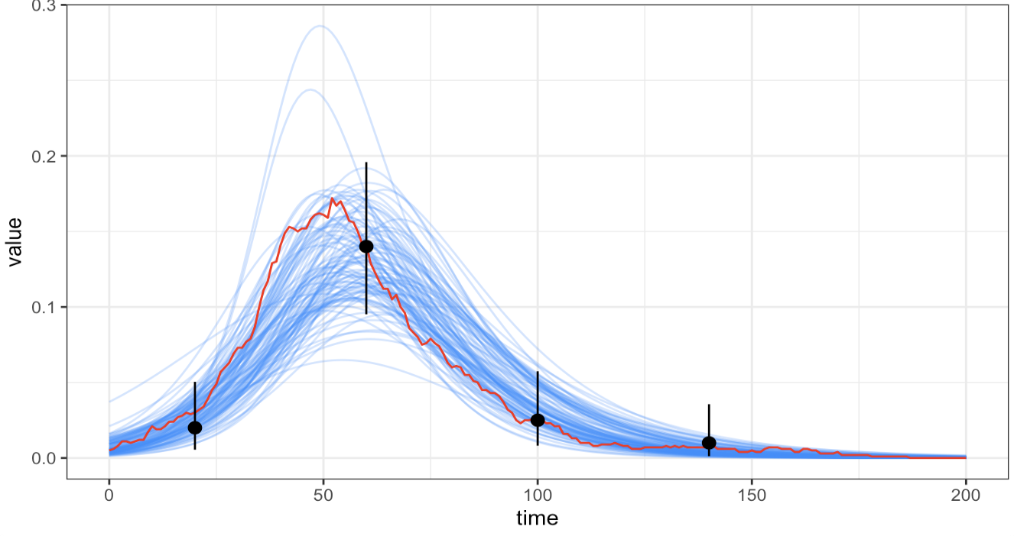
Model fit from the enhanced survey

