Slide 1
C++ functions and running in parallel
Bob Verity, Pete Winskill

Slide 2








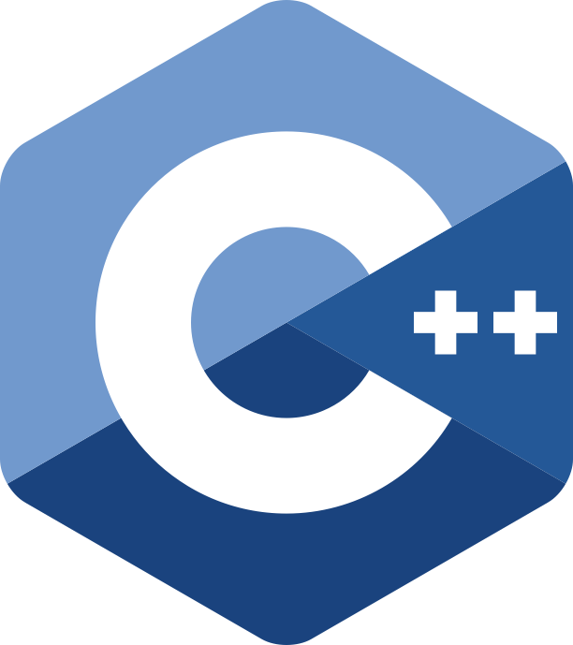


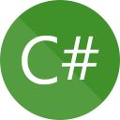


Why code in C++?
Interpreted languages
source code executed by an interpreter
Compiled languages
source code translated to machine code prior to execution

Slide 3
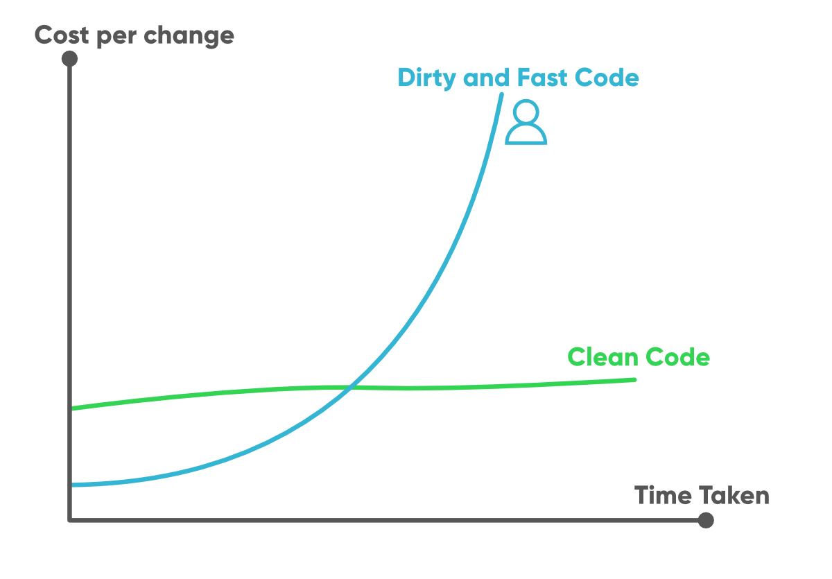
Why code in R?
How much time is spent writing your code vs running your code?
Is the code just for you?
Is it for a single analysis?
Is run-time holding you back?
Are you hogging the cluster?
How quickly can you write & debug R vs C++ code?

Slide 4
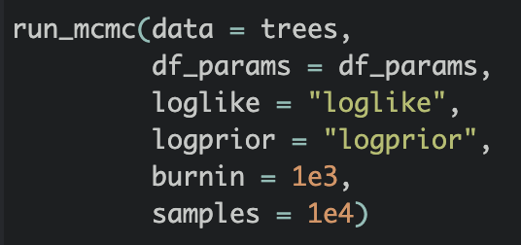
How to use C++ functions in drjacoby
Write your functions in a separate .cpp file
Source this file into R using Rcpp::sourceCpp(”file.cpp")
In run_mcmc(), refer to the function names in quotation marks

Slide 5
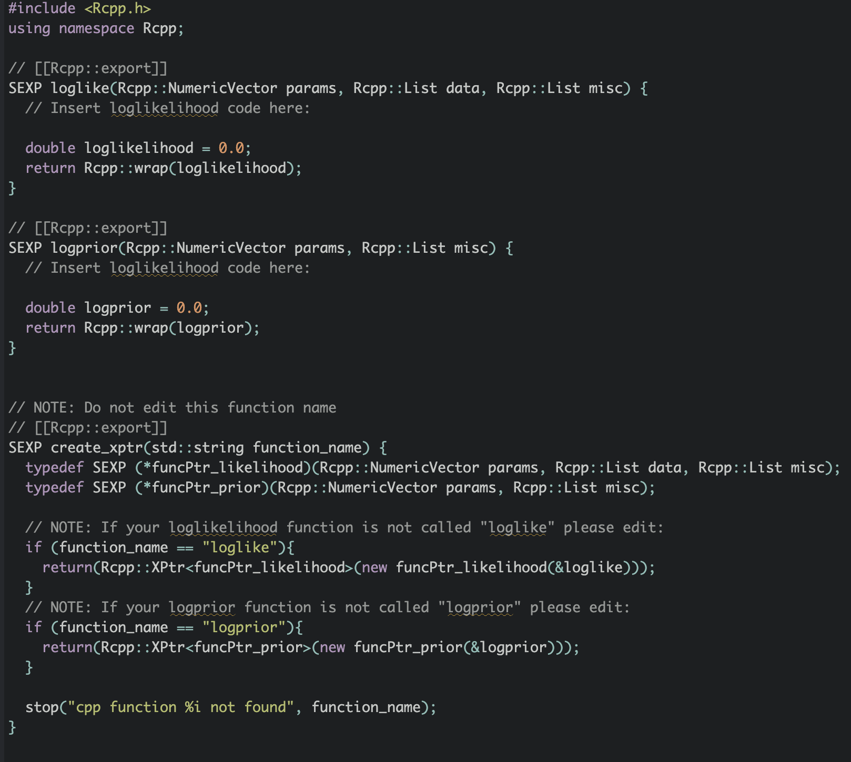
How to use C++ functions in drjacoby
cpp_template(”name.cpp")
What are you doing, don’t touch this!

Slide 6
How to use C++ functions in drjacoby
Same inputs and outputs, but in Rcpp format

Slide 7
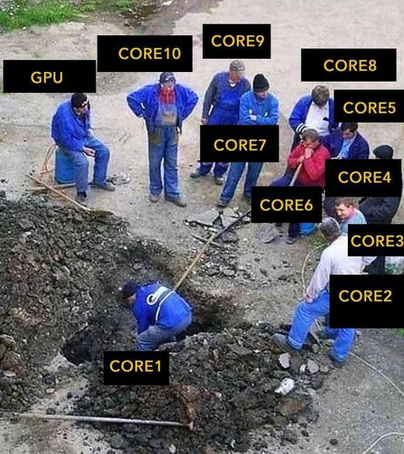
Why run in parallel?
MCMC is an “embarrassingly parallel” problem
Roughly linear increase in speed
Very easy via parallel package

Slide 8

Further things to do
Bring in your own data and get modelling!
Try to code the same model in e.g. drjacoby and Rstan
Read more on the drjacoby main page. One thing we have not covered here is “likelihood blocks” (https://mrc-ide.github.io/drjacoby)
If you have a nice example that demonstrates a feature, write it up as Rmarkdown and we’ll try and include it on the website

