Slide 1
Improving mixing via parallel Tempering
Bob Verity, Pete Winskill

Slide 2
Problems to motivate using PT
MCMC is very sluggish, mixing very poorly
  Revisit quadratic regression
Posterior may contain distinct peaks that are well-separated
  Gaussian process model

Slide 3
Gaussian Process (GP)
Underlying function has high autocorrelation
Capture this autocorrelation in a “kernel”
Data has some additional noise
Can we estimate all the parameters of a GP?

Slide 4
Results

Slide 5
Do we always need PT?
PT fixed the quadratic model without us needing to understand why it was mixing badly
But subtracting mean(Girth) from Girth fixes it too, with no PT at all. That is a tenth of the run-time and better mixing: min ESS around 380, against around 135 with PT for the same number of samples
PT earns its keep when you cannot reparameterise your way out of trouble, for example when the posterior has multiple peaks

Slide 6
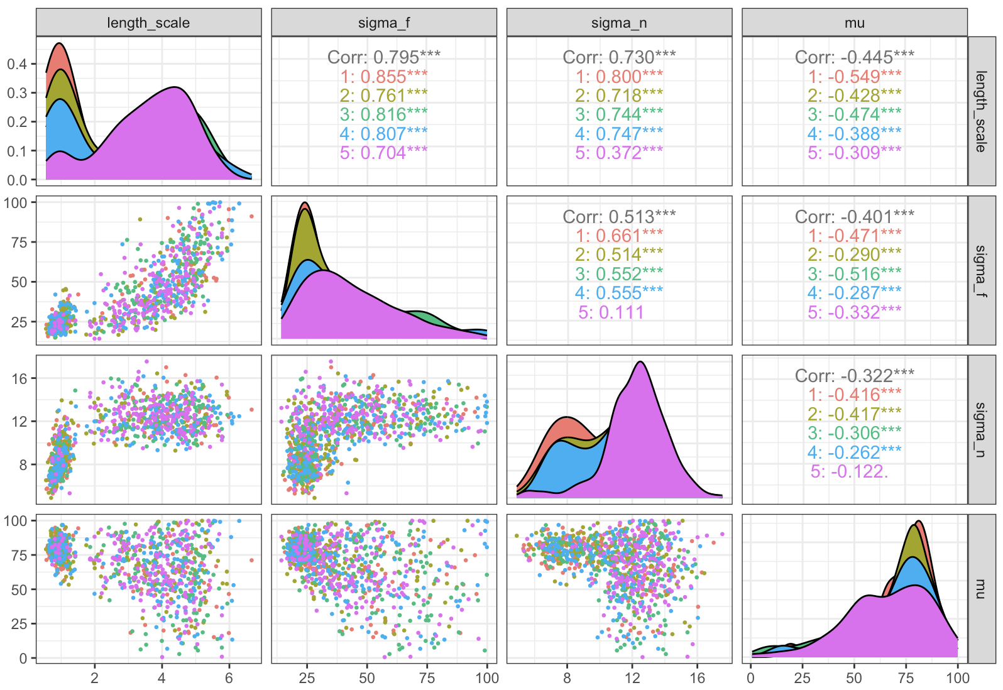
What’s causing the bad mixing?

Slide 7
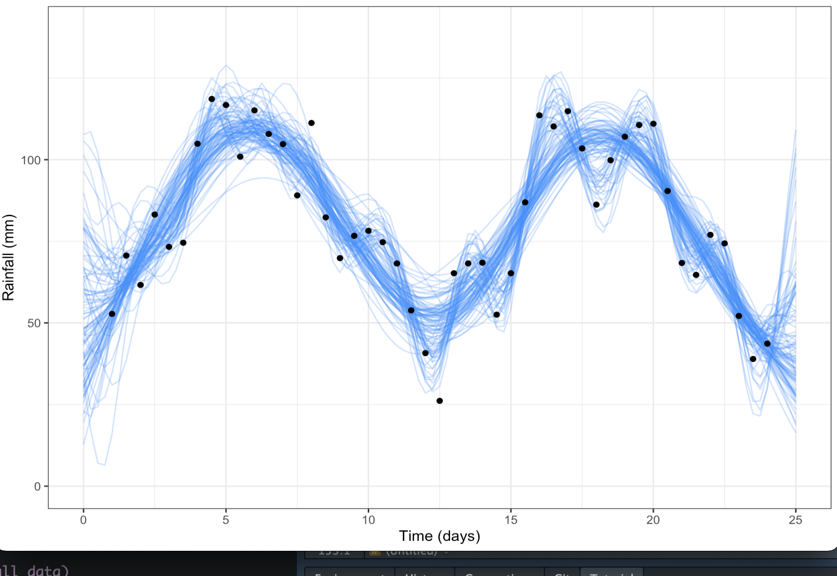
Why are we getting this problem?

