Slide 1
Linking with other packages:
Compartmental modelling in Odin
Bob Verity, Pete Winskill

Slide 2
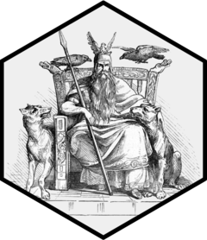
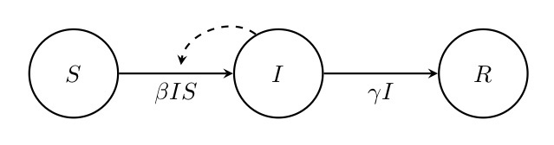
Linking with other packages
Your likelihood and prior functions have access to any other packages and functions that are loaded in your environment
The Odin package makes it easy to solve systems of differential equations. It can handle both deterministic systems and stochastic systems. It is therefore great for compartmental modelling.

Slide 3
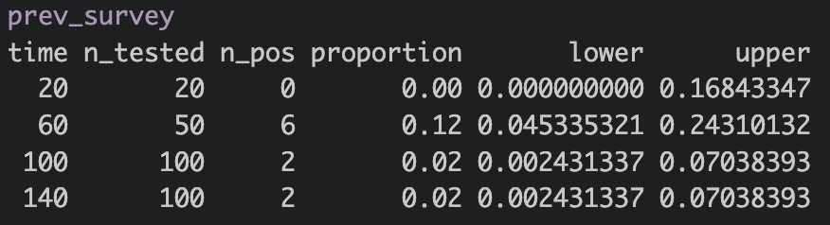
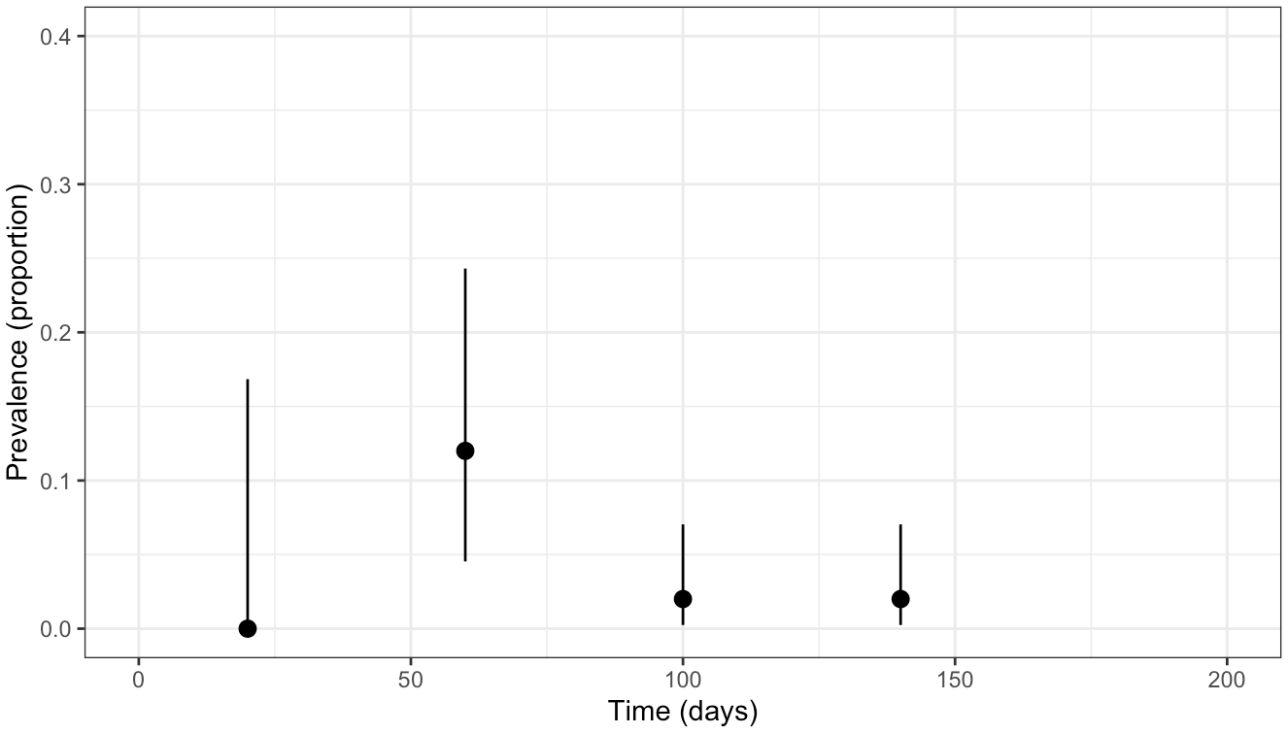
Flu prevalence survey data

Slide 4
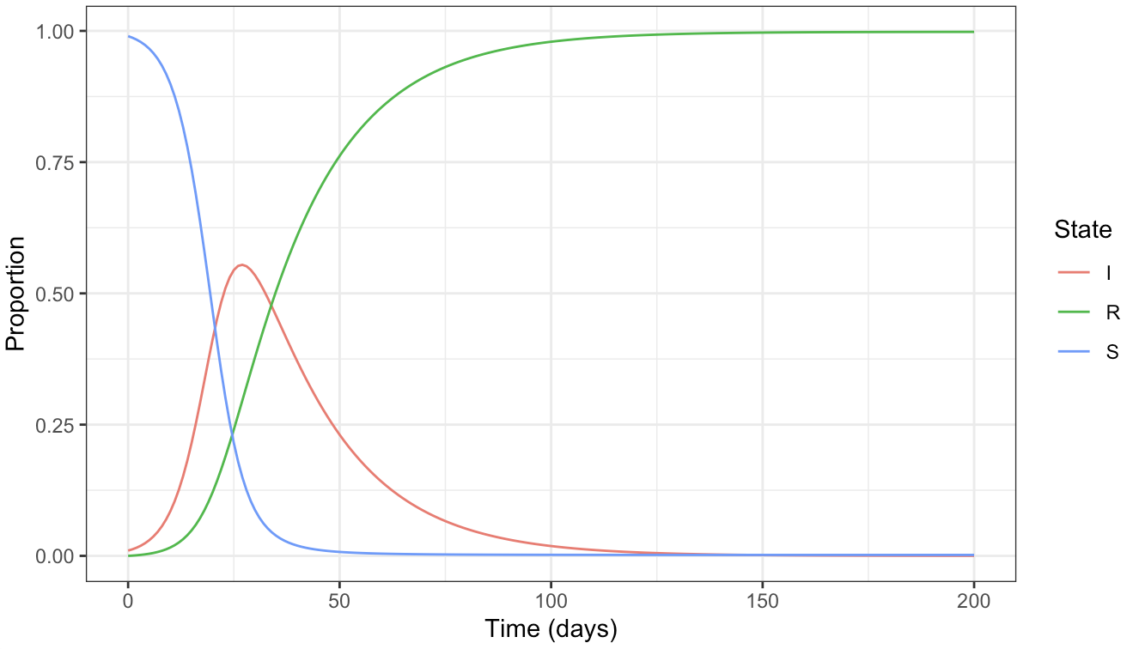
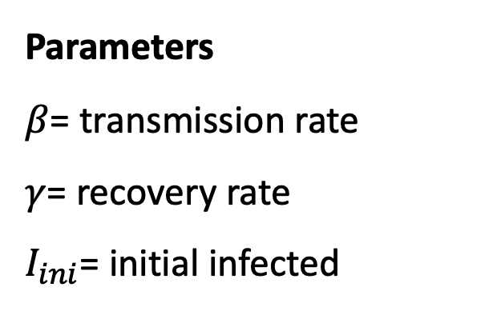
The SIR model
Parameters
$β$= transmission rate
$γ$= recovery rate
$I_{ini}$= initial infected
Can we estimate all three parameters via MCMC?

Slide 5
Results

Slide 6
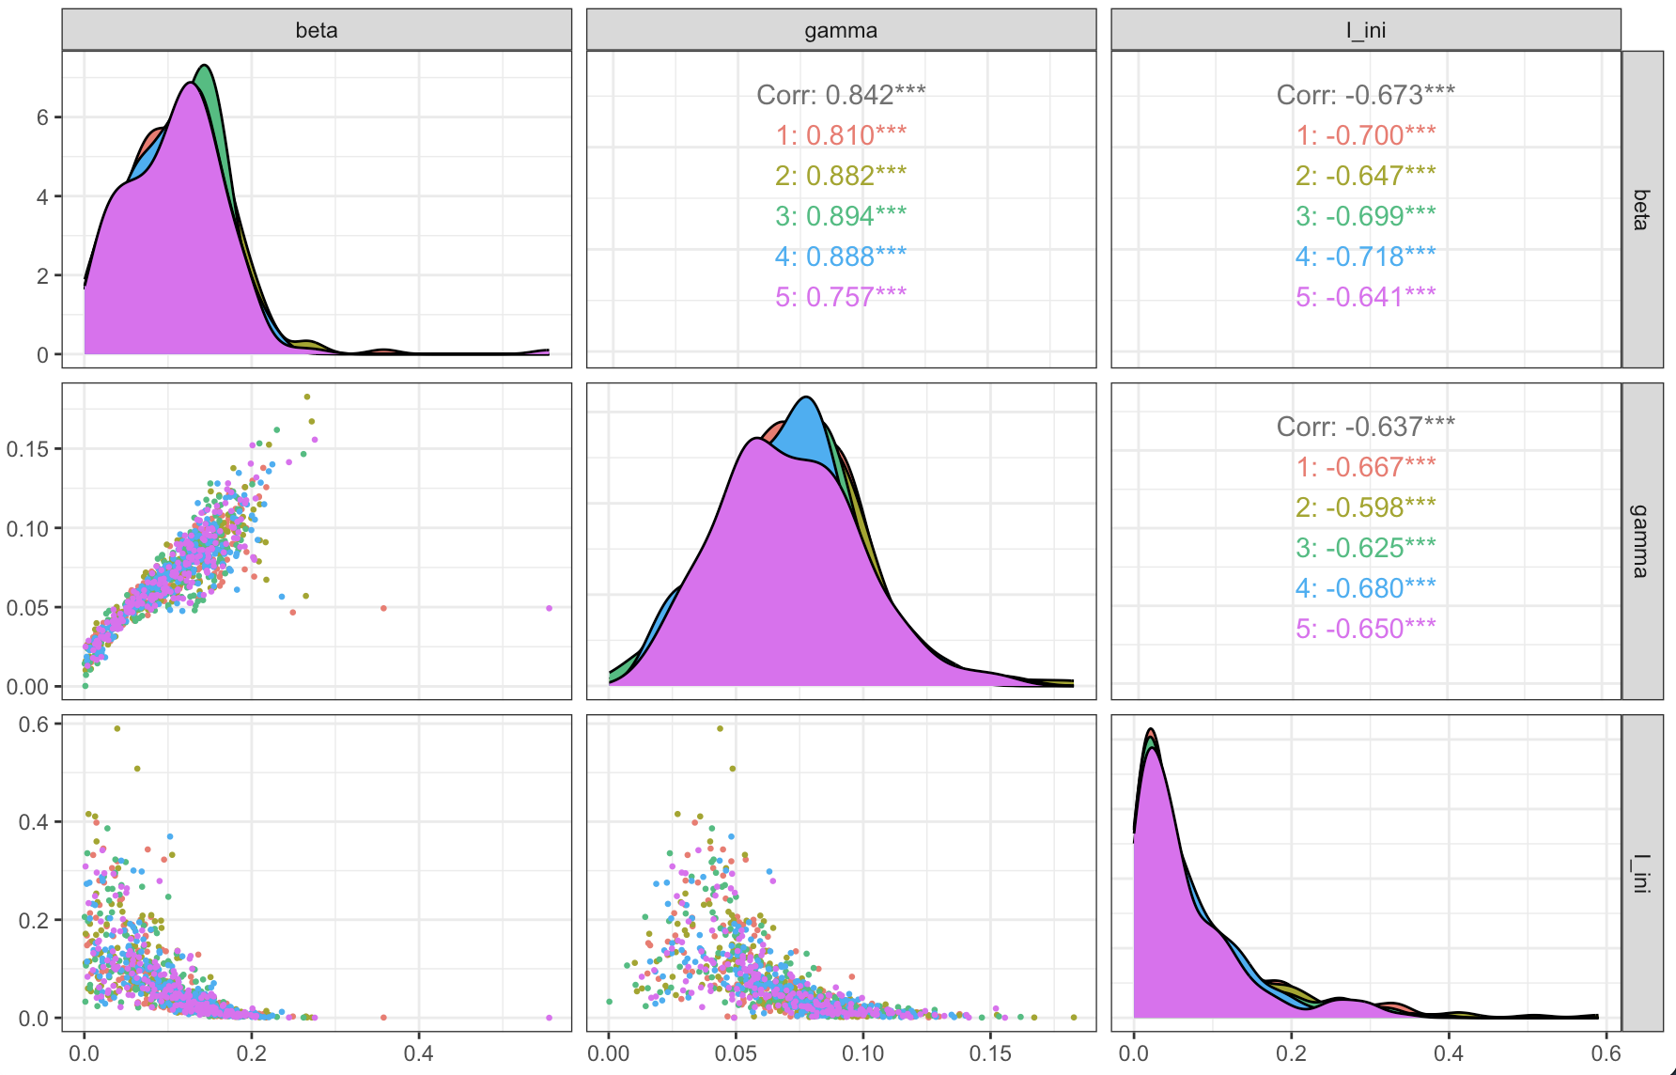
Scatterplots

Slide 7
Brute force or parallel tempering?
Brute force (1 rung, 10,000 samples): around 19 seconds, min ESS around 400
PT (10 rungs, alpha = 3, 2,000 samples): around 50 seconds, min ESS around 950
Per sample, PT wins easily. Per second it is a draw, at around 20 effective samples per second either way
This posterior is a single curved ridge, so a simple sampler gets there in the end. PT earns its keep when there are multiple peaks

Slide 8
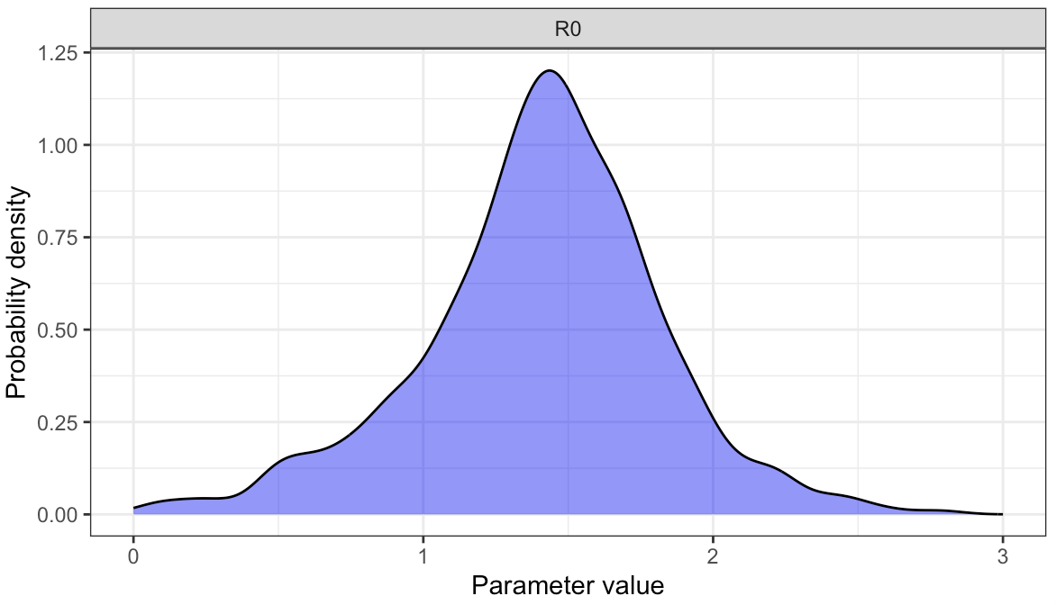
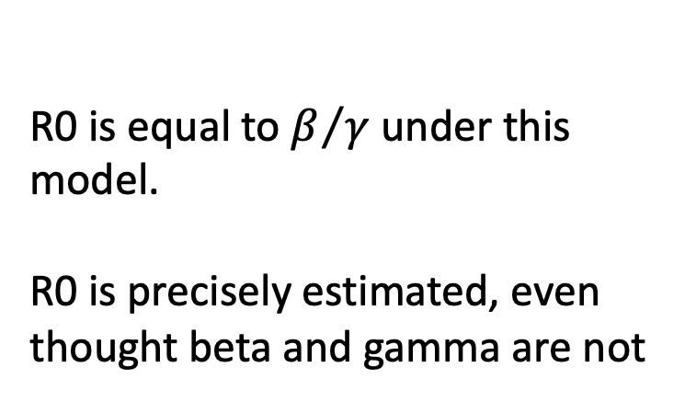
R0
R0 is equal to $β/γ$ under this model.
R0 is precisely estimated, even though beta and gamma are not

Slide 9
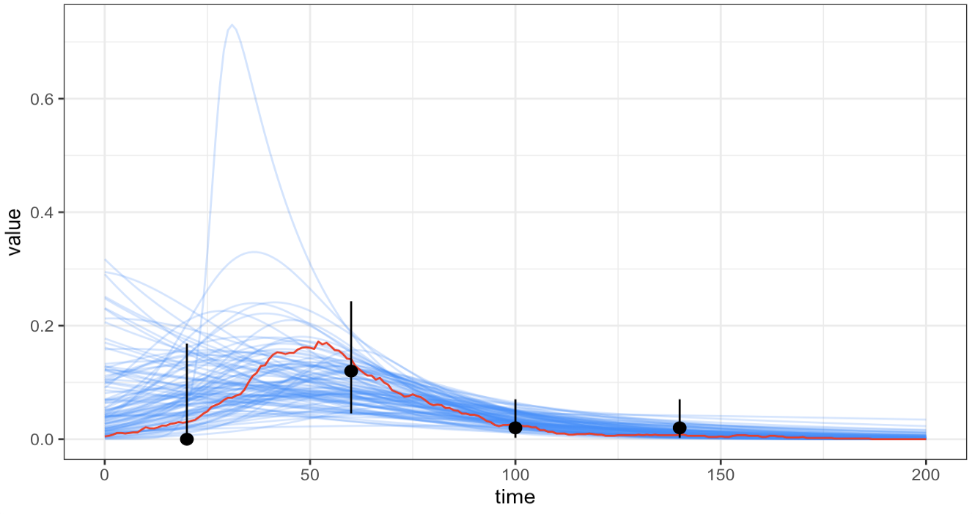
Model fit from the survey

Slide 10
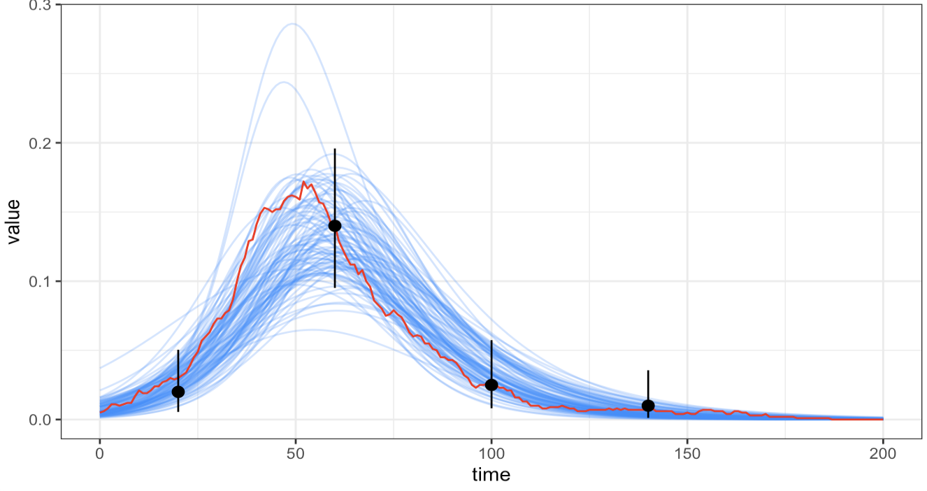
Model fit from the enhanced survey

