Slide 1
Lecture 4: Binary outcomes, comparing proportions Introduction to Statistical Thinking and Data Analysis MSc in Epidemiology / HDA 2019-20
Jeff Eaton (jeffrey.eaton@imperial.ac.uk)
28th October 2019

Slide 2
This week
Time | Session | Topic
Mon 28 Oct 10:00-11:00 | Tutorial | Tutorial sheet 3 review: Linear regression
Mon 28 Oct 11:15-12:15 | Lecture | Binary outcomes, comparing proportions
Mon 28 Oct 14:00-15:30 | Applied Statistics Lab | Project 1 Presentations: Epidemiology and determinants of high blood pressure
Weds 23 Oct 9:30-11:00 | R Statistical Computing | R: Loading and Formatting Data
Weds 23 Oct 14:00-15:30 | Maths Refresher | Linear Algebra I: Introduction to matrices and matrix calculus

Slide 3
Learning objectives
Define and be able to identify binary data.
Understand the origins of the binomial distribution and the normal approximation to the binomial distribution.
Calculate and interpret risk differences, relative risk, and odds ratios.

Slide 4
Readings
Kirkwood and Sterne:
Chapter 14: Probability, risk and odds (of disease)
Chapter 15: Proportions and the binomial distribution
Chapter 16: Comparing two proportions
Chapter 17: Chi-squared test for 2x2 and larger contingency tables
Chapter 18: Controlling for confounding: stratification
Supplementary:
Bland JM, Altman DG. (2000) The odds ratio. 320, 1468.

Slide 5
Probability and odds

Slide 6
Definitions of probability
Frequentist definition: The probability of an event is the proportion of times the event would occur in a large number of repeated trials.
Definition that underpins most of statistics (cf. interpretation of confidence interval).
Examples:
Proportion of coin tosses that turn up “heads”.
Proportion of days in which it rains.
Proportion of prostate cancer patients who survive 5 years.
Subjective (Bayesian) definition: The size of a probability represents degree of belief that an event will occur.
Corresponds more closely with colloquial usage of word probability.
Beliefs (probability) can be updated as new information becomes available.

Slide 7
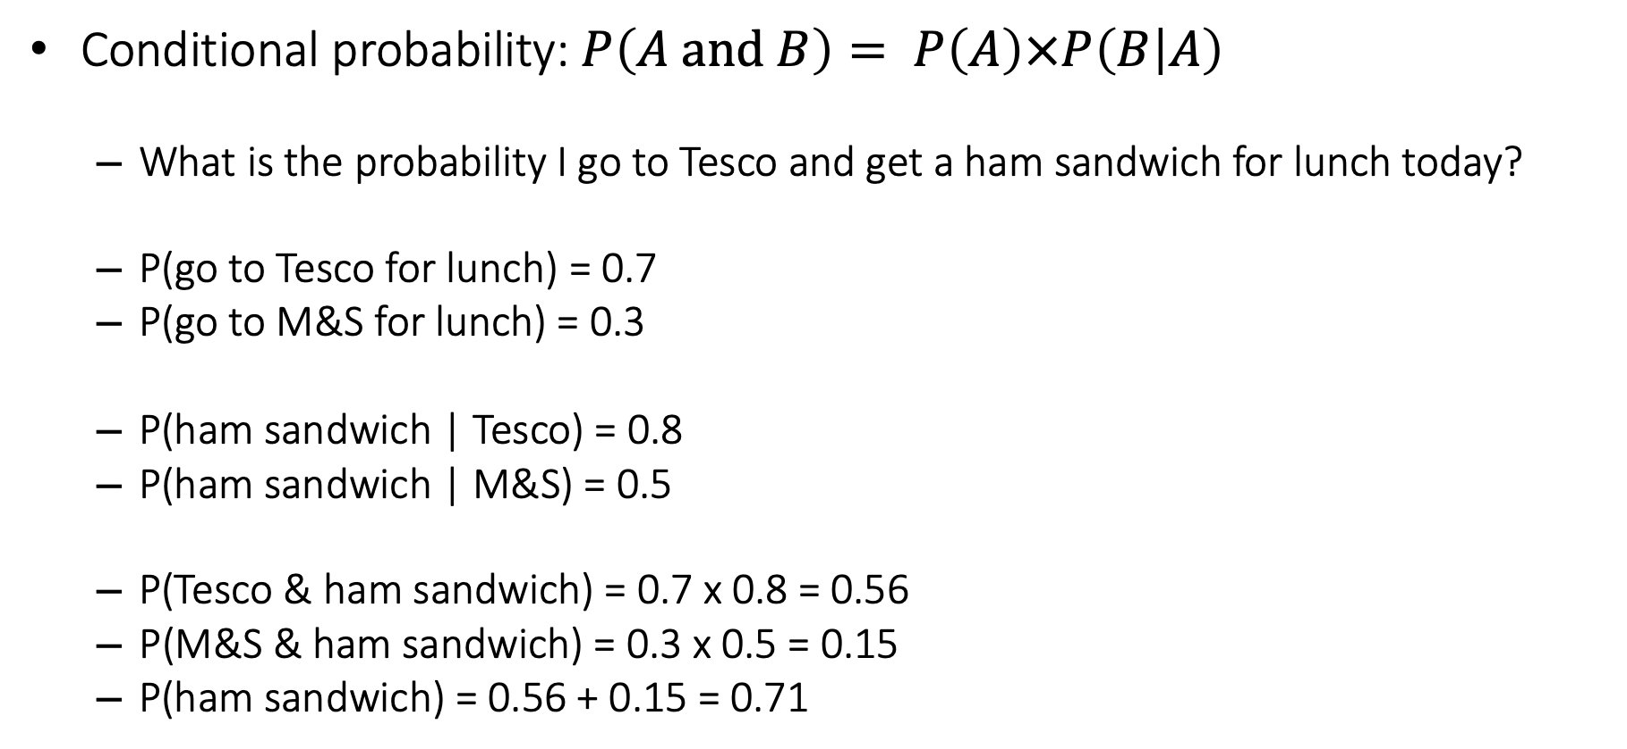
Rules of probabilities
Conditional probability:$P\left(A and B\right)= P\left(A\right)×P\left(B | A\right)$
What is the probability I go to Tesco and get a ham sandwich for lunch today?
P(go to Tesco for lunch) = 0.7
P(go to M&S for lunch) = 0.3
P(ham sandwich | Tesco) = 0.8
P(ham sandwich | M&S) = 0.5
P(Tesco & ham sandwich) = 0.7 x 0.8 = 0.56
P(M&S & ham sandwich) = 0.3 x 0.5 = 0.15
P(ham sandwich) = 0.56 + 0.15 = 0.71

Slide 8
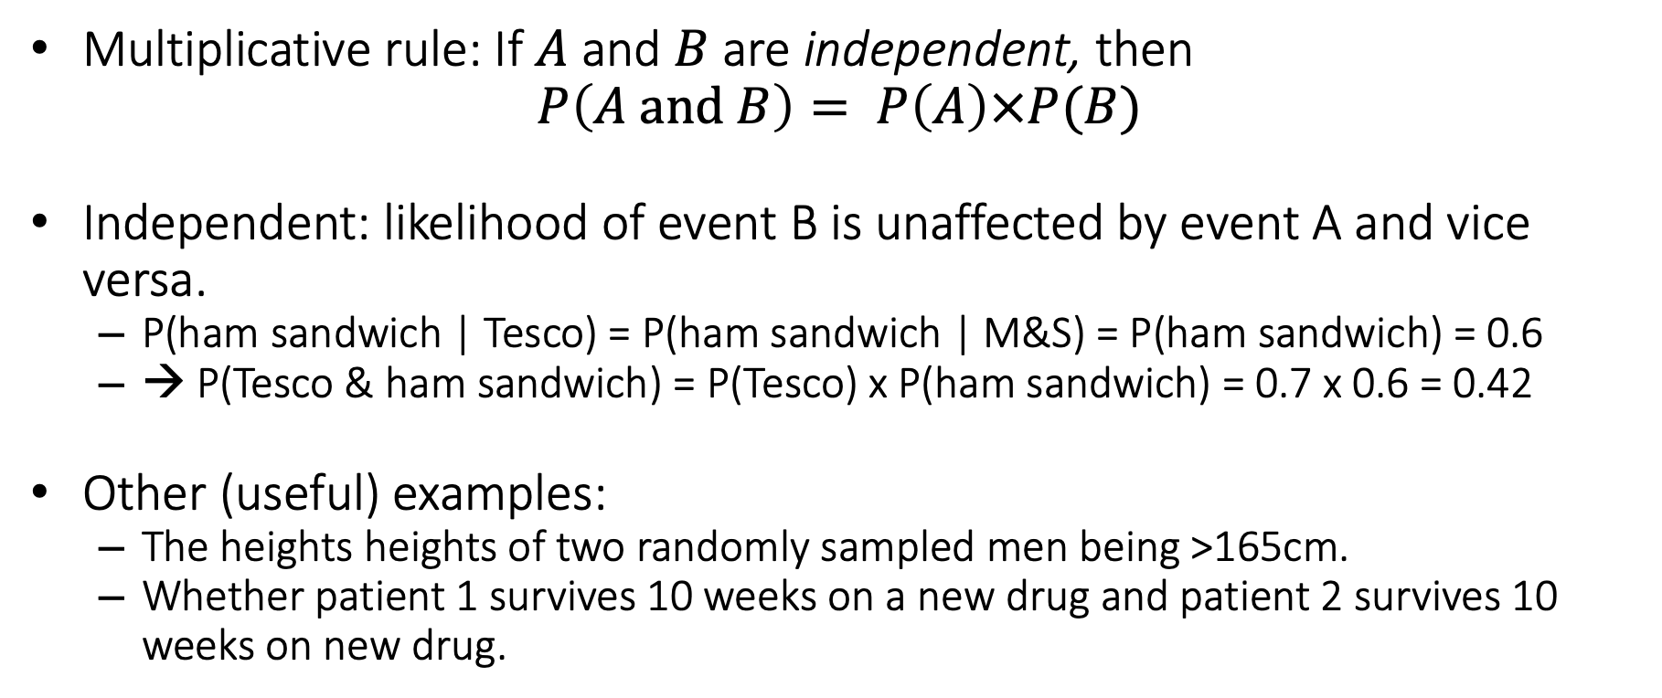
Rules of probabilities
Multiplicative rule: If $A$ and $B$are independent, then $P\left(A and B\right)= P\left(A\right)×P(B)$
Independent: likelihood of event B is unaffected by event A and vice versa.
P(ham sandwich | Tesco) = P(ham sandwich | M&S) = P(ham sandwich) = 0.6
→ P(Tesco & ham sandwich) = P(Tesco) x P(ham sandwich) = 0.7 x 0.6 = 0.42
Other (useful) examples:
The heights heights of two randomly sampled men being >165cm.
Whether patient 1 survives 10 weeks on a new drug and patient 2 survives 10 weeks on new drug.

Slide 9
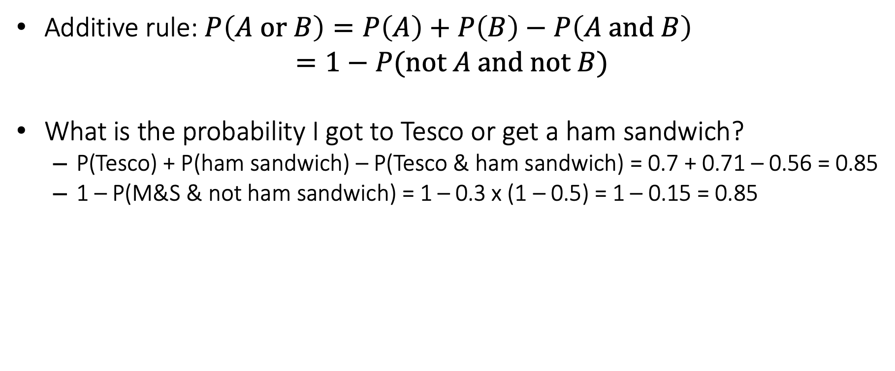
Rules of probabilities
Additive rule: $P\left(A or B\right)=P\left(A\right)+P\left(B\right)−P\left(A and B\right)$ $=1−P(not A and not B)$
What is the probability I got to Tesco or get a ham sandwich?
P(Tesco) + P(ham sandwich) – P(Tesco & ham sandwich) = 0.7 + 0.71 – 0.56 = 0.85
1 – P(M&S & not ham sandwich) = 1 – 0.3 x (1 – 0.5) = 1 – 0.15 = 0.85

Slide 10
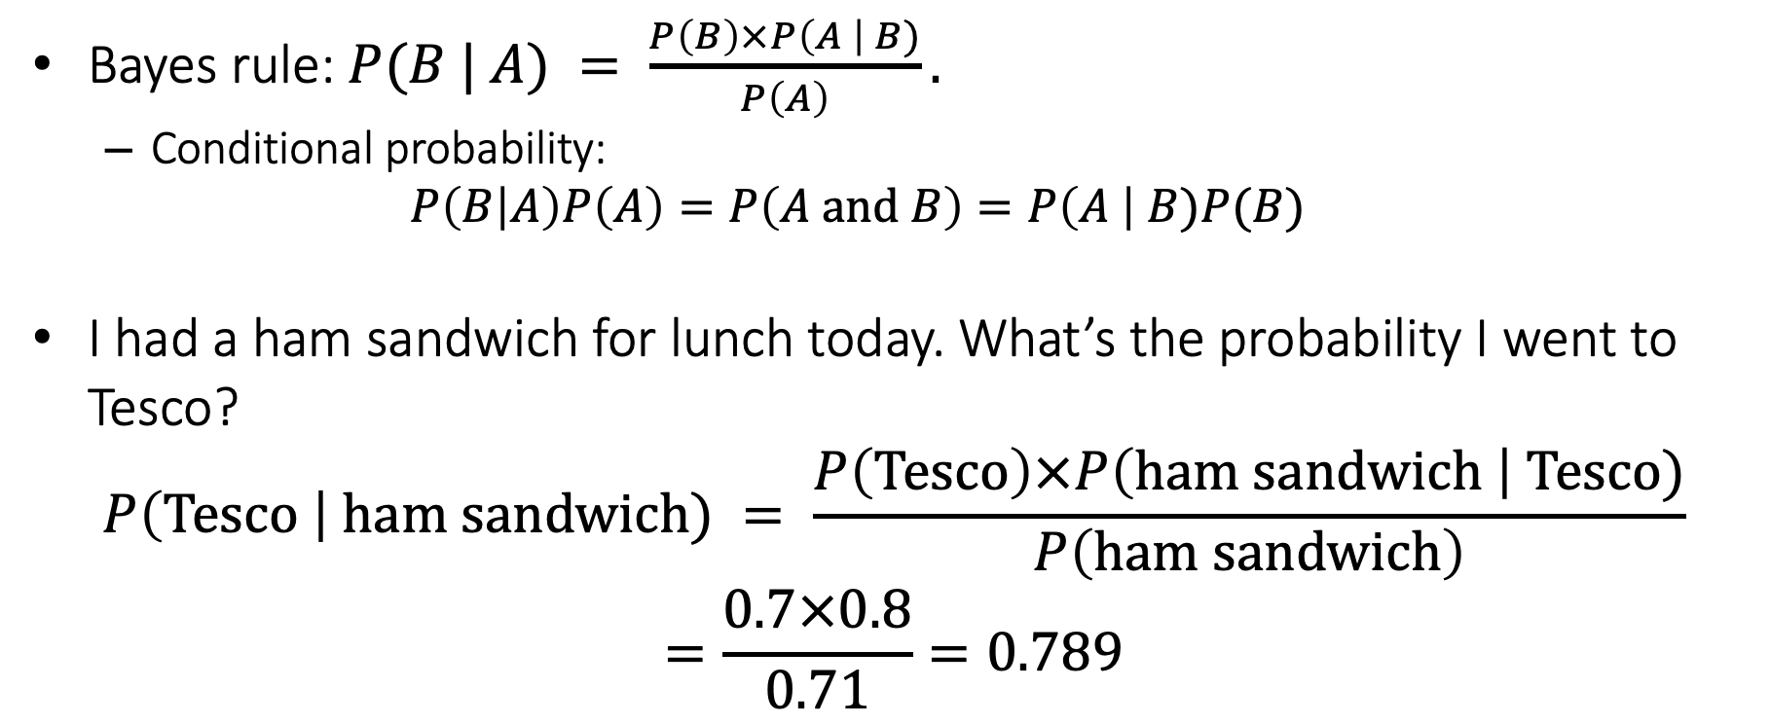
Rules of probabilities
Bayes rule: $P(B | A) = \frac{P\left(B\right)×P\left(A \right| B)}{P\left(A\right)}.$
Conditional probability:
$$P\left(B | A\right)P\left(A\right)=P\left(A and B\right)=P\left(A \right| B)P(B)$$
I had a ham sandwich for lunch today. What’s the probability I went to Tesco?
$$P\left(Tesco \right| ham sandwich) = \frac{P\left(Tesco\right)×P\left(ham sandwich \right| Tesco)}{P\left(ham sandwich\right)}$$
$$=\frac{0.7×0.8}{0.71}=0.789$$

Slide 11
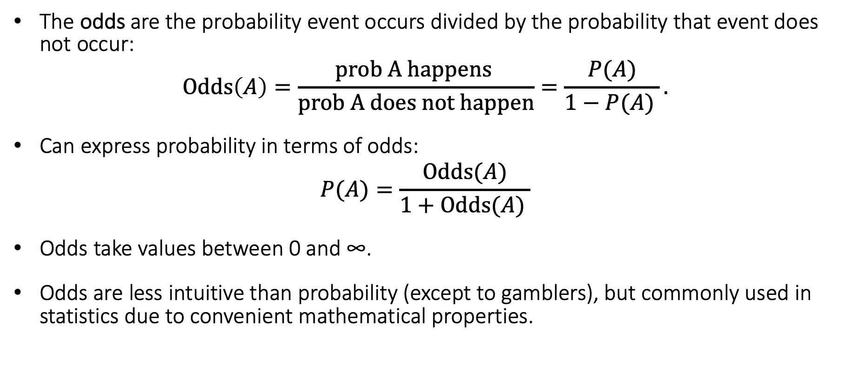
Odds
The odds are the probability event occurs divided by the probability that event does not occur:
$$Odds\left(A\right)=\frac{prob A happens }{prob A does not happen}=\frac{P(A)}{1−P(A) }.$$
Can express probability in terms of odds:
$$P(A)=\frac{Odds(A)}{1+Odds(A) }$$
Odds take values between 0 and ∞.
Odds are less intuitive than probability (except to gamblers), but commonly used in statistics due to convenient mathematical properties.

Slide 12
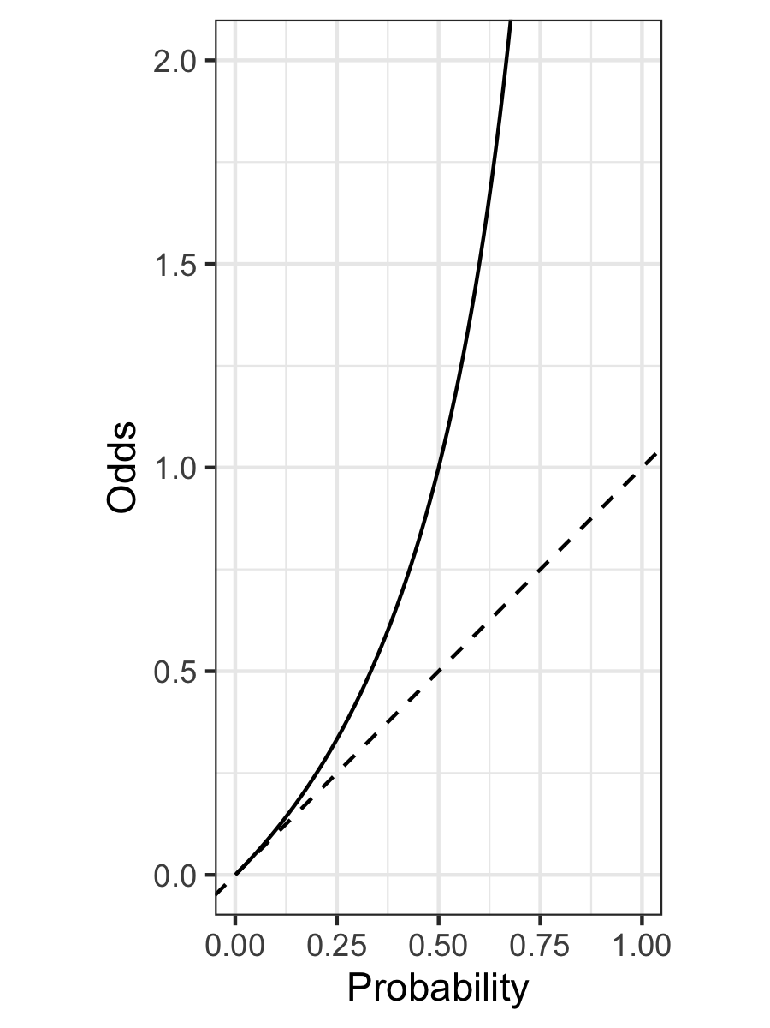
Comparing probability and odds
Probability | Odds
0 | 0
0.01 | 0.0101
0.05 | 0.0526
0.1 | 0.111
0.2 | 0.25
0.5 | 1
0.9 | 9
0.95 | 19
0.99 | 99
0.999 | 999

Slide 13
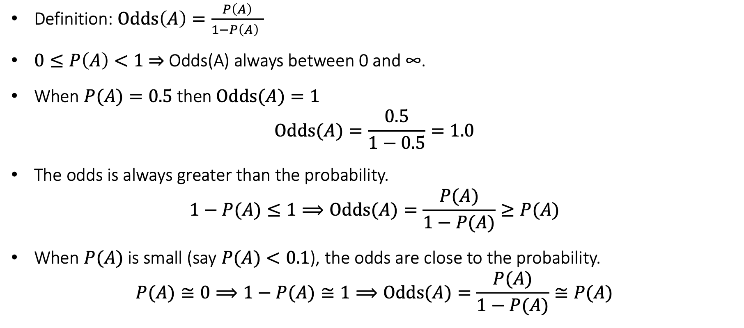
Properties of odds
Definition: $Odds\left(A\right)=\frac{P\left(A\right)}{1−P\left(A\right) }$
$0≤P\left(A\right)<1$ ⇒ Odds(A) always between 0 and ∞.
When $P(A)=0.5$ then $Odds(A)=1$
$$Odds(A)=\frac{0.5}{1−0.5}=1.0$$
The odds is always greater than the probability.
$$1−P(A)≤1⟹Odds(A)=\frac{P(A)}{1−P(A)}≥P(A)$$
When $P(A)$ is small (say $P(A)<0.1$), the odds are close to the probability.
$$P(A)≅0⟹1−P(A)≅1⟹Odds(A)=\frac{P(A)}{1−P(A)}≅P(A)$$

Slide 14
The binomial distribution

Slide 15


Did you have a ham sandwich for lunch?
30% of Brits have a ham sandwich for
Random sample 2 people and ask “did you have a ham sandwich for lunch yesterday?”
What is the probability that $x$ people respond ‘Yes’?
Responses ($n=2)$ | ‘Yes’ ($x$) | Probability
○○ | 0 | $$0.7×0.7=0.49$$
●○ | 1 | $$0.3×0.7=0.21$$
○● | 1 | $$0.7×0.3=0.21$$
●● | 2 | $$0.3×0.3=0.09$$
P(x = 0) = 0.49
P(x = 1) = 0.21 + 0.21 = 0.42
P(x = 2) = 0.09

Slide 16
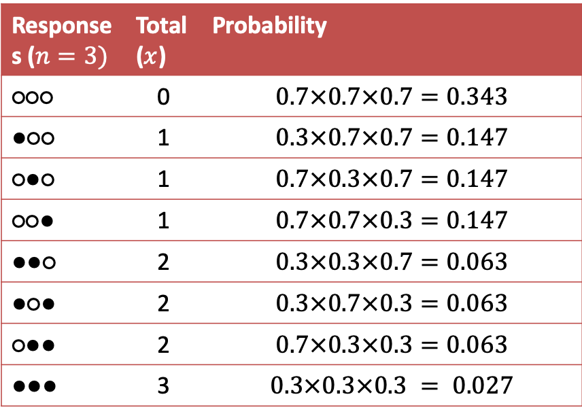
Did you have a ham sandwich for lunch?
Random sample 3 people and ask “did you have a ham sandwich for lunch yesterday?”
Responses ($n=3)$ | Total ($x$) | Probability
○○○ | 0 | $$0.7×0.7×0.7=0.343$$
●○○ | 1 | $$0.3×0.7×0.7=0.147$$
○●○ | 1 | $$0.7×0.3×0.7=0.147$$
○○● | 1 | $$0.7×0.7×0.3=0.147$$
●●○ | 2 | $$0.3×0.3×0.7=0.063$$
●○● | 2 | $$0.3×0.7×0.3=0.063$$
○●● | 2 | $$0.7×0.3×0.3=0.063$$
●●● | 3 | $$0.3×0.3×0.3 = 0.027$$
P(x = 0) = 0.343
P(x = 1) = 3 x 0.147 = 0.441
P(x = 2) = 3 x 0.063 = 0.189
P(x = 3) = 0.027

Slide 17
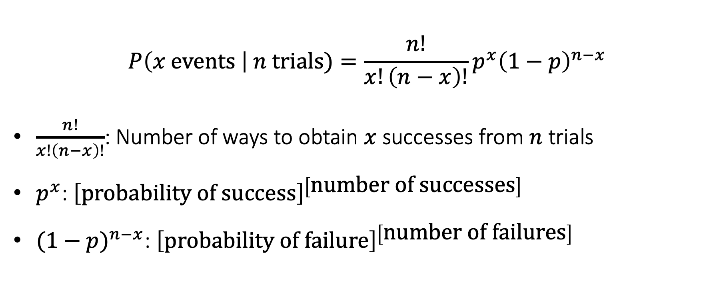
Binomial distribution formula
$$P\left(x \text{events} \right| n \text{trials})=\frac{n!}{x!\left(n−x\right)!}p^{x}{\left(1−p\right)}^{n−x}$$
$\frac{n!}{x!\left(n−x\right)!}$: Number of ways to obtain $x$ successes from $n$ trials
$p^{x}$: ${\left[\text{probability} \text{of} \text{success}\right]}^{\left[\text{number} \text{of} \text{successes}\right] }$
${(1−p)}^{n−x}$: ${\left[\text{probability} \text{of} \text{failure}\right]}^{\left[\text{number} \text{of} \text{failures}\right] }$

Slide 18
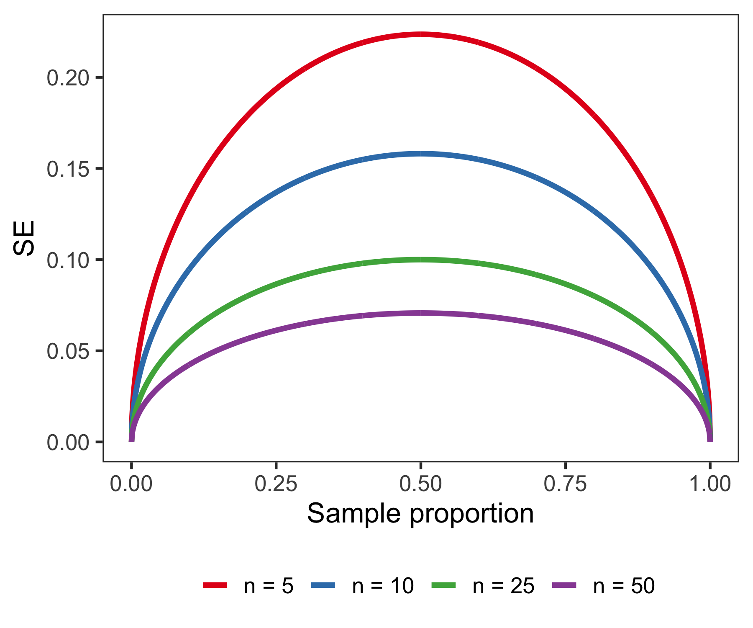
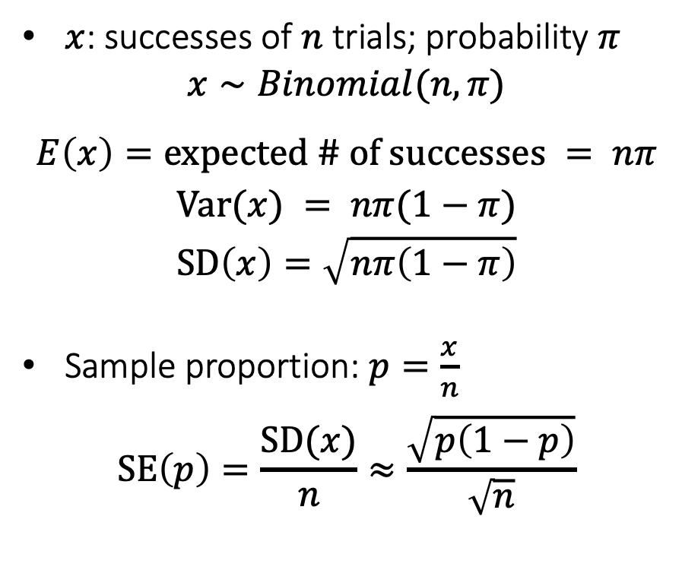
Standard error of a proportion
$x$: successes of $n$ trials; probability $π$
$$x∼Binomial(n, π)$$
$$\begin{aligned}E\left(x\right)=\text{expected}\text{ \# }\text{of} \text{succes}\text{s}\text{es} = nπ\end{aligned}$$
$$Var(x) = nπ(1−π)$$
$$SD\left(x\right)=\sqrt{nπ\left(1−π\right)}$$
Sample proportion: $p=\frac{x}{n}$
$$SE\left(p\right)=\frac{SD(x)}{n}≈\frac{\sqrt{p\left(1−p\right)}}{\sqrt{n}}$$

Slide 19
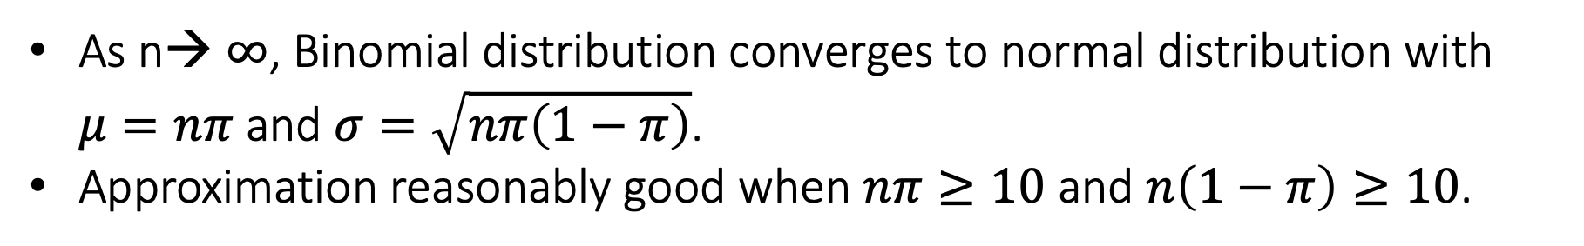
Normal approximation to the binomial distribution
As n→ $∞$, Binomial distribution converges to normal distribution with $μ=nπ$ and $σ=\sqrt{nπ\left(1−π\right)}$.
Approximation reasonably good when $nπ≥10$ and $n\left(1−π\right)≥10$.

Slide 20
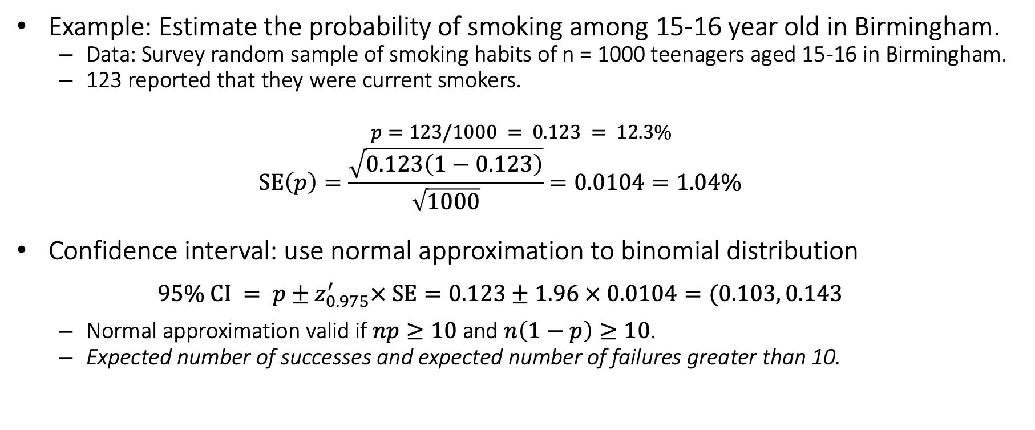
Confidence interval for a proportion
Example: Estimate the probability of smoking among 15-16 year old in Birmingham.
Data: Survey random sample of smoking habits of n = 1000 teenagers aged 15-16 in Birmingham.
123 reported that they were current smokers.
$$p=123/1000 = 0.123 = 12.3\%$$
$$SE\left(p\right)=\frac{\sqrt{0.123\left(1−0.123\right)}}{\sqrt{1000}}=0.0104=1.04\%$$
Confidence interval: use normal approximation to binomial distribution
$$95\% CI = p±z_{0.975}^{′}× SE=0.123±1.96 × 0.0104=(0.103, 0.143$$
Normal approximation valid if $np≥10$ and $n\left(1−p\right)≥10$.
Expected number of successes and expected number of failures greater than 10.

Slide 21

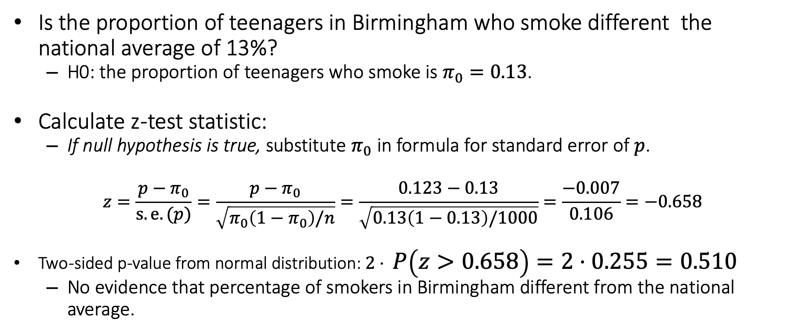
Hypothesis test for a proportion
Is the proportion of teenagers in Birmingham who smoke different the national average of 13%?
H0: the proportion of teenagers who smoke is $π_{0}=0.13$.
Calculate z-test statistic:
If null hypothesis is true, substitute $π_{0}$ in formula for standard error of $p$.
$$z=\frac{p−π_{0}}{s.e.(p)}=\frac{p−π_{0}}{\sqrt{π_{0}\left(1−π_{0}\right)/n}}=\frac{0.123−0.13}{\sqrt{0.13\left(1−0.13\right)/1000}}=\frac{−0.007}{0.106}=−0.658$$
Two-sided p-value from normal distribution: $2⋅ P\left(z>0.658\right)=2⋅0.255=0.510$
No evidence that percentage of smokers in Birmingham different from the national average.
$$z=\frac{p−π_{0}}{s.e.(p)}=\frac{p−π_{0}}{\sqrt{π_{0}\left(1−π_{0}\right)/n}}$$

Slide 22
Testing equality of a proportion in R
prop.test(x, n, p = NULL,
alternative = c("two.sided", "less", "greater"),
conf.level = 0.95, correct = TRUE)
x: number of successes
n: number of trials
p: reference proportion for hypothesis test
correct: TRUE/FALSE whether to apply continuity correction
> prop.test(123, 1000, p = 0.13, correct = FALSE)
1-sample proportions test without continuity correction
data: 123 out of 1000, null probability 0.13
X-squared = 0.43324, df = 1, p-value = 0.5104
alternative hypothesis: true p is not equal to 0.13
95 percent confidence interval:
0.1040741 0.1448112
sample estimates:
p
0.123

Slide 23
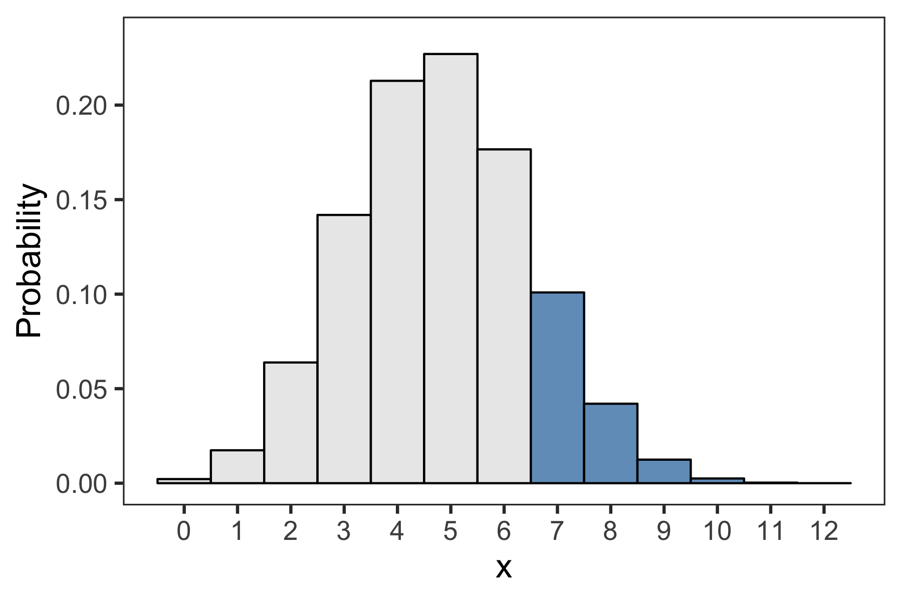
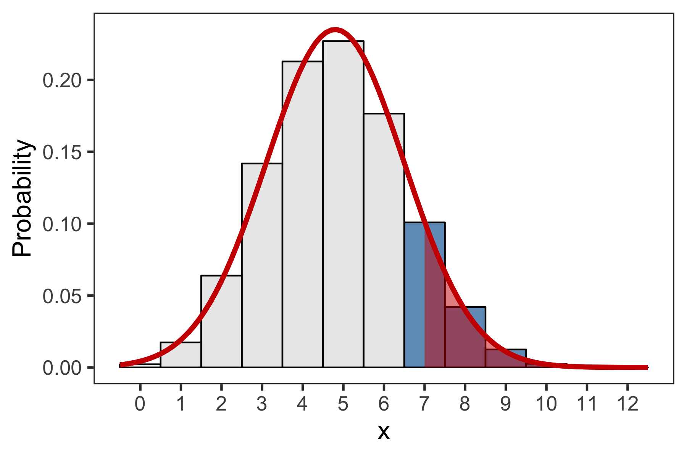
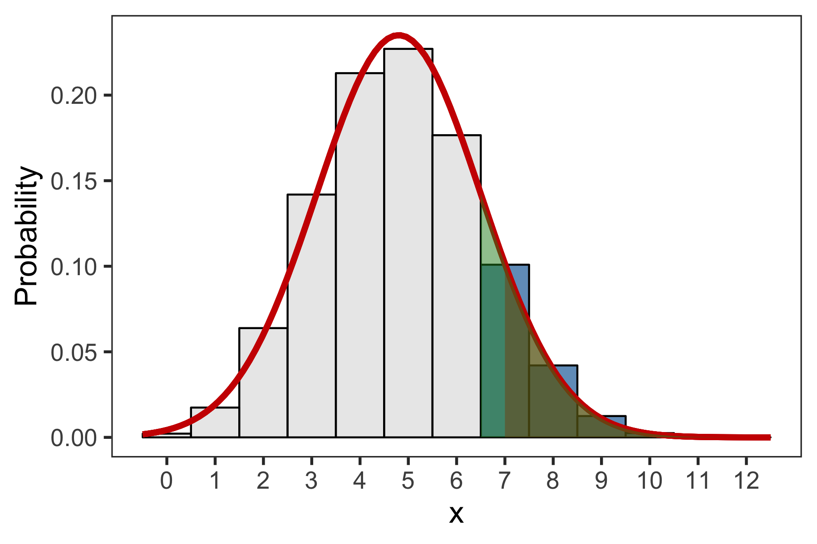
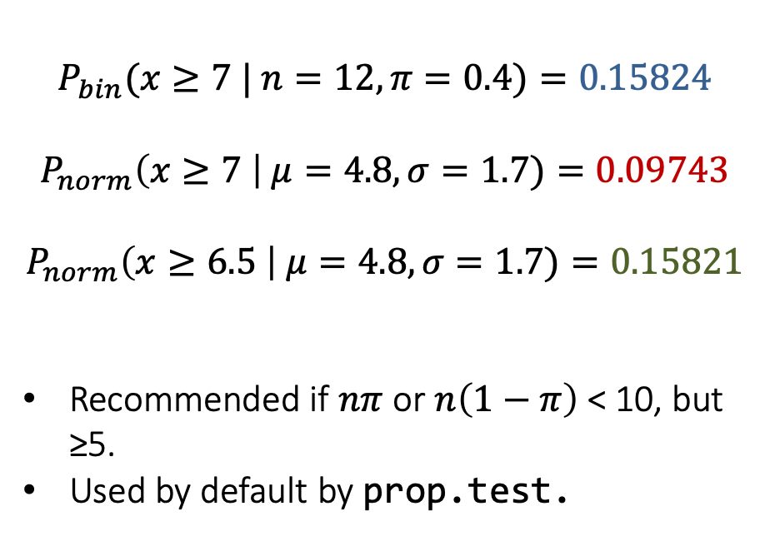
Continuity correction
How accurate is the normal approximation to the binomial distribution?
$$P_{bin}(x≥7 | n=12, π=0.4)=0.15824$$
$$P_{norm}\left(x≥7 \right| μ=4.8, σ=1.7)=0.09743$$
$$P_{norm}\left(x≥6.5 \right| μ=4.8, σ=1.7)=0.15821$$
Recommended if $nπ$ or $n\left(1−π\right)$ < 10, but ≥5.
Used by default by prop.test.

Slide 24
Testing equality of a proportion in R
> prop.test(123, 1000, p = 0.13, correct = FALSE)
1-sample proportions test without continuity correction
data: 123 out of 1000, null probability 0.13
X-squared = 0.43324, df = 1, p-value = 0.5104
alternative hypothesis: true p is not equal to 0.13
95 percent confidence interval:
0.1040741 0.1448112
sample estimates:
p
0.123
## prop.test(123, 1000, p = 0.13, correct = TRUE)
> prop.test(123, 1000, p = 0.13)
1-sample proportions test with continuity correction
data: 123 out of 1000, null probability 0.13
X-squared = 0.37356, df = 1, p-value = 0.5411
alternative hypothesis: true p is not equal to 0.13
95 percent confidence interval:
0.1036114 0.1453445
sample estimates:
p
0.123

Slide 25
Comparing two proportions

Slide 26
Comparing two proportions
Compare the occurrence of a binary outcome between two groups
Extremely common design in medical statistics.
Two groups: exposed vs. unexposed; treatment vs. control (placebo)
Outcome: occurrence of disease; relapse, etc.

Slide 27
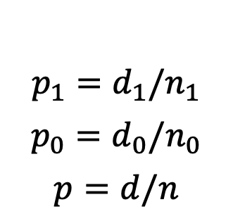
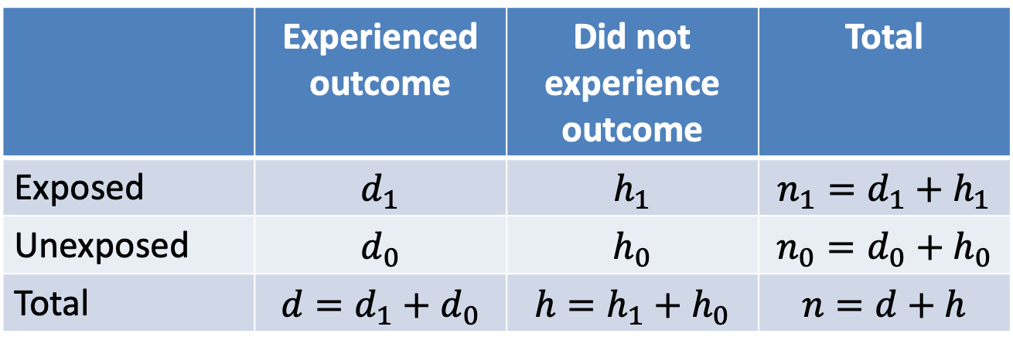
2x2 contingency table
Contingency table: summary of relationship between categorical variables.
Convention: rows correspond to exposure; columns to outcome.
Question: are proportions of events in each row the same?
 | Experienced outcome | Did not experience outcome | Total
Exposed | $$d_{1}$$ | $$h_{1}$$ | $${n_{1}=d}_{1}+h_{1}$$
Unexposed | $$d_{0}$$ | $$h_{0}$$ | $${n_{0}=d}_{0}+h_{0}$$
Total | $$d=d_{1}+d_{0}$$ | $$h=h_{1}+h_{0}$$ | $$n=d+h$$
$$p_{1}=d_{1}/n_{1}$$
$$p_{0}=d_{0}/n_{0}$$
$$p=d/n$$

Slide 28
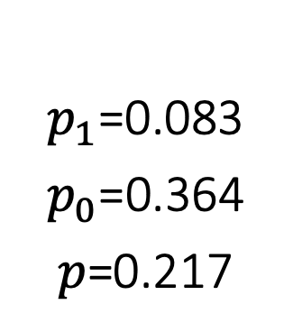
2x2 contingency table
Example: n = 460 adults enrolled in flu vaccine trial.
240 received vaccine / 220 received placebo
20 flu cases in vaccine group / 80 in placebo group
 | Flu | No flu | Total
Vaccine
Placebo
Total |  |  | 460
 | Flu | No flu | Total
Vaccine |  |  | 240
Placebo |  |  | 220
Total |  |  | 460
 | Flu | No flu | Total
Vaccine | 20 |  | 240
Placebo | 80 |  | 220
Total |  |  | 460
 | Flu | No flu | Total
Vaccine | 20 | 220 | 240
Placebo | 80 | 140 | 220
Total | 100 | 360 | 460
$p_{1}$=0.083
$p_{0}$=0.364
$p$=0.217

Slide 29
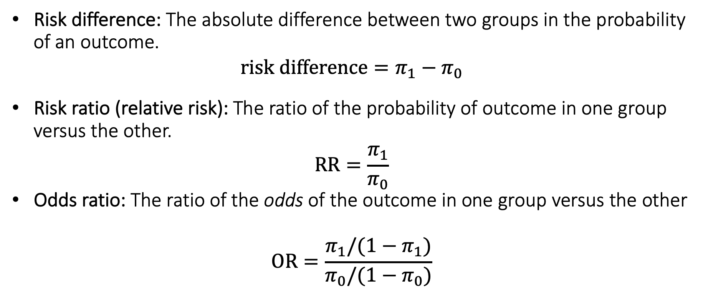
Measures of difference for proportions
Risk difference: The absolute difference between two groups in the probability of an outcome.
$$risk difference=π_{1}−π_{0}$$
Risk ratio (relative risk): The ratio of the probability of outcome in one group versus the other.
$$RR=\frac{π_{1}}{π_{0}}$$
Odds ratio: The ratio of the odds of the outcome in one group versus the other
$$OR=\frac{π_{1}/(1−π_{1})}{π_{0}/(1−π_{0})}$$

Slide 30
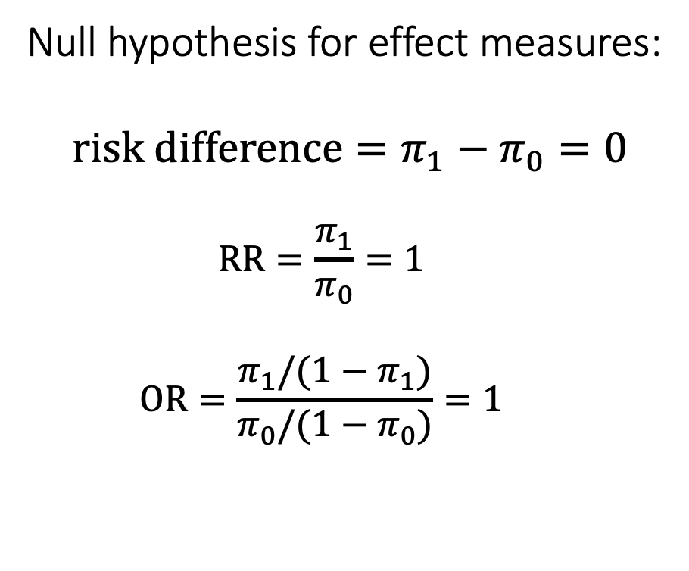

Null hypothesis for comparing proportions
Null hypothesis: no difference in risk between groups
$$π_{1}=π_{0}$$
Null hypothesis for effect measures:
$$risk difference=π_{1}−π_{0}=0$$
$$RR=\frac{π_{1}}{π_{0}}=1$$
$$OR=\frac{π_{1}/(1−π_{1})}{π_{0}/(1−π_{0})}=1$$

Slide 31
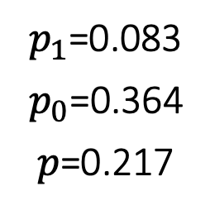
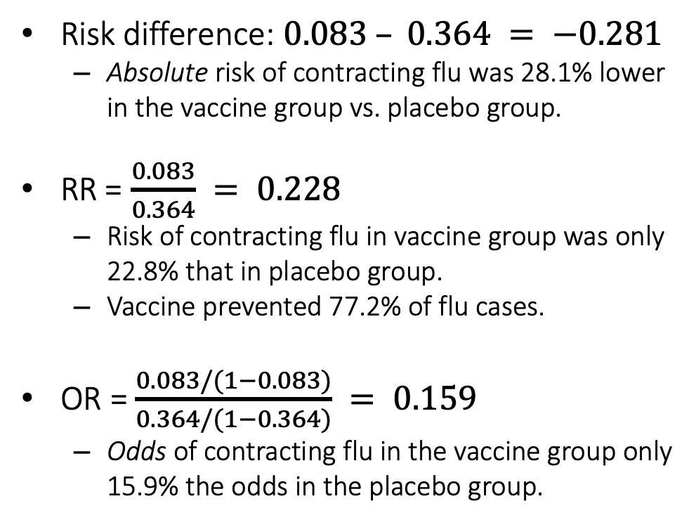
Measures of difference for proportions
Risk difference: $0.083 – 0.364 = −0.281$
Absolute risk of contracting flu was 28.1% lower in the vaccine group vs. placebo group.
RR = $\frac{0.083}{0.364} = 0.228$
Risk of contracting flu in vaccine group was only 22.8% that in placebo group.
Vaccine prevented 77.2% of flu cases.
OR = $\frac{0.083/(1−0.083)}{0.364/(1−0.364)} = 0.159$
Odds of contracting flu in the vaccine group only 15.9% the odds in the placebo group.
 | Flu | No flu | Total
Vaccine | 20 | 220 | 240
Placebo | 80 | 140 | 220
Total | 100 | 360 | 460
$p_{1}$=0.083
$p_{0}$=0.364
$p$=0.217

Slide 32
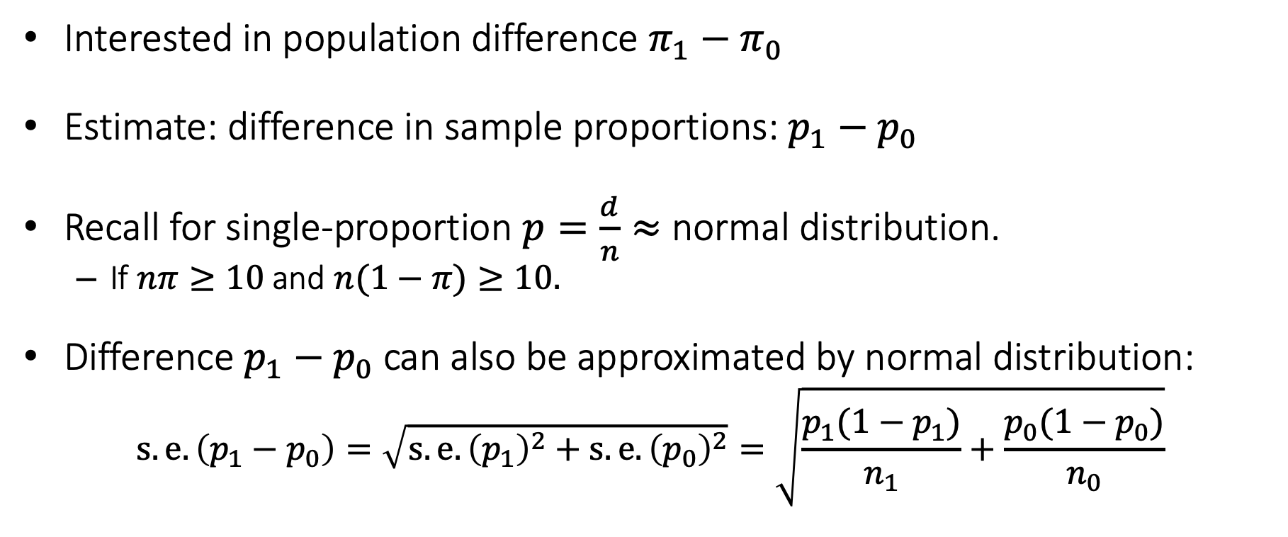
Confidence interval for risk difference
Interested in population difference $π_{1}−π_{0}$
Estimate: difference in sample proportions: $p_{1}−p_{0}$
Recall for single-proportion $p=\frac{d}{n}≈$ normal distribution.
If $nπ≥10$ and $n(1−π)≥10.$
Difference $p_{1}−p_{0}$ can also be approximated by normal distribution:
$$s.e.\left(p_{1}−p_{0}\right)=\sqrt{s.e.{\left(p_{1}\right)}^{2}+s.e.{\left(p_{0}\right)}^{2}}=\sqrt{\frac{p_{1}(1−p_{1})}{n_{1}}+\frac{p_{0}(1−p_{0})}{n_{0}}}$$

Slide 33
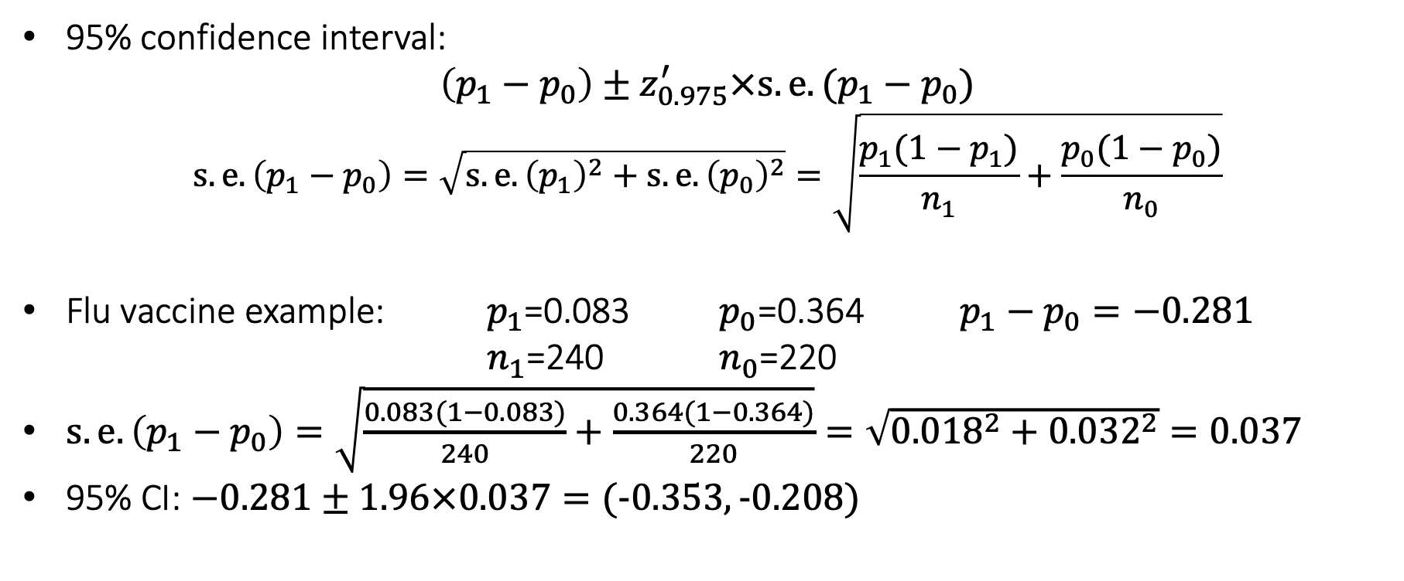
Confidence interval for risk difference
95% confidence interval:
$$\left(p_{1}−p_{0}\right)±z_{0.975}^{′}×s.e.(p_{1}−p_{0})$$
$$s.e.\left(p_{1}−p_{0}\right)=\sqrt{s.e.{\left(p_{1}\right)}^{2}+s.e.{\left(p_{0}\right)}^{2}}=\sqrt{\frac{p_{1}(1−p_{1})}{n_{1}}+\frac{p_{0}(1−p_{0})}{n_{0}}}$$
Flu vaccine example: $p_{1}$=0.083 $p_{0}$=0.364 $p_{1}−p_{0}=−0.281$ $n_{1}$=240 $n_{0}$=220
$s.e.\left(p_{1}−p_{0}\right)=\sqrt{\frac{0.083(1−0.083)}{240}+\frac{0.364(1−0.364)}{220}}=\sqrt{{0.018}^{2}+{0.032}^{2}}=0.037$
95% CI: $−0.281±1.96×0.037=(−0.353, −0.208)$

Slide 34
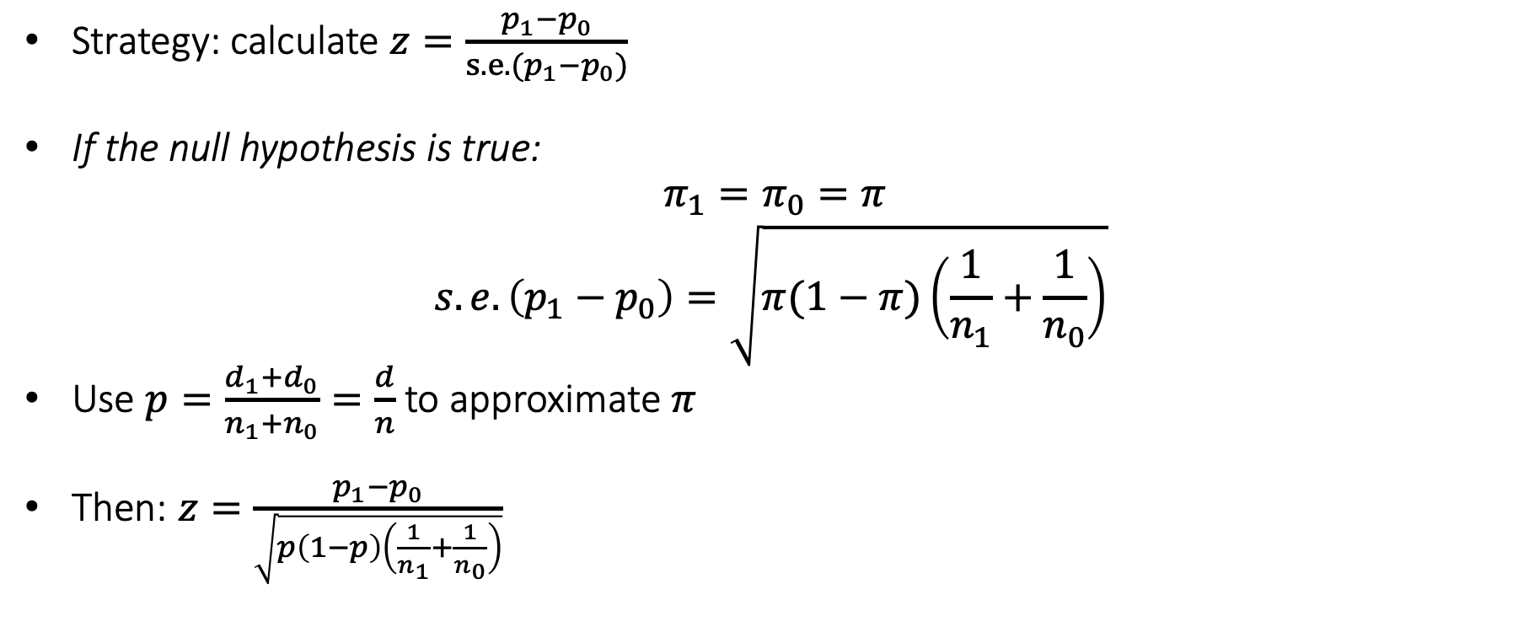
Hypothesis test for risk difference = zero
Strategy: calculate $z=\frac{p_{1}−p_{0}}{s.e.(p_{1}−p_{0})}$
If the null hypothesis is true:
$π_{1}=π_{0}=π$
$$s.e.\left(p_{1}−p_{0}\right)=\sqrt{π(1−π)\left(\frac{1}{n_{1}}+\frac{1}{n_{0}}\right)}$$
Use $p=\frac{d_{1}+d_{0}}{n_{1}+n_{0}}=\frac{d}{n}$ to approximate $π$
Then: $z=\frac{p_{1}−p_{0}}{\sqrt{p\left(1−p\right)\left(\frac{1}{n_{1}}+\frac{1}{n_{0}}\right)}}$

Slide 35
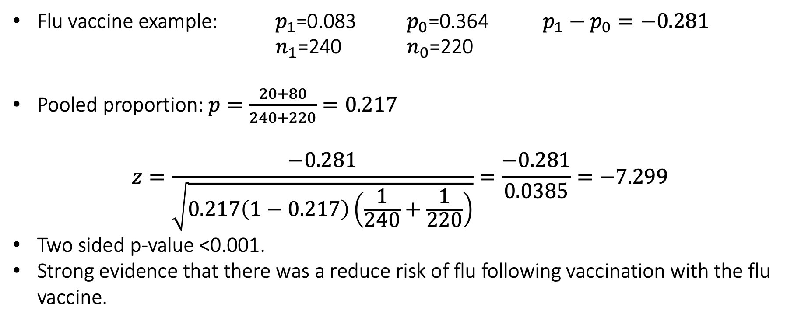
Hypothesis test for risk difference = zero
Flu vaccine example: $p_{1}$=0.083 $p_{0}$=0.364 $p_{1}−p_{0}=−0.281$ $n_{1}$=240 $n_{0}$=220
Pooled proportion: $p=\frac{20+80}{240+220}=0.217$
$$z=\frac{−0.281}{\sqrt{0.217\left(1−0.217\right)\left(\frac{1}{240}+\frac{1}{220}\right)}}=\frac{−0.281}{0.0385}=−7.299$$
Two sided p-value <0.001.
Strong evidence that there was a reduce risk of flu following vaccination with the flu vaccine.

Slide 36
Risk difference in R
> prop.test(c(20, 80), c(240, 220), correct = FALSE)
2-sample test for equality of proportions without continuity correction
data: c(20, 80) out of c(240, 220)
X-squared = 53.008, df = 1, p-value = 3.321e-13
alternative hypothesis: two.sided
95 percent confidence interval:
-0.3528516 -0.2077545
sample estimates:
prop 1 prop 2
0.08333333 0.36363636

Slide 37
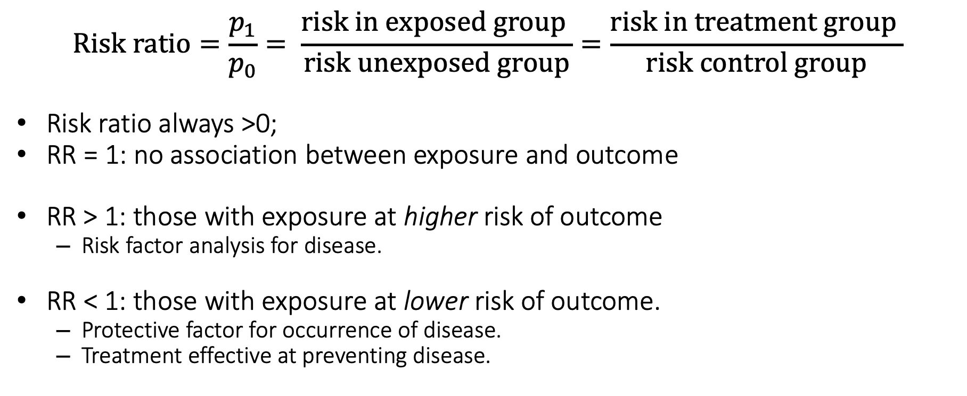
Interpreting the risk ratio
$$Risk ratio=\frac{p_{1}}{p_{0}}= \frac{risk in exposed group }{risk unexposed group}=\frac{risk in treatment group }{risk control group}$$
Risk ratio always >0;
RR = 1: no association between exposure and outcome
RR > 1: those with exposure at higher risk of outcome
Risk factor analysis for disease.
RR < 1: those with exposure at lower risk of outcome.
Protective factor for occurrence of disease.
Treatment effective at preventing disease.

Slide 38
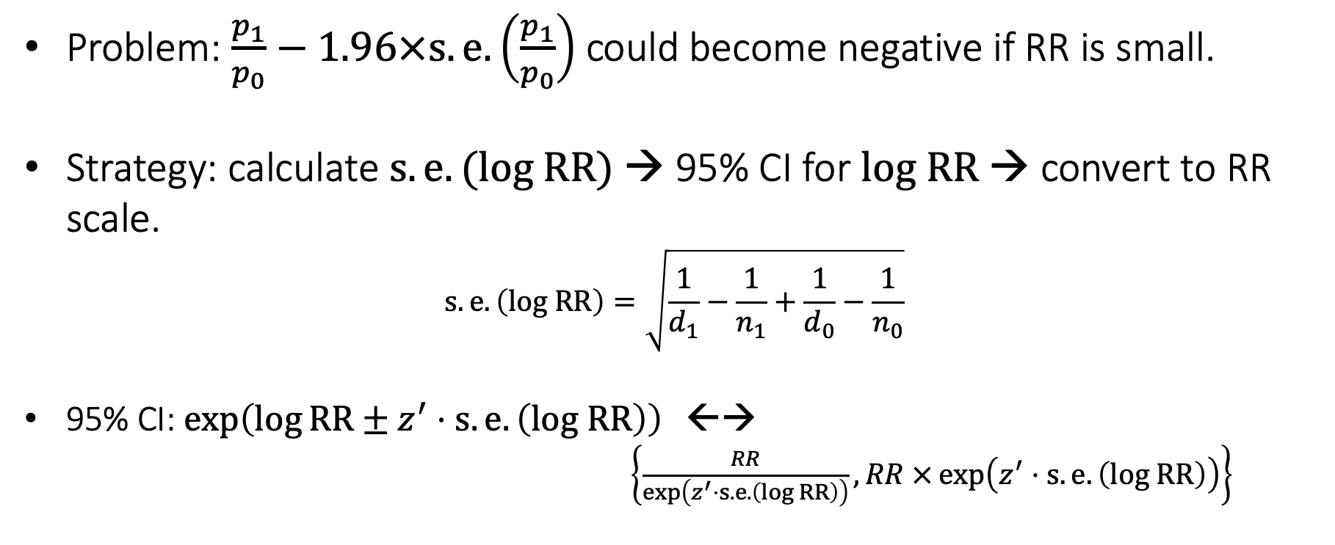
Confidence interval for RR
Problem: $\frac{p_{1}}{p_{0}}−1.96×s.e.\left(\frac{p_{1}}{p_{0}}\right)$ could become negative if RR is small.
Strategy: calculate $s.e.(log RR)$ → 95% CI for $log RR$ → convert to RR scale.
$$s.e.\left(log RR\right)=\sqrt{\frac{1}{d_{1}}−\frac{1}{n_{1}}+\frac{1}{d_{0}}−\frac{1}{n_{0}}}$$
95% CI: $\exp\left(\log{RR±z^{′}⋅s.e.\left(log RR\right)}\right)$ ←→
$\left\{\frac{RR}{\exp\left(z^{′}⋅s.e.\left(log RR\right)\right)},RR ×\exp\left(z^{′}⋅s.e.\left(log RR\right)\right)\right\}$

Slide 39
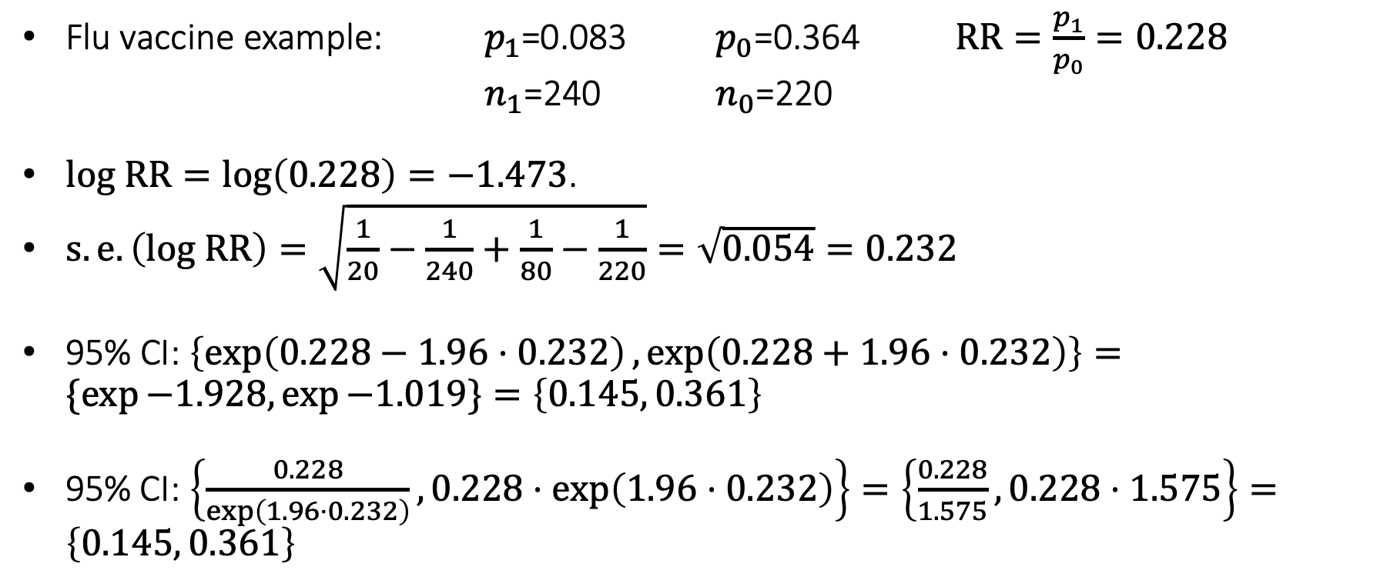
Confidence interval for RR
Flu vaccine example: $p_{1}$=0.083 $p_{0}$=0.364 $RR=\frac{p_{1}}{p_{0}}=0.228$ $n_{1}$=240 $n_{0}$=220
$log RR=\log\left(0.228\right)=−1.473$.
$s.e.\left(log RR\right)=\sqrt{\frac{1}{20}−\frac{1}{240}+\frac{1}{80}−\frac{1}{220}}=\sqrt{0.054}=0.232$
95% CI: $\left\{\exp\left(0.228−1.96⋅0.232\right),\exp\left(0.228+1.96⋅0.232\right)\right\}=\{\exp{−1.928,\exp{−1.019\}=\left\{0.145, 0.361\right\}}}$
95% CI: $\left\{\frac{0.228}{exp\left(1.96⋅0.232\right)},0.228⋅\exp\left(1.96⋅0.232\right)\right\}=\left\{\frac{0.228}{1.575}, 0.228⋅1.575\right\}=\left\{0.145, 0.361\right\}$

Slide 40
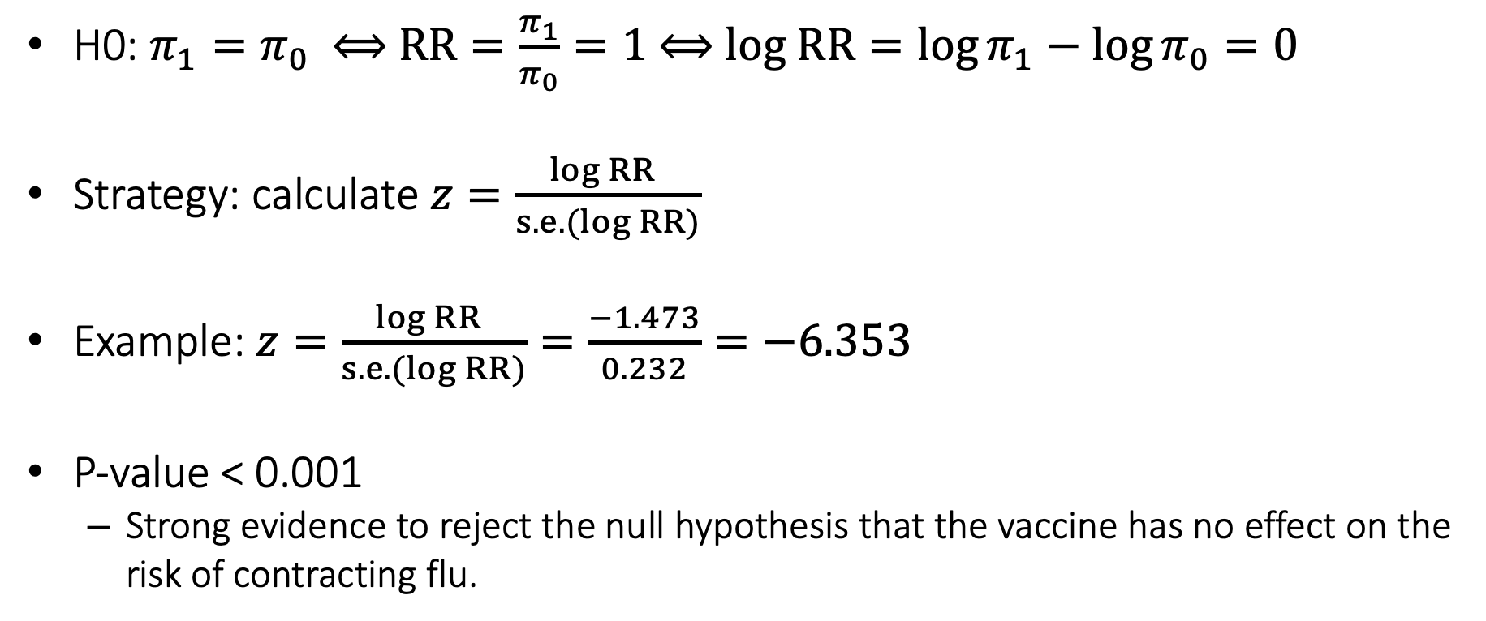
Hypothesis test for risk ratio
H0: $π_{1}=π_{0}$ ⟺ $RR=\frac{π_{1}}{π_{0}}=1 \text{⟺ }log RR=\log{π_{1}−\log{π_{0}}}=0$
Strategy: calculate $z=\frac{log RR }{s.e.(log RR)}$
Example: $z=\frac{log RR }{s.e.(log RR)}=\frac{−1.473}{0.232}=−6.353$
P-value < 0.001
Strong evidence to reject the null hypothesis that the vaccine has no effect on the risk of contracting flu.

Slide 41
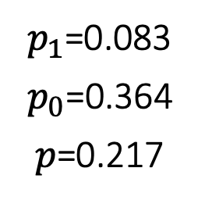
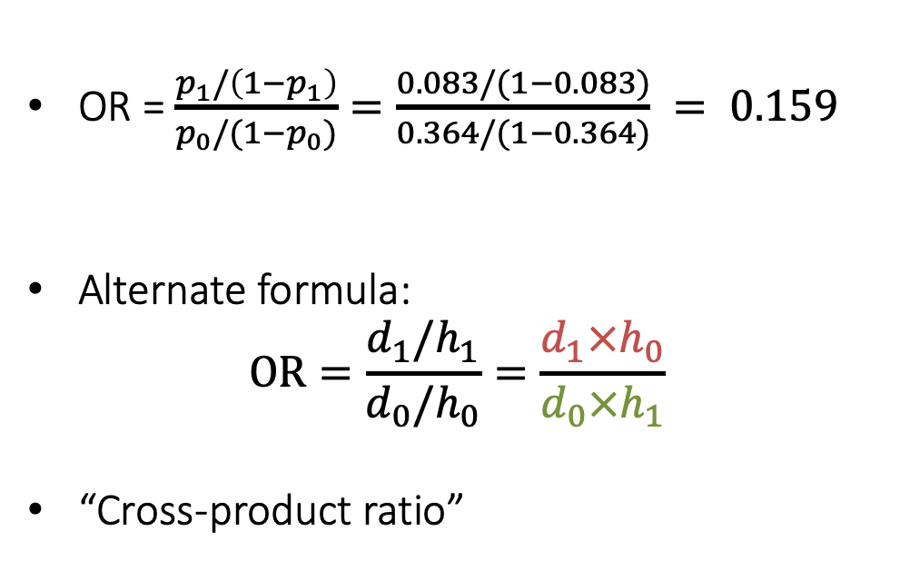
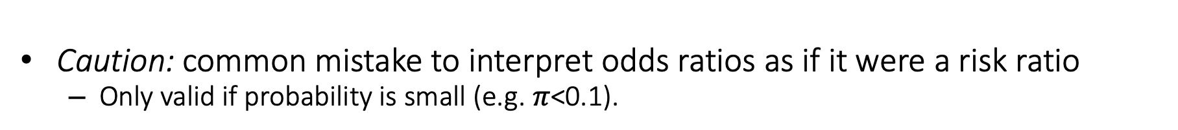
Calculating the Odds ratio
OR = $\frac{p_{1}/\left(1−p_{1}\right)}{p_{0}/(1−p_{0})}=\frac{0.083/(1−0.083)}{0.364/(1−0.364)} = 0.159$
Alternate formula:
$$OR=\frac{d_{1}/h_{1}}{d_{0}/h_{0}}=\frac{d_{1}×h_{0}}{d_{0}×h_{1}}$$
“Cross-product ratio”
 | Flu | No flu | Total
Vaccine | d₁=20 | h₁=220 | n₁=240
Placebo | d₀=80 | h₀=140 | n₀=220
Total | d=100 | h=360 | n=460
$p_{1}$=0.083
$p_{0}$=0.364
$p$=0.217
Caution: common mistake to interpret odds ratios as if it were a risk ratio
Only valid if probability is small (e.g. $π$<0.1).

Slide 42
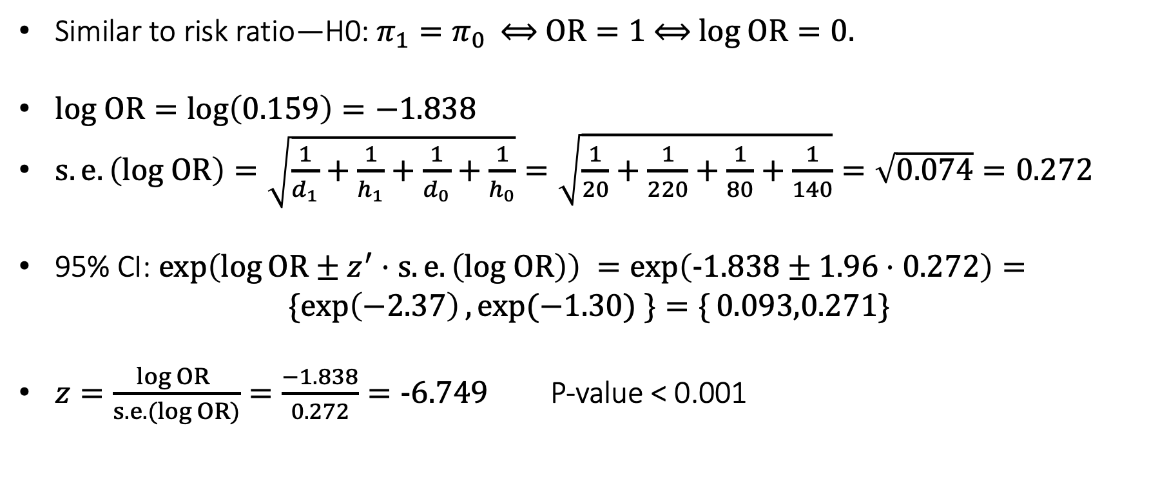
Inference for the odds ratio
Similar to risk ratio—H0: $π_{1}=π_{0}$ ⟺ $OR=1 \text{⟺ }log OR=0.$
$log OR=log\left(0.159\right)=−1.838$
$s.e.\left(log OR\right)=\sqrt{\frac{1}{d_{1}}+\frac{1}{h_{1}}+\frac{1}{d_{0}}+\frac{1}{h_{0}}}=\sqrt{\frac{1}{20}+\frac{1}{220}+\frac{1}{80}+\frac{1}{140}}=\sqrt{0.074}=0.272$
95% CI: $\exp\left(\log{OR±z^{′}⋅s.e.\left(log OR\right)}\right) =\exp\left(−1.838±1.96⋅0.272\right)=$
$$\{\exp\left(−2.37\right),\exp{(−1.30) \}=\{}0.093,0.271\}$$
$z=\frac{log OR }{s.e.(log OR)}=\frac{−1.838}{0.272}=−6.749$ P-value < 0.001

Slide 43
Key property of odds ratios
Odds ratio for exposure = odds ratio for disease
‘Odds ratio for exposure’: Odds of exposure in those with disease vs. no disease.
Prospective study
Case-control study
 | Disease | No disease | Total
Exposure | d₁=? | h₁=? | n₁=N₁
Control | d₀=? | h₀=? | n₀=N₀
Total | d=? | h=? | n=N
 | Disease | No disease | Total
Exposure | d₁=? | h₁=? | n₁=?
Control | d₀=? | h₀=? | n₀=?
Total | d=D | h=H | n=N
$Odd ratio for disease= \frac{d_{1}/h_{1}}{d_{0}/h_{0}}=\frac{d_{1}×h_{0}}{d_{0}×h_{1}}$ $= \frac{d_{1}/d_{0}}{h_{1}/h_{0}}=Odd ratio for exposure$

Slide 44

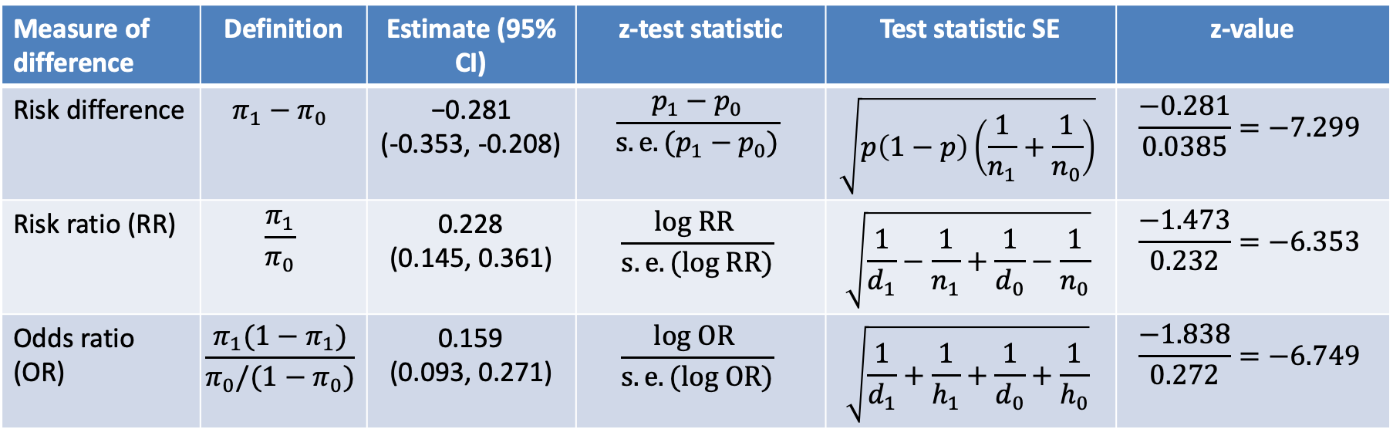
Summary: Comparison of two means
Measure of difference | Definition | Estimate (95% CI) | z-test statistic | Test statistic SE | z-value
Risk difference | $$π_{1}−π_{0}$$ | −0.281 (-0.353, -0.208) | $$\frac{p_{1}−p_{0}}{s.e.(p_{1}−p_{0})}$$ | $$\sqrt{p\left(1−p\right)\left(\frac{1}{n_{1}}+\frac{1}{n_{0}}\right)}$$ | $$\frac{−0.281}{0.0385}=−7.299$$
Risk ratio (RR) | $$\frac{π_{1}}{π_{0}}$$ | 0.228 (0.145, 0.361) | $$\frac{log RR }{s.e.(log RR)}$$ | $$\sqrt{\frac{1}{d_{1}}−\frac{1}{n_{1}}+\frac{1}{d_{0}}−\frac{1}{n_{0}}}$$ | $$\frac{−1.473}{0.232}=−6.353$$
Odds ratio (OR) | $$\frac{π_{1}(1−π_{1})}{π_{0}/(1−π_{0})}$$ | 0.159 (0.093, 0.271) | $$\frac{log OR }{s.e.(log OR)}$$ | $$\sqrt{\frac{1}{d_{1}}+\frac{1}{h_{1}}+\frac{1}{d_{0}}+\frac{1}{h_{0}}}$$ | $$\frac{−1.838}{0.272}=−6.749$$
All inference relied on normal approximation to binomial distribution.
Valid if $nπ≥10$ and $n(1−π)≥10$

Slide 45
Questions?

