Slide 1
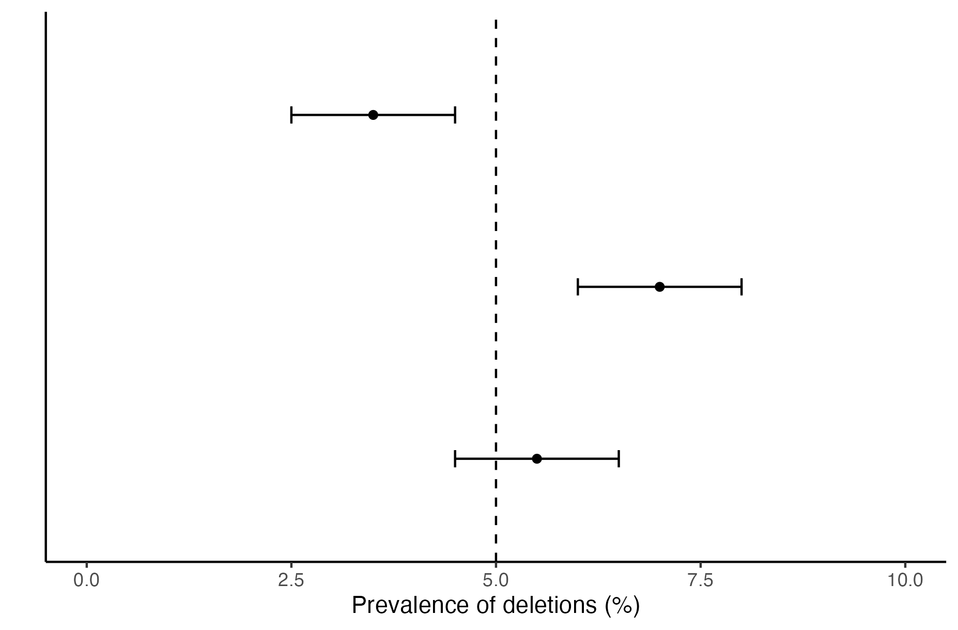



Confidence Interval interpretation
Z-test interpretation
Outcome 1
$$Z<−1.96$$
Significant
negative direction
Outcome 2
$$Z>1.96$$
Significant
positive direction
Outcome 3
$$−1.96<Z<1.96$$
Non-significant

