Slide 1
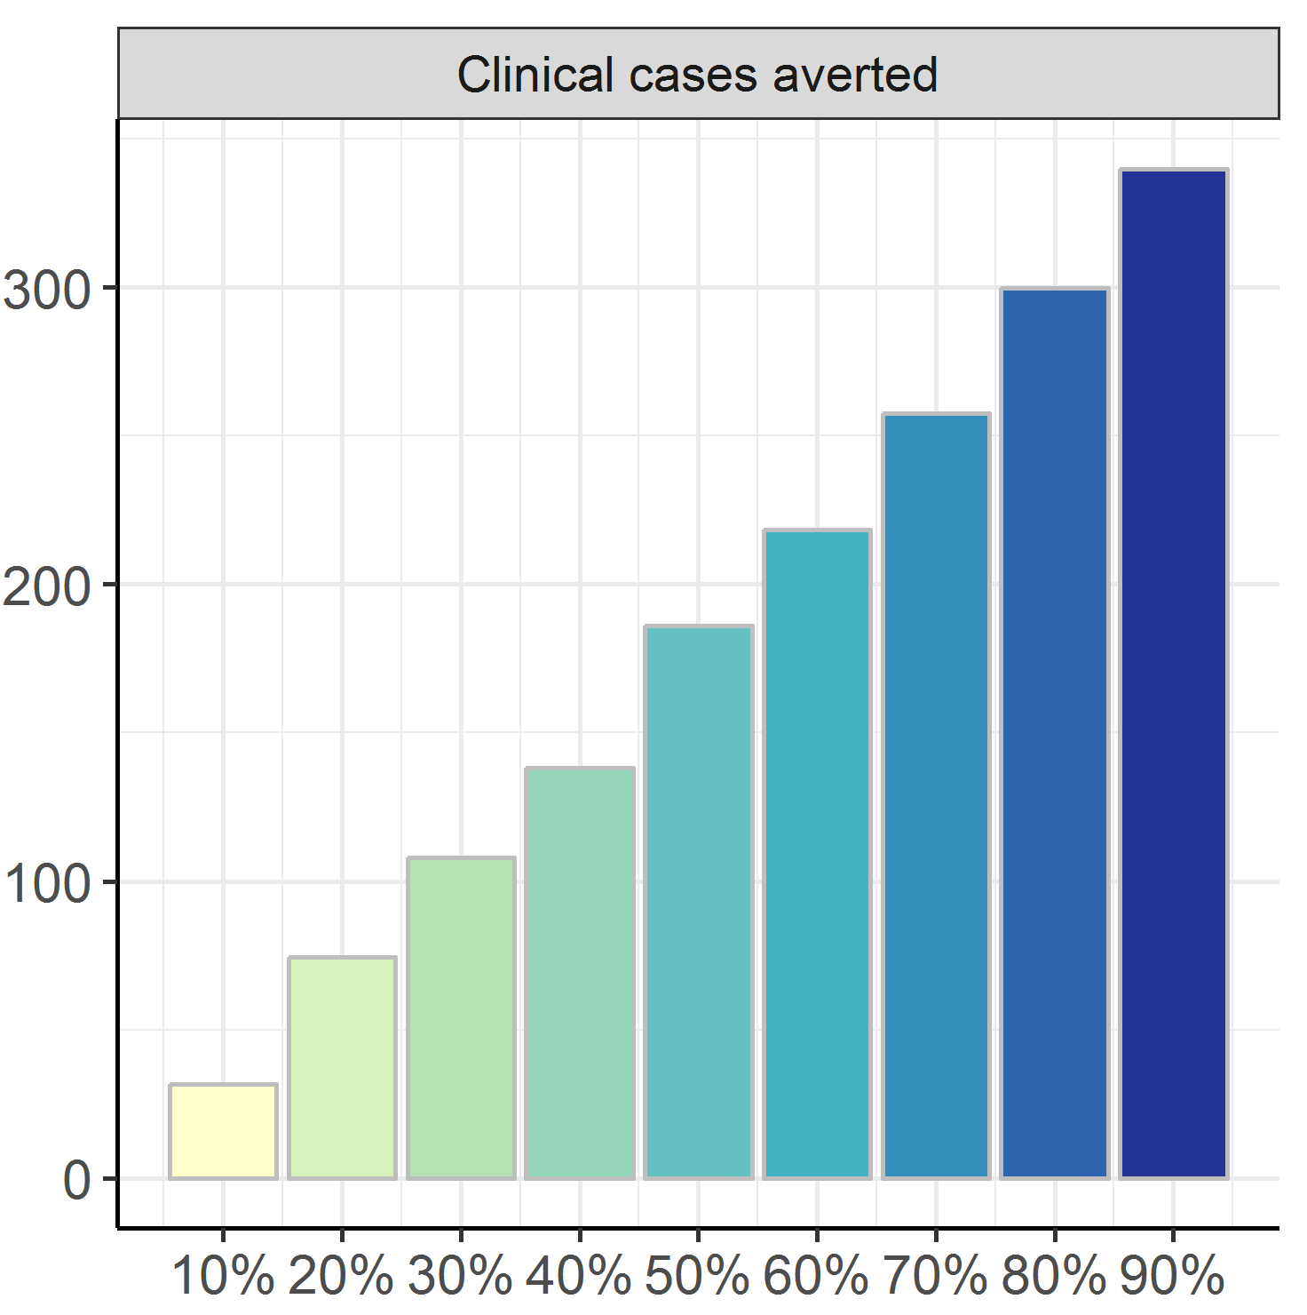
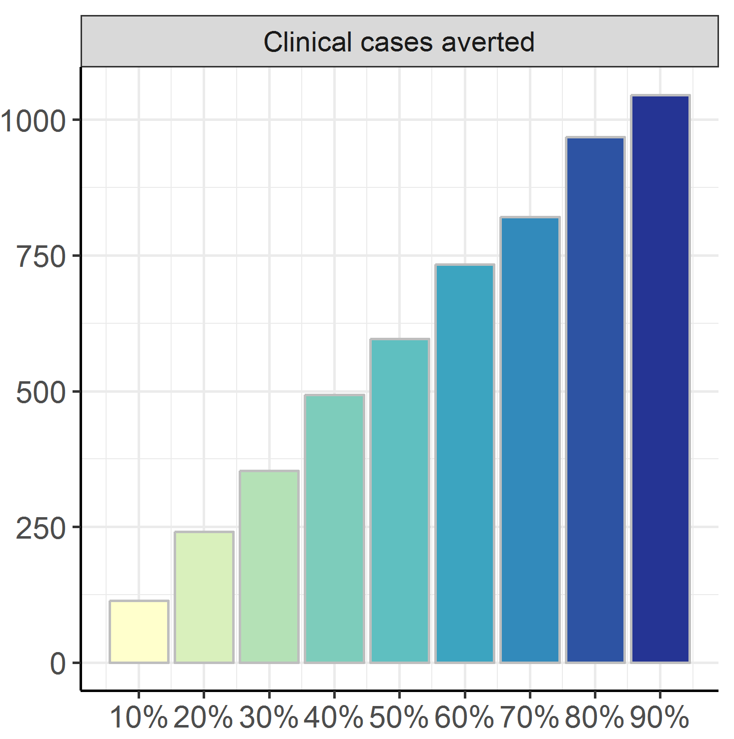
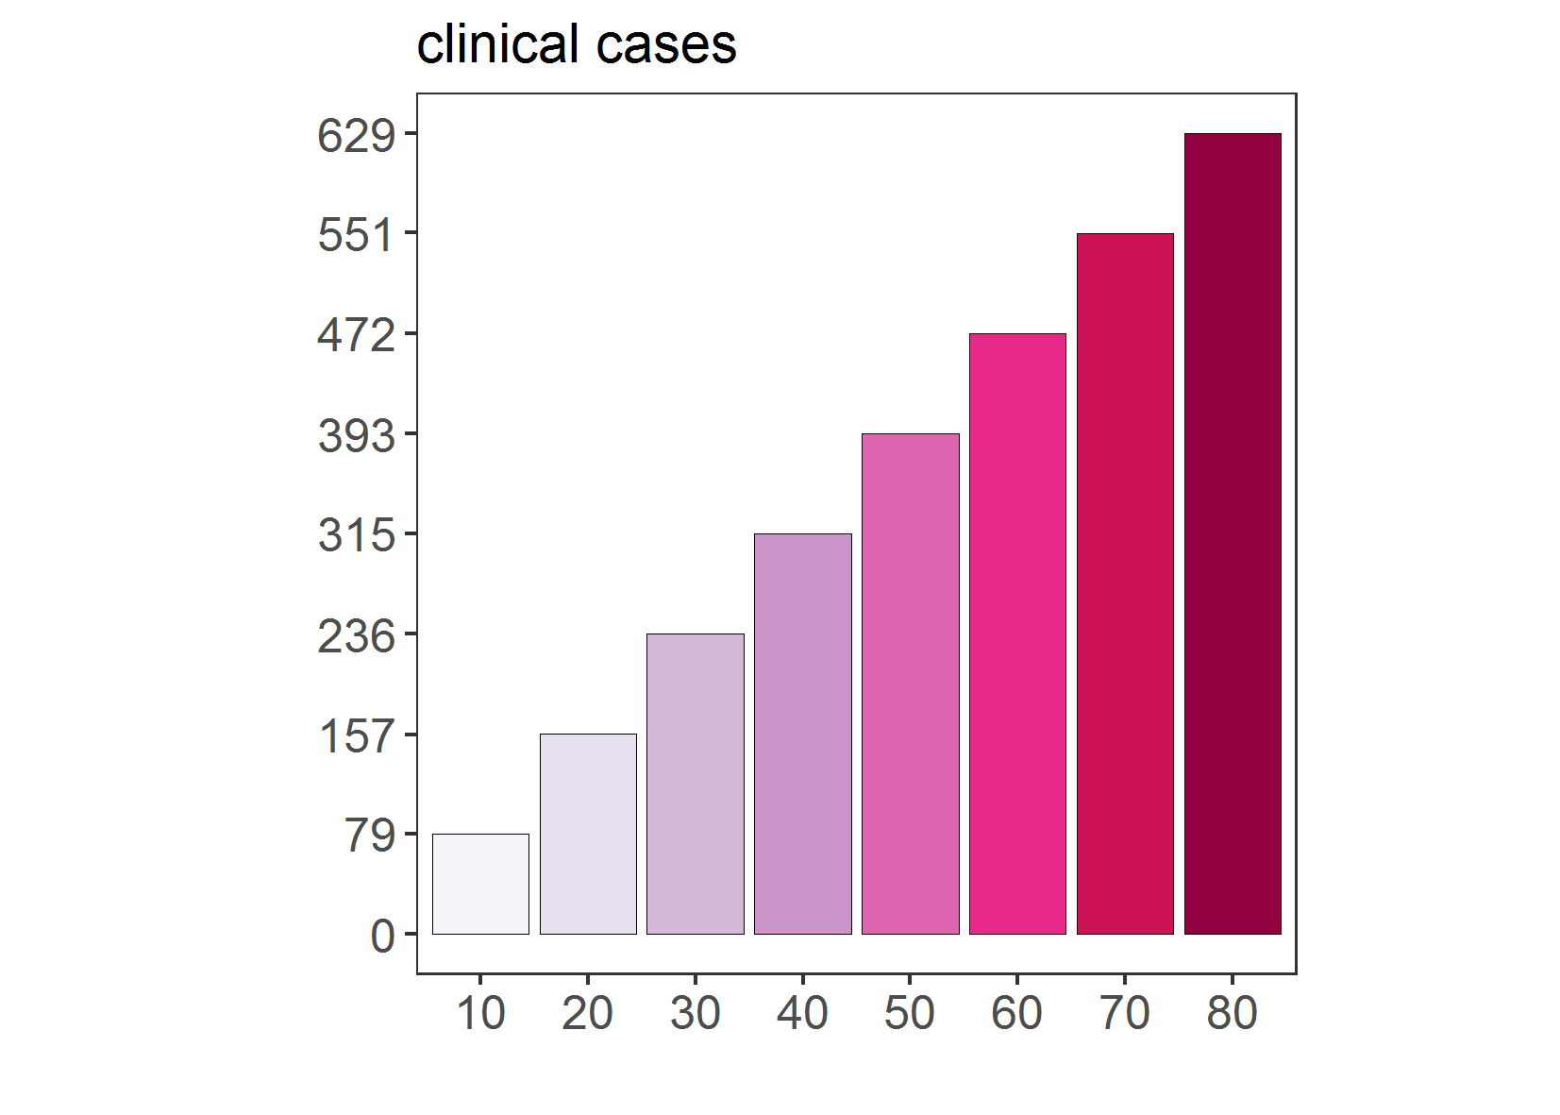
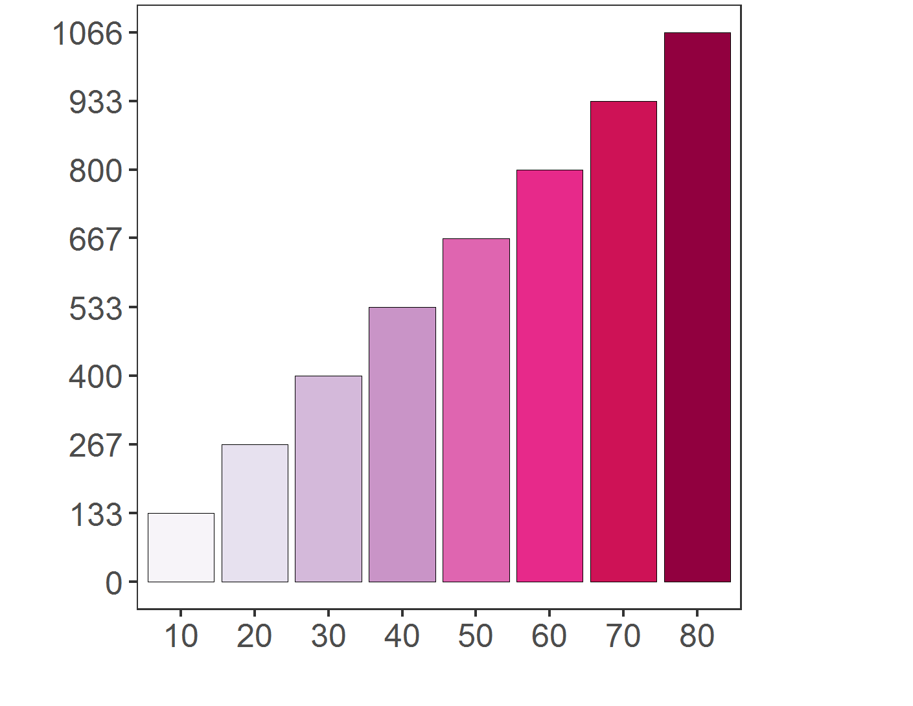
PfPR₂₋₁₀ = 20%
PfPR₂₋₁₀ = 50%
Imperial College
Cumulative events averted per 1,000
SwissTPH
Cumulative events averted per 1,000
vaccination coverage (%)
vaccination coverage (%)

