Slide 1
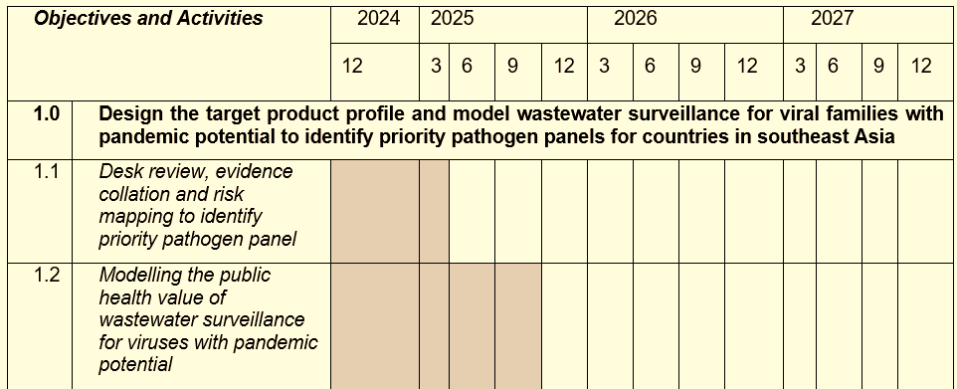
Epidemiological modelling to support WaSSP activities – an overview:
WaSSP Objective 1: “Design the target product profile and model wastewater surveillance for viral families with pandemic potential to identify priority pathogen panels.”
Aims of initial WaSSP Modelling Work (late 2024 to Sept 2025):
Identify priority pathogens most suitable for wastewater surveillance, and most important pathogen features associated with suitability.
Assess comparative importance of different pathogen properties (e.g. shedding kinetics, disease course, transmissibility) on wastewater surveillance sensitivity.
Evaluate the public health value of wastewater surveillance for priority pathogens relative to clinical surveillance-based approaches.

Slide 2
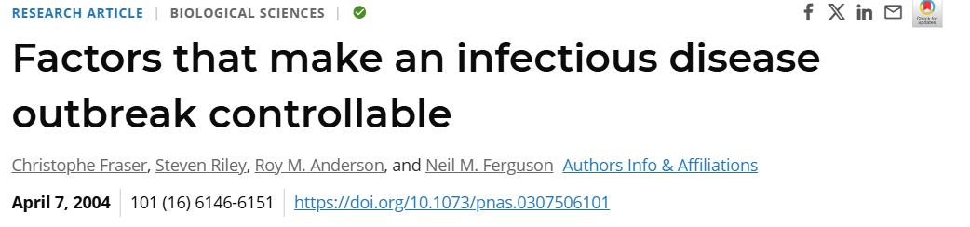
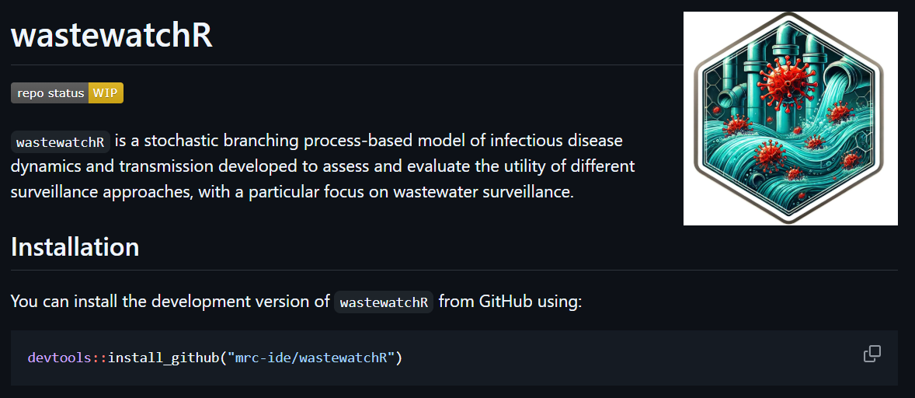
Development of an open-source wastewater surveillance modelling framework
Branching process modelling framework to enable evaluation of timeliness of wastewater and clinical surveillance for different pathogens.
Explicitly models:
Pathogen properties (e.g. transmissibility, shedding characteristics, disease course)
Health systems factors (e.g. healthcare seeking behaviour)
Evolution (e.g acquisition of mutations that improve transmissibility in human host)
Serological dynamics (e.g. seroconversion, seroreversion)
Different surveillance approaches (currently supporting clinical, wastewater and sero-surveillance).
Fraser et al, PNAS, 2004:
https://www.pnas.org/doi/10.1073/pnas.0307506101

Slide 3
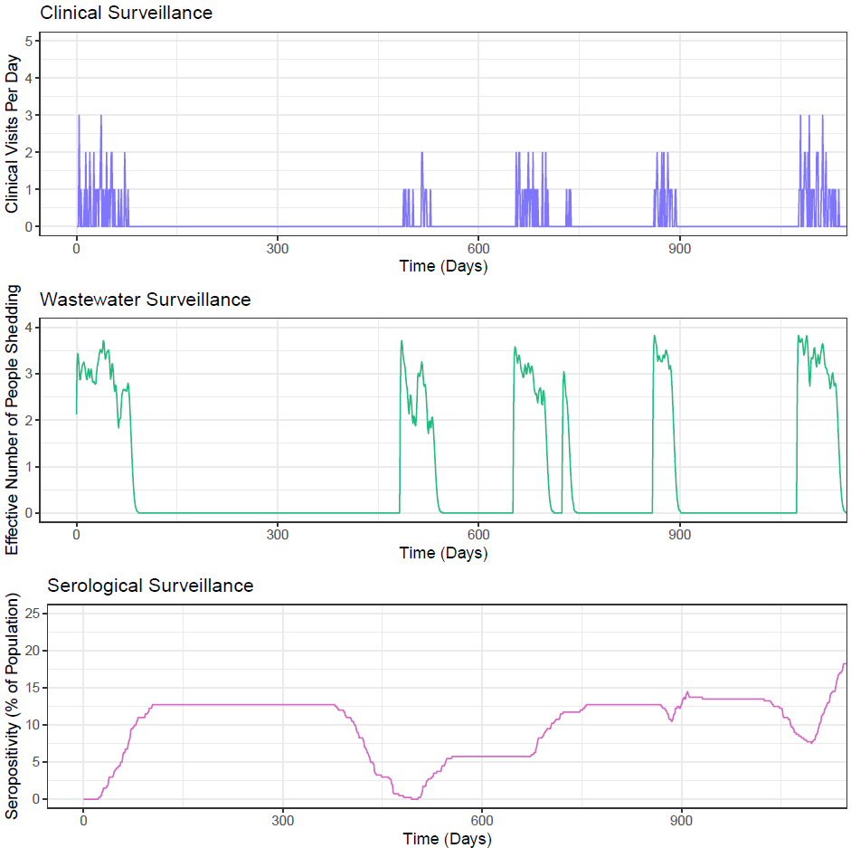
Development of an open-source wastewater surveillance modelling framework
Branching process modelling framework to enable evaluation of timeliness of wastewater and clinical surveillance for different pathogens.
Explicitly models:
Pathogen properties (e.g. transmissibility, shedding characteristics, disease course)
Health systems factors (e.g. healthcare seeking behaviour)
Evolution (e.g acquisition of mutations that improve transmissibility in human host)
Serological dynamics (e.g. seroconversion, seroreversion)
Different surveillance approaches (currently supporting clinical, wastewater and sero-surveillance).

Slide 4
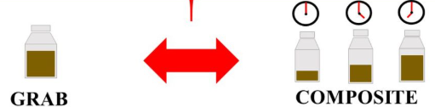

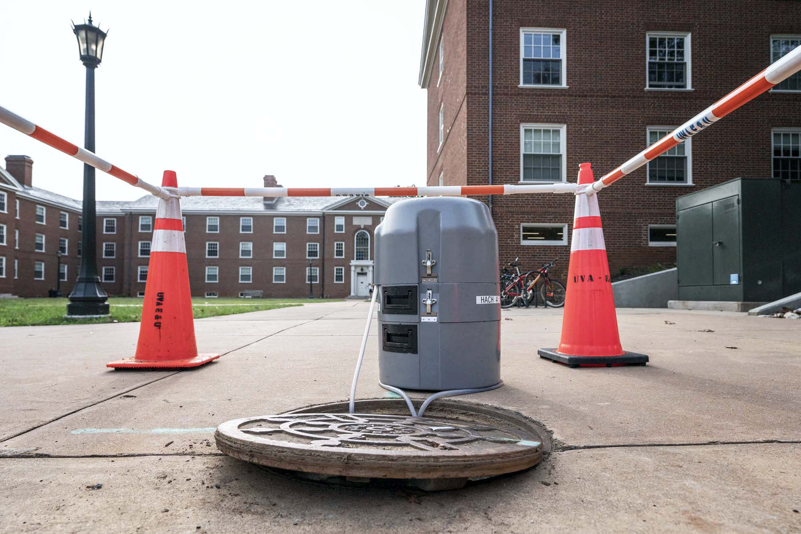
Updates (i) Recent additions to the wastewater surveillance modelling component
Explicitly represent sampling frequency & method:
Allows specification of how often (e.g., daily vs. weekly) wastewater is sampled.
Support different sampling strategies (autosampler, grab sampling and moore swab).
Expansion of detection frameworks:
Previously used a simple binary threshold for detection based on number of people shedding.
We can now detect using a logistic detection curve where probability of detection increases smoothly with number shedding.

Slide 5
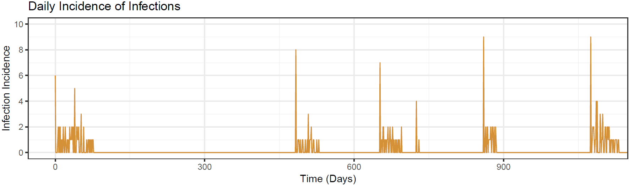
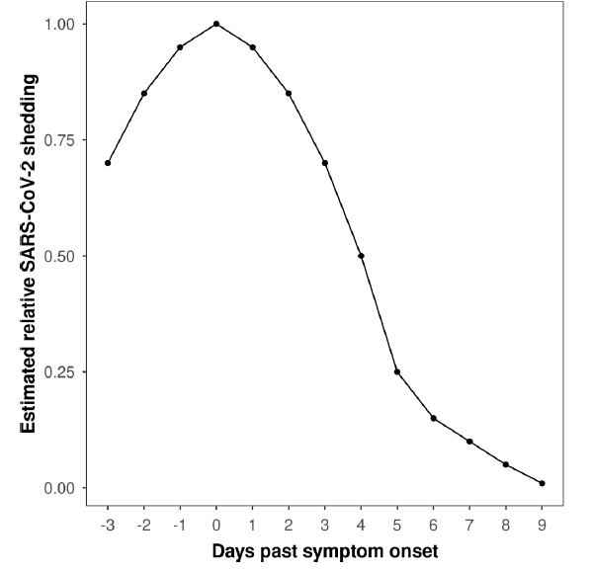
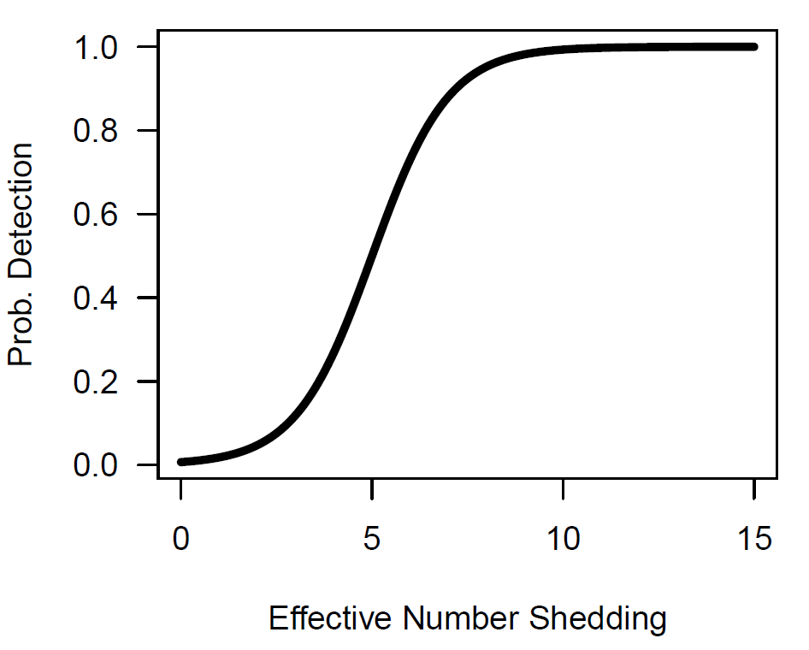
Updated wastewater surveillance & detection approach
Daily Incidence of Infections
Shedding
Kinetics
Profile
Daily Number of Infections Shedding
Successful Detection?
(I.e. is the sample positive?)
Amount of Viral Material in Sample
Sampling Frequency & Methodology
Logistic Detection Curve

Slide 6
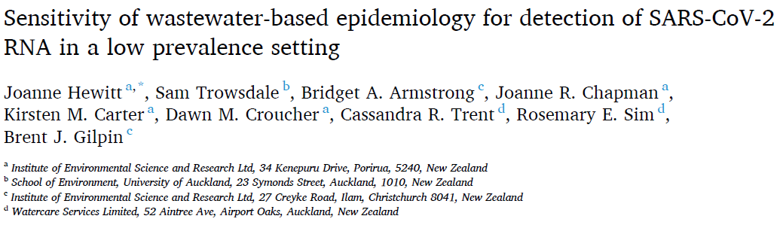
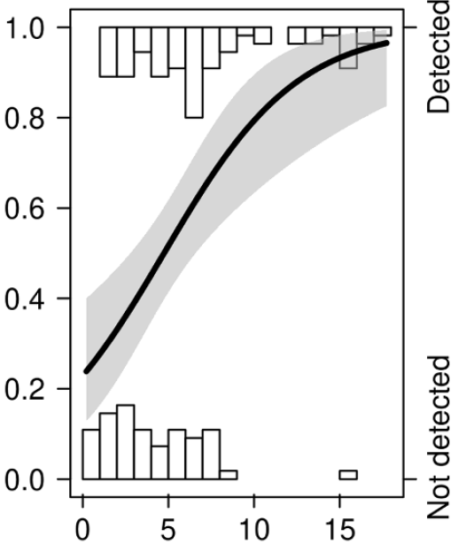

Updates (ii) Inferring SC2 wastewater sensitivity
Data from Hewitt et al reanalysed.
Tracked individuals in managed isolation and quarantine facility (MIQF) in New Zealand.
Included asymptomatic testing and so represents a reasonable estimate of total infections.
RT-qPCR detection of SC2 at wastewater treatment plant (WWTP) 5km downstream of MIQF.
~30% probability of detection when number of shedding infections is 1 per 100,000 (0.001% prevalence).
Increases to ~90% at 10 per 100,000 (0.01% prevalence).

Slide 7
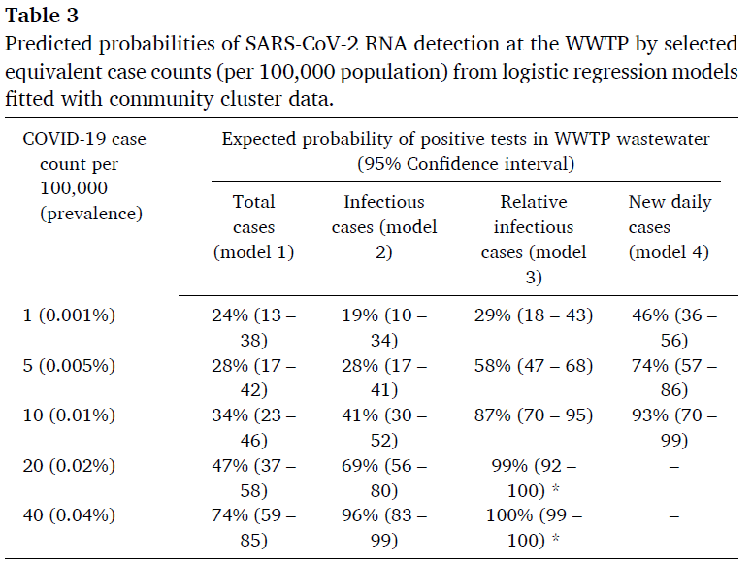
Updates (ii) Inferring SC2 wastewater sensitivity
Data from Hewitt et al reanalysed.
Tracked individuals in managed isolation and quarantine facility (MIQF) in New Zealand.
Included asymptomatic testing and so represents a reasonable estimate of total infections.
RT-qPCR detection of SC2 at wastewater treatment plant (WWTP) 5km downstream of MIQF.
~30% probability of detection when number of shedding infections is 1 per 100,000 (0.001% prevalence).
Increases to ~90% at 10 per 100,000 (0.01% prevalence).

Slide 8
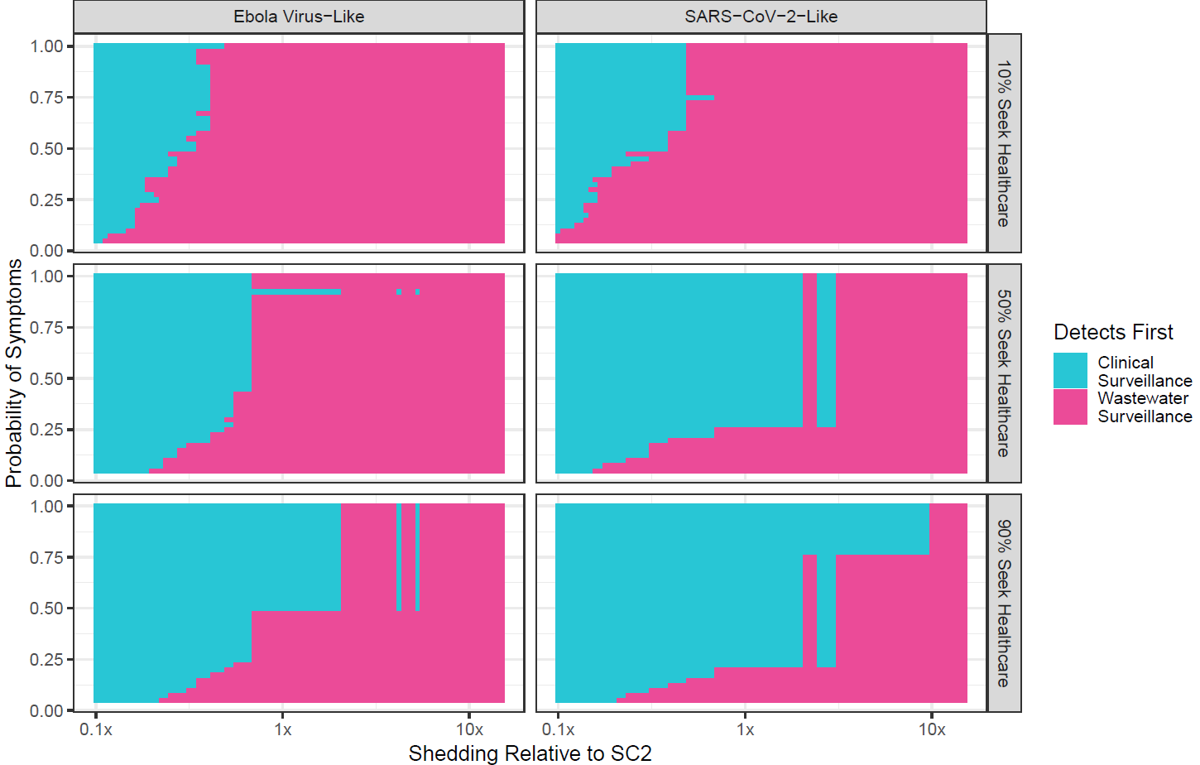
Updates (iii) Provisional modelling wastewater surveillance utility vs clinical surveillance for pathogen “archetypes”
2 pathogen archetypes (“Ebola-like” and “SARS-CoV-2-like”) with different generation times and shedding profiles.
Assume fortnightly wastewater sampling with autosampler.
Vary:
Proportion of infections displaying symptoms (y-axis).
Faecal shedding relative to SARS-CoV-2 (x-axis).
Healthcare seeking behaviour (10%, 50% or 90% of symptomatic infections seek healthcare).
Note: these are provisional results, and the model is stochastic (hence the noise!).

Slide 9
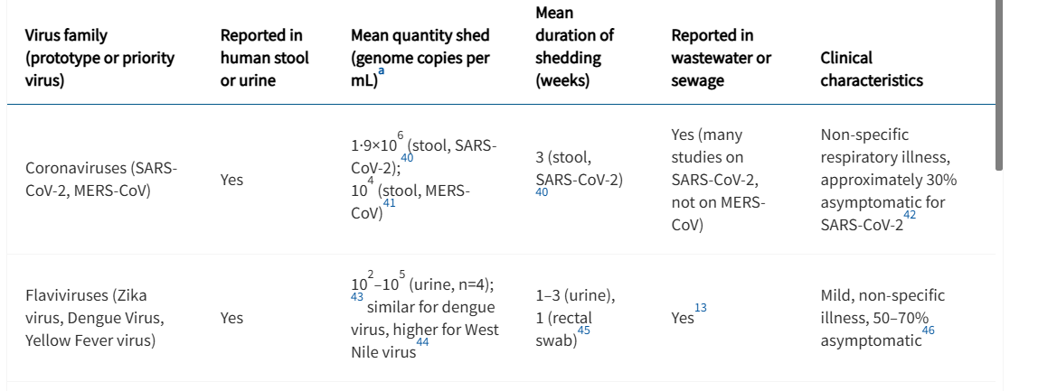
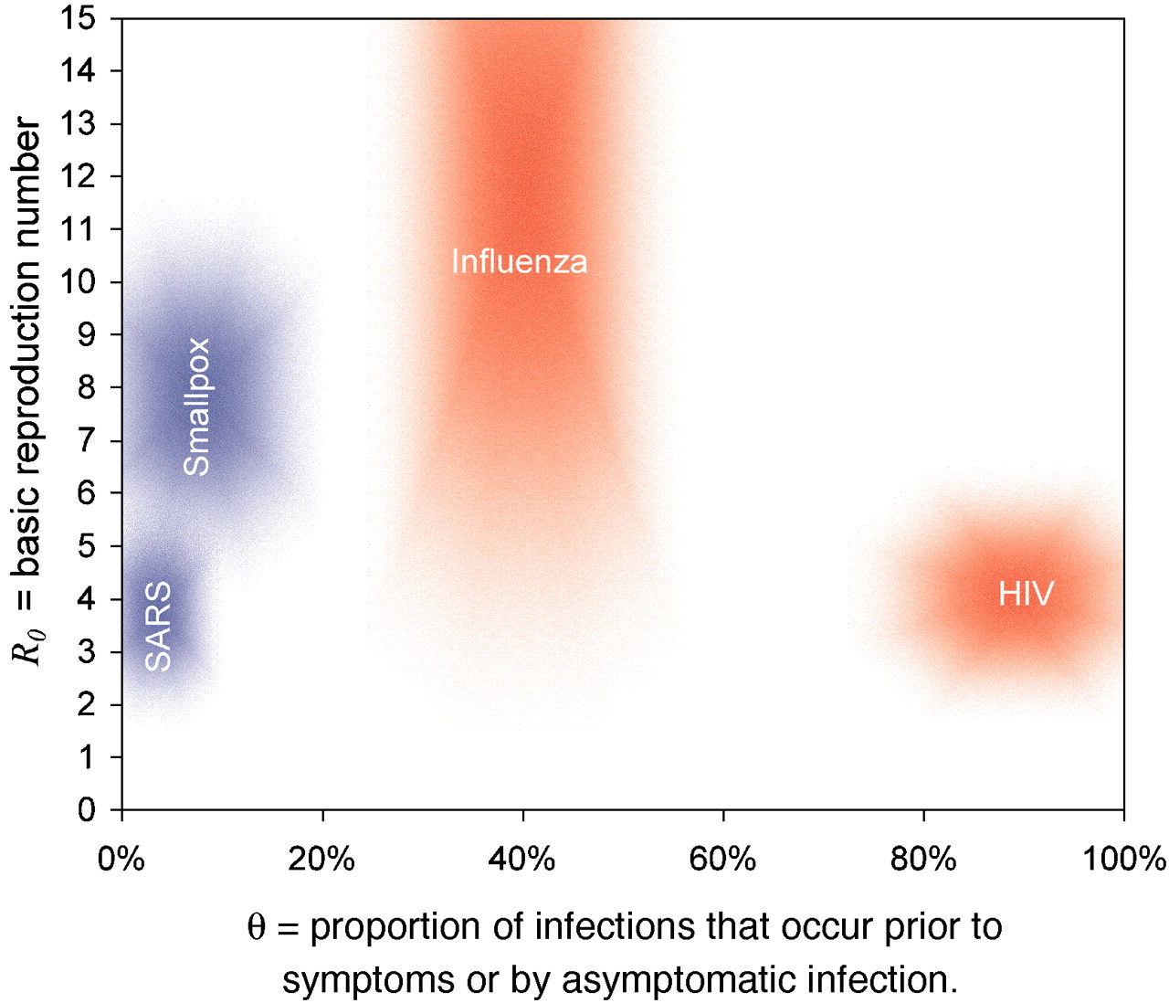
Next Steps
Literature review to support model parameterisation.
Particular focus on pathogen shedding parameters (e.g. kinetics and total amount shed during infection – esp. relative to SARS-CoV-2).
Results generation to generate shortlist of priority pathogens and support TPP design.
For which pathogens do model predictions suggest wastewater surveillance dominates clinical surveillance?
Which pathogen features are most important predicted determinants of wastewater surveillance sensitivity?
Further refinement of modelling framework:
Increase granularity and detail in wastewater surveillance simulation.
Empirically motivated patterns of zoonotic spillover and pathogen evolution.
Grassly et al, Lancet Microbe, 2024: https://www.thelancet.com/journals/lanmic/article/PIIS2666-5247(24)00192-7/fulltext
Fraser et al, PNAS, 2004:
https://www.pnas.org/doi/10.1073/pnas.0307506101

