Slide 1
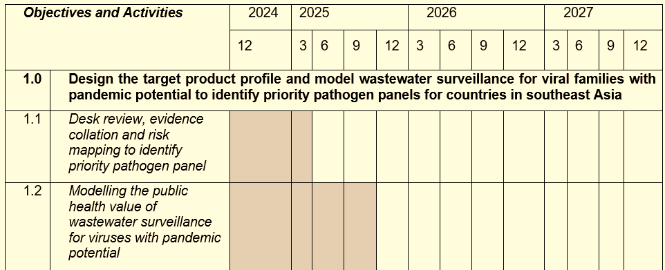
Epidemiological modelling to support WaSSP activities – an overview:
WaSSP Objective 1: “Design the target product profile and model wastewater surveillance for viral families with pandemic potential to identify priority pathogen panels.”
Aims of initial WaSSP Modelling Work (late 2024 to Sept 2025):
Identify priority pathogens most suitable for wastewater surveillance, and most important pathogen features associated with suitability.
Assess comparative importance of different pathogen properties (e.g. shedding kinetics, disease course, transmissibility) on wastewater surveillance sensitivity.
Evaluate the public health value of wastewater surveillance for priority pathogens relative to clinical surveillance-based approaches.

Slide 2
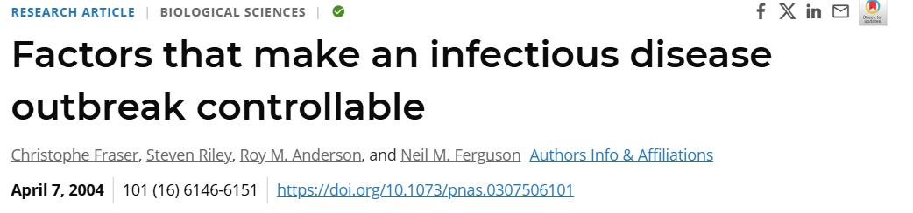
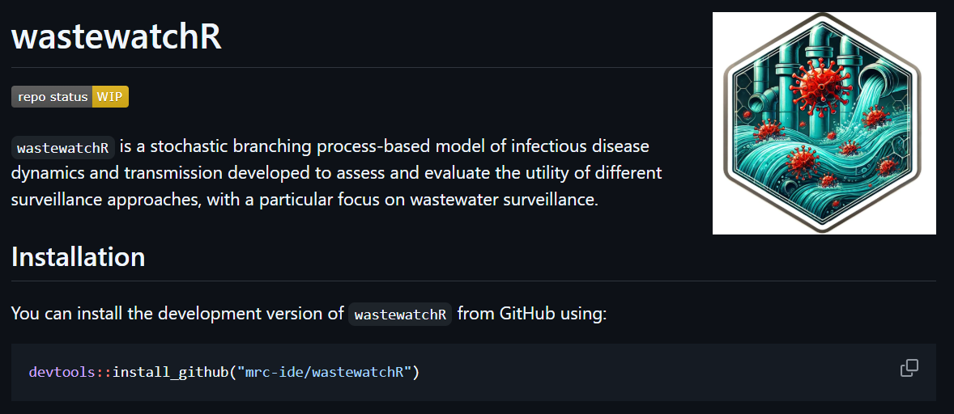
Ongoing development of an open-source wastewater surveillance modelling framework
Branching process modelling framework to enable evaluation of timeliness of wastewater and clinical surveillance for different pathogens.
Being developed as an open-source, freely accessible R package.
Explicitly models:
Pathogen properties (e.g. transmissibility, shedding characteristics, disease course)
Health systems factors (e.g. healthcare seeking behaviour)
Evolution (e.g acquisition of mutations that improve transmissibility in human host)
Serological dynamics (e.g. seroconversion, seroreversion)
Different surveillance approaches (currently supporting clinical, wastewater and sero-surveillance).
Fraser et al, PNAS, 2004:
https://www.pnas.org/doi/10.1073/pnas.0307506101

Slide 3
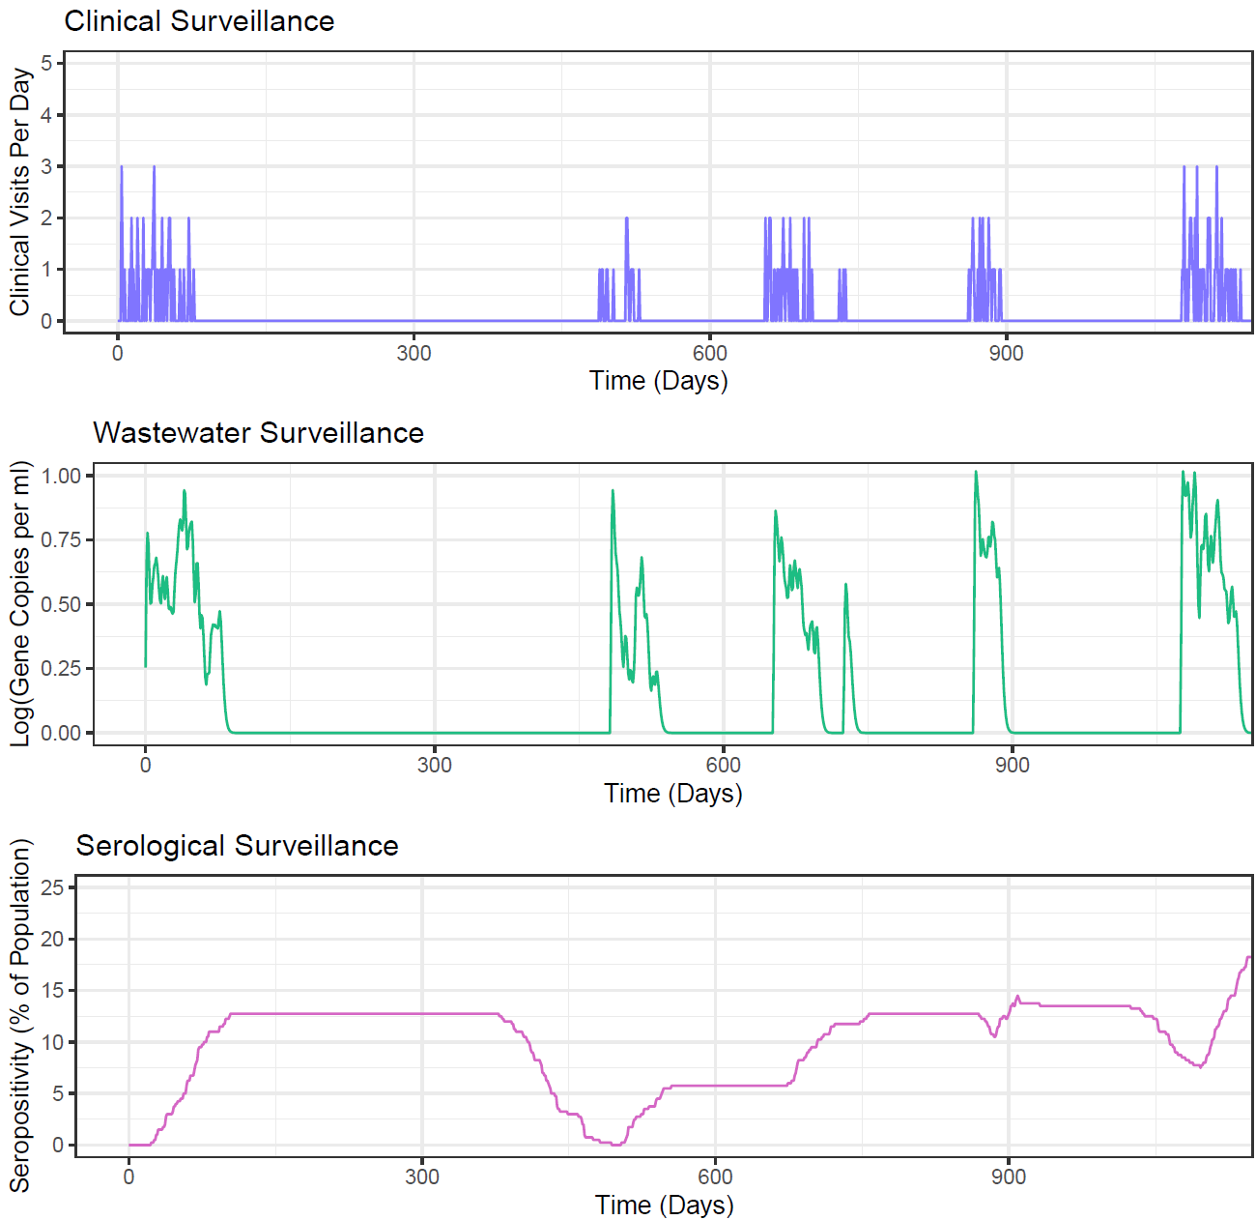
Ongoing development of an open-source wastewater surveillance modelling framework
Branching process modelling framework to enable evaluation of timeliness of wastewater and clinical surveillance for different pathogens.
Being developed as an open-source, freely accessible R package.
Explicitly models:
Pathogen properties (e.g. transmissibility, shedding characteristics, disease course)
Health systems factors (e.g. healthcare seeking behaviour)
Evolution (e.g acquisition of mutations that improve transmissibility in human host)
Serological dynamics (e.g. seroconversion, seroreversion)
Different surveillance approaches (currently supporting clinical, wastewater and sero-surveillance).

Slide 4
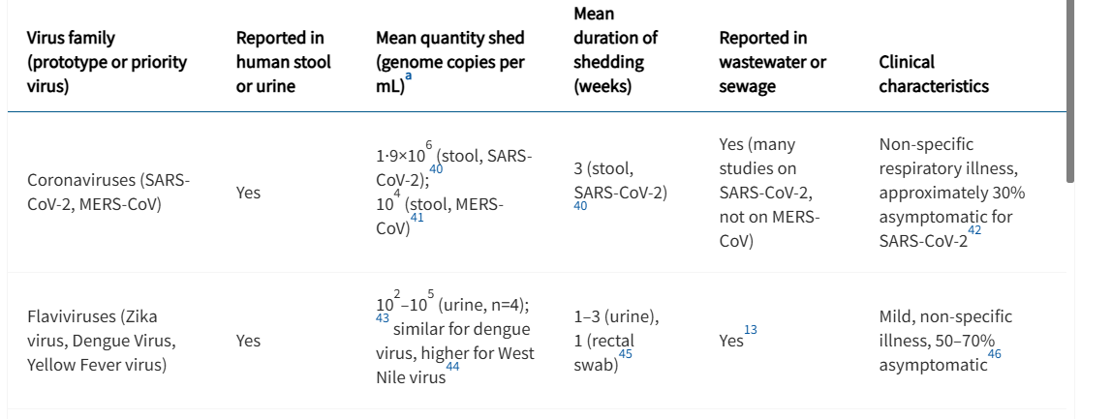
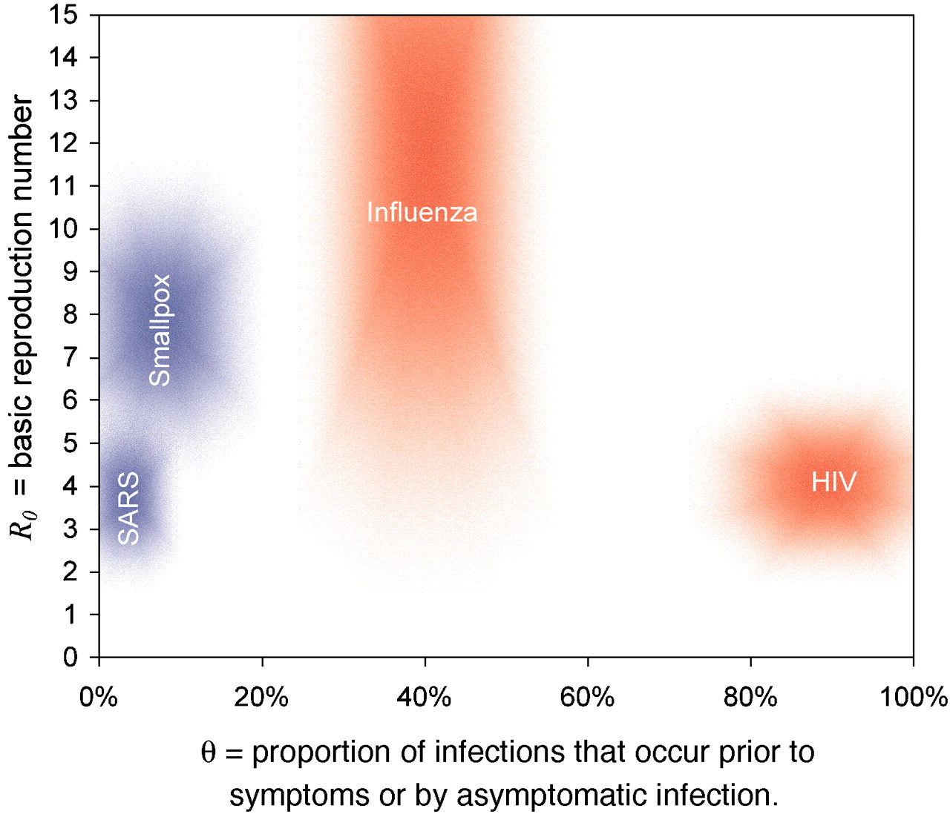
Next Steps
Literature review to support model parameterisation.
Particular focus on pathogen shedding parameters (e.g. kinetics and total amount shed during infection).
Results generation to generate shortlist of priority pathogens and support TPP design.
For which pathogens do model predictions suggest wastewater surveillance dominates clinical surveillance?
Which pathogen features are most important predicted determinants of wastewater surveillance sensitivity?
Further refinement of modelling framework:
Increase granularity and detail in wastewater surveillance simulation.
Empirically motivated patterns of zoonotic spillover and pathogen evolution.
Grassly et al, Lancet Microbe, 2024: https://www.thelancet.com/journals/lanmic/article/PIIS2666-5247(24)00192-7/fulltext
Fraser et al, PNAS, 2004:
https://www.pnas.org/doi/10.1073/pnas.0307506101

