Slide 1
Predicting Obesity
MICHAEL CARLSON, ALKA LINK, GRACE PITTS
DS 3021 Final Project

Slide 2
Is it possible to predict obesity using contextual health factors rather than relying on BMI?
Notes:
We are asking this question because BMI can be a misleading mesaure of health. By exploring whether contextual health factors (like family history, food intake, physical activity levels, etc.) can better predict obesity, we have the ability to move toward more personalized and accurate health assessments. This could help individuals along with doctors in reducing misclassification of obesity and can lead to better health outcomes.

Slide 3
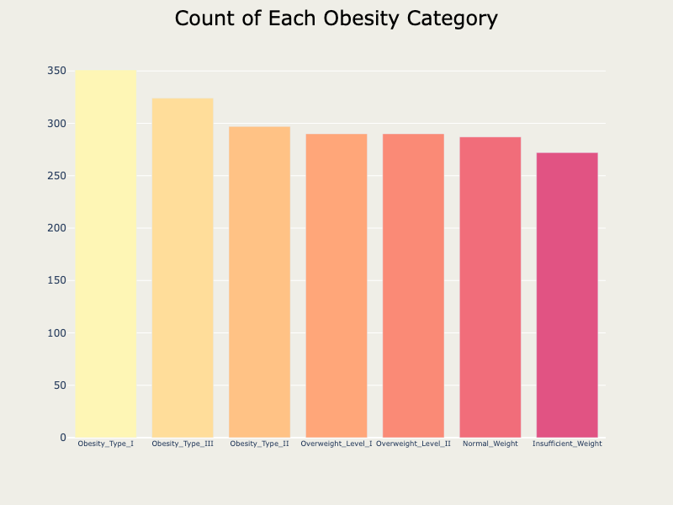
EXPLORATORY DATA ANALYSIS: KEY INSIGHTS
Data has no missing values and each variable is the right data type for analysis
Each category of our target variable is balanced, as seen on the right
The weight distribution shows a clear trend: individuals in higher obesity categories have higher weight

Slide 4
OUR METHOD
Random Forest Classifier
Combining techniques of RandomizedSearchCV and RepeatedStratifiedKFold, for a balance of comprehensive evaluation and efficiency
Utilizing parameters of max depth, minimum samples split, minimum samples leaf, number of estimators, and max features.
By refitting the model to F1 scoring, we ensure accuracy among both false positives and false negatives, treating all classes fairly even with imbalanced classes

Slide 5
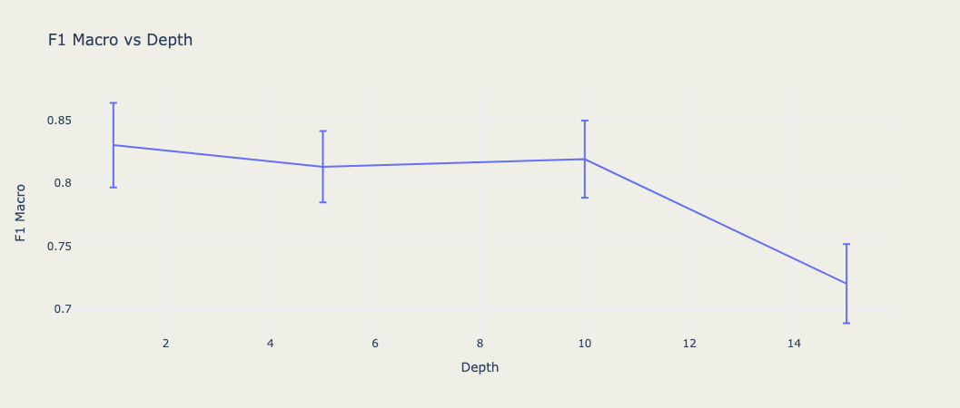
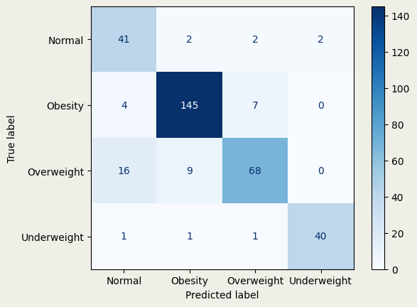
RESULTS & CONCLUSION
OUR BEST MODEL ACHIEVED AN F1 SCORE OF 0.818 AT A MAX DEPTH OF 10
FUTURE WORK: WE WOULD LIKE TO HAVE A LARGER DATASET WITH MORE EXTENSIVE FEATURES TO BETTER PREDICT OBESITY.
YES! IT IS POSSIBLE TO PREDICT OBESITY USING CONTEXTUAL HEALTH FACTORS RATHER THAN RELYING ON BMI.

