Slide 1
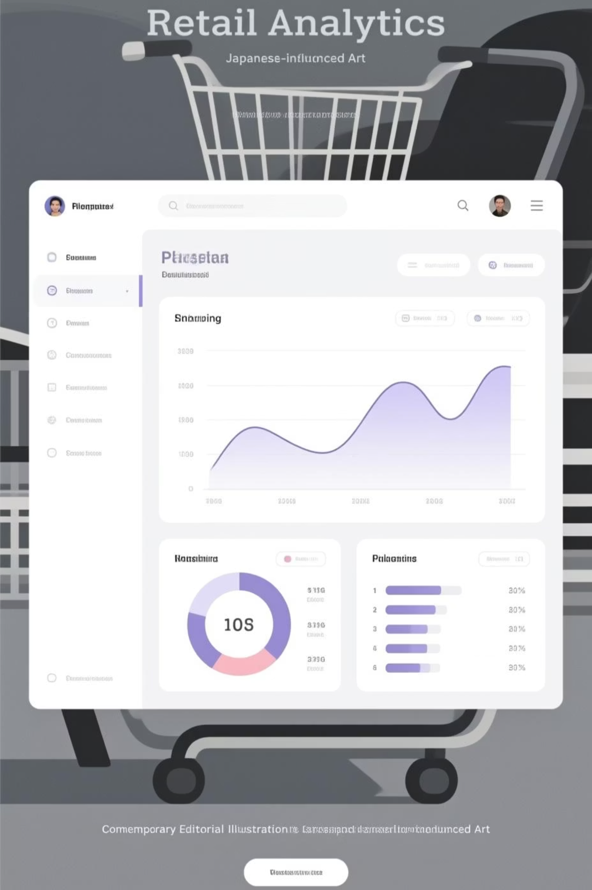
Customer Shopping Behavior Analysis
Analyzing 3,900 purchases to uncover insights into spending patterns, customer segments, and product preferences that drive strategic business decisions.

Slide 2
Dataset Overview
3,900
18
25
50
Total Purchases
Data Features
Product Types
Locations
Transactions analyzed across all categories
Columns tracking demographics and behavior
Unique items across four categories
Geographic distribution of customers
Key features include customer demographics (age, gender, location, subscription status), purchase details (item, category, amount, season), and shopping behavior (discounts, reviews, shipping preferences).

Slide 3
Data Preparation Process
01
02
03
Data Loading & Exploration
Cleaning & Standardization
Feature Engineering
Imported dataset using pandas and analyzed structure with df.info() and .describe() for summary statistics.
Handled 37 missing review ratings using median imputation by category. Renamed columns to snake_case format.
Created age_group bins and purchase_frequency_days. Verified data consistency and removed redundant promo_code_used column.
04
Database Integration
Connected Python to PostgreSQL and loaded cleaned data for advanced SQL analysis.

Slide 4
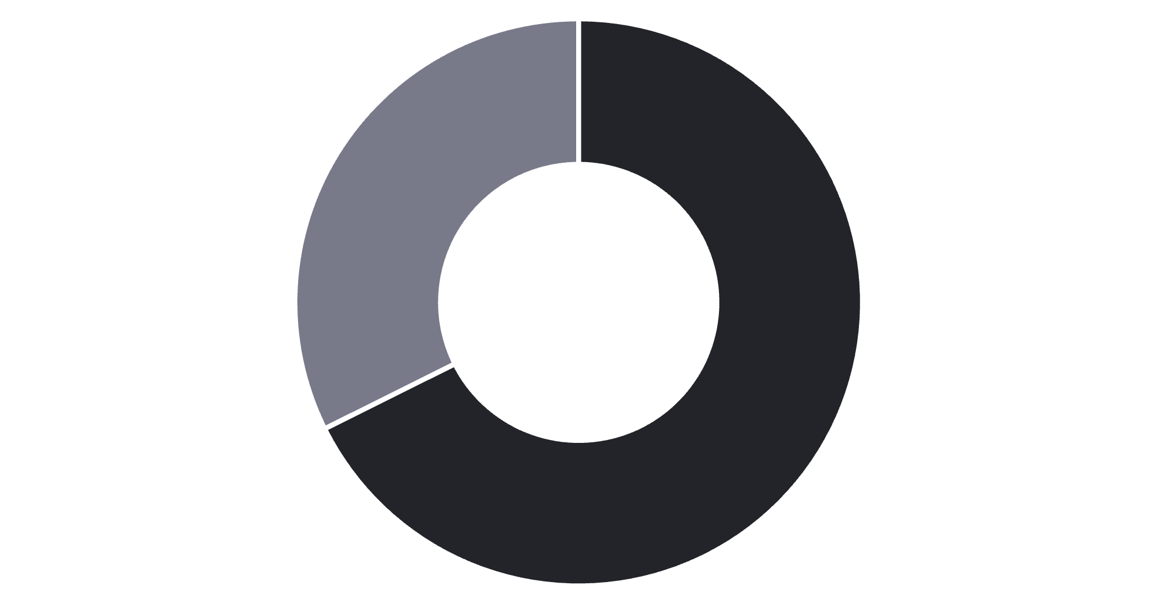
Revenue Analysis by Gender
Key Finding
Male customers generate $157,890 in revenue compared to $75,191 from female customers—more than double the contribution.
This significant gap suggests opportunities for targeted marketing to increase female customer engagement.
Male
Female

Slide 5
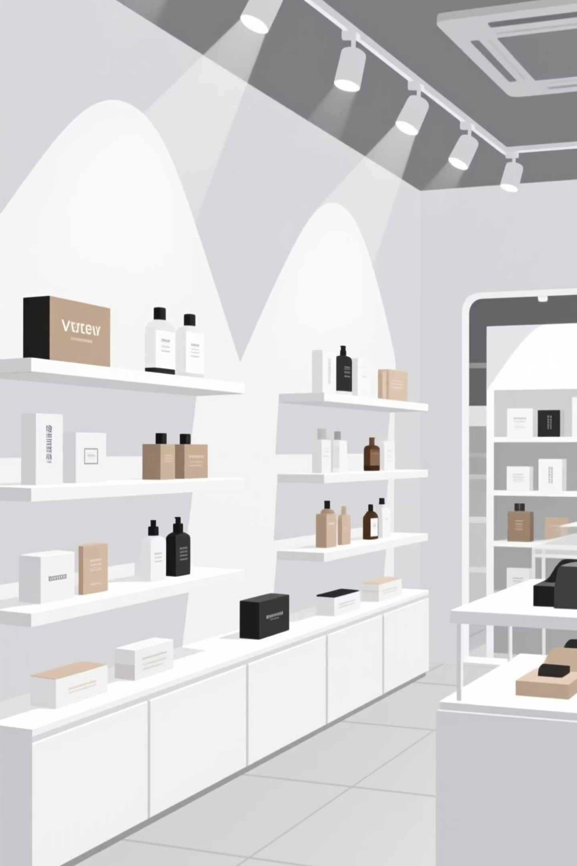
Product Performance Insights
Top-Rated Products
Discount Leaders
Gloves (3.86), Sandals (3.84), and Boots (3.82) lead in customer satisfaction ratings.
Hat (50%), Sneakers (49.66%), and Coat (49.07%) have highest discount purchase rates.
Category Winners
Blouse (Clothing), Jewelry (Accessories), and Jacket (Outerwear) are most purchased in their categories.

Slide 6



Customer Segmentation
1
New (83)
2
Returning (701)
3
Loyal (3,116)
The majority of customers (80%) fall into the Loyal segment with multiple purchases, while only 2% are new customers. This indicates strong retention but highlights the need for acquisition strategies.

Slide 7


Subscription & Spending Patterns
27%
73%
Subscribers
Non-subscribers
Only 1,053 customers (27%) have subscriptions, generating $62,645 in revenue.
Among customers with 5+ purchases:
958 are subscribers
2,518 are non-subscribers
Repeat buyers show lower subscription rates, indicating untapped conversion potential.

Slide 8
Shipping & Discount Impact
Express Shipping Premium
Smart Discount Users
Age Group Revenue
839 customers used discounts but still spent above average ($59.76), showing discounts don't always reduce revenue.
Young Adults lead with $62,143, followed by Middle-aged ($59,197), Adult ($55,978), and Senior ($55,763).
Express shipping customers spend $60.48 on average vs. $58.46 for standard—indicating willingness to pay more.

Slide 9
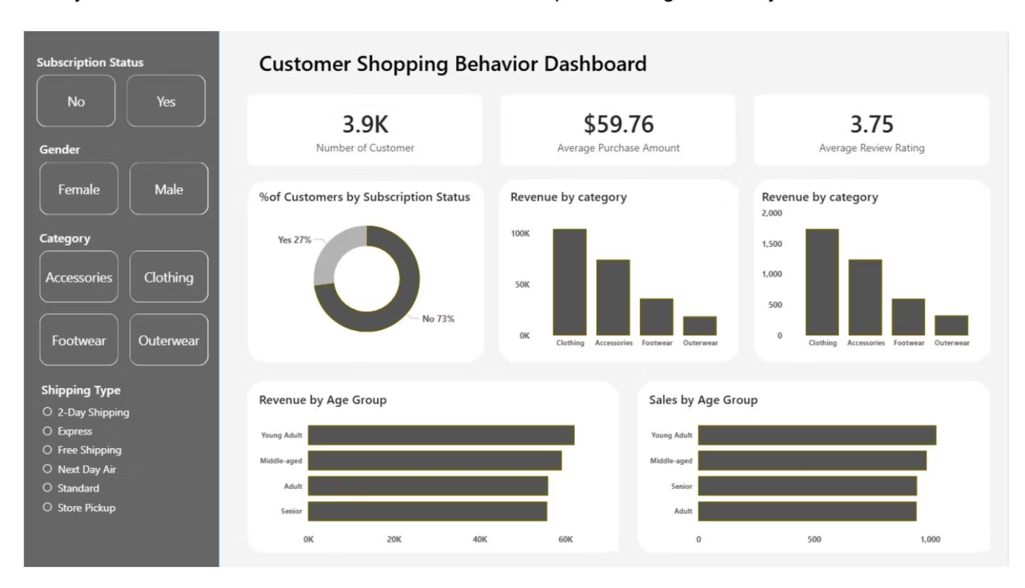
Interactive Dashboard
Our Power BI dashboard provides real-time visualization of customer behavior, revenue trends, and product performance across all segments and categories.

Slide 10




Strategic Recommendations
Boost Subscriptions
Promote exclusive benefits to convert the 73% non-subscriber base, especially among repeat buyers.
Loyalty Programs
Reward repeat buyers to accelerate movement into the Loyal segment and increase lifetime value.
Optimize Discounts
Balance promotional strategies—839 high spenders used discounts, proving strategic discounting maintains margins.
Targeted Marketing
Focus on Young Adults and express-shipping users. Highlight top-rated products (Gloves, Sandals, Boots) in campaigns.

