Slide 1


Stock Market Movement Prediction
using Twitter Sentiment Analysis

Slide 2

Team members
Enrollment No. | Name
AU1841057 | Mayankkumar Tank
AU1841076 | Rahul Chocha
AU1841109 | Jeet Karia
AU1841124 | Prince Dalsaniya

Slide 3

Introduction
Days back when Internet was just a dream for common people, at that time they were not surrounded by so much of information that we have now.
Here we are focusing on the stock market and its features like close price, open price, Returns, etc. And trying to predict that features based on sentiments of investors/peoples on twitter or any other microblogging websites.

Slide 4

Problem Statement
The inefficiency that we were working on was more accurate predictions/forecasting of stock market trends with the help of twitter’s features like bullishness, positive tweets, negative tweets, etc.
And combining above mentioned tweet’s features with financial data features and inferring results out of it and forecasting.

Slide 5
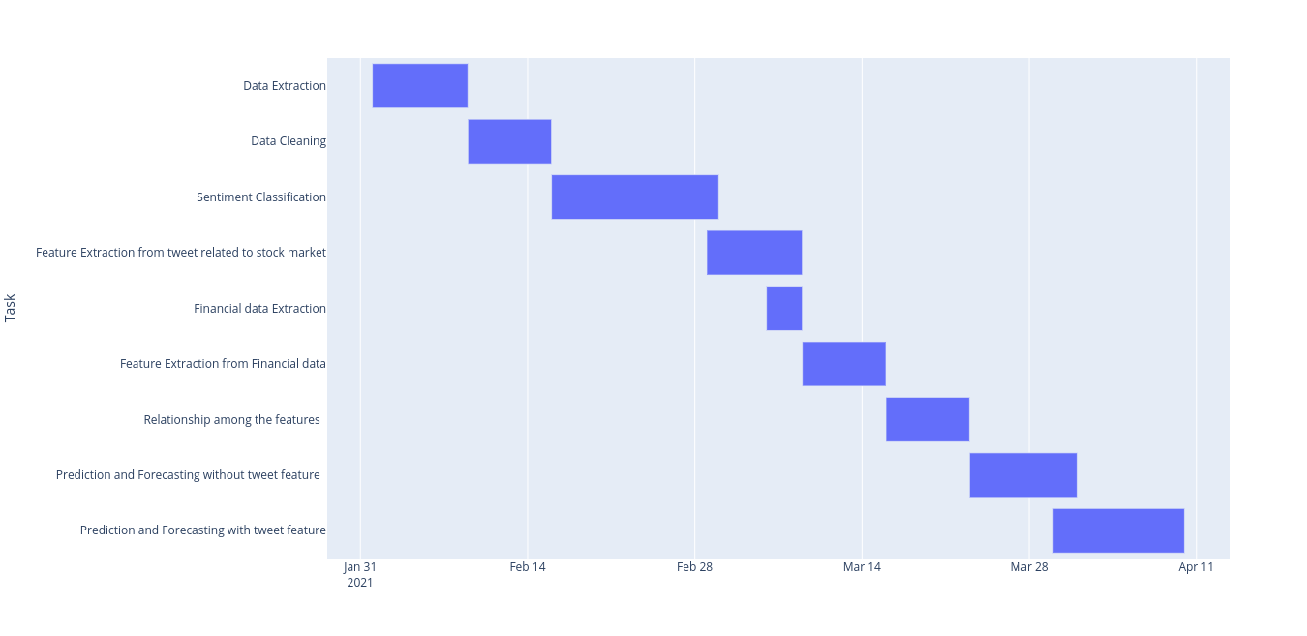
GANTT chart

Slide 6

Existing body of work
Anuja P Jain and Prof Padma Dandannavar have implemented different ML techniques and modes to find the Twitter sentiment analysis and compared their accuracy among different techniques (like naive bayesian classifier, logistic regression and etc.) [2].
T. Rao and S.Srivastava have done accurate work related to predicting the stock market movements using Twitter sentiments. In their work, they work upon the particular timeframe which gives them better accuracy and also gives the better forecast results for the stock price [1].
T.P. Souza and O.Kolchyna have done a similar kind of work where they are also applying the twitter sentiment to finance [4].

Slide 7
Our Approach
Classification
Financial Feature Extraction
Data Extraction
Extracting tweets using web scraping company wise for specific days
Classifying tweets into positive, negative or neutral for the company.
Extracting financial features like closing price, open price, volatility, return.
Data Cleaning
Twitter Feature Extraction
Removing stopwords, punctuation marks, spelling correction, lemmatization on tweets.
Extracting features like bullishness, positive, negative, agreement over a range of days.

Slide 8



Our Approach
Bullishness of ‘t’ day
Relationship among the features
Performed correlation, Granger’s Causality Analysis, ADF Test for checking series stationarity, and inferring which features are important.
= #positive tweets on day ‘t’
= #negative tweets on day ‘t’
Prediction and Forecasting
Implemented ARIMA model for univariate time series forecasting, linear regression for multivariate time series prediction.

Slide 9
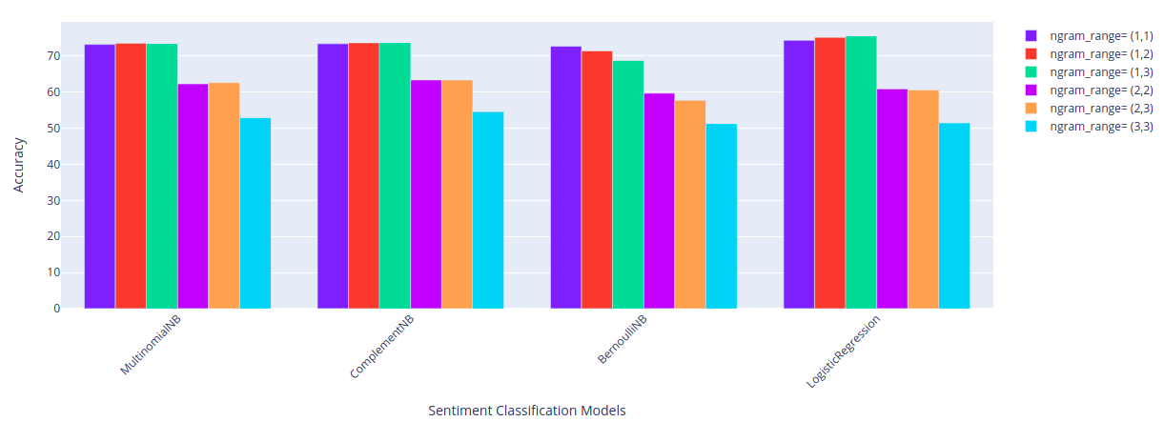
Final Results
Fig 1: Comparison of different classification algorithms

Slide 10
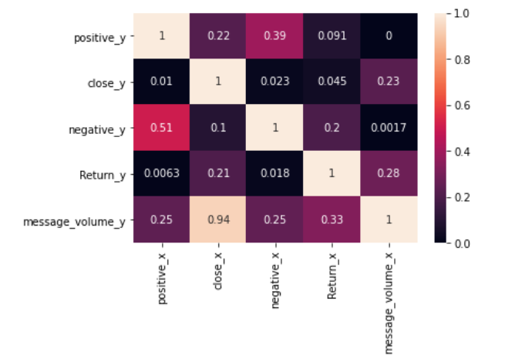
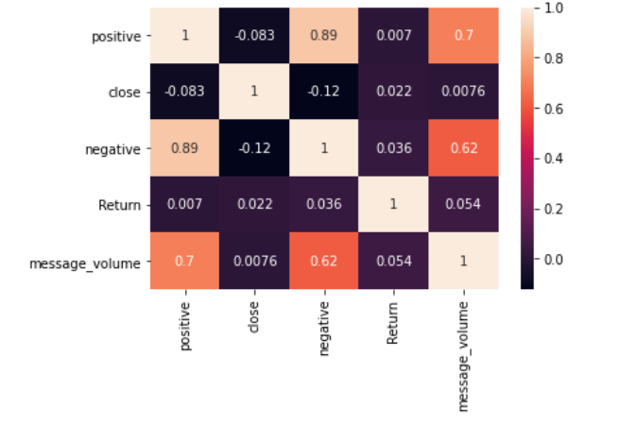
Final Results
Fig 2: Features Correlation matrix
Fig 3: Features GCA matrix

Slide 11
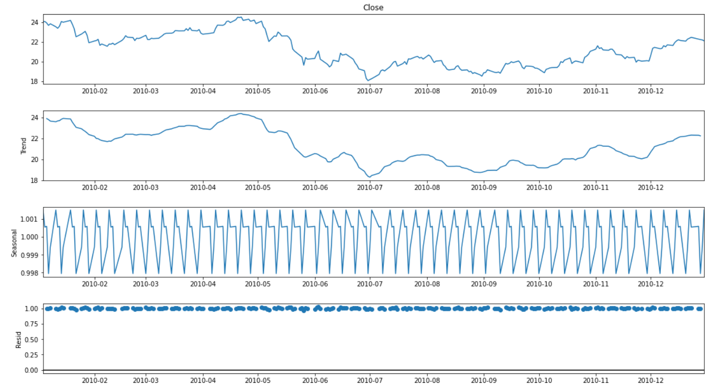
Final Results
Fig 4: Decomposing time series into trend, seasonal trend and residues

Slide 12
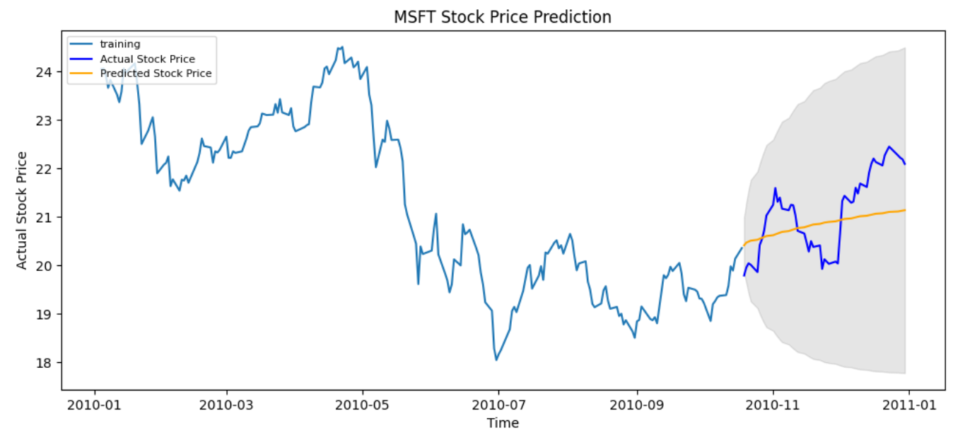
Final Results
Fig 5: Forecasting without tweet features (univariate time-series) using ARIMA model

Slide 13
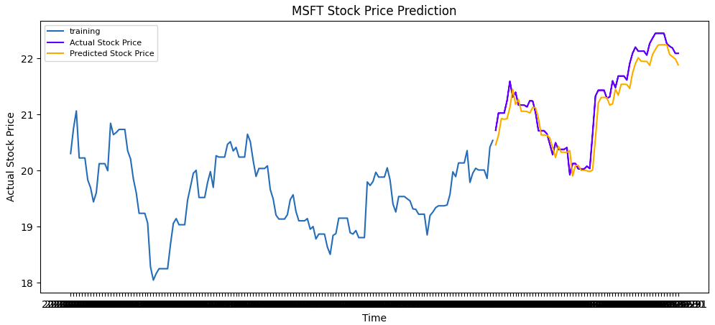
Final Results
Fig 6: Forecasting without tweet features (univariate time-series) using ARIMA model

Slide 14

Final Results
Fig 7: RMSE for ARIMA forecasting model
Fig 8: RMSE for Linear Regression prediction model

Slide 15

Conclusions
Using just the univariate time series, we get the rough idea of overall trend that close price will be following throughout the forecast time.
To obtain the values of close price from different time series like positive tweets, negative tweets and return we have used OLS regression which gives much better results with more data. The problem that occurred with us was, we were having very less data points.
Twitter sentiments do play a significant role in deciding the stock market price.

Slide 16
Role of each group member
01
Github Repository making
ARIMA model forecasting and GCA
Difference in prediction and forecasting
Presentation and report writing
Mayank Tank
02
Linear Regression
MNB with modification from scratch
Algorithm Comparison
Presentation and report writing
Rahul Chocha
03
ARIMA model forecasting
Granger Causality Analysis
Code merging and commenting on the code
Presentation and report
Jeet Karia
04
Data extraction
Web scraping of tweets
Prince Dalsaniya

Slide 17
References
1) T. Rao and S. Srivastava, “Analyzing stock market movements using twitter sentiment analysis”
2) A.Jain, P. Dandannavar, “Application of Machine Learning Techniques to Sentiment Analysis”
3) Time series Forecasting using Granger’s Causality and Vector Autoregressive Model
4) T. P. Souza,Olga Kolchyna,Philip Treleaven and Tomaso Aste,”Twitter Sentiment Analysis Applied to Finance: A Case Study in the Retail Industry”,July 2015
5) Feroz Kazi,”Using Granger Causality Test to Know If One Time Series Is Impacting in Predicting Another?”,Jul 2020
6) Aishwarya Singh,”A Gentle Introduction to Handling a Non-Stationary Time Series in Python”,Sep 2018
7) Aishwarya Singh,”Stock Market Price Trend Prediction Using Time Series Forecasting”,Nov 2020
8) Jason Brownlee,”How to Create an ARIMA Model for Time Series Forecasting in Python”,Dec 2020
9) Jason Brownlee,”How to Check if Time Series Data is Stationary with Python”,Aug 2020
10) Robert Nau,”Statistical forecasting:notes on regression and time series analysis”

Slide 18


