Slide 1


Stock market movement prediction using Twitter Sentiment Analysis

Slide 2

Team members
Enrollment No. | Name
AU1841057 | Mayankkumar Tank
AU1841076 | Rahul Chocha
AU1841109 | Jeet Karia
AU1841124 | Prince Dalsaniya

Slide 3

Introduction
Twitter is almost like a micro-blogging service on which most investors and people put out their opinions.
So, twitter is important platform which influences the stock market movements and decides the sentiments of the market.
It will be useful to set the strategy for common people or to decide on which stock to invest and which to sell.

Slide 4

Problem Statement
As social media heavily influences the decisions of the people around the globe, it becomes potential bet to bet on and predict the stock market movements.
So, we are finding the correlation that financial stock market data’s features has and twitter’s sentiments has.
So, we are extracting features from the tweets and the financial data and correlating them and inferring fruitful conclusions about the future prices and making successful hedging strategies.

Slide 5

Existing body of the work
T. Rao and S.Srivastava have used similar approach for correlation financial data feature and tweets’ features and then forecasting future prices or stock movements [2].
T.P. Souza and O.Kolchyna have done similar work where they are also considering the emotions of the tweets which includes calm, alert, sure, vital, kind and many more [5].
What T.Rao and S.Srivastava is doing differently is, they are taking particular time frames and analyzing results accordingly which shows better accuracy and also gives better forecaste results.
A.Jain, P. Dandannavar have implemented different ML techniques and compared their accuracy among different techniques [3].

Slide 6

Approach to solve the problem
First, extracting meaningful and conclusive information which is in the form of tweets.
Performing pre-processing on extracted tweets which includes stop-words removal, punctuation marks removal, spelling correction, stemming and lemmatization.
Then extracting features from the tweets based on the n-gram operation that we desire to do.
Making an efficient classification model which classifies tweets into positive, negative and neutral.

Slide 7
Approach to solve the problem
Finding the features from tweets related to the stock market like bullishness, Agreement, etc.
Extracting financial data of some predetermined time frame and generating features from it like Returns, volatility, Closing price, etc.
Correlating both of the data’s features using different correlation tool like GCA.
Inferring the results out of the correlation and predicting the future stock movement/prices.

Slide 8
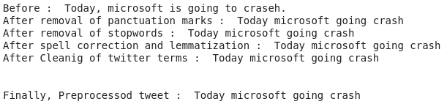
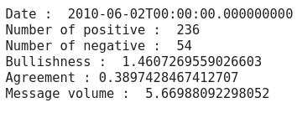

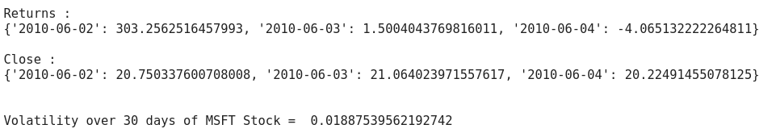
Initial Result
Stock market related features from tweets
Cleaning and preprocessing
Financial data features

Slide 9
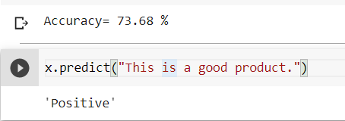


Initial Result
Predicted results from developed model

Slide 10

Role of each member in project
Jeet : Implemented SVM for sentiment classification and extraction of financial data features, also determining the distribution of the financial data.
Mayank : Data cleaning, Data preprocessing and Feature extraction from tweets for stock market.
Rahul : Implementation of various models for sentiment classification like different naive bayesian, logistic regression etc.
Prince : Dataset Collection.
Notes:
Moving onto the work done by all team members, we have Jeet who has tried to implement SVM model for sentiment classification and extracting the financial data features, and also tried to determine how they are distributed. Next we have Mayank. He has done data cleaning and preprocessing, and made the tweets ready for sentiment analysis. Also he has worked on extracting the financial features from the tweets like bullishness, bearishness, etc as he also mentioned previously.
Talking about Rahul, he has implemented various models for sentiment classification including different types of naive bayesian(gussion, multinomial, complement), logistic regression, and etc.
Meanwhile I was working on building the database. Main requirement of database is to get tweets from 2010-2011. For that we have contacted twitter. They were giving only few(5000) tweets per month. But that wasn’t enough. Working with twitter API took a lot of our time. So, after that I started working on making a web scraper which collects tweets related to 13 companies for everyday of certain time period.

Slide 11

Future work
We can extend this to predicting future prices by analyzing sentiments from other microblogging services like Stocktwits etc.
Trying classification with different techniques like decision tree and even using different correlation techniques.
Notes:
Now taking about future work we are going to try predicting prices of the stocks by analysing sentiments from the other microblogging services like StockTweets, etc.
We also can try implementing different techniques like decision tree and etc for classification and even use different techniques to correlate financial data to the tweets’ sentiments.

Slide 12

References
[1] “Sentiment Analysis for Stock Price Prediction” (towardsdatascience.com)
[2] T.Rao and S.Srivastava, “Analyzing Stock Market Movement Using Twitter Sentiment Analysis”
[3] A.Jain, P. Dandannavar, “Application of Machine Learning Techniques to Sentiment Analysis”
[4] “Time series Forecasting using Granger’s Causality and Vector Autoregressive Model” (towardsdatascience.com)
[5] “Twitter Sentiment Analysis Applied to Finance: A Case Study in the Retail Industry” (researchgate.com)
Notes:
These are the references and yeah that all from our side. Thank you. Now we are open for questions and answers.

