Slide 1
Big Data Applications Symposium - Summer 2019
Project Name: NYC MTA Ridership Predictor
Team: Jason Chan, Reggie Gomez
Abstract: New York City’s MTA system has been strained with over crowding and delays. If we can predict ridership, the MTA will have a better tool to management their limited resources. We developed an application that ingest transit and weather data from the between beginning 2015 to end 2018. We then to provide insight on how weather and seasonal patterns affect ridership with a predictive model. We conclude that weather may not be a strong predictor of ridership of the MTA.

Slide 2
NYC MTA Ridership Predictor
Motivation
Who are the users of this application? MTA Management
Who will benefit from this application? MTA Riders
Why is this application important?
The ability to understand and predict potential ridership numbers can help the MTA management make better decisions on staffing, security, train scheduling and general resource management for the MTA system.

Slide 3
NYC MTA Ridership Predictor
Goodness
What steps were taken to assess the ‘goodness’ of the analytic itself?
Input validation: correct datatypes and missing values
Completeness of data: ratio of unique turnstiles reporting
Machine learning scoring metrics: R² value, mean squared error.

Slide 4
NYC MTA Ridership Predictor
Actuation/Remediation
What actuation or remediation actions are/could be performed by this application?
MTA management can optimize staffing, security, train scheduling and general resource management for the MTA system. We can have a more efficient MTA system without necessarily spending more on capital investments, but through better utilization of existing resources.
For example: if the MTA can predict a rise in ridership in the next week, they can schedule more trains to operate or increase staffing at certain stations.

Slide 5
NYC MTA Ridership Predictor
Data Sources
Name: MTA Turnstile Data
Description: Weely reports. Reports are cumulative turnstile data for every station reported every 4 hours for the respective week.
Size of data: ~9.2 GB
Name: MTA Fare Data
Description: Weekly Reports. Reports include a breakdown of all the fare types used per station for the respective week.
Size of data: ~400 MB
Name: NOAA Daily Weather Summaries
Description: Daily weather summary for a collection New York City region weather stations. Data points included average wind speed, inches of rain, inches of snow, and average daily temperature.
Size of data: ~50 MB

Slide 6
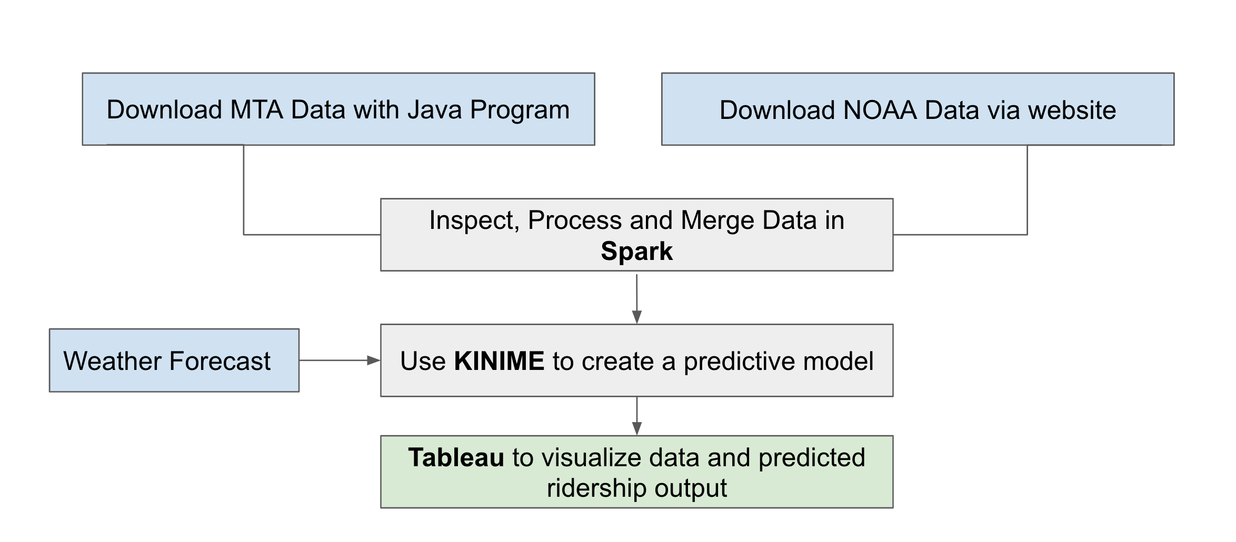
NYC MTA Ridership Predictor
Design Diagram
Platform(s) on which the application runs:
Java program for downloading MTA datasets.
Scala program to process and merge data on NYU’s HPC Cluster.
KNIME workflow to build a predictive model.
Tablaeu to display data, prediction and insights

Slide 7
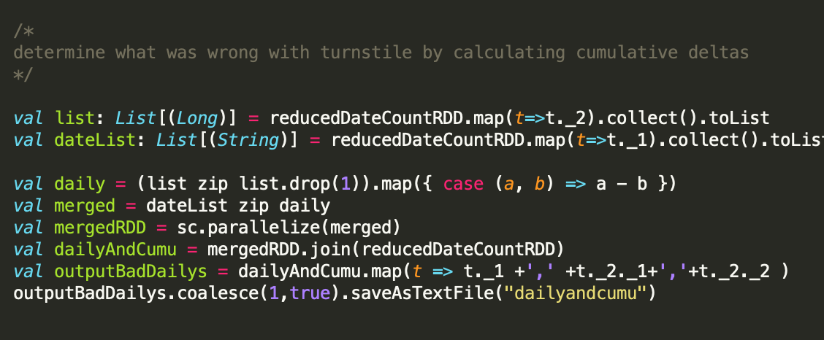
NYC MTA Ridership Predictor
Code Walkthrough
Calculating Cumulative Deltas

Slide 8
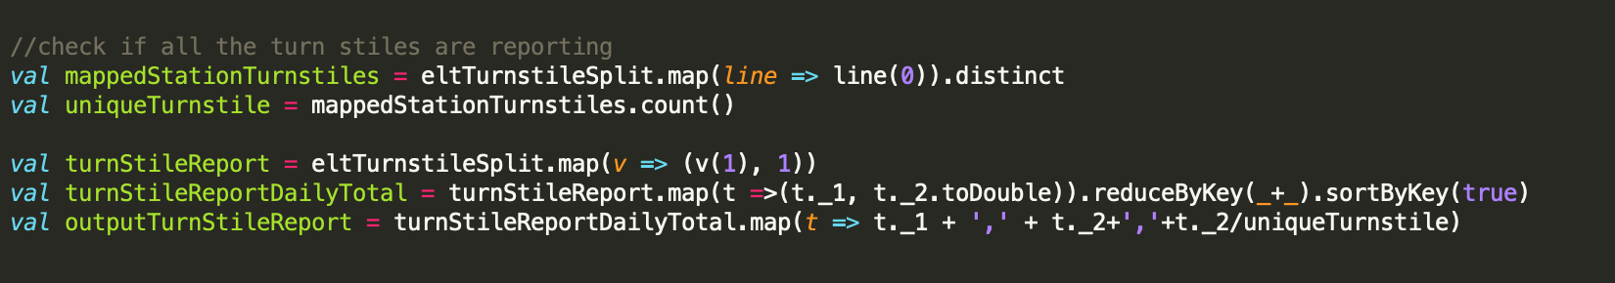
NYC MTA Ridership Predictor
Code Walkthrough
Calculating Ratio of Reporting Turnstiles by date

Slide 9
NYC MTA Ridership Predictor
Insights
1. We were unable to predict ridership reliably with weather data. The R2 values for different ML algorithms used such as multi-variable regression to gradient boosted trees ranged from .01 to .25. Low R2 value general indicates that the model explains none or very little of the variability of the response data around its mean
2. Daily average for 2018 from MTA’s Facts page was 4.7M.
Our computed daily average ridership based on fares was 2.9M for 2018.
3. ~73% of all unique turnstiles are being reported daily. Other turnstiles may be offline or just not being reported.
Notes:
http://web.mta.info/nyct/facts/ridership/

Slide 10
NYC MTA Ridership Predictor
Obstacles
1. Turnstile data only showed cumulative count every 4 hours. We needed to calculate the difference for all the turnstiles at the same time of day to determine the daily total.
2. Turnstiles sometimes go off line. We calculated a ratio to determine how many turnstiles are being reported per day.
3. We determined turnstile data was really bad. Some days the numbers were over 1 BILLION while other days, the daily count was NEGATIVE.
Observation: Average turns per day for date range Jan 1, 2015 to Dec 31, 2018 was ~63 MILLION. This is a lot more than the 4.7M daily average

Slide 11
NYC MTA Ridership Predictor
Summary
Weather data may not be a strong predictor of ridership. Past research shows reduced ridership during adverse weather, however, this is not what our data and predictive model showed us. Previous research also came from cities with residents that may not need to rely on public transit for commutes. Thus, it is possible that a densely populate city such as NYC is an outlier for the USA.
Our research also showed us MTA data is of poor quality or incomplete. Other researchers and news articles also indicate poor reporting from the MTA.
Acknowledgements
Thank you HPC for all the help and support!

Slide 12
NYC MTA Ridership Predictor
Acknowledgements
A. J. Khattak and A. D. Palma, “The impact of adverse weather conditions on the propensity to change travel decisions: A survey of Brussels commuters,” Transportation Research Part A: Policy and Practice, vol. 31, no. 3, pp. 181–203, 1997.
S. A. Changnon, “Effects of summer precipitation on urban transportation,” Climatic Change, vol. 32, no. 4, pp. 481–494, 1996.
A. Singhal, C. Kamga, and A. Yazici, “Impact of weather on urban transit ridership,” Transportation Research Part A: Policy and Practice, vol. 69, pp. 379–391, 2014.
V. Stover and E. Mccormack, “The Impact of Weather on Bus Ridership in Pierce County, Washington,” Journal of Public Transportation, vol. 15, no. 1, pp. 95–110, 2012.
“Turnstile Data,” mta.info. [Online]. Available: http://web.mta.info/developers/turnstile.html.
National Centers for Environmental Information and Ncei, “Climate Data Online Search,” Search | Climate Data Online (CDO) | National Climatic Data Center (NCDC). [Online]. Available: https://www.ncdc.noaa.gov/cdo-web/search.
“Fare Data,” mta.info. [Online]. Available: http://web.mta.info/developers/fare.html.

Slide 13
NYC MTA Ridership Predictor
Demo!

Slide 14
NYC MTA Ridership Predictor
Thank you!

