Slide 1
Dynamic Programming
Divide and Conquer and Greedy Algorithms are powerful techniques in situations which fit their strengths
Dynamic Programming can usually be used in a broader set of applications
DP uses some graph algorithm techniques in a specific fashion
Some call Dynamic Programming and Linear Programming (next chapter) the "Sledgehammers" of algorithmic tools
"Programming" in these names does not come from writing code as we normally consider it
These names were given before modern computers and programming was tied to the meaning of "planning"

Slide 2
Divide and Conquer
A
B
C
B
E
F
G
E
G
H
E
F
G
Note Redundant Computations

Slide 3
Dynamic Programming
A
B
C
B
E
F
G
E
G
H
E
F
G
start solving sub-problems at the bottom

Slide 4
Dynamic Programming
A
E: solution_{E}
F: solution_{F}
G: solution_{G}
B: solution_{B}
B
C
B
E
F
G
E
G
H
E
F
G
Find the proper ordering for the subtasks
Build a table of results as we go
That way do not have to recompute any intermediate results
Notes:
Would really do all the leafs first before b

Slide 5
Dynamic Programming
A
A
B
C
B
B
C
E
F
G
E
G
H
E
F
G
E
F
G
H

Slide 6
Fibonacci Series
0, 1, 1, 2, 3, 5, 8, 13, 21, 34, …
Exponential if we just implement the algorithm directly
DP approach: Build a table with dependencies, store and use intermediate results – O(n) time, space O(n) but…
Note that dependencies form a DAG with each table cell corresponding to a node in the DAG
Notes:
Show column with empty cells and graph dependencies, far left of white board to look at later
And with certain base conditions set from which we start as we fill in

Slide 7
Example – Longest Increasing Subsequence
5 2 8 6 3 6 9 7
2 3 6 7
Consider the sequence as a graph of n nodes
What algorithm could you use to find longest increasing subsequence?
Notes:
Not necessarily unique
Consider binary path represented with 1 for a node in path and 0 not. Then legal paths would be ones were the value difference between consecutive 1's is an increase. Just return the binary number with most 1's.
Could start from all 1's. Then all with 1 0, etc. until find first legal path.

Slide 8
Example – Longest Increasing Subsequence
5 2 8 6 3 6 9 7
2 3 6 7
What algorithm would you use to find longest increasing subsequence?
Could try all possible paths
2^{n} possible paths (why)?
There are less increasing paths
Complexity is n·2^{n}
Very expensive because lots of work done multiple times
sub-paths repeatedly checked
Notes:
Consider binary path represented with 1 if node is in path else 0. Score is 0 if not increasing, else # of 1s. Just return the longest.

Slide 9
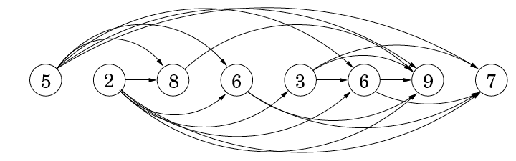
Example – Longest Increasing Subsequence
Could represent the sequence as a DAG with edges corresponding to increasing values
Problem is then just finding the longest path in the DAG
DP approach – solve in terms of smaller subproblems with memory
Start with a table and see if see we can build up the DAG and relationship equation
Notes:
Look at the node with the 8 and think of a general relationship. What is its longest
How long to create DAG – n^2 – But we can just do that as we go in the array using our array rep (adjacency matrix or list) rather than create dag
Walk through example
Implement with a memory vector of size, make first index 1
How do we reconstruct path if we want it. Prev pointer updates

Slide 10

Example – Longest Increasing Subsequence
Could represent the sequence as a DAG with edges corresponding to increasing values
Problem is then just finding the longest path in the DAG
DP approach – solve in terms of smaller subproblems with memory
L(j) is the longest path (increasing subsequence) ending at j
(plus one since we are counting nodes in this problem)
Any node could be the last node in the longest path so we check each one
Build table to track values and avoid recomputes – Complexity? - Space?
Notes:
How long to create DAG – n^2
Walk through example – once dependencies are in graph, do not need to remember actual values: 5, 2, 8, etc.
Implement with a memory vector of size n, Don't need to actually create the DAG, just check the dependencies as we go down the array, with NO graph representation at all; loop through to find increasing cells on the fly.
How do we reconstruct path if we want it. Prev pointer updates, thus really O(n) space

Slide 11
Example – Longest Increasing Subsequence
Complexity: O(n²)
Memory Complexity? – must store intermediate results to avoid recomputes O(n)
Note that for our longest increasing subsequence problem we get the length, but not the path
Can fix this (ala Dijkstra) by also saving prev(j) each time we find the max L(j) so that we can reconstruct the longest path
Why not use divide and conquer style recursion?
Notes:
Use n as number of elements in our list (verses V and E for purely graph problems)
Note DAG requires up to order N^2 storage. – Or order N*avg out degree for both creation and storage. Could be up to n^2.
Could do same alg without the DAG step and would still be N^2 time with only N storage – Just do Max on all preceding numbers and skip those that are greater.
O(n·average_indegree) if using an adjcancy list rep of the actual created DAG, but it would be n^2 to build the dag so still n^2. Book says O(E) but that would be on the DAG

Slide 12
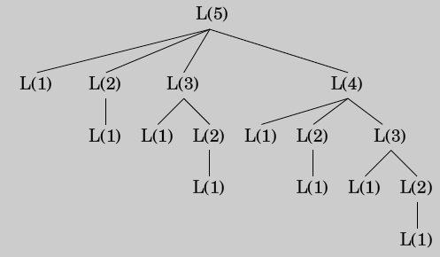
Example – Longest Increasing Subsequence
Why not use divide and conquer style recursion?
Recursive version is exponential (lots of redundant work)
Versus an efficient divide and conquer that cuts the problem size by a significant amount at each call and minimizes redundant work
This case just goes from a problem of size n to size n-1 at each call

Slide 13
When is Dynamic Programming Efficient
Anytime we have a collection of subproblems such that:
There is an ordering on the subproblems, and a relation that shows how to solve a subproblem given the answers to "smaller" subproblems, that is, subproblems that appear earlier in the ordering – No cycles!
Problem becomes an implicit DAG with each subproblem represented by a node, with edges giving dependencies
Just one order to solve it? - Any linearization works
Notes:
Both a 1-d table (vector)
Fibonacci has set DAG, wheres LIS depends on sequesnce and is created for the particular sequence
Don't want to start solving L(2) until L(1) is done. Note it is a DAG with order dependencies defined by the edges
all L(i) already done before calculating L(j) rather than top down recursive approach
No base cases in Largest Increasing Subsequence

Slide 14
When is Dynamic Programming Efficient
Create an appropriately dimensioned table to store values of each node – One table element per node
Set any necessary base cases in the table
Fill in the table following the DAG dependencies between nodes (i.e. table elements)
Does Fibonacci algorithm fit this model?
Does largest increasing subsequence fit this model?
Ordering is in the for loop – an appropriate linearization, finish L(1) before starting L(2), etc.
DAG relation is L(j) = 1 + max{L(i) : (i,j) ∈ E} – different for each sequence unlike the fixed dependencies of Fibonacci
Notes:
Both a 1-d table (vector)
Fibonacci has set DAG, wheres LIS depends on sequesnce and is created for the particular sequence
Don't want to start solving L(2) until L(1) is done. Note it is a DAG with order dependencies defined by the edges
all L(i) already done before calculating L(j) rather than top down recursive approach
No base cases in Largest Increasing Subsequence

Slide 15
When is Dynamic Programming Optimal?
DP is optimal when the optimality property is met
First make sure solution is correct
The optimality property: An optimal solution to a problem is built from optimal solutions to sub-problems
Question to consider: Can we divide the problem into sub-problems such that the optimal solutions to each of the sub-problems combine into an optimal solution for the entire problem?

Slide 16
When is Dynamic Programming Optimal?
The optimality property: An optimal solution to a problem is built from optimal solutions to sub-problems
Consider Longest Increasing Subsequence algorithm
Is L(1) optimal? (or any base cases in general)
As you go through the ordering does the relation always lead to an optimal intermediate solution?
Markovian assumption – not dependent on history, just current/recent states
Note that the optimal path from j to the end is independent of how we got to j (Markovian)
Thus choosing the longest incoming path must be optimal
Notes:
draw a node on the board with incoming edges and lengths (2 and 3), and then show that given an optimal path to the end, choosing 3 is the only optimal total path.

Slide 17
Dynamic Programming and Memory
Trade off some memory complexity for storing intermediate results so as to avoid recomputes
How much memory
Depends on variables in relation
Just one variable requires a vector: L(j) = 1 + max{L(i) : (i,j) ∈ E}
A two variable relation L(i,j) would require a 2-d array, etc.
Notes:
Note prev(j) is the backpointer if j happens to be part of the best path, which we do not know yet

Slide 18
Another Example – Binomial Coefficient
How many ways to choose k items from a set of size n (n choose k)
Just do recursion?
Notes:
Quick example not from equation and then with equation, if n=3 and k =2, then what is (a, b c) then (a,b), (b, c) (a,c) = 3 = 3!/2!(1!)
n! would overflow computer real fast for first equation
Intuition of equation? Not obvious, but importantly gives us a way to break down in a recursive manner (DC, DP, etc.)
Divide and conquer opportunity? NO – size just decreases by 1, but when look back by some constant, think DP as an option! Exponential for second equation
Dynamic – there is an ordering (previous n and k) and a relation (equation above)

Slide 19
Unwise Recursive Method for C(5,3)
C(5,3)
C(4,2)
C(4,3)
C(3,1)
C(3,2)
C(3,2)
C(3,3)
C(2,0)
C(2,1)
C(2,1)
C(2,2)
C(2,1)
C(2,2)
1
C(1,0)
C(1,1)
C(1,0)
C(1,1)
C(1,0)
C(1,1)
1
1
1
1
1
1
1
1
1
Notes:
and redundant computations

Slide 20
Wiser Method – No Recomputes
C(5,3)
C(4,2)
C(4,3)
C(3,1)
C(3,2)
C(3,3)
C(2,0)
C(2,1)
C(2,2)
C(1,0)
C(1,1)

Slide 21
Try DP! Recurrence Relation to Table
Use the variables to index a table
Figure out the base case(s) and put it/them in the table first
Show the DAG dependencies and fill out the table until we get to the desired answer
Let's do it for C(5,3)
Notes:
Start the table on the board for C(5,3), do n rows k columns
then show dependencies
complexity is n^2

Slide 22
DP Table = C(5,3)
n k: | 0 | 1 | 2 | 3
0
1
2
3
4
5
Notes:
Table size (2 variables)
Base cases and then show DAG dependencies. (Note diagonal base (and above) follows relation)
Where should we start from. Recursive (from solution will create redundancies). Start from top left and work frontier forward until reach goal

Slide 23
DP Table = C(5,3)
n k: | 0 | 1 | 2 | 3
0 | 1 | 0 | 0 | 0
1 | 1 | 1 | 0 | 0
2 | 1 |  | 1 | 0
3 | 1 |  |  | 1
4 | 1
5 | 1
Notes:
Table size (2 variables)
Base cases and show dependencies. (Note diagonal base (and above) follows relation)
Where should we start from. Recursive (from solution will create redundancies). Start from top left and work frontier forward until reach goal

Slide 24
DP Table = C(5,3)
n k: | 0 | 1 | 2 | 3
0 | 1 | 0 | 0 | 0
1 | 1 | 1 | 0 | 0
2 | 1 | 2 | 1 | 0
3 | 1 |  |  | 1
4 | 1
5 | 1
Notes:
Goes a row at a time

Slide 25
DP Table = C(5,3)
n k: | 0 | 1 | 2 | 3
0 | 1 | 0 | 0 | 0
1 | 1 | 1 | 0 | 0
2 | 1 | 2 | 1 | 0
3 | 1 | 3 | 3 | 1
4 | 1 | 4 | 6 | 4
5 | 1 | 5 | 10 | 10
What is the complexity?
Notes:
Table is n^2 with each calculation O(1) so total is n^2
Could maintain growing array, or just recalculate each time
Could gain some be realizing do not have to calculate bottom left of table (problem dependant)

Slide 26
DP Table = C(5,3)
n k: | 0 | 1 | 2 | 3
0 | 1 | 0 | 0 | 0
1 | 1 | 1 | 0 | 0
2 | 1 | 2 | 1 | 0
3 | 1 | 3 | 3 | 1
4 | 1 | 4 | 6 | 4
5 | 1 | 5 | 10 | 10
What is the complexity? Number of cells (table size) × complexity to compute each cell, Space?
Notes:
Table is n^2 with each calculation O(1) so total is O(nk) usually n^2
Could maintain growing array, or just recalculate each time
Could gain some be realizing do not have to calculate bottom left of table in this case since dependencies are up and diagonal. Just a diagonal patch up to the 0 frontier (problem dependant)
Space only need be O(k) since can just keep 2 rows

Slide 27
DP Table = C(5,3)
n k: | 0 | 1 | 2 | 3
0 | 1 | 0 | 0 | 0
1 | 1 | 1 | 0 | 0
2 | 1 | 2 | 1 | 0
3 | 1 | 3 | 3 | 1
4 | 1 | 4 | 6 | 4
5 | 1 | 5 | 10 | 10
1
5 1
Notice a familiar pattern?

Slide 28
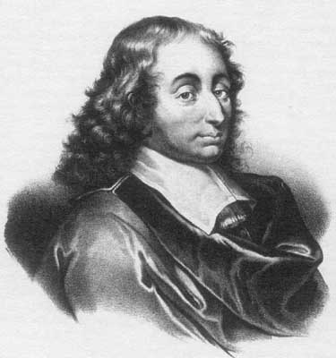
Pascal’s Triangle
Blaise Pascal (1623-1662)
Second person to invent the calculator
Religious philosopher
Mathematician and physicist
Pascal's Triangle is a geometric arrangement of the binomial coefficients in a triangle
Pascal's Triangle holds many other mathematical patterns

Slide 29
Edit Distance
A natural measure of similarity between two strings is the extent to which they can be aligned, or matched up
The Edit Distance between two strings is the minimum number of edits to convert the first string to the second
Edit options for first string are substitute, insert, or delete
Assume each edit option has equal cost for the moment
What is the edit distance of the example below?
THARS
OTHER
Notes:
Could always use lots of substitutes, but not minimal

Slide 30
Edit Distance
A natural measure of similarity between two strings is the extent to which they can be aligned, or matched up
The Edit Distance between two strings is the minimum number of edits to convert the first string to the second
Edit options are substitute, insert, or delete
Assume each has equal cost for the moment
What is the edit distance of the example below?
-THARS insert, cost 1
OTHER
Notes:
Insert is equivalent to deleting O from the second string

Slide 31
Edit Distance
A natural measure of similarity between two strings is the extent to which they can be aligned, or matched up
The Edit Distance between two strings is the minimum number of edits to convert the first string to the second
Edit options are substitute, insert, or delete
Assume each has equal cost for the moment
What is the edit distance of the example below?
-THERS substitute, cost 1
OTHER

Slide 32
Edit Distance
A natural measure of similarity between two strings is the extent to which they can be aligned, or matched up
The Edit Distance between two strings is the minimum number of edits to convert the first string to the second
Edit options are substitute, insert, or delete
Assume each has equal cost for the moment
What is the edit distance of the example below?
Could be more than one way to edit with same distance
-THERS delete, represented as insert in 2nd word OTHER-
Notes:
Edit distance = 3, Optimal?

Slide 33
Edit Distance
Give me a simple algorithm for doing edit distance?
THARS
OTHER
-THERS
OTHER-

Slide 34
Edit Distance
Give me a simple algorithm for doing edit distance?
Number of possible alignments grows exponentially with string length n, so we try DP to solve it efficiently
Two things to consider
Is there an ordering on the subproblems, and a relation that shows how to solve a subproblem given the answers to "smaller" subproblems, that is, subproblems that appear earlier in the ordering
Is it the case that an optimal solution to a problem is built from optimal solutions to sub-problems
Notes:
Try all possible alignments and return one with lowest cost

Slide 35
DP approach to Edit Distance
Assume two strings x and y of length m and n respectively
Consider the edit subproblem E(i,j) = E(x[1…i], y[1…j])
For x = "taco" and y = "texco" E(2,3) = E("ta","tex")
The final solution is E(m,n) = E(4,5)
This notation gives a natural way to start from small cases and build up to larger ones
Common paradigm for breaking down DP problems
Let's start by building a table
What are the base cases?
What is the relationship E(i,j) of the next open cell based on previous cells?
Notes:
This is a common model for breaking down DP problems

Slide 36
Let's fill in the base cases first:
E(0,0) = E("" ,"") = ?
E(2,0) = E("TH" ,"") = ?
E(0,3) = E("", "OTH") = ?
 |  | O | T | H | E | R
 | E(0,0) | E(0,1) | E(0,2)
T | E(1,0) | E(1,1) | E(1,2)
H | E(2,0) | E(2,1) | E(2,2)
A |  |  |  | E(i,j)
R
S |  |  |  |  |  | Goal
i:
j:
Notes:
i is first word, the one we are editing
Show a couple on the board
E(2,0) = E("TH", ""), requires 2 deletes thus cost of 2
E(0,3) = E("", "OTH") requires 3 inserts, thus cost of 3

Slide 37
Let's think about general expression E(i,j) using cell E(2,2) = E("TH", "OT")
Focus on right alignment "H" and "T". There are only 3 options to consider:
match/substitution:
insert:
delete:
Which one will we want to use? The one leading to the lowest E(2,2)
E(i, j) = min[…]
 |  | O | T | H | E | R
 | 0 | 1 | 2 | 3 | 4 | 5
T | 1 | E(1,1) | E(1,2)
H | 2 | E(2,1) | E(2,2)
A | 3 |  |  | E(i,j)
R | 4
S | 5 |  |  |  |  | Goal
i:
j:

Slide 38
Let's think about general expression E(i,j) using cell E(2,2) = E("TH", "OT")
Focus on right alignment "H" and "T". There are only 3 options to consider:
match/substitution: 1 (substitute) + E(1,1) = 1 + E("T", "O") (consumed H and T)
insert:
delete:
Which one will we want to use? The one leading to the lowest E(2,2)
E(i, j) = min[diff(i, j) + E(i-1, j-1), …]
 |  | O | T | H | E | R
 | 0 | 1 | 2 | 3 | 4 | 5
T | 1 | E(1,1) | E(1,2)
H | 2 | E(2,1) | E(2,2)
A | 3 |  |  | E(i,j)
R | 4
S | 5 |  |  |  |  | Goal
i:
j:
Notes:
insert comes from left

Slide 39
Let's think about general expression E(i,j) using cell E(2,2) = E("TH", "OT")
Focus on right alignment "H" and "T". There are only 3 options to consider:
match/substitution: 1 (substitute) + E(1,1) = 1 + E("T", "O") (consumed H and T)
insert: 1 + E(2,1) = 1 + E("TH", "O") (T is consumed)
delete:
Which one will we want to use? The one leading to the lowest E(2,2)
E(i, j) = min[diff(i, j) + E(i-1, j-1), 1 + E(i, j-1), …]
 |  | O | T | H | E | R
 | 0 | 1 | 2 | 3 | 4 | 5
T | 1 | E(1,1) | E(1,2)
H | 2 | E(2,1) | E(2,2)
A | 3 |  |  | E(i,j)
R | 4
S | 5 |  |  |  |  | Goal
i:
j:

Slide 40
Let's think about general expression E(i,j) using cell E(2,2) = E("TH", "OT")
Focus on right alignment "H" and "T". There are only 3 options to consider:
match/substitution: 1 (substitute) + E(1,1) = 1 + E("T", "O") (consumed H and T)
insert: 1 + E(2,1) = 1 + E("TH", "O") (T is consumed)
delete: 1 + E(1,2) = 1 + E("T", "OT") (H is consumed)
Which one will we want to use? The one leading to the lowest E(2,2)
E(i, j) = min[diff(i, j) + E(i-1, j-1), 1 + E(i, j-1), 1 + E(i-1, j)]
 |  | O | T | H | E | R
 | 0 | 1 | 2 | 3 | 4 | 5
T | 1 | E(1,1) | E(1,2)
H | 2 | E(2,1) | E(2,2)
A | 3 |  |  | E(i,j)
R | 4
S | 5 |  |  |  |  | Goal
i:
j:
Notes:
What is general dag dependency?

Slide 41
Let's fill some in
E(i,j) = min[diff(i,j) + E(i-1,j-1), 1 + E(i,j-1), 1 + E(i-1,j)]
So will current cell be part of solution?
Who knows, keep backpointers
 |  | O | T | H | E | R
 | 0 | 1 | 2 | 3 | 4 | 5
T | 1
H | 2
A | 3
R | 4
S | 5 |  |  |  |  | Goal
i:
j:
Notes:
Show that we can do row at a time, column at a time, 1 diagonal
Save rest for Challenge question
When filling in value for E(1,1) does that mean final solution will go though this? No!

Slide 42
**Challenge Question**
Fill in the rest
What is best edit distance? Is it unique?
Show path through table and alignment of the two words
What is the time and space complexity of the algorithm?
E(i,j) = min[diff(i,j) + E(i-1,j-1), 1 + E(i,j-1), 1 + E(i-1,j)]
 |  | O | T | H | E | R
 | 0 | 1 | 2 | 3 | 4 | 5
T | 1 | 1 | 1 | 2 | 3 | 4
H | 2 | 2 | 2
A | 3 | 3
R | 4 | 4
S | 5 | 5 |  |  |  | Goal
i:
j:
Notes:
Show that we can do row at a time, column at a time, couple diagonal
Save rest for Challenge question

Slide 43
**Challenge Question**
What is best edit distance? 3. Is it unique? Yes. Why?
Show path through table and alignment of the two words
-THERS
OTHER-
What is the time and space complexity of the algorithm? O(mn)
 |  | O | T | H | E | R
 | 0 | 1 | 2 | 3 | 4 | 5
T | 1 | 1 | 1 | 2 | 3 | 4
H | 2 | 2 | 2 | 1 | 2 | 3
A | 3 | 3 | 3 | 2 | 2 | 3
R | 4 | 4 | 4 | 3 | 3 | 2
S | 5 | 5 | 5 | 4 | 4 | 3
i:
j:
Notes:
Red backpointers cost
Unique if each cell on path has only one possible back pointer – no ties
Could we do with less memory. NOT if you want to recover alignment, which we usually do
O(mn) ~ O(n^2) for common case where words are similar length

Slide 44
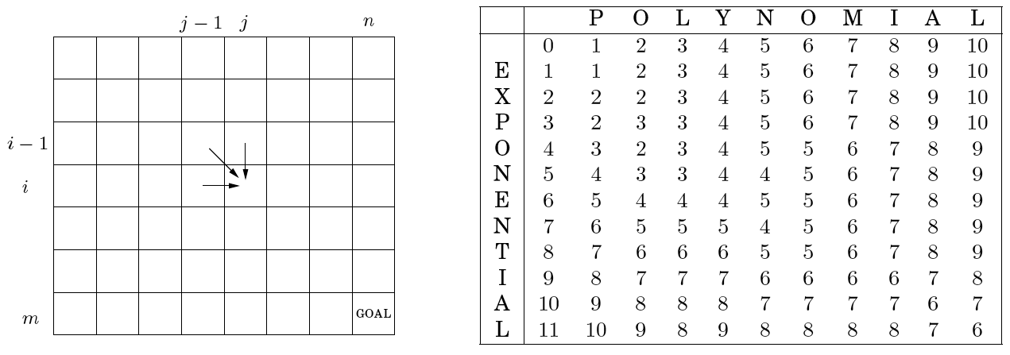
Edit Distance Algorithm
For i = 0,1,2,…, m E(i, 0) = i // length of string(x) - Exponential
For j = 0,1,2,…, n E(0, j) = j // length of string(y) - Polynomial
For i = 1,2,…, m
For j = 1,2,…, n
E(i, j) = min[diff(i, j) + E(i-1, j-1), 1 + E(i, j-1), 1 + E(i-1, j)]
Return E(m, n)
Notes:
Order? Could do row at a time, column at a time, or a diagonal wave from top left to bottom right – Thus space is O(n) if we want – Save this for later slide
Any top down shortcuts in this case
DP complexity – number of cells times complexity to compute each cell
Complexity is O(mn)

Slide 45
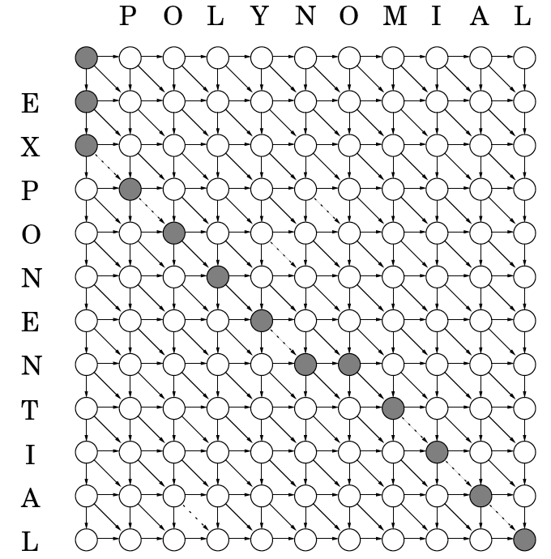
Edit Distance Example and DAG
This is a weighted DAG with weights of 0 and 1. We can just find the least cost path in the DAG to retrieve optimal edit sequence(s)
Diagonal arrows are either matches (dashed) with cost 0 or substitutions with cost 1
Right arrows are insertions into "Exponential" with cost 1
Down arrows are deletions from "Exponential " with cost 1
Edit distance of 6
EXPONEN-TIAL
--POLYNOMIAL
Can set costs arbitrarily based on goals
Notes:
Look at sample cells (one of each type) to see what they mean
Could be more than one optimal edit sequence (note one in this graph with –T/OM vs TO-/OM
Do example tacos and texco – edit distance is 3 with 2 insertions

Slide 46
Space Requirements
Basic table is m × n which is O(n²) assuming m and n are similar
What order options can we use to calculate cells
But do we really need to use O(n²) memory?
How can we implement edit-distance using only O(n) memory?
However, What about prev pointers and extracting the actual alignment with the O(n) approach?
Thus, in practice space is O(n²)
Notes:
2 column arrays
Can't extract actual alignment with O(n) memory approach. Thus, rarely used.

Slide 47
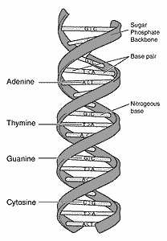
Gene Sequence Alignment
X=ACGCTC Y=ACTTG

Slide 48
Needleman-Wunsch Algorithm
Gene Sequence Alignment a type of Edit Distance
ACGCT-C
A--CTTG
Uses Needleman-Wunsch Algorithm
This is just edit distance with a different edge weighting (i.e. different edge lengths on DAG and we find shortest path)
You will use Needleman-Wunsch in your project
Cost (Typical Needleman-Wunsch costs are shown):
Match: c_{match} = -3 (a reward)
Insertion into x (= deletion from y): c_{indel} = 5
Insertion into y (= deletion from x): c_{indel} = 5
Substitutions of a character from x into y (or from y into x): c_{sub} = 1
You will use the above costs in your HW and project
Does that change the base cases?
Notes:
Yes. Multiples of 5, Start Needleman-Wunsch back on Thars/Other table slide, or at least look at gen E(i.j) and show the changes

Slide 49
Gene Alignment Project
You will implement two versions, both using our dynamic programming edit distance with Needleman-Wunsch
Unrestricted: Gives the optimal edit score in O(mn) time and O(mn) space and extracts the actual alignment
Banded: Give the best score assuming the table will not go beyond a band of k from the diagonal. Faster but not always optimal score.
You will align 10 supplied real gene sequences with each other (100/2 = 50 alignments)
atattaggtttttacctacc
caggaaaagccaaccaact
Some values are given to you for debugging purposes, your other results will be used to test your code correctness
Must do each within a performance requirement (x seconds)
Notes:
Show Demo
Why is alignment of Exponential/Polynomial -1, follows different path than our example given new costs
Go back to earlier slide and have them figure out why with the new edit costs, won't be the same path

Slide 50
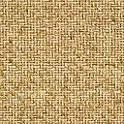
Knapsack
Given items x₁, x₂,…, x_{n}
each with weight w_{i} and value v_{i}
find the set of items which maximizes the total value ∑x_{i}v_{i}
under the constraint that the total weight of the items ∑x_{i}w_{i} does not exceed a given W
Many resource problems follow this pattern
Task scheduling with a CPU
Allocating files to memory/disk
Bandwidth on a network connection, etc.
There are two basic variations depending on whether an item can be chosen more than once (repetition)
Notes:
They do w/o repetition in their HW

Slide 51
Knapsack Approaches
Item | Weight | Value
1 | 6 | $30
2 | 3 | $14
3 | 4 | $16
4 | 2 | $9
W = 10
What is greedy algorithm? Is it optimal?
What is the simple algorithm with guaranteed optimal?
Notes:
since w/o repetition can be represented as a binary number – exponential version?
Note that with repetitions is less simple, lot more options to consider.

Slide 52
Knapsack Approaches
Item | Weight | Value
1 | 6 | $30
2 | 3 | $14
3 | 4 | $16
4 | 2 | $9
W = 10
Exponential number of item combinations
2^{n} for Knapsack without repetition – why?
Many more for Knapsack with repetition
How about DP?
Always ask what are the subproblems
Notes:
since w/o repetition can be represented as a binary number – exponential version?
Let's think about K() for knapsack WITH repetition first – K(w) – either less capacity or less items
Start table with initial condition then consider an arbitrary cell K(w). At this point have m items so far. Only possible links back are to each K(w-) which are optimal, for taking away one of the m items.
Which one? The one which (with the value added), gives us the maximum at K(w)
Note K(w) monotonically increasing with w so we don't have to consider if that is that cell is the moment that an item was added

Slide 53
Knapsack with Repetition
Two types of subproblems possible
consider knapsacks with less capacity
consider fewer items
Define K(w) = maximum value achievable with a knapsack of capacity w
Final answer is K(W)
Subproblem relation – if we were to add item i to get K(w), then removing i leaves optimal solution K(w-w_{i})
Can only add item i if w_{i} ≤ w
Thus K(w) = max_{i:wi≤w}[K(w – w_{i}) + v_{i}]
Note DAG is not a n-1 type recurrence (like edit distance) but varies for each particular knapsack problem
Notes:
NOT considering removing the item from the bag, just finding the optimal without item and then checking value if we added it.
Show table with DAG links

Slide 54
Knapsack with Repetition Algorithm
Item | Weight | Value
1 | 6 | $30
2 | 3 | $14
3 | 4 | $16
4 | 2 | $9
K(0) = 0
for w = 1 to W
K(w) = max_{i:wi≤w}[K(w – w_{i}) + v_{i}]
return(K(W))
Build Table – Table size? – Do example
Complexity is ?
W = 10
Notes:
Do example, Memory is just a vector

Slide 55
Knapsack with Repetition Algorithm
Item | Weight | Value
1 | 6 | $30
2 | 3 | $14
3 | 4 | $16
4 | 2 | $9
K(0) = 0
for w = 1 to W
K(w) = max_{i:wi≤w}[K(w – w_{i}) + v_{i}]
return(K(W))
Build Table – Table size?
Complexity is O(nW)
Bad news: W can get very large, n is typically proportional to log_{b}(W) which would make the order in n be O(nb^{n}) which is exponential in n
More on complexity issues in Ch. 8
W = 10
Notes:
Do example, Memory is just a vector
Look at DAG. It is longest DAG path. Very similar to longest increasing subsequence problem which also found longest DAG path
Certain similar patterns emerge in setting up DP problems, add a slide reviewing them, here or later?

Slide 56
Recursion and Memoization
function K(w)
if w = 0 return(0)
K(w) = max_{i:wi≤w}[K(w – w_{i}) + v_{i}]
return(K(W))
function K(w)
if w = 0 return(0)
if K(w) is in hashtable return(K(w))
K(w) = max_{i:wi≤w}[K(w – w_{i}) + v_{i}]
insert K(w) into hashtable
return(K(w))
K(0) = 0
for w = 1 to W
K(w) = max_{i:wi≤w}[K(w-w_{i}) + v_{i}]
return(K(W))
Recursive (DC – Divide and Conquer) version could do lots of redundant computations plus the overhead of recursion
However, would if we insert all intermediate computations into a hash table – Memoize
Usually still solve all the same subproblems with recursive or normal DP (e.g. edit distance)
For knapsack we might avoid unnecessary computations in the DP table because w is decremented by w_{i} (more than 1) each time.
Still O(nW) but with better constants than DP for some cases

Slide 57
Recursion and Memoization
Insight: When can we gain efficiency by recursively starting from the final goal and only solving those subproblems required for the specific goal?
If we knew exactly which subproblems were needed for the specific goal we could have done a more direct (best-first) approach
With DP, we do not know which of the subproblems are needed so we compute all that might be needed
However, in some cases the final solution will never require that certain previous table cells be computed
For example if there are 3 items in knapsack, with weights 50, 80, and 100, we could do recursive DC and avoid computing K(75), K(76), K(77), etc. which could never be necessary, but would have been calculated with the standard DP algorithm
Would this approach help us for Edit Distance?
Notes:
Note that a smarter normalization of the weights could also solve much of this
and when we need all previous cells anyway, might as well avoid the call stack overhead that would happen with recursion and memoization

Slide 58
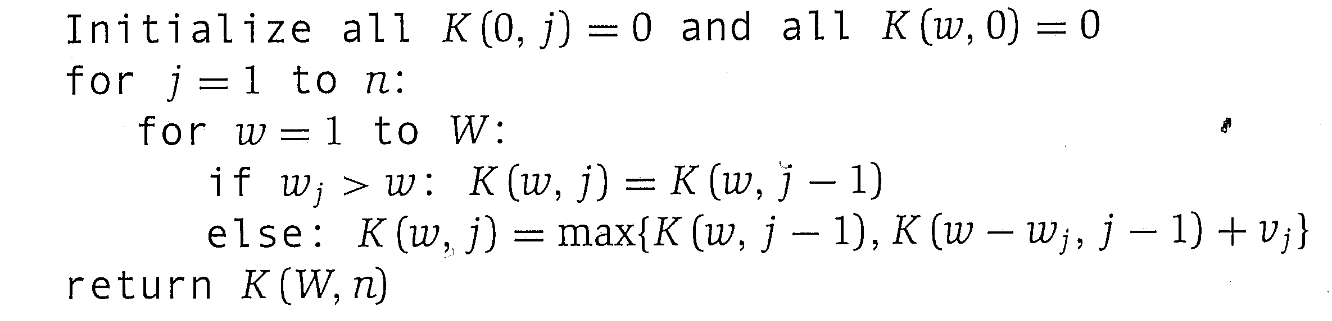
Knapsack without Repetition
Our relation now has to also track what items are available
K(w, j) = maximum value achievable given capacity w while only considering items 1,…, j
Means only items 1,…, j are available, but we actually just use some subset
Final answer is K(W, n)
Items can be in any order as we have to consider all of them regardless
Express relation as: either the j^{th} item is in the solution or not
K(w,j) = max [K(w – w_{j}, j-1) + v_{j}, K(w, j-1)]
If w_{j} > w then ignore first case
Table and Base cases?
Notes:
Track both size of sack and number of items to build up relation
Walk through example
make a slide with the table (multiple slides) and dag pointers
If use j can mark it so that we can recreate the items in knapsack

Slide 59
Knapsack without Repetition Example
 | w=0 | 1 | 2 | 3 | 4 | 5 | 6 | 7 | 8 | 9 | 10
0 | 0 | 0 | 0 | 0 | 0 | 0 | 0 | 0 | 0 | 0 | 0
1 | 0
2 | 0
3 | 0
4 | 0 |  |  |  |  |  |  |  |  |  | Goal
Item | Weight | Value
1 | 6 | $30
2 | 3 | $14
3 | 4 | $16
4 | 2 | $9
W = 10
Notes:
K1.5) means? K(2,8) means? best value for sack of capacity 8 with items 1 and 2 available

Slide 60
Knapsack without Repetition Example
 | w=0 | 1 | 2 | 3 | 4 | 5 | 6 | 7 | 8 | 9 | 10
0 | 0 | 0 | 0 | 0 | 0 | 0 | 0 | 0 | 0 | 0 | 0
1 | 0 | 0 | 0 | 0 | 0 | 0 | 30
2 | 0
3 | 0
4 | 0
Item | Weight | Value
1 | 6 | $30
2 | 3 | $14
3 | 4 | $16
4 | 2 | $9
W = 10
Notes:
Focus on cell 1,6 as an example of the two options

Slide 61
Knapsack without Repetition Example
 | w=0 | 1 | 2 | 3 | 4 | 5 | 6 | 7 | 8 | 9 | 10
0 | 0 | 0 | 0 | 0 | 0 | 0 | 0 | 0 | 0 | 0 | 0
1 | 0 | 0 | 0 | 0 | 0 | 0 | 30 | 30 | 30 | 30 | 30
2 | 0
3 | 0
4 | 0
Always an edge from above. Won't show anymore. Will just show first and informative diagonal edges.
Item | Weight | Value
1 | 6 | $30
2 | 3 | $14
3 | 4 | $16
4 | 2 | $9
W = 10
Notes:
Just keep comparing above and 6 back
and informative down edges
Do column 2 and then save rest for challenge

Slide 62
**Challenge** Finish table. What is complexity? Show how you know which items are in the sack
 | w=0 | 1 | 2 | 3 | 4 | 5 | 6 | 7 | 8 | 9 | 10
0 | 0 | 0 | 0 | 0 | 0 | 0 | 0 | 0 | 0 | 0 | 0
1 | 0 | 0 | 0 | 0 | 0 | 0 | 30 | 30 | 30 | 30 | 30
2 | 0 | 0 | 0 | 14 | 14 | 14 | 30 | 30 | 30 | 44 | 44
3 | 0
4 | 0 |  |  |  |  |  |  |  |  |  | Goal
Update back pointer to recover optimal sack
Item | Weight | Value
1 | 6 | $30
2 | 3 | $14
3 | 4 | $16
4 | 2 | $9
W = 10
Notes:
Would if we added volume as a bag and item feature?
Could we do it with less memory? Yes – but don’t know which items are in bag.

Slide 63
**Challenge** Finish table. What is complexity? How do you know which items are in the sack?
 | w=0 | 1 | 2 | 3 | 4 | 5 | 6 | 7 | 8 | 9 | 10
0 | 0 | 0 | 0 | 0 | 0 | 0 | 0 | 0 | 0 | 0 | 0
1 | 0 | 0 | 0 | 0 | 0 | 0 | 30 | 30 | 30 | 30 | 30
2 | 0 | 0 | 0 | 14 | 14 | 14 | 30 | 30 | 30 | 44 | 44
3 | 0 | 0 | 0 | 14 | 16 | 16 | 30 | 30 | 30 | 44 | 46
4 | 0 | 0 | 9 | 14 | 16 | 23 | 30 | 30 | 39 | 44 | 46
Item | Weight | Value
1 | 6 | $30
2 | 3 | $14
3 | 4 | $16
4 | 2 | $9
W = 10
Notes:
Follow backpointers from goal. Diagonal pointer means items is in optimal sack.

Slide 64
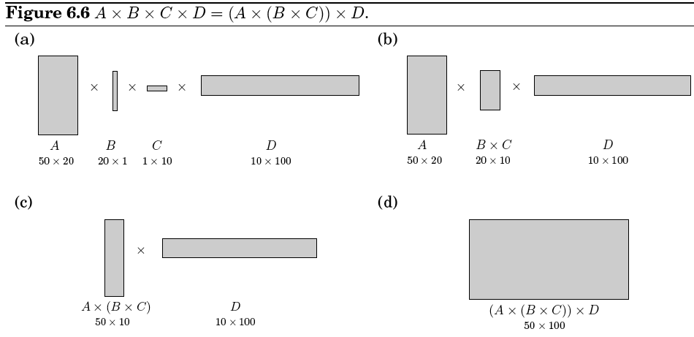
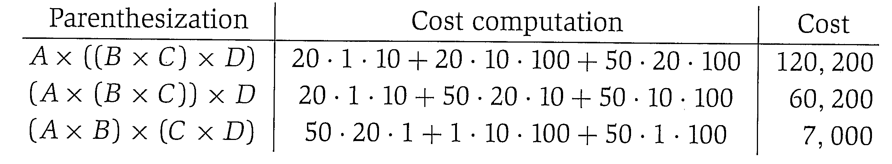
Chain Matrix Multiplication
Multiplying an m × n matrix with an n × p matrix takes O(mnp) time and results in a matrix of size m × p
Chains of Matrix Multiplies are common in numerical algorithms
Matrix Multiply is not commutative but is associative
A · (B · C) = (A · B) · C
Parenthesization can make a big difference in speed
Notes:
Final will be 50x100 regardless of order. note both matrices must have same n
Does greedy work? Smallest initial work is in the top two and is bad
Brute Force approach? Try all possible parenthesizations and return minimum
Note that to be able to multiply the column size of the 1st array MUST match row size of second array, which will happen all the way through if fulfilled in initial ordering

Slide 65
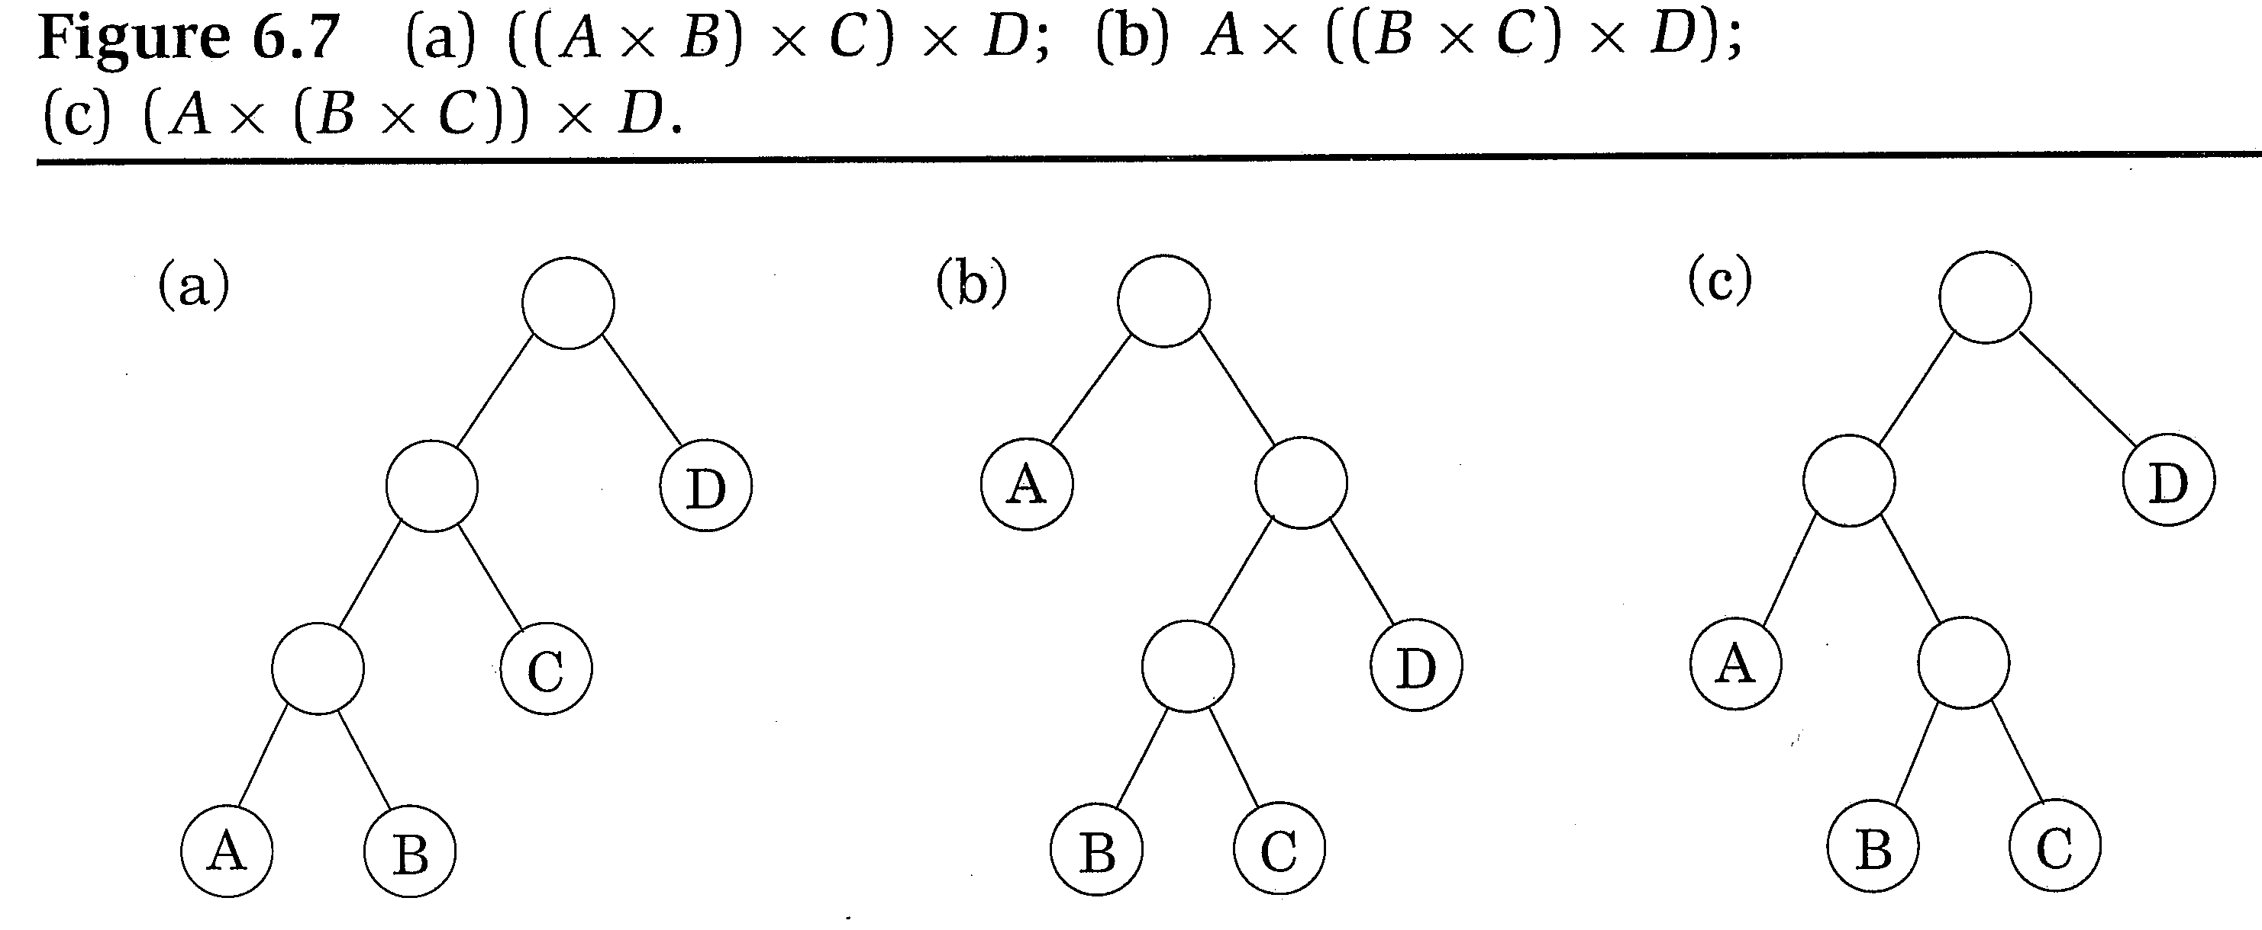
DP Solution
Want to multiply A₁ × A₂ × ··· × A_{n}
with dimensions m₀ × m₁, m₁ × m₂, ··· , m_{n-1} × m_{n}
A linear ordering for parenthesizations is not natural, but we can represent them as a binary tree
Possible orderings are exponential
Consider cost for each subtree
C(i,j) = minimal cost of multiplying A_{i} × A_{i+1} × ··· × A_{j} 1 ≤ i ≤ j ≤ n
C(i,j) represents the cost of j-i matrix multiplies
Notes:
Exponential Algorithm
Draw a tree on the board for C(i,j) discussion
In fig 6.7a the left child of the root represents C(1,3) with A=1, B=2, etc. which is A1*A2*A3 with (j=3)-(i=1) Matrix multiplies
What will be array sizes that are multiplied at root level for 6.7a m0 (A row) X C (Column) matrix by Drow X D column: m0 * m3 * m4 SHOW THIS!
Just two possible parenthesizations for that subtree

Slide 66
Chain Matrix Multiply Algorithm
Each subtree breaks the problem into two more subtrees such that the left subtree has cost C(i,k) and the right subtree has cost C(k+1,j) for all k such that i ≤ k < j (e.g. What are children of C(3,7))
The cost of the original subtree is the cost of its two children subtrees plus the cost of combining those subtrees
C(i,j) = min_{i≤k<j}[C(i,k) + C(k+1,j) + m_{i-1} · m_{k} · m_{j}]
Left matrix must be m_{i-1} × m_{k} and right matrix must be m_{k} × m_{j}
Let's build bottom up! Table and Base cases?
Final solution is?
Notes:
Show a case of C(3,7). What does it mean. What are possible k's? Down in tree. Min of C(3,3) * C(4,7) or C(3,4) * C(5,7) or C(3,5) * C(6,7) – including the cost of multiplying the two sub-trees
Could go top down but redundancies. Let's build bottom up.
Start drawing table!!

Slide 67
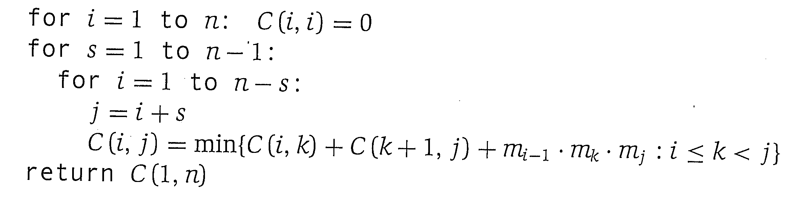

Chain Matrix Multiply Algorithm
j:
 | 1 | 2 | 3 | 4
1 | 0 |  |  | Goal
2 | - | 0
3 | - | - | 0
4 | - | - | - | 0
i:
Base cases: C(i,i) = 0, C(i,j) for i > j is undefined
Final solution is C(1,n). What is complexity?
m₀ = 50, m₁ = 20, m₂ = 1, m₃ = 10, m₄ = 100
Notes:
Dependencies grow as you get closer to the goal cell (as values of k increase linearly)
Loops let you fill in next diagonal moving towards goal
Write in the costs for the second diagonal 1,2 2,3 and 3,4
Review that first then ask complexity? n^3
Note for the sub-tree of C(1,3) there are only two options C(1,1)+ C(2,3) or C(1,2)+C(3,3) – show what trees these are and show their costs
C(1,1)+ C(2,3) + 50*20*10 = 0+ 20*1*10 + 50*20*10 = 10,200
C(1,2)+C(3,3) + 50*1*10 = 50*20*1 + 50*1*10 = 1,500
We want the min of those two.
Draw a tree on the board for C(i,j) discussion
Walk through algorithm for our problem
diagonal is base = 0, fill in upper diagonal (where j > i)

Slide 68
m₀ = 50, m₁ = 20, m₂ = 1, m₃ = 10, m₄ = 100
s | i | j | k | n-s | min terms (one for each k) | C(i,j)
1 | 1 | 2 | 1 | 3 | C(1,1)+C(2,2)+50·20·1 = 0+0+1000 = 1000 | 1000
 | 2 | 3 | 2 |  | C(2,2)+C(3,3)+20·1·10 = 0+0+200 = 200 | 200
 | 3 | 4 | 3 |  | C(3,3)+C(4,4)+1·10·100 = 0+0+1000 = 1000 | 1000
2 | 1 | 3 | 1 2 | 2 | C(1,1)+C(2,3)+50·20·10 = 0+200+10,000 = 10,200 C(1,2)+C(3,3)+50·1·10 = 1000+0+500 = 1500 | 1500
 | 2 | 4 | 2 3 |  | C(2,2)+C(3,4)+20·1·100 = 0+1000+2000 = 3000 C(2,3)+C(4,4)+20·10·100 = 200+0+20,000 = 20,200 | 3000
3 | 1 | 4 | 1 2 3 | 1 | C(1,1)+C(2,4)+50·20·100 = 0+3000+10,000 = 103,000 C(1,2)+C(3,4)+50·1·100 = 1000+1000+5000 = 7000 C(1,3)+C(4,4)+50·10·100 = 1500+0+50,000 = 51,500 | 7000
Notes:
s is which diagonal on the way to goal
Show subtrees on the board as we go to make it more clear C(1,2) C(2,3), C(1,3), C(1,4).
FILL IN TABLE ON THE BOARD – Use above to help fill in the table – starts with 1,2 and only possible k is 1

Slide 69
Shortest Paths and DP
We used BFS, Dijkstra's and Bellman-Ford to solve shortest path problems for different graphs
DP also good for these types of problems and often better
Dijkstra and Bellman-Ford can actually be cast as DP algorithms
All Pairs Shortest Paths
Assume graph G with weighted edges (which could be negative)
We want to calculate the shortest path between every pair of nodes
We could use Bellman-Ford (which has complexity O(|V| · |E|)) one time each for every node
Complexity would be |V| · (|V| · |E|) = O(|V|² · |E|)
Floyd's algorithm using DP can do it in O(|V|³)
You'll do this for a homework
Notes:
Skip Floyd Marshall? It is simpler, so do if there is not time for matrix. Currently also a HW

Slide 70
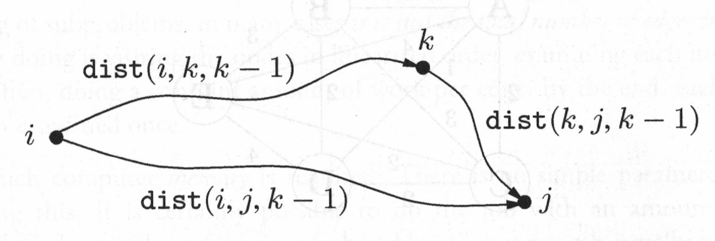
Floyd-Warshall Algorithm
Arbitrarily number the nodes from 1 to n
Define dist(i,j,k) as the shortest path from (between if not directed) i to j which can pass through nodes {1,2,…,k}
First assume we can only have paths of length one (i.e. with no intermediate nodes on the path) and store the best paths dist(i,j,0) which is just the edge length between i and j
Next, just check whether adding the node k as a possible intermediate node will improve things
What is relation dist(i,j,k) = ?
Notes:
Similar to knapsack w/o repetition
First table (k=0) has edge lengths between nodes (infinite if no edge)
Table 2 (k=1) checks for current i,j and also if it gets shorter if pass through node 1 (up to node k), (3 constraints to last table) – Easy, easy
Put picture on board of path through node k
Draw first two nodes on the board (i.e. k = 0), then make
add 3rd, update distance – What is the relation? k=1 DO THIS BEFORE PUT UP RELATION – EASY to SEE this way!!!!
add 4th…
Then draw paths (later) such that adding new k allows combination to two (currently optimal) sub-paths which could be better than current.
Do algorithm: Make a graph with 4 nodes where adding node 1 gets shorter distance
connect node 1 to 2 and 3, node 3 to 2 and 4
Do first table
base: dist(i.i.k) = length of edge between i and J or infinite if no edge
One n by n matrix for each value k

Slide 71
Floyd-Warshall Algorithm
Just check whether adding the node k as a possible intermediate node will improve things
dist(i,j,k) = min[dist(i,j,k-1), dist(i,k,k-1) + dist(k,j,k-1)]
What kind of table and base cases?
Can think of memory as one n×n (i,j) matrix for each value k
What is the algorithm?
Notes:
First table (k=0) has edge lengths between nodes (infinite if no edge)
Table 2 (k=1) checks for current i,j and also if it gets shorter if pass through node 1 (up to node k), (3 constraints to last table) – Easy, easy
Put picture on board of path through node k
Draw first two nodes on the board (i.e. k = 0), then make
add 3rd, update distance – What is the relation? k=1 DO THIS BEFORE PUT UP RELATION – EASY to SEE this way!!!!
add 4th…
Then draw paths (later) such that adding new k allows combination to two (currently optimal) sub-paths which could be better than current.
Do algorithm: Make a graph with 4 nodes where adding node 1 gets shorter distance
connect node 1 to 2 and 3, node 3 to 2 and 4
Do first table
base: dist(i.i.k) = length of edge between i and J or infinite if no edge
One n by n matrix for each value k

Slide 72
Floyd's Example
dist(i,j,k) = ?
0 | 3 | 1 | 5
∞ | 0 | 4 | 7
2 | 6 | 0 | ∞
∞ | 1 | 3 | 0
 | ?
dist(i,j,0)
dist(i,j,1)
What does node represent in table 2 and what is relation?

Slide 73
Floyd's Example – Directed Graph
dist(i,j,k) = min[dist(i,j,k-1), …
0 | 3 | 1 | 5
∞ | 0 | 4 | 7
2 | 6 | 0 | ∞
∞ | 1 | 3 | 0
 | ?
dist(i,j,0)
dist(3,2,1)
What does node represent in table 2 and what is relation?
Shortest dist from node 3 to node 2 which could pass through node 1
Notes:
Draw nodes on board

Slide 74
Floyd's Example – Directed Graph
dist(i,j,k) = min(dist(i,j,k-1), dist(i,k,k-1) + ?]
0 | 3 | 1 | 5
∞ | 0 | 4 | 7
2 | 6 | 0 | ∞
∞ | 1 | 3 | 0
 | ?
dist(i,j,0)
dist(3,2,1)
What does node represent in table 2 and what is relation?
Shortest dist from node 3 to node 2 which could pass through node 1
Notes:
Draw nodes on board

Slide 75
Floyd's Example – Directed Graph
dist(i,j,k) = min[dist(i,j,k-1), dist(i,k,k-1) + dist(k,j,k-1)]
0 | 3 | 1 | 5
∞ | 0 | 4 | 7
2 | 6 | 0 | ∞
∞ | 1 | 3 | 0
 | 5
dist(i,j,0)
dist(3,2,1)
Add prev ptr in cell (3,2) back to node 1, in order to later recreate the shortest path
Time and space complexity?
Notes:
Consider an d(4,2,2). What are possible paths? Don’t need to search through all. Just build up the simple DP
Consider d(10,20,8) with picture of paths on the board.

Slide 76
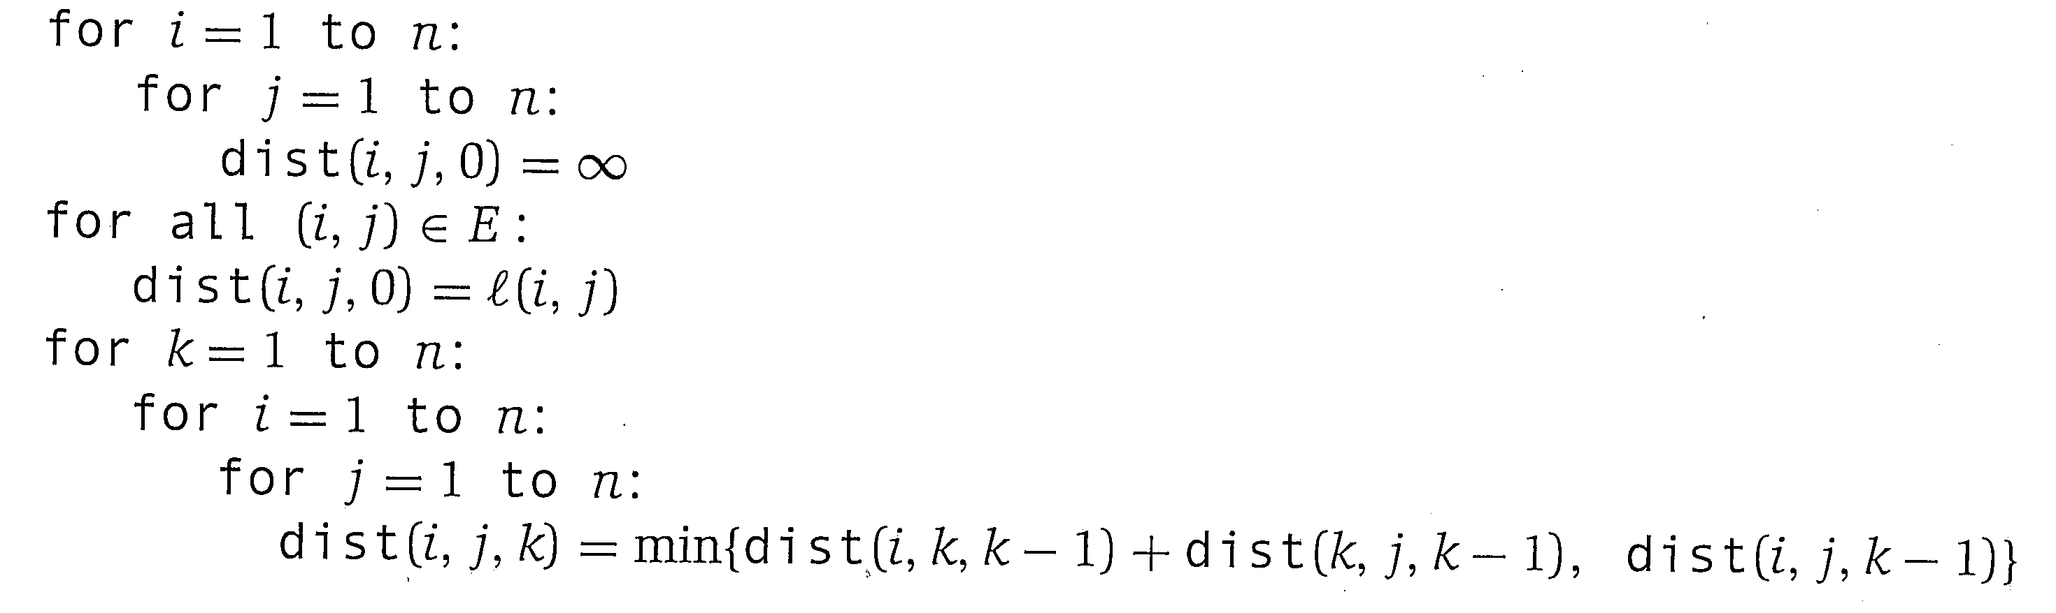
Floyd-Warshall Algorithm
Time and Space Complexity?
Notes:
n^3 time
Last table will have final results

Slide 77
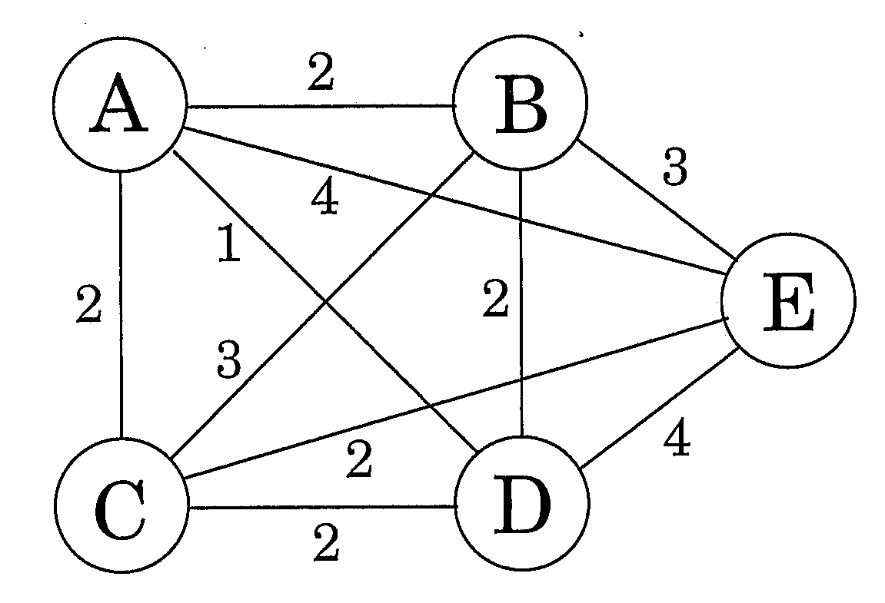
TSP – Travelling Salesman Problem
Assume n cities (nodes) and an intercity distance matrix D = {d_{ij}}
We want to find a path which visits each city once and has the minimum total length
TSP is in NP: No known polynomial solution
Why not start with small optimal TSP paths and then just add the next city, similar to previous DP approaches?
Can't just add new city to the end of a circuit
Would need to check all combinations of which city we should have prior to the new city, and which city to have following the new city
This could cause reshuffling of the other cities
Notes:
Simple undirected version

Slide 78
TSP Solution
Could try all possible paths of G and take the minimum
There are n! possible paths, and (n-1)! unique paths if we always set city 1 to node 1
DP approach much faster but still exponential (more later)
For S ⊆ V and including node 1, and j ∈ S, let C(S,j) be the minimal TSP path of S starting at 1 and ending at j
For |S| > 1 C(S,1) = ∞ since path cannot start and end at 1
Relation: consider each optimal TSP cycle ending in a city i, and then find total if add edge from i to new last city j
C(S,j) = min_{i ∈ S:i≠j}C(S-{j},i) + d_{ij}
Notes:
Min of (Best TSP ending in i + d(i,j))
Relation is like knapsack without repetition??
Table size 2^n by n

Slide 79
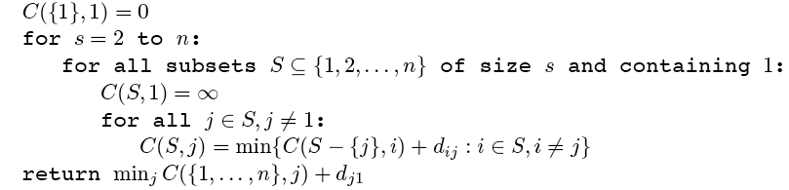
TSP Algorithm
C(S,j) = For S ⊆ V and including node 1, and j ∈ S, let C(S,j) be the minimal TSP path of S starting at 1 and ending at j
What is table size?
Space and Time Complexity?
Notes:
Show start up for 4 cities with initial distance matrix, no real choices until you get to subset of size 4

Slide 80
TSP Algorithm
Table is n × 2^{n-1}
Algorithm has n × 2^{n-1} subproblems each taking time n
Time Complexity is thus O(n²2^{n})
Trying each possible path has time complexity O(n!)
For 100 cities DP is 100²×2¹⁰⁰ = 1.3×10³⁴
Trying each path is 100! = 9.3×10¹⁵⁷
Thus DP is about 10¹³⁴ times faster for 100 cities
We will consider approximation algorithms in Ch. 9
Notes:
2^n-1 since it is powerset lf all set except city 1 which is in every subset, but stil O(2^n) since 2^n+1 = O(2^n)
n^2 each one because loop for all j (n), and then test across all i (n)
Show start up for 4 cities with initial distance matrix, no real choices until you get to subset of size 4

Slide 81
sdfsdf
 | 1 | 2 | 3 | 4
1,1 | 0
1,2 | ∞ | 3
1,3 | ∞ |  | 5
1,4 | ∞ |  |  | 9
1,2,3 | ∞
1,2,4 | ∞
1,3,4 | ∞
1,2,3,4 | ∞
 | 1 | 2 | 3 | 4
1 | 0 | 3 | 5 | 9
2 |  | 0 | 1 | 2
3 |  |  | 0 | 6
4 |  |  |  | 0
S
C({1,2}, 2) = min{C({1,1},1)+d₁₂} = min{0+3} = 3

Slide 82
sdfsdf
 | 1 | 2 | 3 | 4
1,1 | 0
1,2 | ∞ | 3
1,3 | ∞ |  | 5
1,4 | ∞ |  |  | 9
1,2,3 | ∞ | 5+1=6 | 3+1=4
1,2,4 | ∞ | 9+2=11 |  | 3+2=5
1,3,4 | ∞ |  | 9+6=15 | 5+6=11
1,2,3,4 | ∞
 | 1 | 2 | 3 | 4
1 | 0 | 3 | 5 | 9
2 |  | 0 | 1 | 2
3 |  |  | 0 | 6
4 |  |  |  | 0
S
C({1,2,3}, 2) = min{C({1,3},3)+d₃₂} = min{5+1} = 6

Slide 83
sdfsdf
 | 1 | 2 | 3 | 4
1,1 | 0
1,2 | ∞ | 3
1,3 | ∞ |  | 5
1,4 | ∞ |  |  | 9
1,2,3 | ∞ | 5+1=6 | 3+1=4
1,2,4 | ∞ | 9+2=11 |  | 3+2=5
1,3,4 | ∞ |  | 9+6=15 | 5+6=11
1,2,3,4 | ∞ | 13 | 9 | 8
 | 1 | 2 | 3 | 4
1 | 0 | 3 | 5 | 9
2 |  | 0 | 1 | 2
3 |  |  | 0 | 6
4 |  |  |  | 0
S
C({1,2,3,4}, 2) = min{C({1,3,4},3)+d₃₂, C({1,3,4},4)+d₄₂} =
min{15+1, 11+2} = 13

Slide 84
sdfsdf
 | 1 | 2 | 3 | 4
1,1 | 0
1,2 | ∞ | 3
1,3 | ∞ |  | 5
1,4 | ∞ |  |  | 9
1,2,3 | ∞ | 5+1=6 | 3+1=4
1,2,4 | ∞ | 9+2=11 |  | 3+2=5
1,3,4 | ∞ |  | 9+6=15 | 5+6=11
1,2,3,4 | ∞ | 13 | 9 | 8
 | 1 | 2 | 3 | 4
1 | 0 | 3 | 5 | 9
2 |  | 0 | 1 | 2
3 |  |  | 0 | 6
4 |  |  |  | 0
S
return(min{C({1,2,3,4}, 2)+d₂₁, C({1,2,3,4}, 3)+d₃₁, C({1,2,3,4}, 4)+d₄₁,} =
min{13+3, 9+5, 8+9} = 14

Slide 85
Using Dynamic Programming
Many applications can gain efficiency by using Dynamic Programming
Works when there are overlapping subproblems
The recursive approach would lead to much duplicate work
And when subproblems (given by a recursive definition and DAG dependencies) are only slightly (constant factor) smaller than the original problem
If smaller by a multiplicative factor, consider divide and conquer

Slide 86
Dynamic Programming Applications
Example Applications
Fibonacci
String algorithms (e.g. edit-distance, gene sequencing, longest common substring, etc.)
Dykstra's algorithm
Bellman-Ford
Dynamic Time Warping
Viterbi Algorithm – critical for HMMs, Speech Recognition, etc.
Recursive Least Squares
Knapsack style problems, Coins, TSP, Towers-of Hanoi, etc.
Lots more and still being discovered

