Slide 1

Automatic generation
of
web CRUD applications
Supervisor: Marco Brambilla

Slide 2
Context
More than 80% people have access to the web and web applications are replacing old software.
Different mobile frameworks rely on web development.
Generators provide complex code, require too much configuration and are not based on the newest technologies.

Slide 3
Goals
Code’s simplicity
Lack of configuration
Rapid development
Automatic documentation & testing
Coherence and standardization

Slide 4
Input
Database schema
Set of Java classes with custom annotations

Slide 5
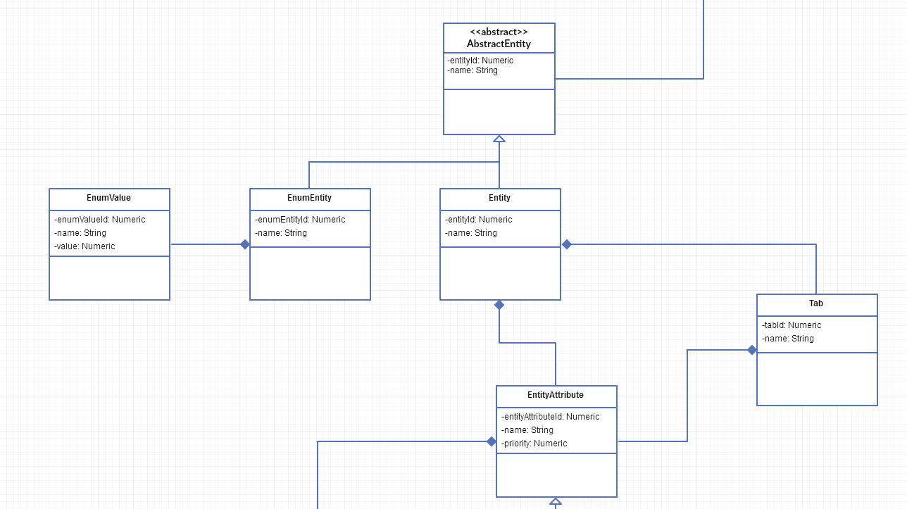
Transformation
The input model is transformed into the designed metamodel instance.
Project
Entity
Field
Security

Slide 6

Output
Server side [Spring Framework]
Repository layer component
Service layer component
Controller layer component
Client side [AngularJS]
Service component
Controller component
Template component

Slide 7

Focus on: annotation
Metamodel contains the structure for additional information that helps the generation.
These data are filled by Java annotations.
Entity: @Cache, @MaxDescendantLevel,@IgnoreMenu,…
Field: @Between, @DescriptionField, @Tab,…
Validation: @Size, @NotBlank, @NotNull

Slide 8
Focus on: security
Generated application support different levels of security:
Multirole management
Access level policy
Access level policies are defined by ??????? EntityGroup, Entity and Field, in a hierarchy solution.
The framework provides two different policies:
Block with restriction
Access with permission

Slide 9
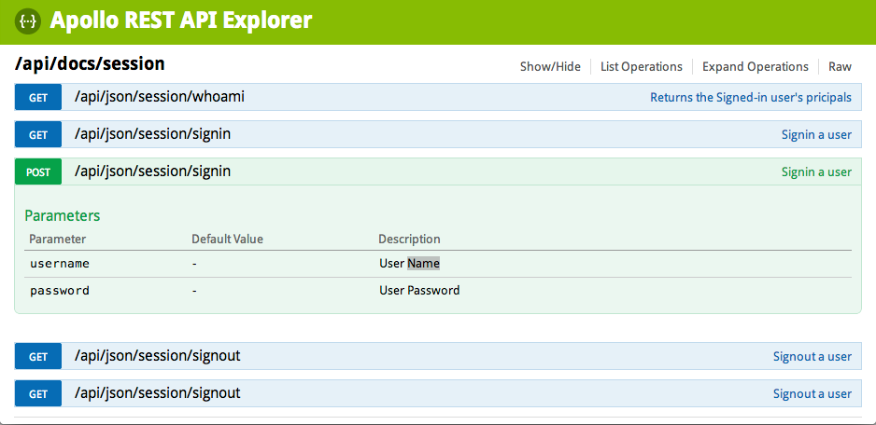
Focus on: documentation
Swagger is the adopted framework for documentation. It grants:
Textual description of each REST API
Technical description of each JSON
Possibility to test each REST API

Slide 10
Focus on: self generation
Designed metamodel can be represented as an instance of itself.
This means that, after the first core’s implementation, it has been possible to automatically generate a web interface towards the metamodel.
This allows developers (and non-developers..) performing CRUD operations on their domain problems’s instance.

Slide 11
Focus on: continuous generation
The key idea is to allow modifying and re-generating just a part of the project.
Re-generation must be able to keep track of custom code added by developers.
It has been implemented by means of Git API at runtime.

Slide 12
Test case: EBSN-Backoffice
EBSN-Backoffice is a management software that provides CMS and customer care feature in an Ecommerce platform.
It is built on top of a PostgreSQL database, made up of more than 200 tables.
The framework allowed???? generating it in a few hours.

Slide 13
Test case: EBSN-Storepicking
EBSN-Storepicking is a WMS (Warehouse Management System) that keeps track of orders, products and other different issues related to warehouse management.
It is built on top of a Mysql database of 25 tables.
The framework generated a first version of this software after few hours of work.

Slide 14
Results
The implemented framework provided good results in a real world environment.
It generated a basic version of an application, with easy-to-read code, a precise scaffolding and the related documentation.
Generated application is provided with a basic graphic layout that would require some time to be customized.

Slide 15
The end
Thank you

